Slide 1
Recitation
Lego+Compilation+Makefile
Runren Zhang, Bingyu Lan

Slide 2
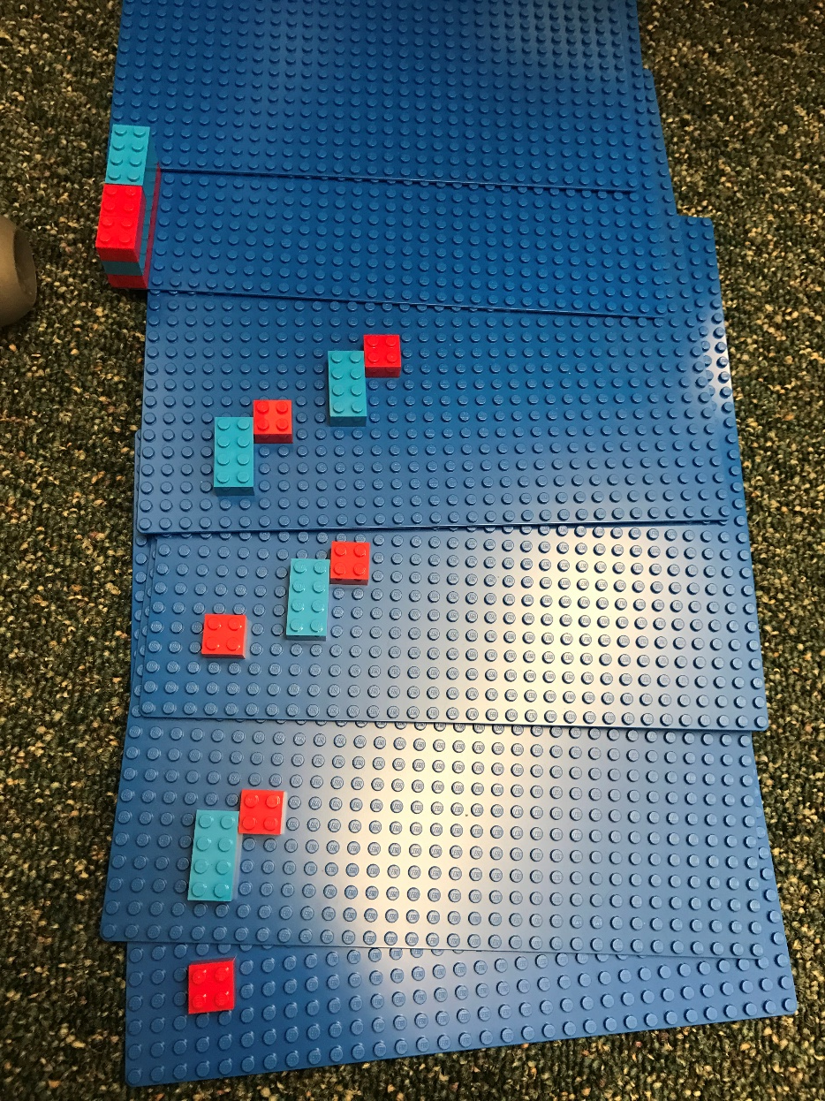
LEGO 1
Count from 1 [inclusive] to N [inclusive], call each number i
If (i + N is even) Place a 2x2 C1 block with its lower left corner at (3*i, 2*i+1)
Otherwise Place a 4x2 C2 block with its lower left corner at (3*i+1, 2*i) such that the long end is vertical

Slide 3
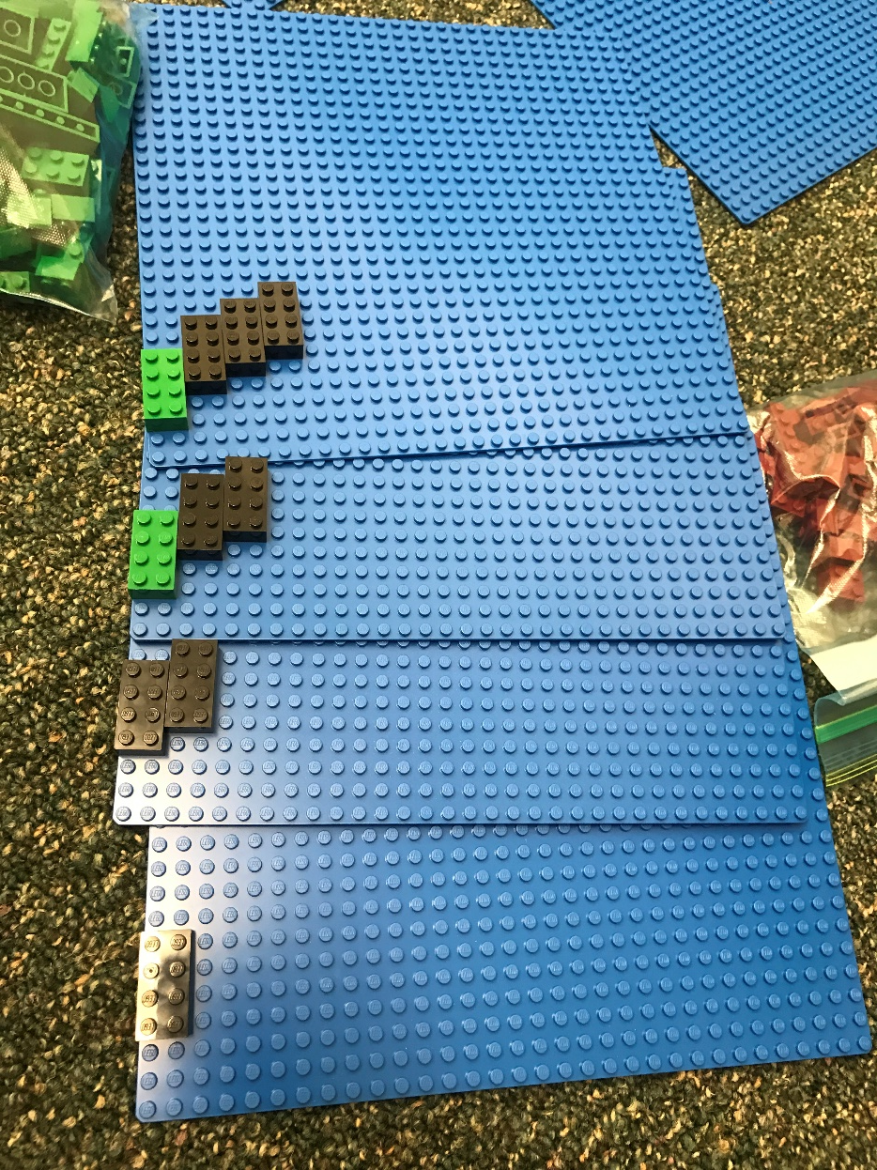
LEGO 2
Count from 1 [inclusive] to N [inclusive], call each number i
If (i >= N/2) Place a 4x2 C1 block with its lower left corner at (2*(i-1), i+2) w/ the long end vertical
Otherwise Place a 4x2 C2 block with its lower left corner at (2*(i-1), 2*i) w/ the long end vertical

Slide 4
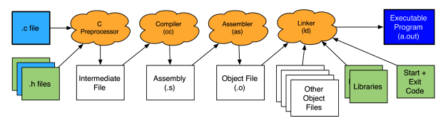
The compilation process

Slide 5
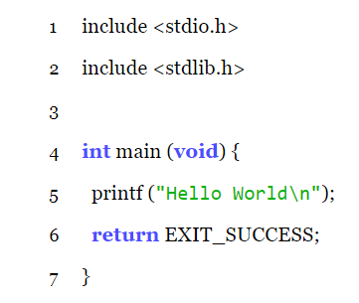
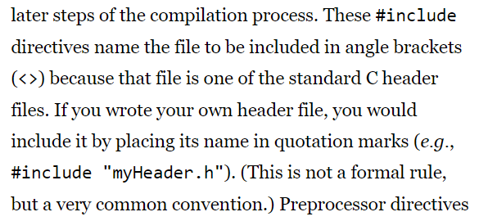
The Preprocessor: Header Files and Defines
#
#

Slide 6
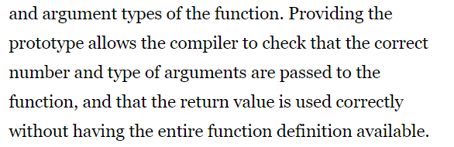
Header Files
1. Function prototypes (take /usr/include/stdio.h as example)
Advantage:

Slide 7

Header Files
2. Macro definitions (take /usr/include/limits.h as example)
Advantage: 1. Easy to change; 2. More readable; 3. Portability

Slide 8
Header Files
3. Type declarations (take /usr/include/stdint.h as example)
Advantage: specifically defined type

Slide 9
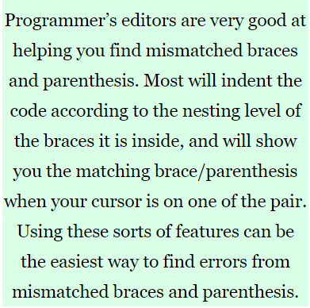
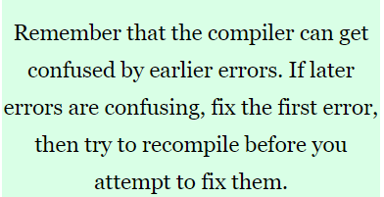

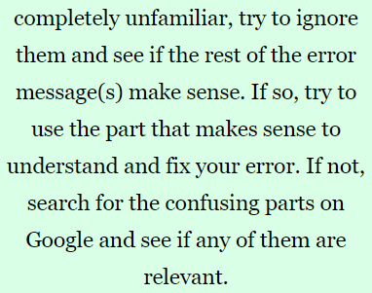
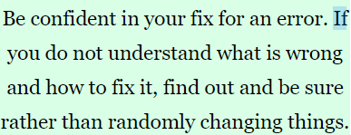
The compiler
Tip 3:
Tip 1:
Tip 2:
Tip 4:

Slide 10
The compilation process
.a, .so

Slide 11
Command line => Makefile
Targets: dependencies
TAB rules
Take 020_rect as example:
rectangle: rectangle.c
gcc -o rectangle -pedantic -std=gnu99 -Wall -Werror rectangle.c
FLAGS

Slide 12
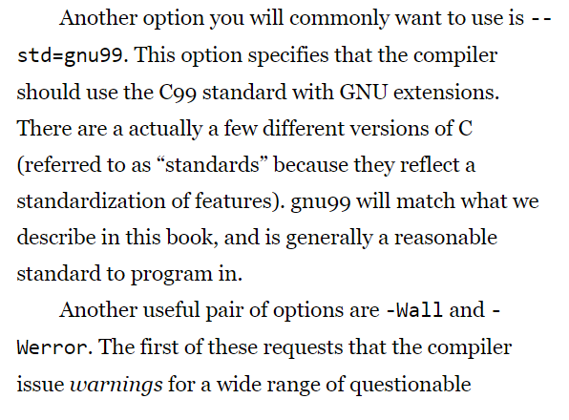
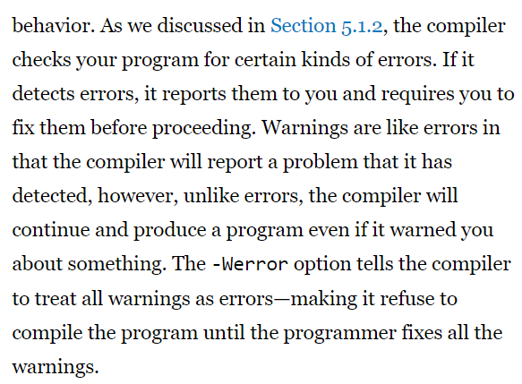
-std=gnu99 -Wall -Werror

Slide 13
Multiple .o files
Take 020_rect as example:
polygon: main.o rectangle.o edge.o point.o
gcc -o polygon -pedantic -std=gnu99 -Wall -Werror main.o rectangle.o edge.o point.o
main.o: main.c rectangle.h edge.h point.h
gcc -pedantic -std=gnu99 -Wall -Werror -c main.c
rectangle.o: rectangle.c rectangle.h edge.h point.h
gcc -pedantic -std=gnu99 -Wall -Werror -c rectangle.c
edge.o: edge.c edge.h point.h
gcc -pedantic -std=gnu99 -Wall -Werror -c edge.c
point.o: point.c point.h
gcc -pedantic -std=gnu99 -Wall -Werror -c point.c
Link
Compile+Assemble
Compile+Assemble
Compile+Assemble
Compile+Assemble

Slide 14
Multiple .o files (Using the variable)
CC= gcc
CFLAGS = -pedantic -std=gnu99 -Wall -Werror
polygon: main.o rectangle.o edge.o point.o
$(CC) $(CFLAG) -o polygon main.o rectangle.o edge.o point.o
main.o: main.c rectangle.h edge.h point.h
$(CC) $(CFLAG) -c main.c
rectangle.o: rectangle.c rectangle.h edge.h point.h
$(CC) $(CFLAG) -c rectangle.c
edge.o: edge.c edge.h point.h
$(CC) $(CFLAG) -c edge.c
point.o: point.c point.h
$(CC) $(CFLAG) -c point.c

Slide 15
Multiple .o files (Using the pattern substitution)
CC= gcc
CFLAGS = -pedantic -std=gnu99 -Wall -Werror
SRCS = $(wildcard *.c)
OBJS=$(patsubst %.c, %.o, $(SRCS))
polygon: $(OBJS)
$(CC) $(CFLAG) -o polygon $(OBJS)
%.o: %.c rectangle.h edge.h point.h
$(CC) $(CFLAG) -c $<

Slide 16
clean
.PHONY: clean
clean:
rm –f polygon *.o *.c~ *.h~
Called by instruction: make clean

Slide 17
Thanks

