Slide 1
Recitation
Arrays+Strings+MultiArrays+FuntionPointers+Midterm1
Runren Zhang, Bingyu Lan

Slide 2
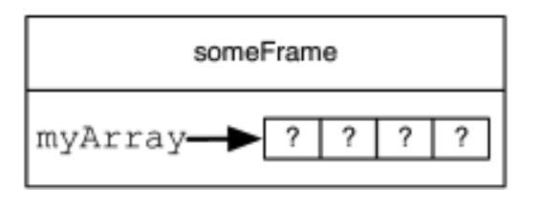
Arrays: Declaration
int myArray[4];
Int myArray[4] = {42, 39, 16, 7};
Int myArray[4] = {0};
Int myArray[] = {42, 39, 16, 7};
sizeof(myArray) = ?

Slide 3
Arrays: Access; passing as parameters
myArray[i] ⬄ *(myArray + i)
&myArray[i] ⬄ &*(myArray + i) ⬄ myArray + i
*&x
&*x
int myFunction(int * myArray, int size)
⬄
int myFunction(int myArray[], int size)

Slide 4
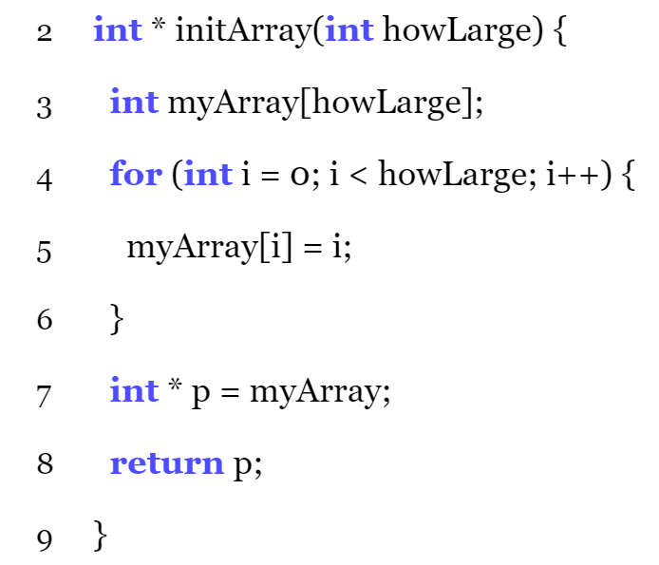
Arrays: dangling pointers
Variables living inside a function frame in stacks will disappear when the function finished.

Slide 5
Arrays: size_t, sizeof()
size_t: unsigned int with the correct number of bits to describe the size or index of an array, declared in stddef.h.
The sizeof operator takes one operand, which can either be a type name or an expression, and evaluates the number of bytes which the type requires. be

Slide 6
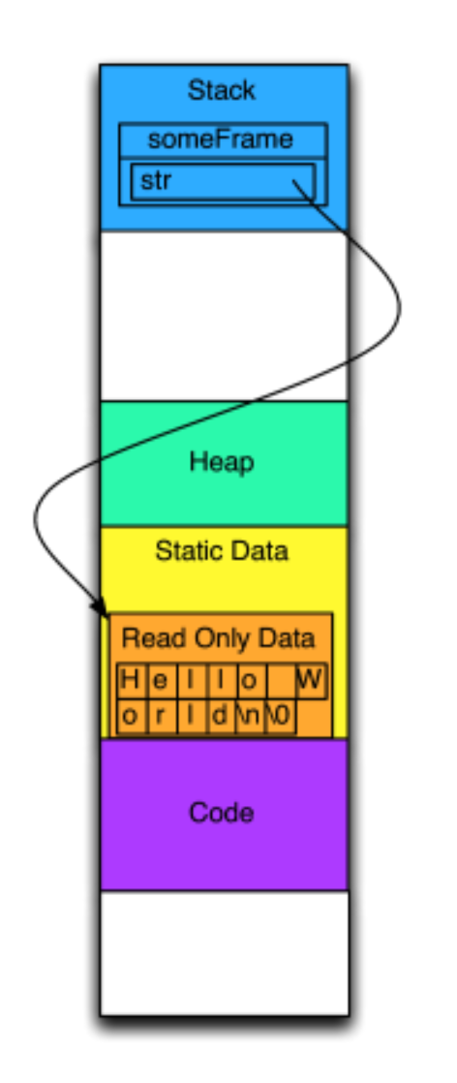
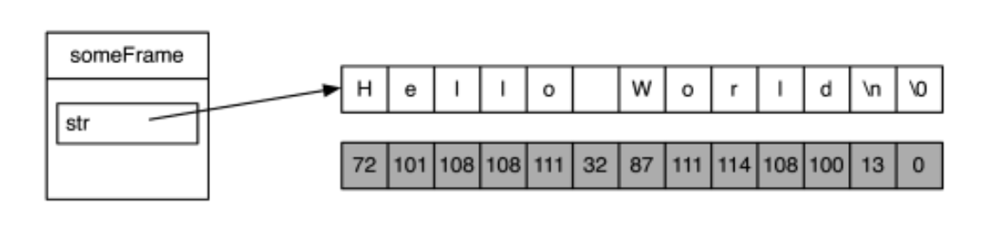
Strings: strings literals
const char *str = “Hello world\n”;

Slide 7
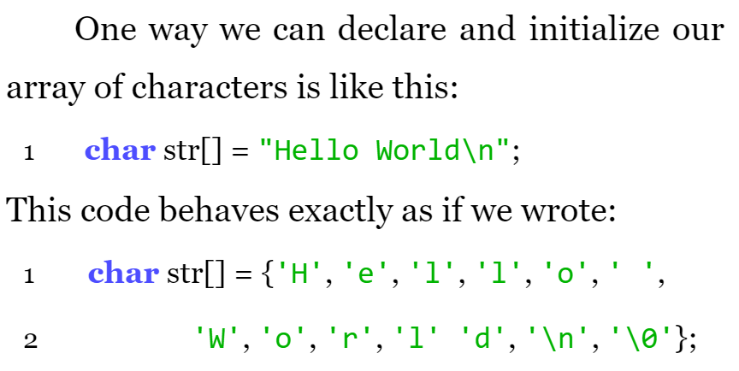
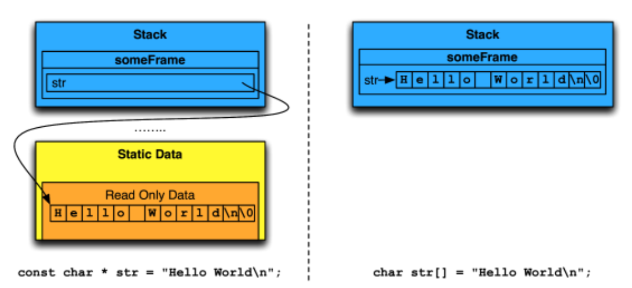
Strings: mutable strings

Slide 8
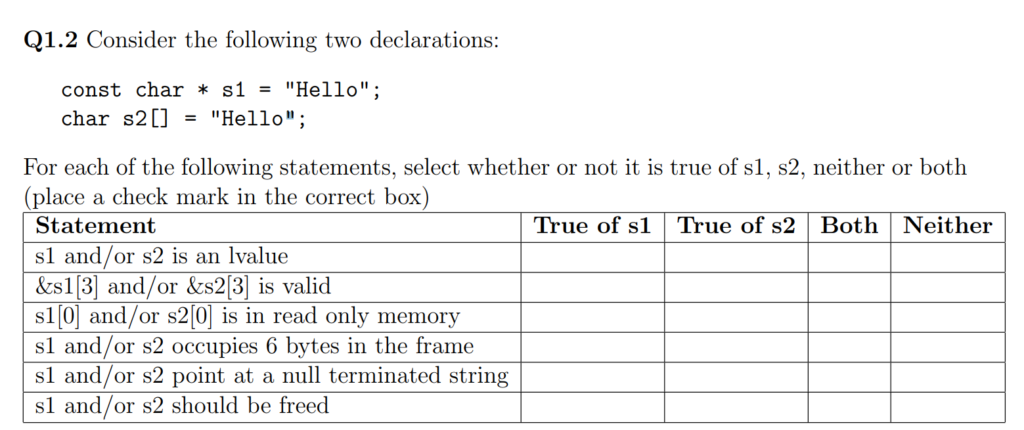
Midterm Q1.2

Slide 9
Midterm Q1.2

Slide 10
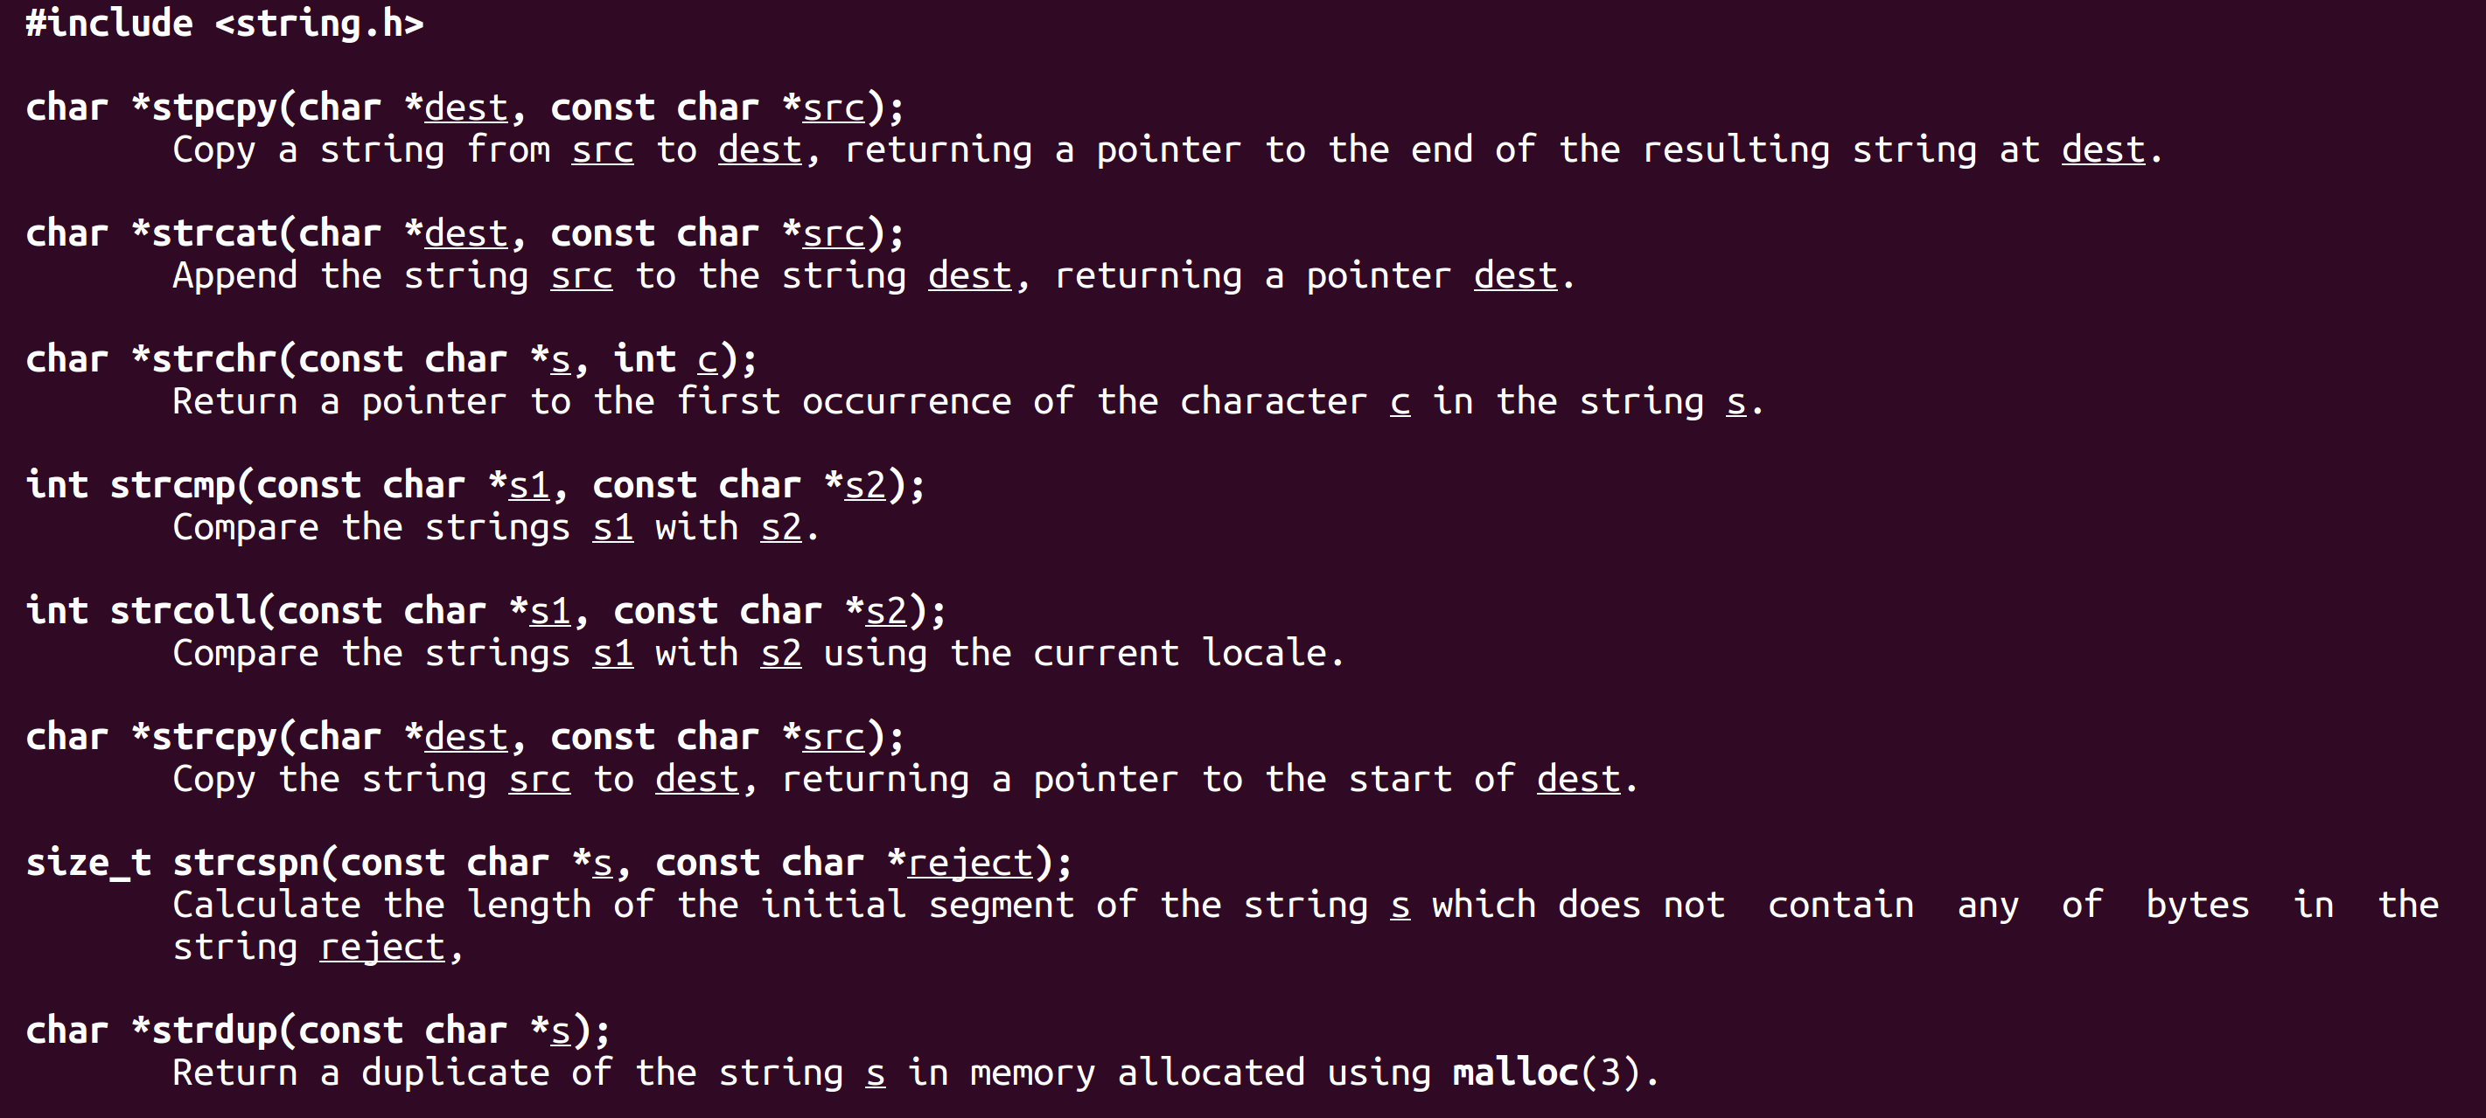
Strings: string library

Slide 11
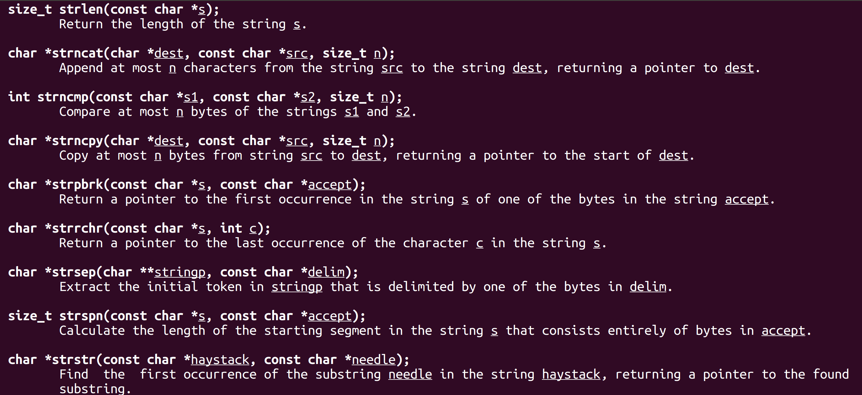
Strings: string library

Slide 12
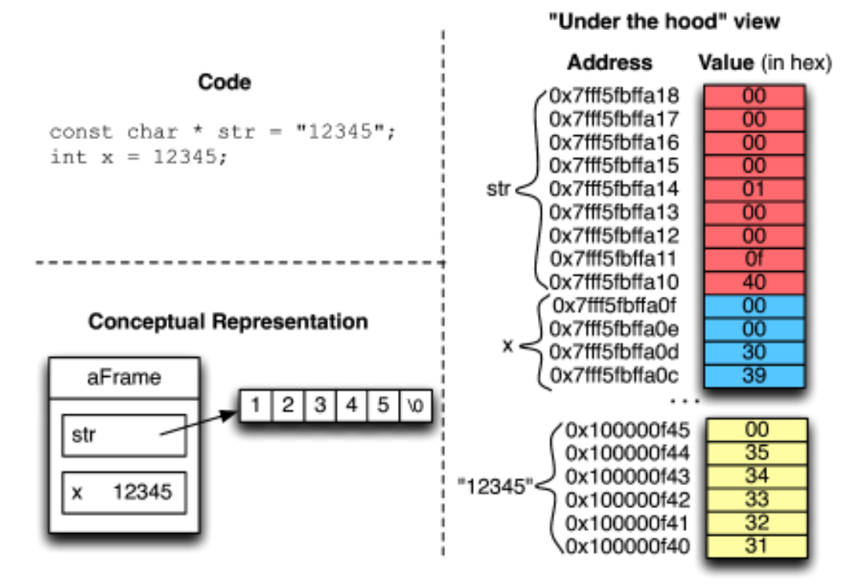
Strings: convert strings to ints

Slide 13
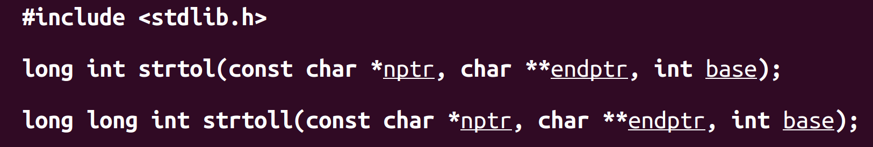
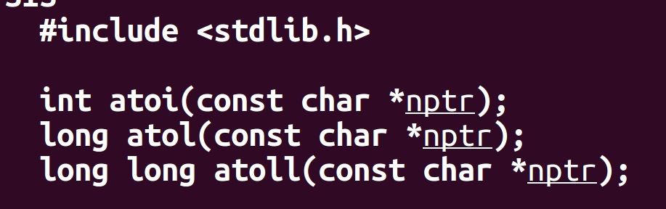
Strings: convert strings to ints

Slide 14
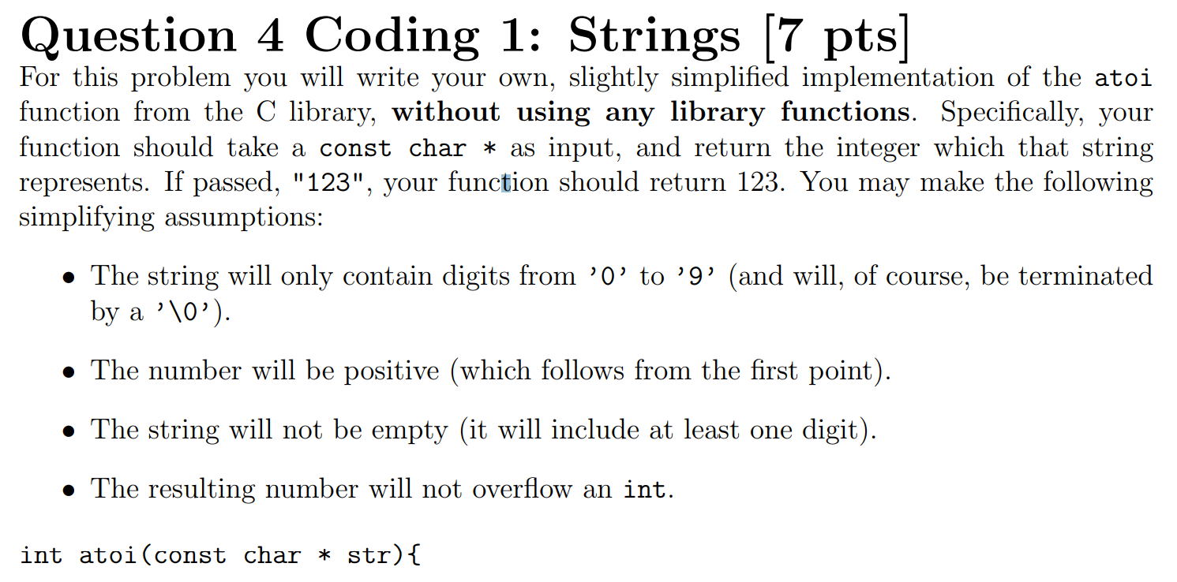
Midterm Q4

Slide 15
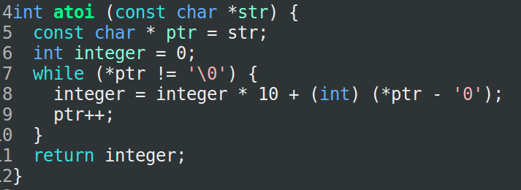

Slide 16
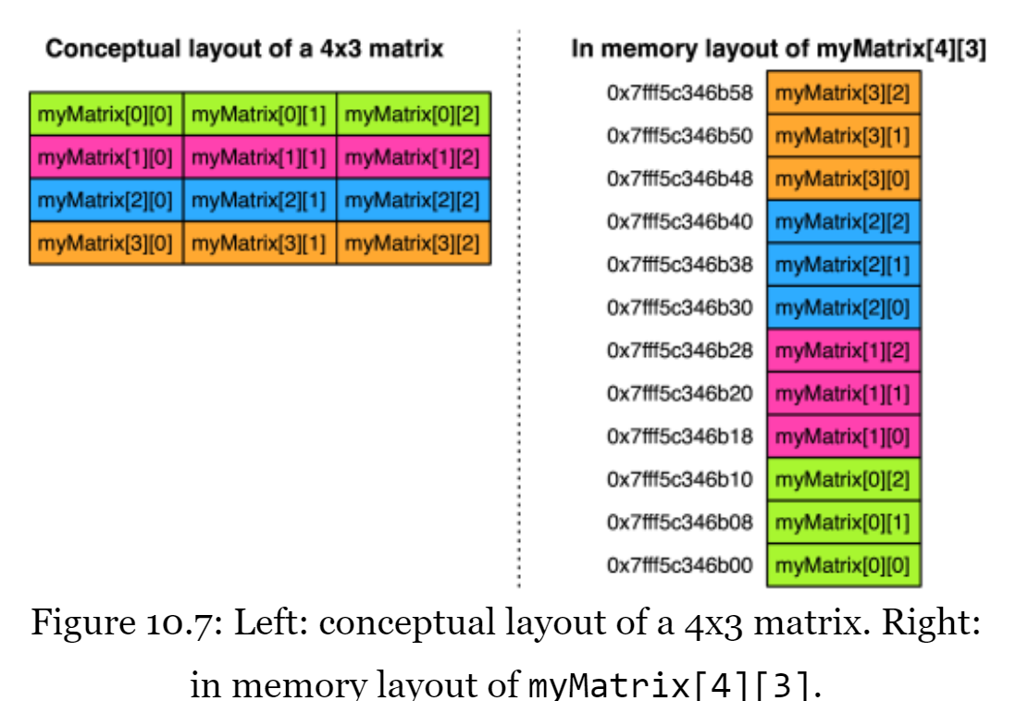
Multidimensional Arrays: declaration
Double myMatrix[4][3];
sizeof(myMatrix);
sizeof(myMatrix[2]);
sizeof(myMatrix[3][0]);

Slide 17
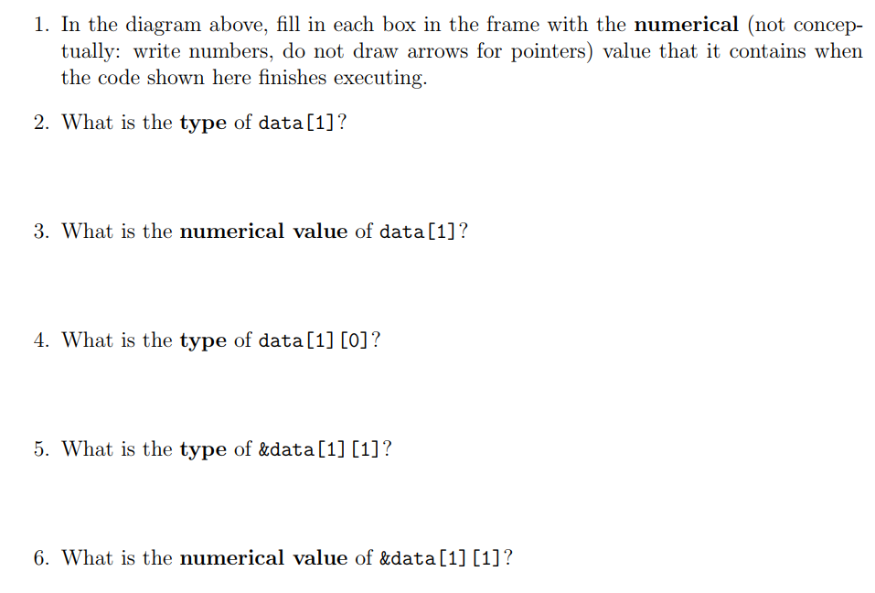
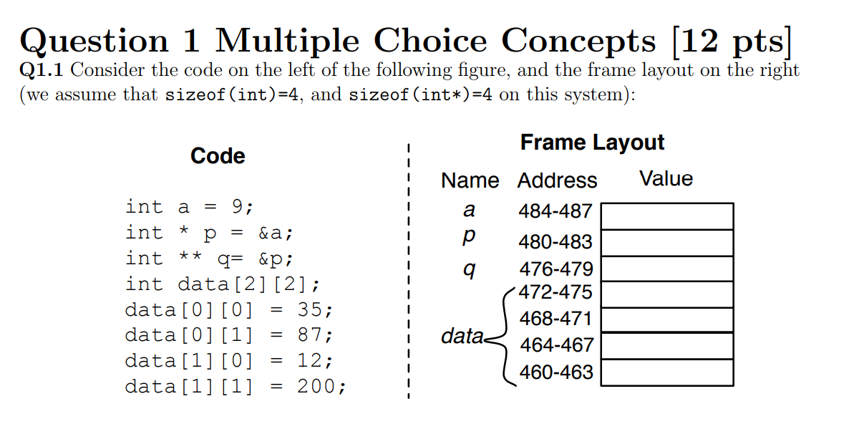
Midterm Q1.1

Slide 18
Midterm Q1.1
int *
9
484
468
480
200
12
int
87
35
int *
472

Slide 19
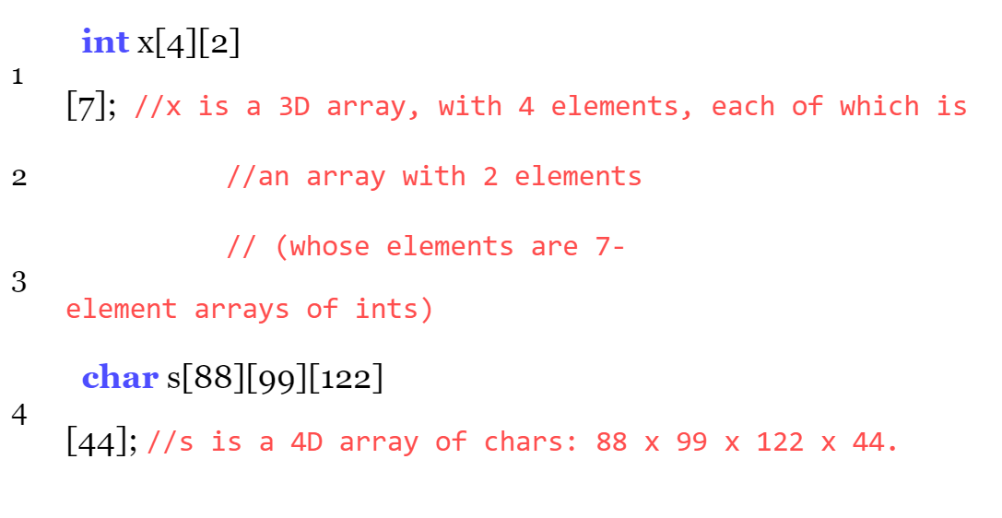
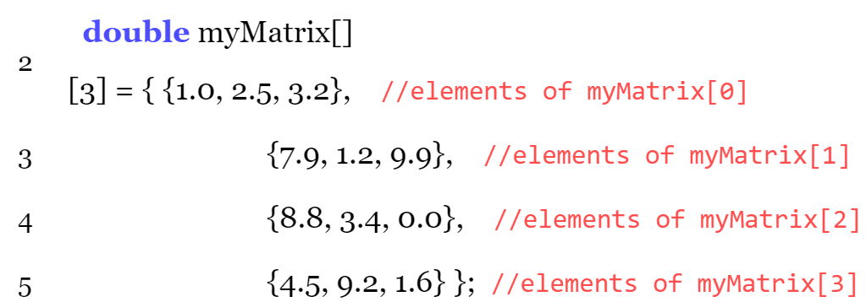
Multidimensional Arrays: initializers
Composability

Slide 20
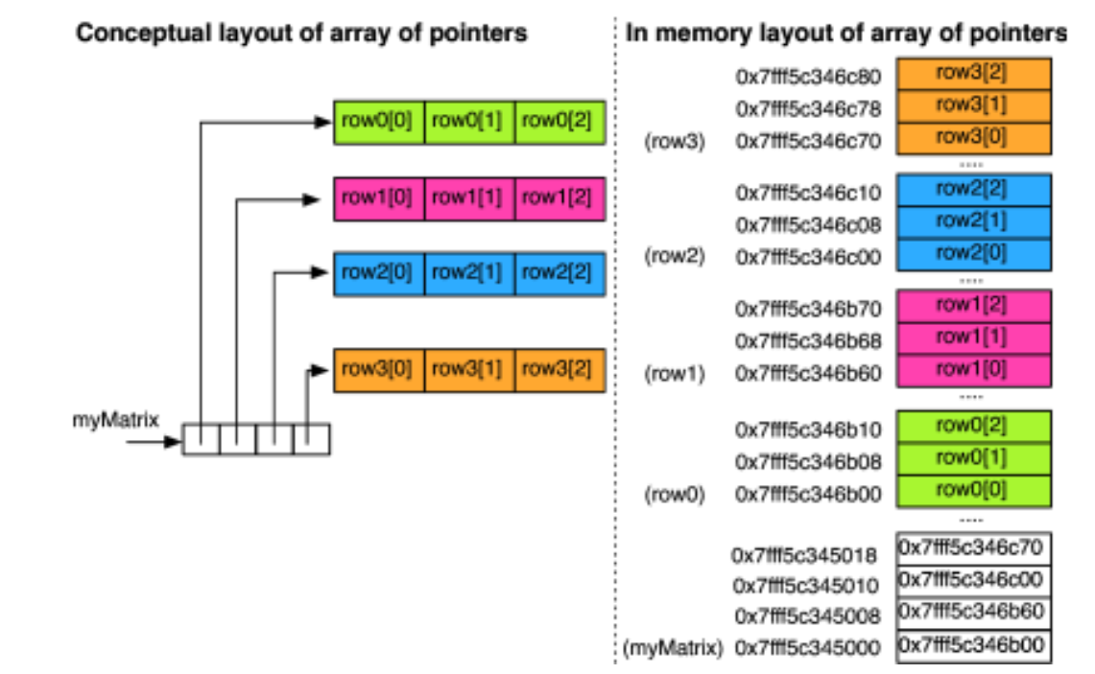
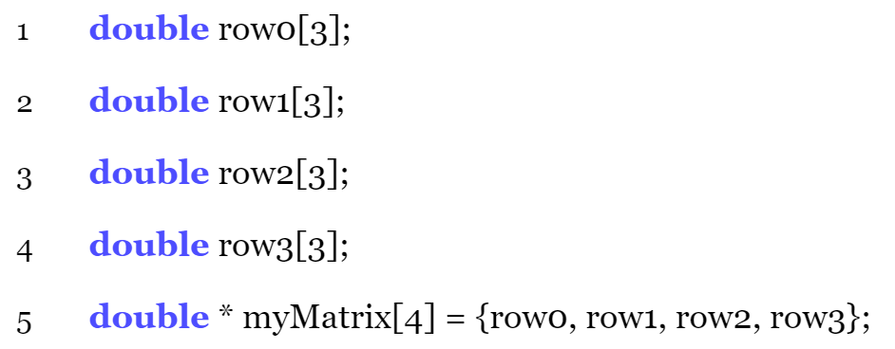
Multidimensional Arrays: array of pointers
Different types, not compatible with each other
sizeof(myMatrix)

Slide 21
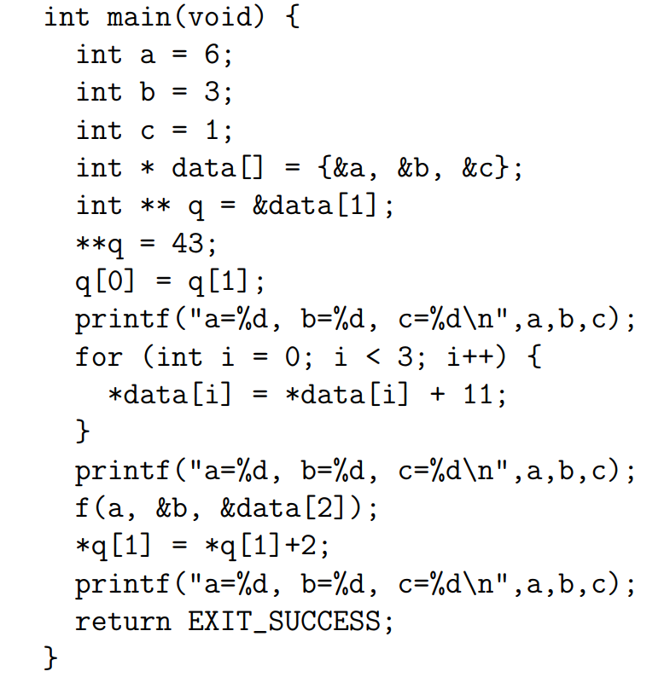
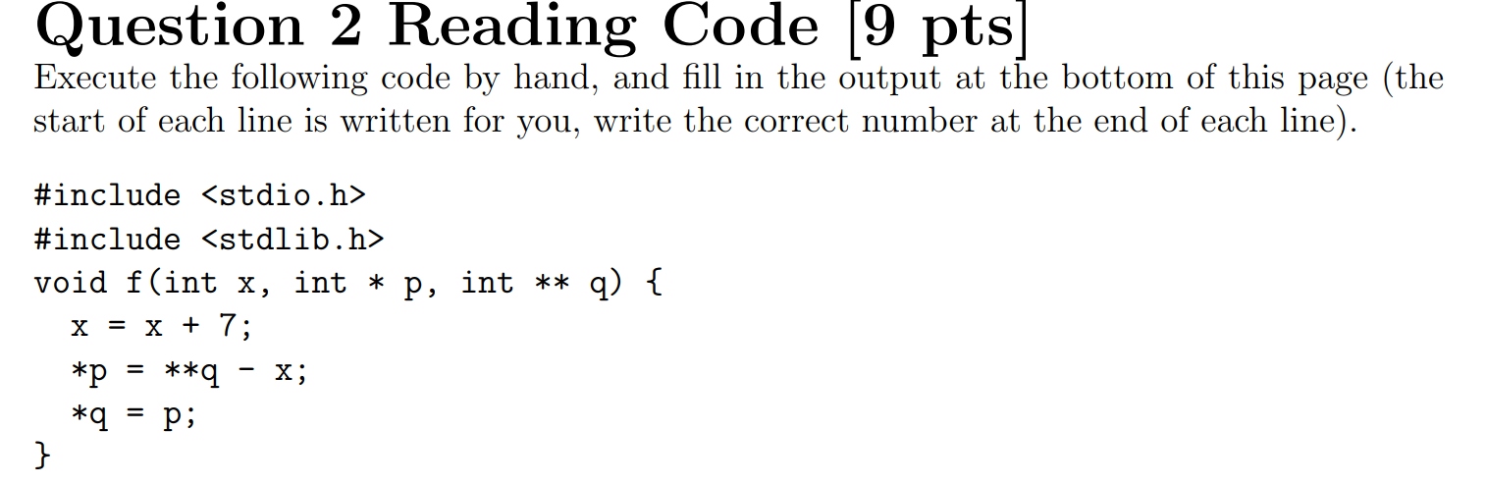
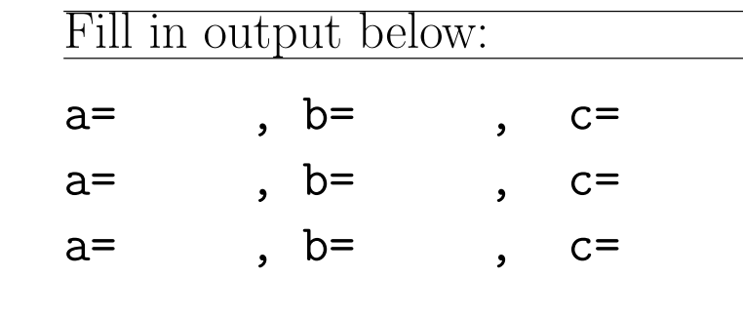
Midterm Q2

Slide 22
Midterm Q2
6
43
1
17
43
23
17
1
23

Slide 23
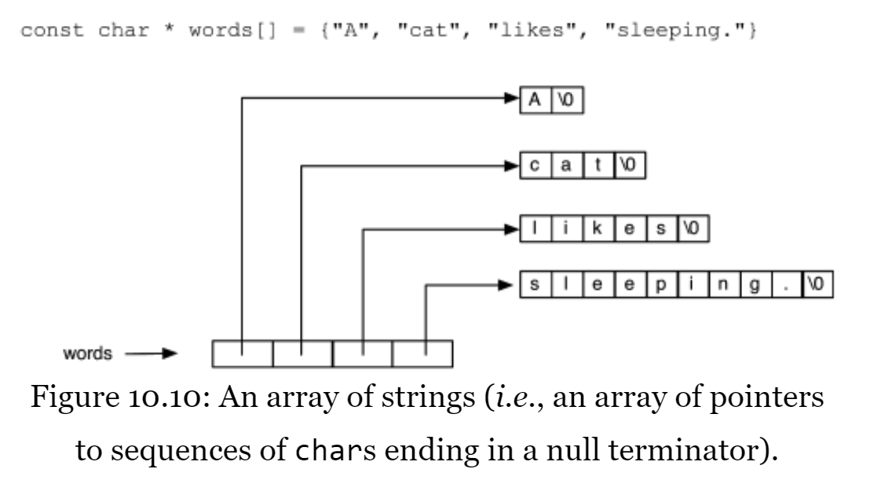
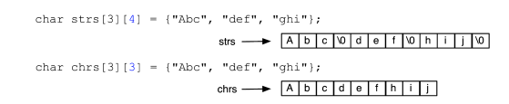
Multidimensional Arrays: array of strings
sizeof(words)

Slide 24
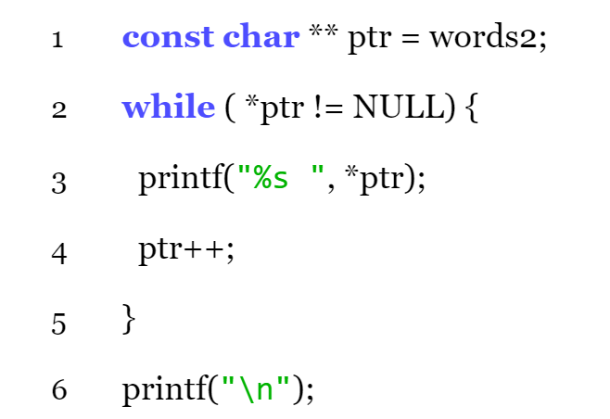
Multidimensional Arrays: array of strings
sizeof(words2)

Slide 25
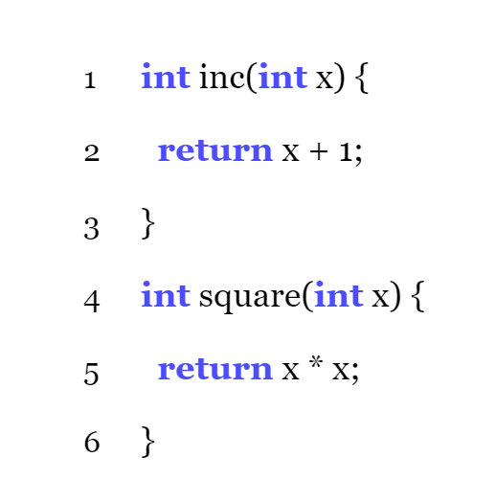
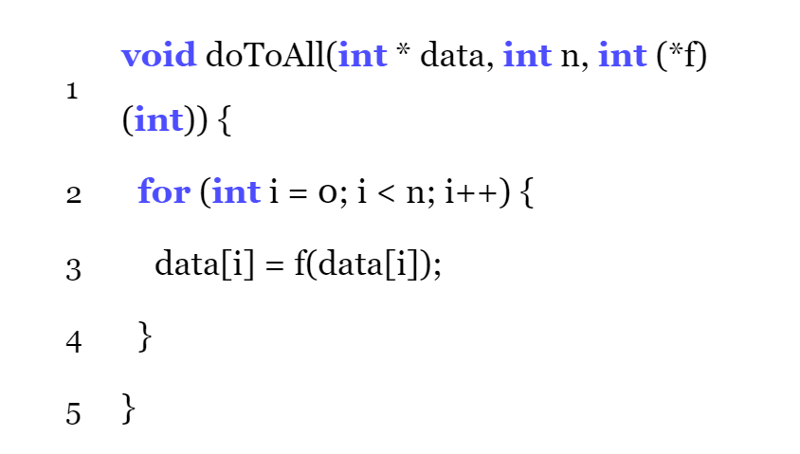
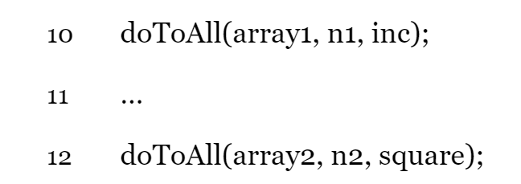
Function pointers

Slide 26
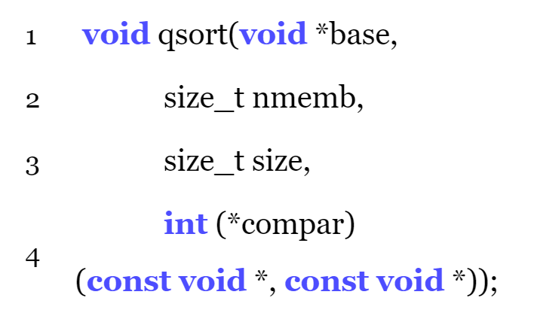
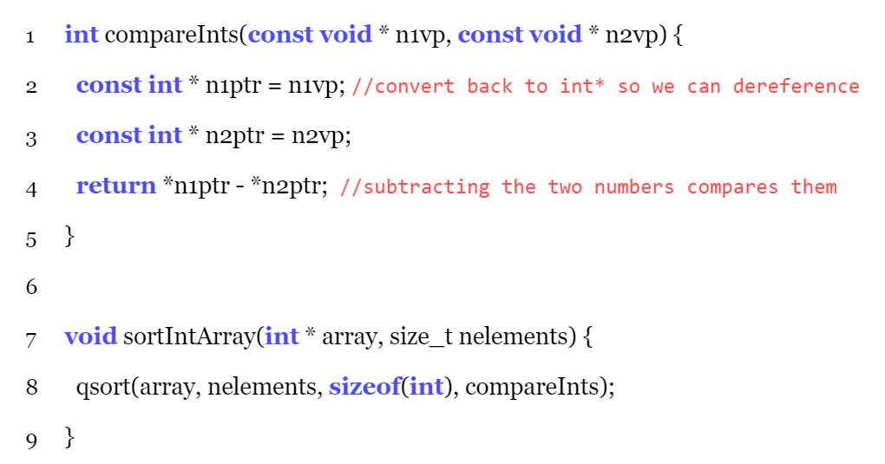
Function pointers: sorting

Slide 27
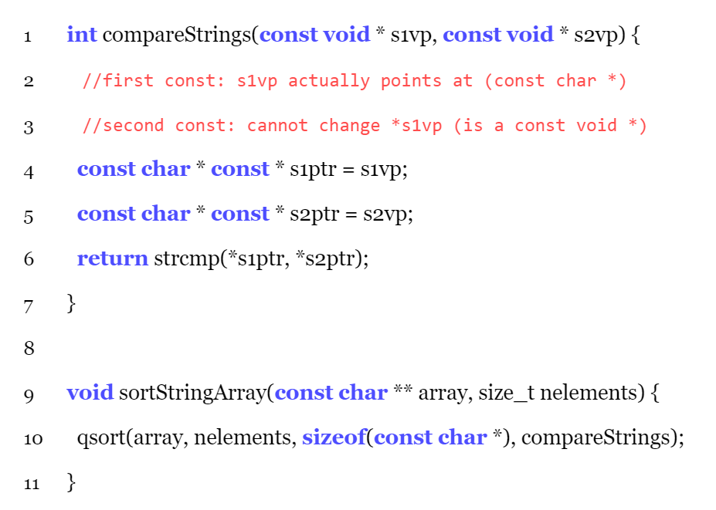
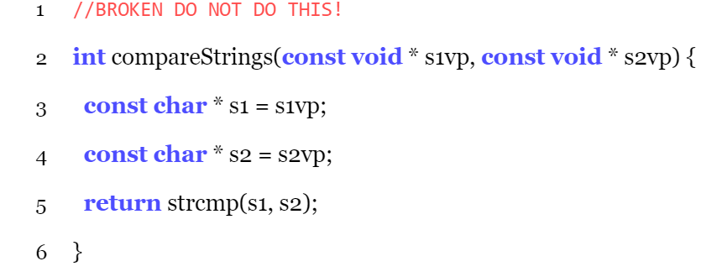
Function pointers: sorting
Where does the const come from

Slide 28
Thanks

