Slide 1
Recitation
Class+Reference+Overloading+Constructor+Destructor+ObjectCopying
Runren Zhang, Bingyu Lan

Slide 2
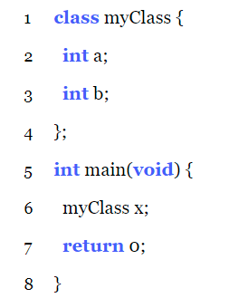
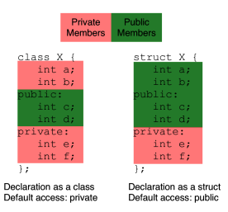
Class: Access Control
public: it can be accessed by any piece of code;
private: it can only be accessed by code within that class.
Do not need class here

Slide 3
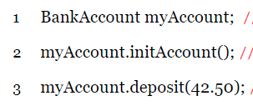
Class: Methods Act on Objects
Methods are functions inside classes.
Access methods in the same way that we can access fields of a struct.
Use dot (.) if we have the object directly or use arrow (->) if we have a pointer to it.
Add an extra parameter to each method, call this, which is a pointer to the object that the method is inside. For a method inside a class of type T, this pointer can be supposed to have a type of T * const.

Slide 4
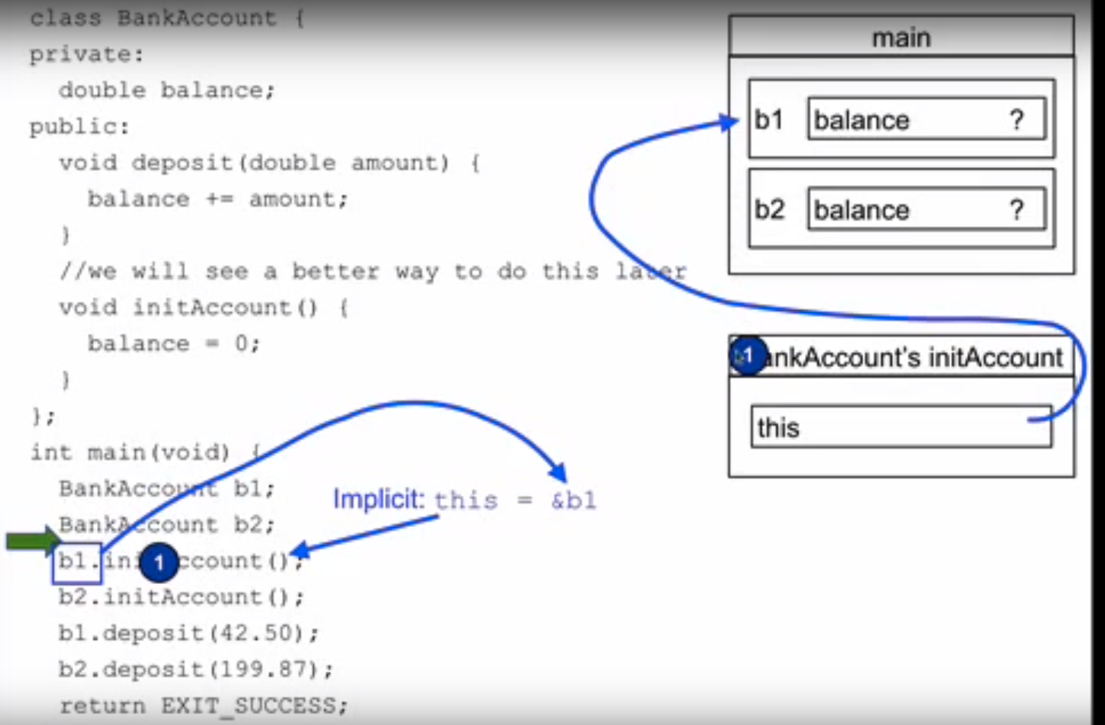

Slide 5
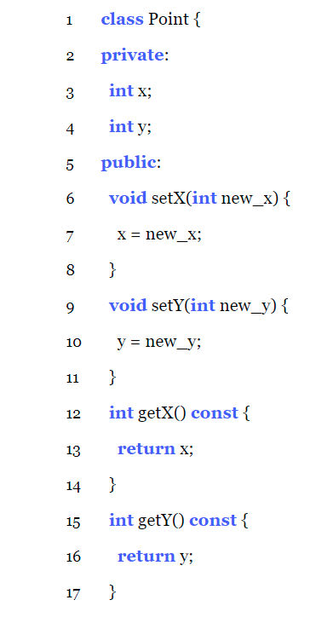
const Methods: methods which do not modify the object itself
T * const this => const T* const this

Slide 6
Plain Old Data (POD) classes
All POD types have direct C analogs and just sequences of fields in memory.
Any class which has members of a non-POD type is itself non-POD; which has members pointing to non-POD types will not make them non-POD.

Slide 7
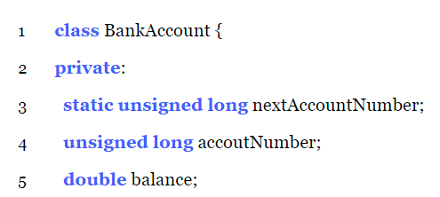
Static Members
All instances of a class share the same “box” for a particular field, which should be declared to be a static field.
Initialized outside any functions or classes;
:: is the scope resolution operator;
Execute before main begins.

Slide 8
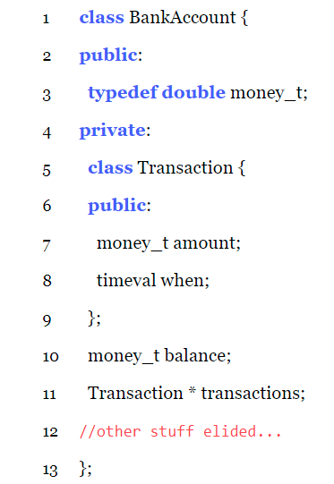
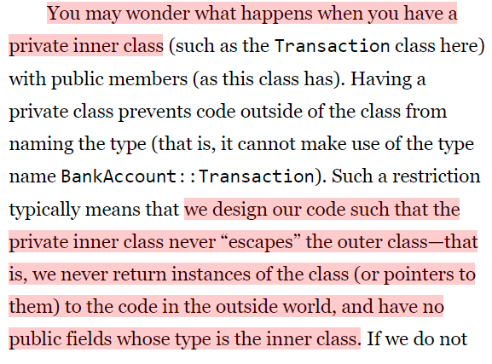
Classes can contain other types
Outside the class: BankAccount::money_t
BankAccount * ptrAccount;
double getTime() const;
Public methods with the private inner class return type

Slide 9
References
A reference is intended to conceptually be “another name for a box”.
int & x = y; declares a reference x which has type “int reference” and references y.
Difference between references and pointers:
Once a reference is initialized, it cannot be changed to refer to a different box. Make the class who has a member with reference type non-POD;
Automatically dereferenced;
Must be initialized when it is declared.
Cannot have NULL references;
Cannot have a reference to a reference (int&&); cannot have a pointer to a reference (int&*); but can have a reference to a pointer (int *&x);
Cannot perform “reference arithmetic”

Slide 10
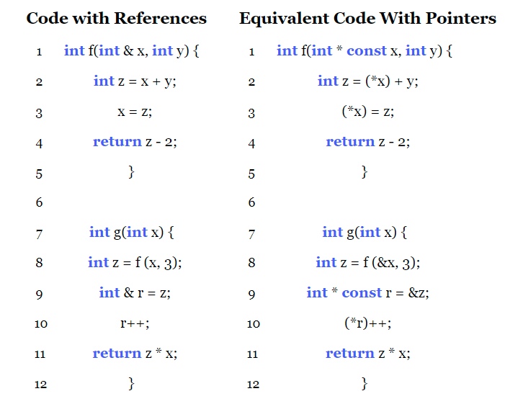
Translate References to Pointers
2 exceptions when translate reference-based code to pointer-based directly fails:
const reference may be initialized from something that is not an lvalue:
const int & x = 3;
Pointers and references are distinct types:
Can define an operator which operates on two references, but not on two pointers.

Slide 11
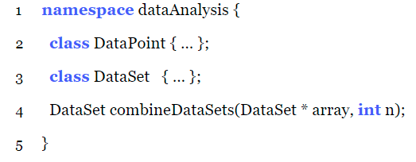
Namespace
Declarations
Usage
Use resolution operator :: by its fully qualified name, std::vector.
Open the entire namespace with the using keyword, using namespace std, then we can just use vector.
Only bring particular itemfrom a namespace into the current scope, using std::vector (preferable)

Slide 12
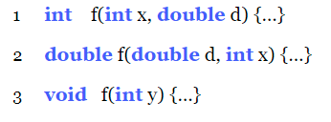
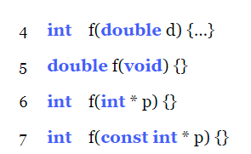
Function Overloading
const int * and int * is different;
Functions which only differ in their return types and/or parameter names are not valid overloadings;
Methods can also overloaded;
The compiler must be able to determine an unambiguous best choice of which overloaded function you want from the parameters that you pass in.

Slide 13
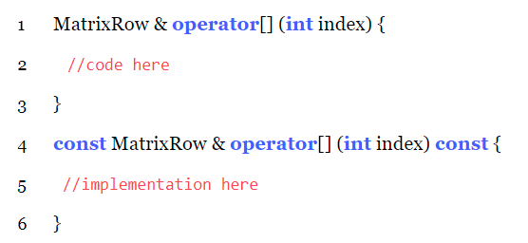
Operator Overloading
Matrix operator+ (const Matrix & rhs) const;
Matrix& operator+= (const Matrix & rhs);

Slide 14
Other Aspects of Switching to c++
1. Compilation
std=gnu++98 or std=gnu++11
2. bool Type
bool type, with values true and false
3. Void Pointers
Any pointer type to a void pointer or assign a void pointer to any pointer type without a cast in C; but in C++ requires an explicit cast. But we seldom use it since the dynamic allocation in C++ returns a correctly typed pointer instead of void *.
4. Standard Headers
<vector>, <cstdlib> (instead of <stdlib.h>)

Slide 15
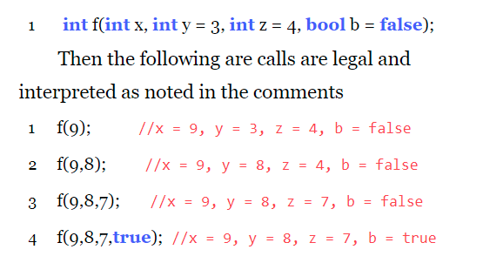
Other Aspects of Switching to c++
5. Code Organization
declare method in .h file;
Write the implementations of class in .cpp files.
6. Default Values

Slide 16
Scope resolution operator ::
1. initialize static member outside any functions and classes;
2. implement the methods outside the declaration of classes;
3. use a inner public class to declare variables outside the outer classes;
4. use a function or class from some namespaces.

Slide 17

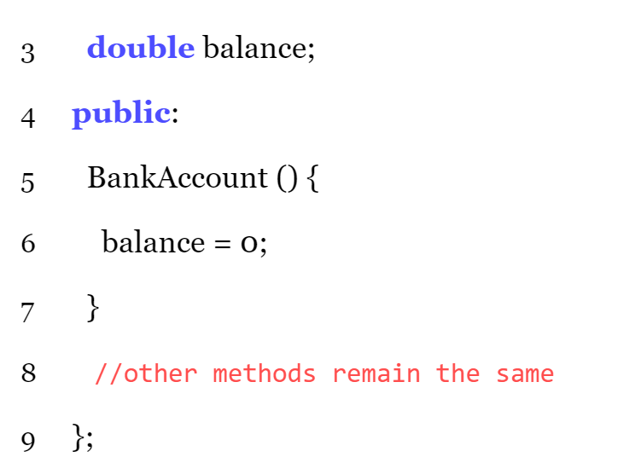
Construction: default constructor
The constructor is only called when a object whose type is a class is created; pointers or references to an object will not call the constructors.
If no constructors are written inside a class, the C++ compiler will provide a default constructor.

Slide 18
Always define a default constructor explicitly
Constructor
is nontrivial
contain
Explicitly defined constructor
No Explicitly defined constructor

Slide 19
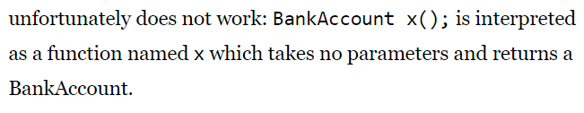
Construction: local variables
BankAccount myAccount(42.3)
BankAccount myAccount
BankAccount myAccount()
Right
Right
Wrong

Slide 20
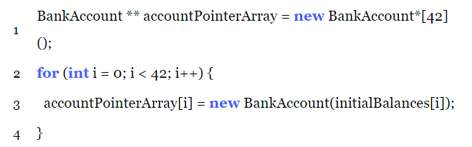
Construction: Dynamic Allocation
BankAccount * accountPtr = new BankAccount();
BankAccount * accountPtr = new BankAccount(initialBalance);
BankAccount * accountPtr = new BankAccount[42]();
Key difference between the dynamic allocation with previous local variable is that only pointers are declared inside the frame; the space dynamic allocated are in the heap.

Slide 21
Initialization with no input parameters
Value initialization
BankAccount * accountPtr = new BankAccount();
Default initialization
BankAccount * accountPtr = new BankAccount;
Value_initialization (newVariable) {
If (newVariable is an object of a classA)
if (the classA has a default constructor)
use the default constructor;
else
loop (fieldA of newVariable)
Value_initialization (fieldA);
end
else
newVariable = 0;
end
Default_initialization (newVariable) {
If (newVariable is a non-POD type)
use the default constructor;
else
left uninitialized;
end
Base case
Base case
Partially rely on the default constructor;
Otherwise use the recursion to do value initialization
Completely rely on the default constructor

Slide 22
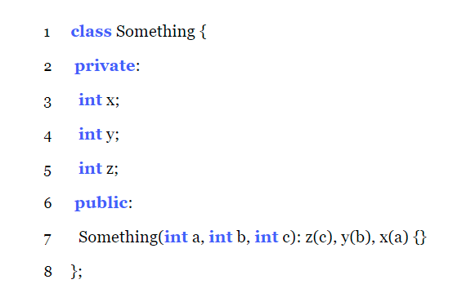

Construction: initializer lists
C++ makes a distinction between initialization and assignment.
Specify in initializer lists: initialization;
Specify in the constructor: assignment (which is already default initialized)
May have undesired behavior;
Slower;
References cannot be initialized this way;
Const field cannot be initialized this way
The order in which fields are initialized by the initializer list is the order in which they are declared in the class, not the order that their initializers are written in the initializer list.

Slide 23
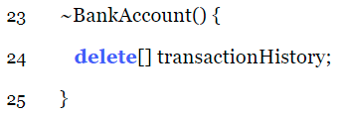
Destruction:
delete ⬄ new
delete[] ⬄ new[]
The number of delete should be the same as the number of new. If using new in function, then delete is expected in function; if using new in constructors, then delete is expected in destructors.
No return type;
May not be overloaded;
Take no parameters
When calling delete or delete[]
A local variable going out of scope, occurring at the closing bracket
The object which a field resides in is destroyed, occurring at the closing bracket of the destructor
The order of deallocate memory is the opposite order from which they were constructed

Slide 24
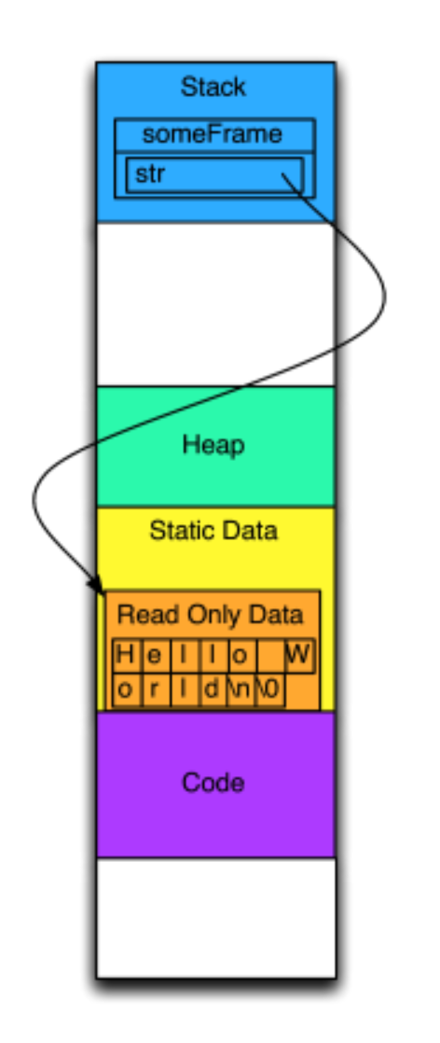
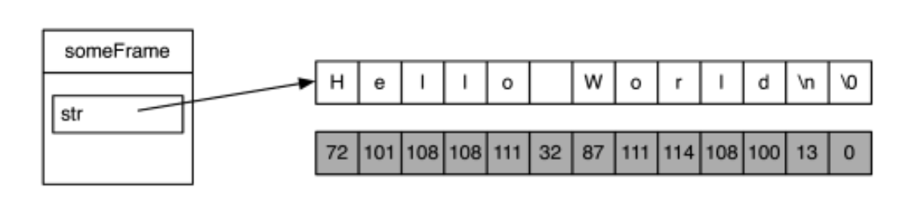
Strings: strings literals
const char *str = “Hello world\n”;

Slide 25
Copy Constructor
Assignment Operator
Deep copy during initialization
When objects are passed to functions by value; when objects are returned from a function by value; explicitly define a new object from an old one.
Free existing resources
Deep copy during assignment

Slide 26
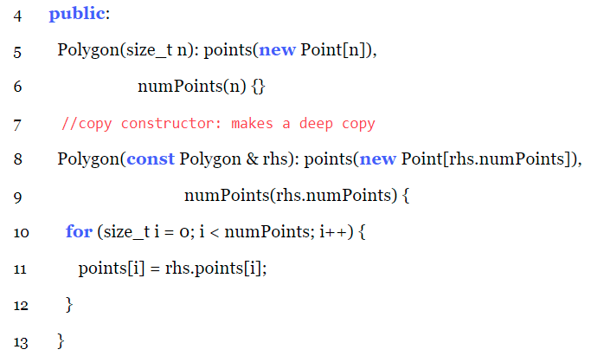
Copy constructor
Only one input parameter: const reference to its own type (const Polygon & in this case).
Why cannot pass by values?

Slide 27
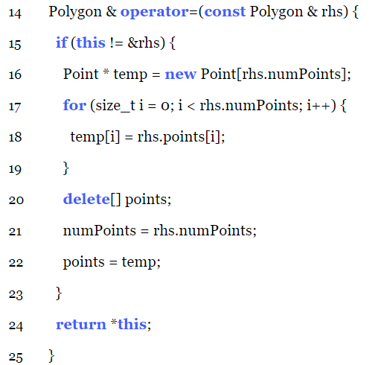
Assignment Operator
Return type is a reference to this object.
Checking if this != &rhs
Cleanup the existing object (especially for the dynamic allocated memory)
First new a memory and then delete the old memory to avoid dangling pointer.

Slide 28
Rule of Three
If you write a destructor, copy constructor or assignment operator in a class, you must write all three of them.
PRETTY IMPORTANT

Slide 29
Thanks

