Slide 1
Recitation
inheritance+exceptions
Runren Zhang, Bingyu Lan

Slide 2
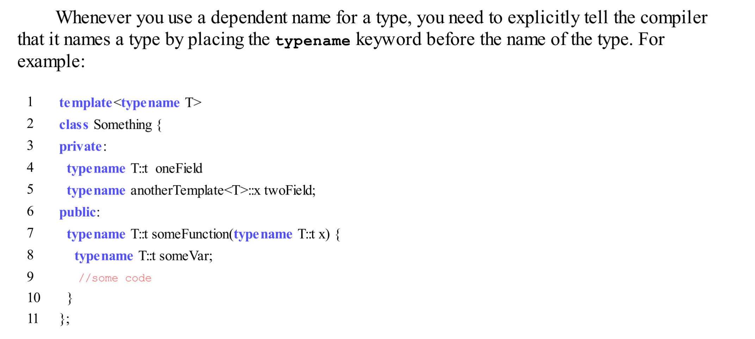
Dependent type names require “typename”
T::t * x
T::t & x
T::t(x)
Rather than making the rules depend on if the compiler can guess from the rest of the context, C++ just always requires typename.

Slide 3
Inheritance
Inheritance is the ability to declare a class in such a way that it obtains all of the fields and methods of another class. The child class can have more fields and methods of its own added to it, and can override the behavior of the methods it inherited.
Inheritance is best used when two classes exhibit an is-a relationship.

Slide 4
Writing classes with inheritance
1. If we declare fields of the same name as those in the parent class, what would happen?
Two different fields of the same name; they are distinct in that they have different fully qualified names. balance will refer to the one defined in child class; BankAccount::balance will refer to the inherited field.
Poor design
2. Access specifier in the inheritance declaration
public: keep the members access unchanged;
private: change all the members access into private;
protected: only change the public members access into protected;

Slide 5
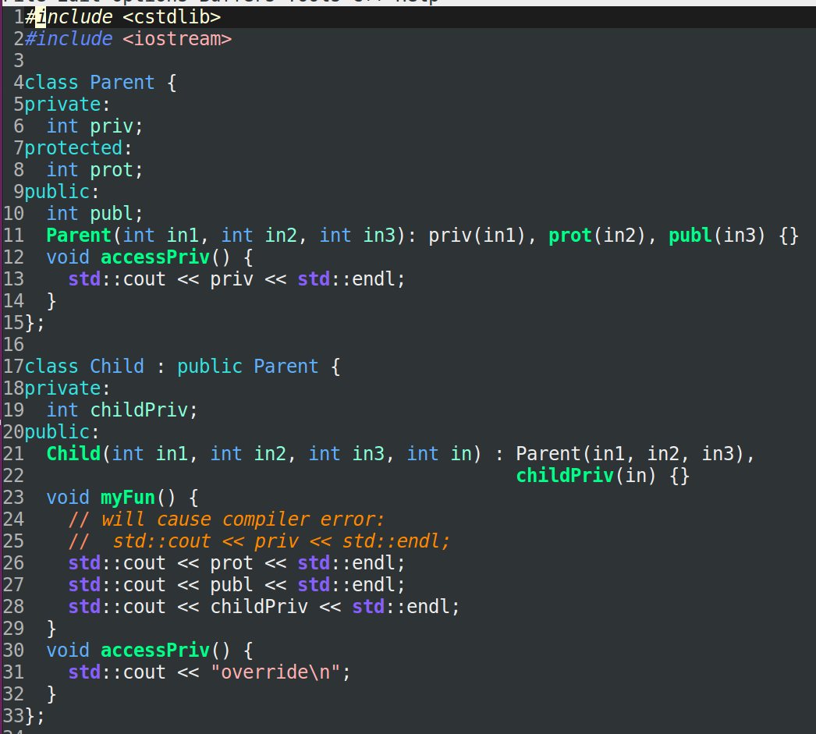
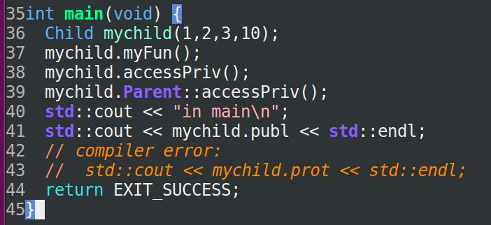
Provided by Genevieve

Slide 6
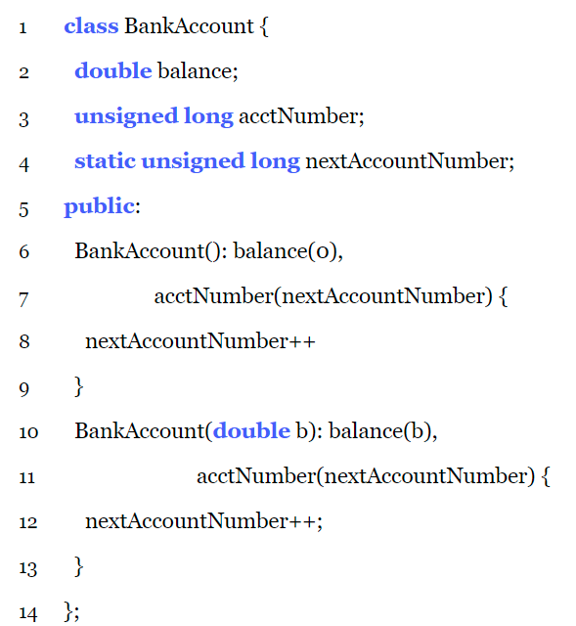
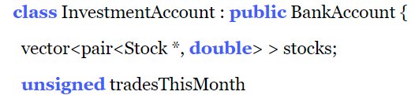
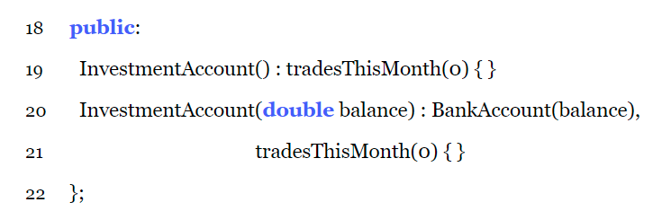
Construction/Destruction
The type of an object is decided by which class’ constructor/destructor is actually executed.

Slide 7
Subtype Polymorphism
The subtype polymorphism allows the programmer to treat an instance of a child class as if it were an instance of one of its parent classes; but polymorphism is only applicable when used with pointers or references.
Reason: the address of different types are the same size regardless of what they point to; but the object itself is of different size.

Slide 8
Subtype Polymorphism
static type
dynamic type
The type obtained by the type checking rules of the compiler; only uses the declared types of variables.
Static dispatch : the static type of the object determines which method to invoke. (Default)
The type of object that is actually pointed at.
Dynamic dispatch: the dynamic type of the object determines which method to invoke. (keyword virtual)
int a = 3;
int * ptr1 = &a；
const int * ptr2 = &a;

Slide 9
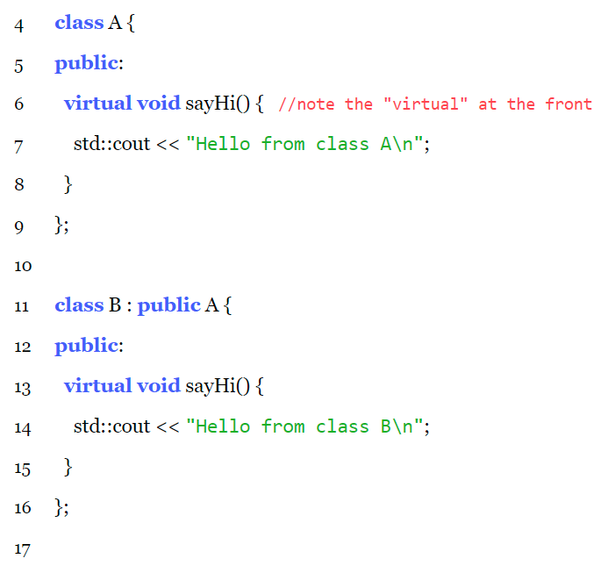
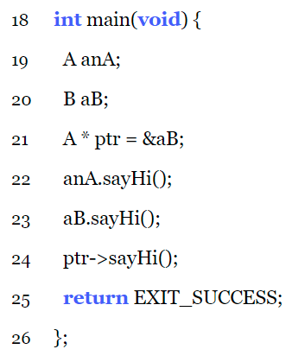
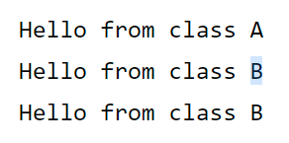
Method Overriding
Whenever a class may participate in polymorphism, its destructors should be declared virtual;
Does the constructors need the virtual keyword?
virtual makes the class non-POD;
The parent class’ version of method can be explicitly requested with the fully qualified name;
Overriding is still legal when changing the return type in the child class to be a subtype of the return type in the parent class (pointers or reference) Covariant

Slide 10
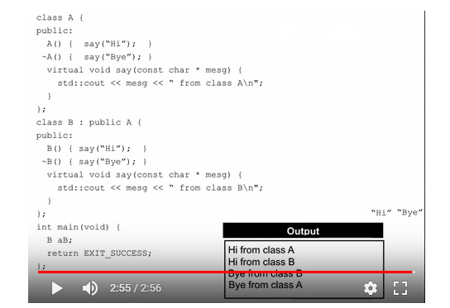
Dynamically dispatching methods during object construction and destruction

Slide 11
C++ specific details: Static vs Dynamic Dispatch
Overriding versus Overloading: what’s the difference?
Overloading:
parentClass: int addThree(int x){return x + 3;}
childClass: double addThree(double x){return x + 3.0;}
Overriding:
parentClass: int addThree(int x){return x + 3;}
childClass: int addThree(int x){return x + 4;}
Borrow from Sean

Slide 12
Abstract methods and classes
When a class has an abstract method in it, that class becomes an abstract class.
The abstract class cannot be instantiated: neither dynamic allocation nor initialize local variable, but can declare a pointer or reference to it.
Any subclass of an abstract class is also abstract unless it defines concrete implementations for all abstract methods in its parents.
The two rules will make an important guarantee to the compile: any object you actually instantiate will have an implementation for all of the methods declared in it.
If the constructor of an abstract class calls an abstract method, then ?

Slide 13
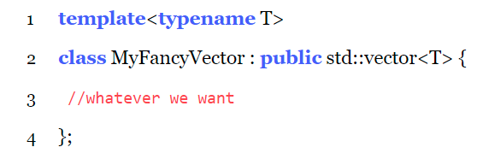
Inheritance and Templates
Aspects that are composable
Aspects that are not composable
To have a templated class inherit from another class; a class inherit from an instantiation of a templated class; a templated class inherit from an instantiation of another template class
A templated class can have virtual methods: virtual methods will be specified whenever a instantiation happens.
A templated method cannot be virtual.
A template function cannot override an inherited method: A non-virtual templated function with the same name of a virtual inherited method is legal but not override the virtual inherited method.

Slide 14
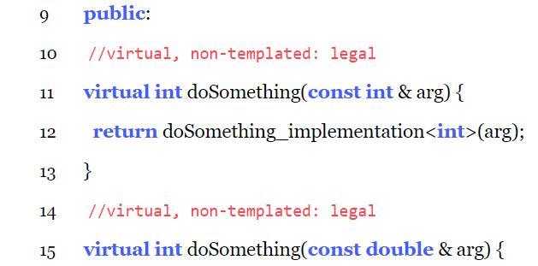
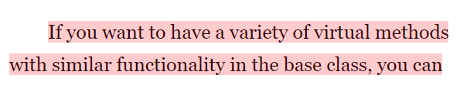
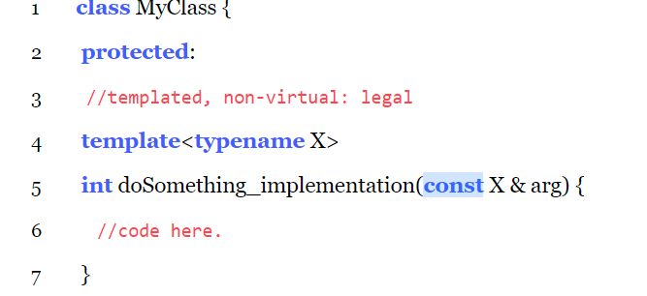
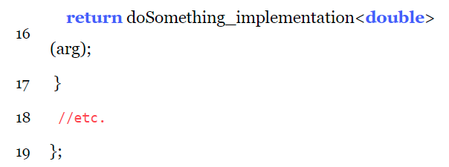

Slide 15
C-Style Error Handling
1. It is easy to forget;
2. “Clutters up” the code;
3. We only know that an error has occurred, and have no additional information about what went wrong. One solution is to use errno, but it is global variable so non-ideal.

Slide 16
C++-Style: expectations
1. Remove the possibility that an error can be silently ignored;
2. “error handling to be as unobtrusive as possible:
Pass the error to its caller with no extra code;
Don’t cause resource leakage.
3. Convey extra information about the error.

Slide 17
C++-Style: Exceptions
1. Place code in a try block; the try block is immediately followed by one or more catch blocks; each catch block specifies how to handle a particular type of exception.
2. Code that detects an error which it cannot handle throws an exception to indicate the problem
3. In C++ we can throw any type of object, but should generally only throw subtypes of std::exception, by including <exception> and <stdexcept>. Can also create subtypes of std::exception by declaring a class which inherits (publicly) from std::exception or any of its existing subtypes.

Slide 18
Exceptions Process
The exception object is potentially copied out of the frame into some location that will persist through handling.
Search_handler(exception object) {
If (execution arrow is inside of a try block)
Jump to the close curly brace of the try block (destruct any variables out of scope appropriately).
If (match the exception type against the handler types)
Handled within the catch block;
Else
Search_handler(exception object);
Else
Propagates out of the function that is in: destroys the function’s frame, including any objects inside it; then returns to wherever the function was called.
Search_handler(exception object);
}

Slide 19
Handled within the catch block
1. bind (a reference to it) the exception object to the variable name declared in the () of the catch block;
2. If throw; is encountered inside of the catch block, then the exception being handled is rethrown => Search_handler(exception object)
3. If the execution arrow reaches the close curly brace of the handler, then exception is finished handling and the object is deallocated and continues normally at the statement immediately following the close curly brace.

Slide 20
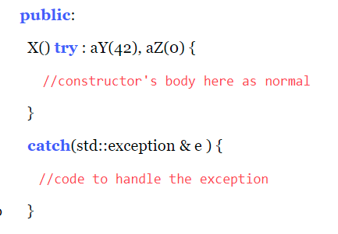
Variations on the try and catch blocks
1. The catch block can be specified to catch any type by placing three dots (…) in the parenthesis following the catch keyword. The cons is that we cannot bind the exception object to a variable;
2. A function try block, primarily of use in a constructor, where the exceptions may occur in the initializer list. One special behavior is that the successfully constructed part of the object will be destroyed before entering the handler.

Slide 21
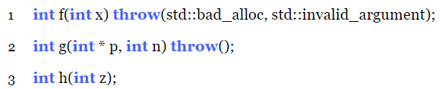
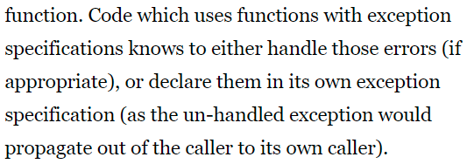
Exceptions as Part of a Function’s Interface

Slide 22
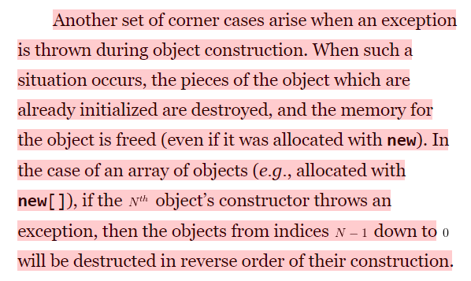
Exception corner case
Handled by two C++ special functions, unexpected() and terminate();

Slide 23

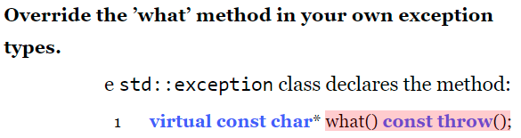


Using exceptions properly

Slide 24
Thanks

