Slide 1
Recitation
Hash Table + Heaps
Runren Zhang, Bingyu Lan
Exercises are borrowed from George

Slide 2
Hash Table
Why do we need hash table?
 | Abstract Data Type (ADT) | Basis Operation | Data Structures | Time complexity
 | Stacks | Push, Pop, Peek | Linked list, arrays | O(1)
 | Queues | Enqueue, Dequeue, Peek | Linked lists, arrays | O(1)
 | Sets | Search, intersect, Union | Balanced search tree | O(logN)
 | Maps | Lookup | Balanced search tree | O(logN)
Expecting O(1) operation time

Slide 3
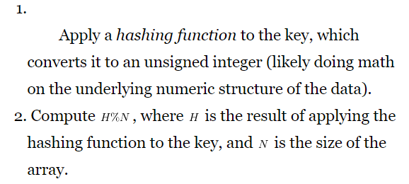

Hash process

Slide 4
How to coordinate the hash table with hash function
1. call hash function (not method) directly in the hash table class definition;
Drawbacks: inflexible and restrictive, cannot use template to pass in
2. write the hash function as a method of the key:
Require a wrapper class which claims key as a field;
Drawbacks: cumbersome to use, need to use wrapper class instead of the key itself
3. Hash function is defined as a method of the other class
Wrap a Hash function inside hash function class;
Advantages: different hash functions can reside in different class and parameterized by template parameter.

Slide 5
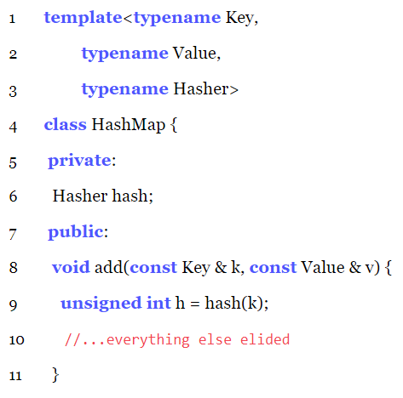

Slide 6
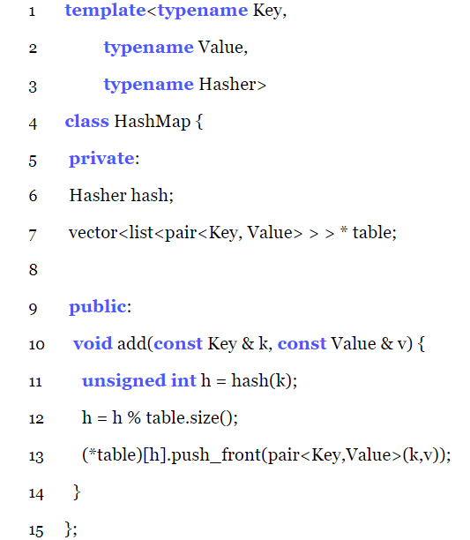
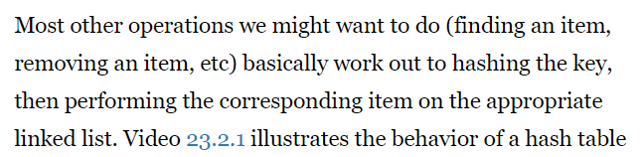
Collision Resolution: Chaining
Strong emphasis on the importance of checking that values are actually the same.

Slide 7
Hash functions
1. valid:
if a ==b, then hash(a) == hash(b)
2. how “good”:
If a!= b, then how likely hash(a) != hash(b)
3. prime number, large number

Slide 8
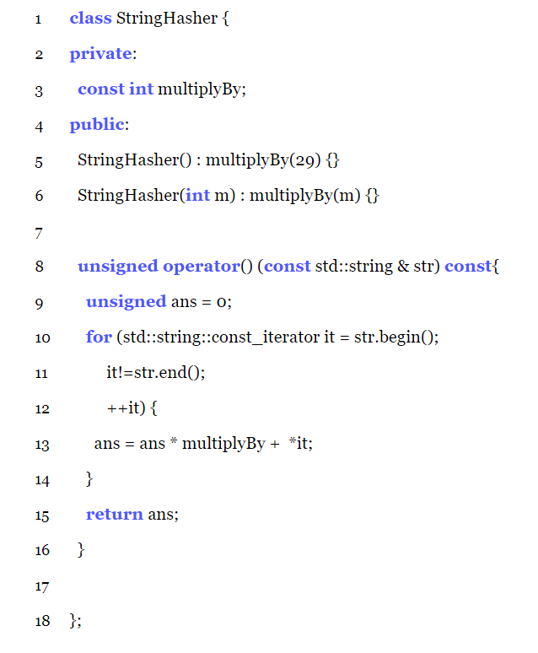
Hash function objects

Slide 9
Rehashing
When
Load factor: the ratio of the number of elements actually stored in the table to the number of buckets.
Threshold is generally 0.5~0.8
How
Step 1. Allocate new hash table with roughly doubling the entries.
Step 2. Traverse the old hash table and rehash every entry to the new hash table
Step 3. Destroy the old hash table
Sizing
X mod the Power of 2 can be computed using bit-wise and << shifts for the mod.
Hash function is less likely to end up with pattern based on a prime number

Slide 10
Exercise 1
Hash function: Lets create a hash function where keys are integers from 0-999. The hash function is the follow:
X and a are inputs in the function.
$$H\left(a\right)=h\left(a_{0}\right) where h\left(a_{i}\right)=h\left(a_{i+1}\right)∗X+a_{i},where a={(a}_{i}a_{i−1}a_{i−2}…{a_{1}a}_{0})$$
unsigned hash(int a, int x){
unsigned ans = 0;
unsigned div = 1;
unsigned tmp = 0;
while (div<a) div = div*10;
while(a>0){
div = div/10;
tmp = a / div;
a = a % div;
ans = ans*x + tmp;
}
return ans;
}

Slide 11
Exercise 2
void rehash() {
vector<list<pair<Key, Value> > > * temp
= new vector<list<pair<Key, Value> > >(2*table->size());
for (typename vector<list<pair<Key, Value> > >::iterator it
= table->begin();
it != table->end(); ++it) {
for (typename list<pair<Key, Value> >::iterator lit = it->begin();
lit != it->end(); ++lit) {
pair<Key, Value> item = *lit;
size_t hashnum = hash(item.first);
hashnum = hashnum % temp->size();
(*temp)[hashnum].push_front(item);
}
}
delete table;
table = temp;
} // borrowed from Genevieve
Rehashing example
class HashMap{
private:
vector<list<pair<Key,Value> > > * table;
...
public:
unsigned hash(Key key){ //the hash function
…
}
...
}

Slide 12
Priority queue
Using BST
Using Heaps
enqueue, dequeue, peek requires O(log(N))
enqueue, dequeue, O(log(N)) peek requires O(1)

Slide 13
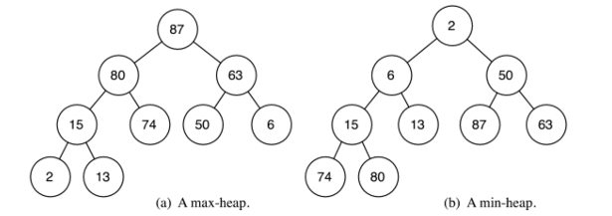
Heaps
Must be a complete binary tree with a maximum or minimum ordering between each node and its children.
We fill the tree from left to right

Slide 14
Insertion
How can I insert nodes to a heap?
Step1: Find the correct place to insert the node so that the tree remains a complete binary tree
Step2: Check to see if we violate the maximum (or minimum) ordering
Step3: If there is a violation fix it by change order between children and father nodes (bubble up)
Step4: If no more violations occur or you reach the root you are done.

Slide 15
Deleting the root
How can I resolve violations caused by deleting the root?
How should I replace the root?
(bubble down)

Slide 16
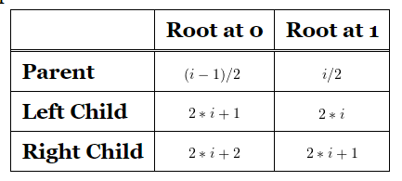
Heap array implementation
(sentinel) 87 80 63 15 74 50 6 2 13
Stop bubble up

Slide 17
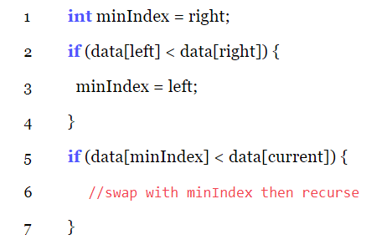
Bubble down
Take care of the array boundary
int minIndex = left;
if (right <= heap_size && data[left] > data[right]) {
minIndex = right;
}
if (left<=heap_size && data[minIndex]<data[current]){
//swap with minIndex then recurse
}

Slide 18
Exercise 1

Slide 19
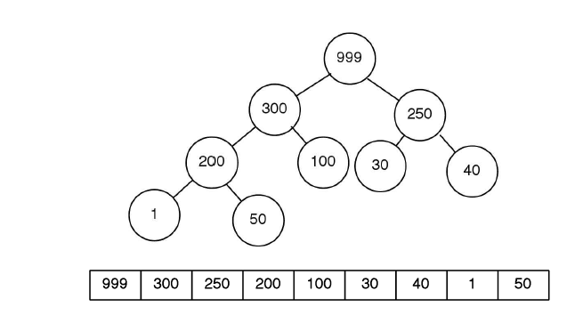

Slide 20
Exercise 2

Slide 21
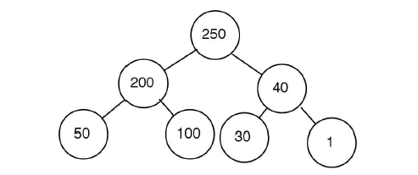

Slide 22
Thanks

