Slide 1
Heart Disease Prediction
Week 4 Machine Learning Capstone
Logistic Regression and Decision Tree · UCI Heart Disease

Slide 2
Dataset and target
920 records and 16 original columns.
Target num was converted to binary: 0 = no disease; 1–4 = disease.
Class counts: {'no disease (0)': 411, 'disease (1)': 509}.
Dropped patient ID and collection site to avoid identifier and site shortcuts.
Most missing: ca (611), thal (486), slope (309).
Source: UCI Heart Disease, CC BY 4.0; see the README for attribution.

Slide 3
Preprocessing and evaluation
One reproducible 80/20 stratified train/test split (random seed 42).
Numeric missing values: training-set median imputation plus missing indicators.
Categorical values: training-set most-frequent imputation and one-hot encoding.
Numeric scaling is fitted for Logistic Regression; Decision Trees use unscaled values.
All preprocessing is inside each model pipeline, fitted on training rows only.
Metrics: accuracy, precision, recall, F1, ROC-AUC, and confusion matrices.

Slide 4
Test-set results
Model | Accuracy | Precision | Recall | F1 | ROC-AUC
Logistic Regression | 0.810 | 0.796 | 0.882 | 0.837 | 0.908
Decision Tree | 0.755 | 0.782 | 0.775 | 0.778 | 0.753

Slide 5
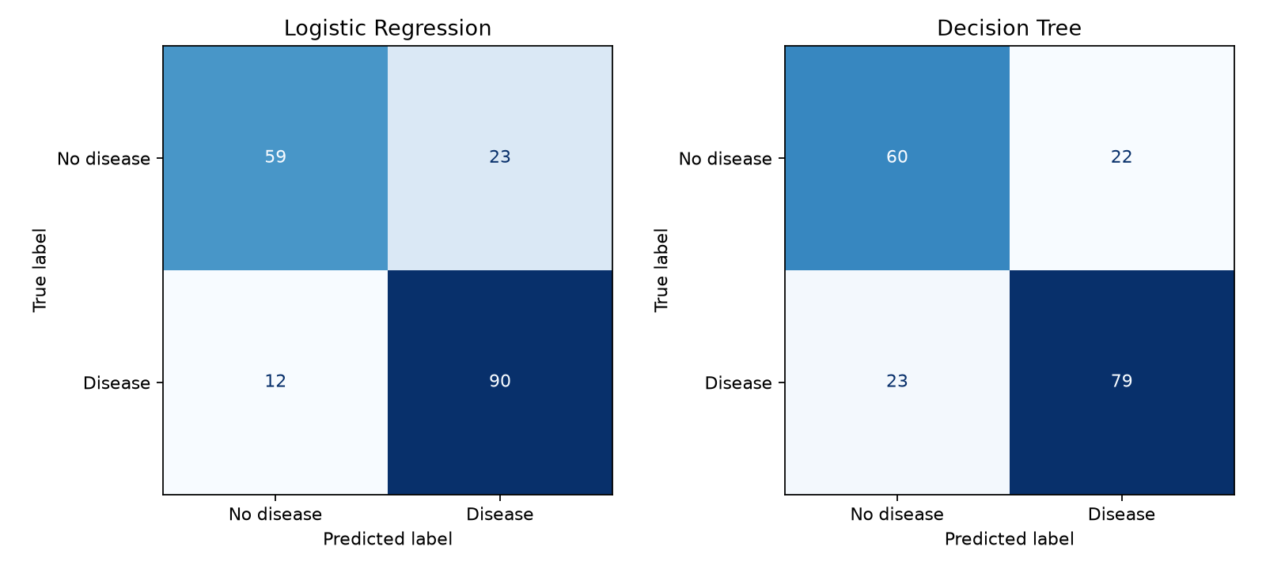
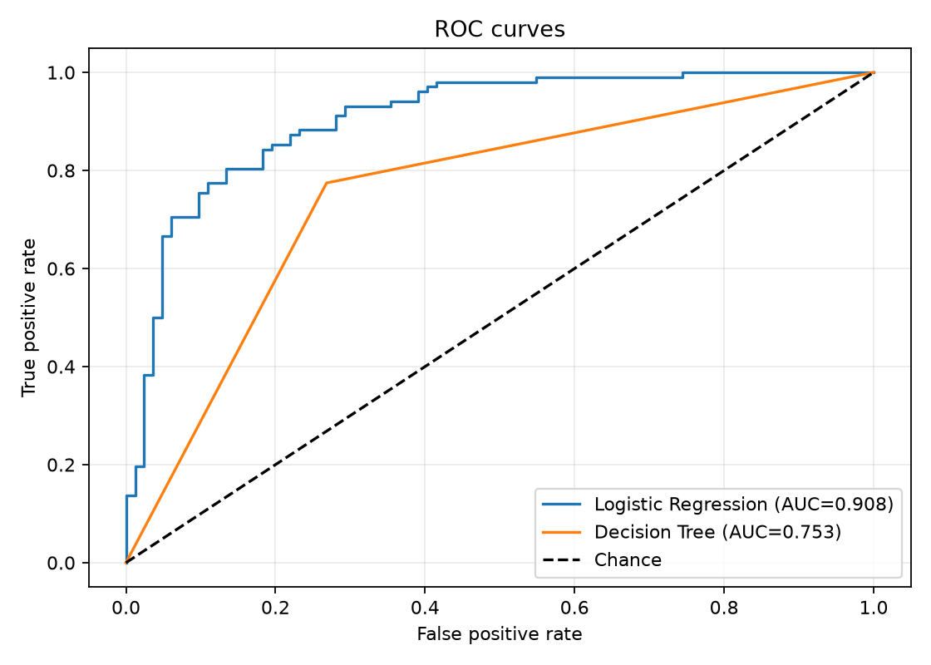
Confusion matrices and ROC curves

Slide 6
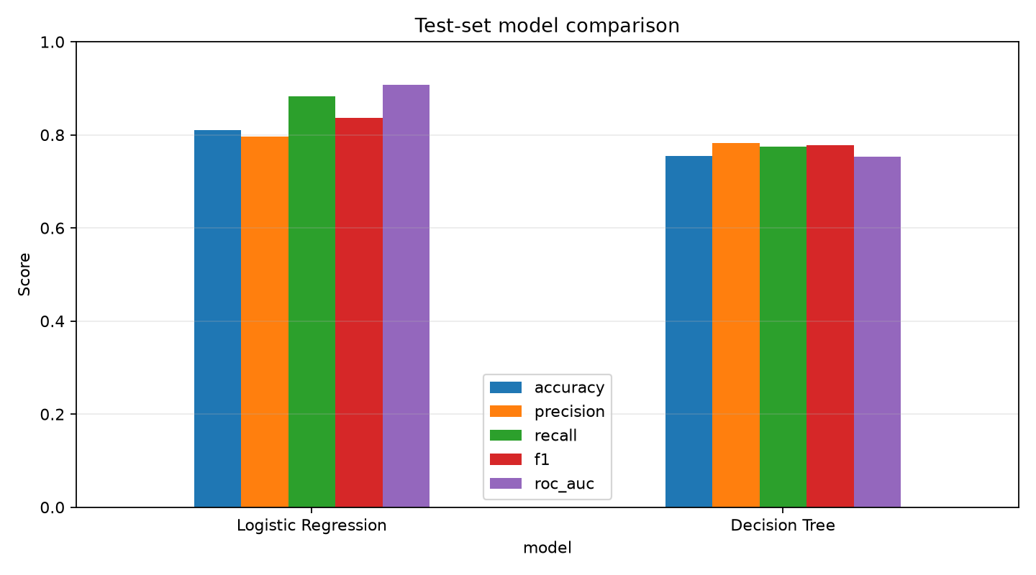
Model comparison

Slide 7
Conclusion and limitations
On this split, Logistic Regression has the strongest ROC-AUC (0.908) among these two baselines.
The combined cohort spans multiple hospitals and has substantial missingness; results may reflect cohort differences.
A single random split is educational evidence, not external clinical validation.
This model is not a clinical diagnostic tool and must not guide patient care.

