Slide 1
🧠
PRAGUE AUTOIMMUNITY CONGRESS · 2026
AI at the Bedside
Clinical Reasoning in the Age of AI Chatbots
2 HOURS
4 SPEAKERS
~80 PARTICIPANTS
3 CLINICAL CASES
YOAD DVIR · OR DEGANY · DAPHNA IDAN · ITAMAR BEN SHITRIT
AI AT THE BEDSIDE · PRAGUE 2026
yoad-dvir.github.io/prague-workshop

Slide 2
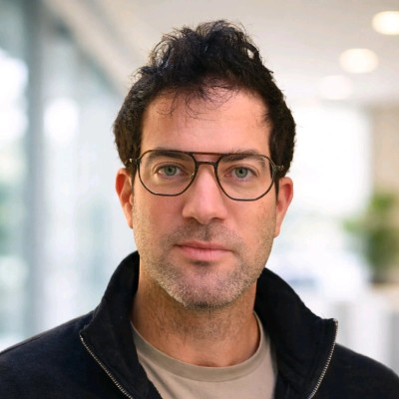
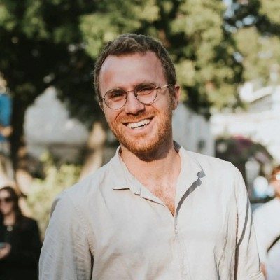
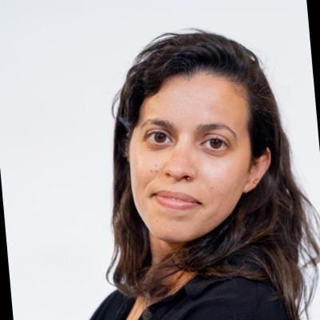
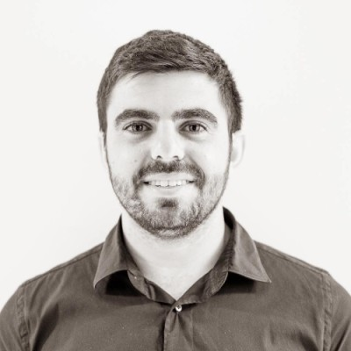
② THE TEAM
Four speakers. One shared angle.
One AI technologist and three clinicians — each bringing a different perspective on how AI shows up in the clinical room.
Yoad Dvir
Or Degany
Daphna Idan
Itamar Ben Shitrit
Cyber & AI Technologist
Silverfort
MD · Hadassah Medical Center
Tel Aviv Univ.
MD/MPH · Head of Research at Medint
Pediatric ED
MD/MPH · Chief of Staff
Soroka · BGU
OPENS · 20 MIN
CLINICAL LEAD · 20 MIN
20 MIN
20 MIN
AI AT THE BEDSIDE · PRAGUE 2026
yoad-dvir.github.io/prague-workshop

Slide 3
③ THE TIMELINE · AT A GLANCE
Two hours · eight segments
The whole workshop in one view — who, what topic, and how long.
Yoad
Or
Daphna
Itamar
AI vs no-AI
☕ Break
Debrief
Close
🎙️ Intro + AI foundations
🩺 Clinical reasoning
🔬 Patient-facing AI
📊 AI at hospital scale
🎯 Case exercise
20m
20m
20m
10m
20m
20m
8m
2m
0:00
0:30
1:00
1:30
2:00
Two blocks. Block 1 builds the foundation. Block 2 pressure-tests it with a live case exercise.
AI AT THE BEDSIDE · PRAGUE 2026
yoad-dvir.github.io/prague-workshop

Slide 4
④ BLOCK 1 · FOUNDATIONS (0:00 → 1:00)
Building the ground
0:00 — 0:20
🎙️ Yoad — Intro, objectives + AI foundations
20m
Opens the workshop: three objectives. How LLMs really work. The CLEAR prompting framework. A live hallucination demo.
0:20 — 0:40
🩺 Or — Clinical reasoning under AI
20m
How diagnosis really works. Where cognitive biases slip in — and which of them AI mitigates vs. amplifies.
0:40 — 1:00
🔬 Daphna — The patient-facing frontier
20m
The Medint model. How AI-augmented research teams help patients with complex cases — and what responsible AI looks like.
1:00 — 1:10
☕ Break
☕
10m
Ten minutes. Coffee, hallway conversations, reset before Block 2.
AI AT THE BEDSIDE · PRAGUE 2026
yoad-dvir.github.io/prague-workshop

Slide 5
⑤ BLOCK 2 · PRESSURE TEST (1:10 → 2:00)
The heart of the workshop
1:10 — 1:30
📊 Itamar — AI meets the hospital
20m
The system view. What data really shows about accuracy, bias, and failure modes. Human-in-the-loop vs. on-the-loop.
1:30 — 1:50
🎯 Case Challenge — AI vs. no-AI
🎯
20m
Round 1: half the room with AI, half without. Round 2: they swap. Everyone experiences both conditions.
1:50 — 1:58
🔍 Live Debrief — Compare outcomes
🔍
8m
What did AI catch that humans missed? What did humans catch that AI missed? Three clinical lenses — Or, Daphna, Itamar.
1:58 — 2:00
🎤 Close · what's next
2m
Yoad closes with the 90-second copilot-to-agent vision — where clinical AI is heading in the next 12 months.
AI AT THE BEDSIDE · PRAGUE 2026
yoad-dvir.github.io/prague-workshop

Slide 6
⑥ OBJECTIVES
Three objectives · clear measurement
By the end of the workshop, every participant walks out with three new capabilities they can use the next day.
01
02
03
🧠
✍️
⚖️
Understand
Operate
Judge
How AI chatbots really work — next-word prediction, not 'understanding'. Why medicine is uniquely hard for them.
How to write safe, effective prompts for clinical reasoning — using the CLEAR framework, ready to use Monday morning.
When to trust AI output, when to question it, and how to spot hallucinations and prompt failures in real time.
AI AT THE BEDSIDE · PRAGUE 2026
yoad-dvir.github.io/prague-workshop

Slide 7
🩺
⑦ THE MESSAGE THAT STAYS IN THE ROOM
The Monday Doctor
The bar we want to clear isn't "a good workshop." It's this: Does the clinician walk out and, next Monday morning — prompt the AI differently?
THANK YOU
AI AT THE BEDSIDE · PRAGUE 2026
yoad-dvir.github.io/prague-workshop

