Slide 1
Beyond Intelligence:
Building Trustworthy and Ethical AI Systems

Slide 2
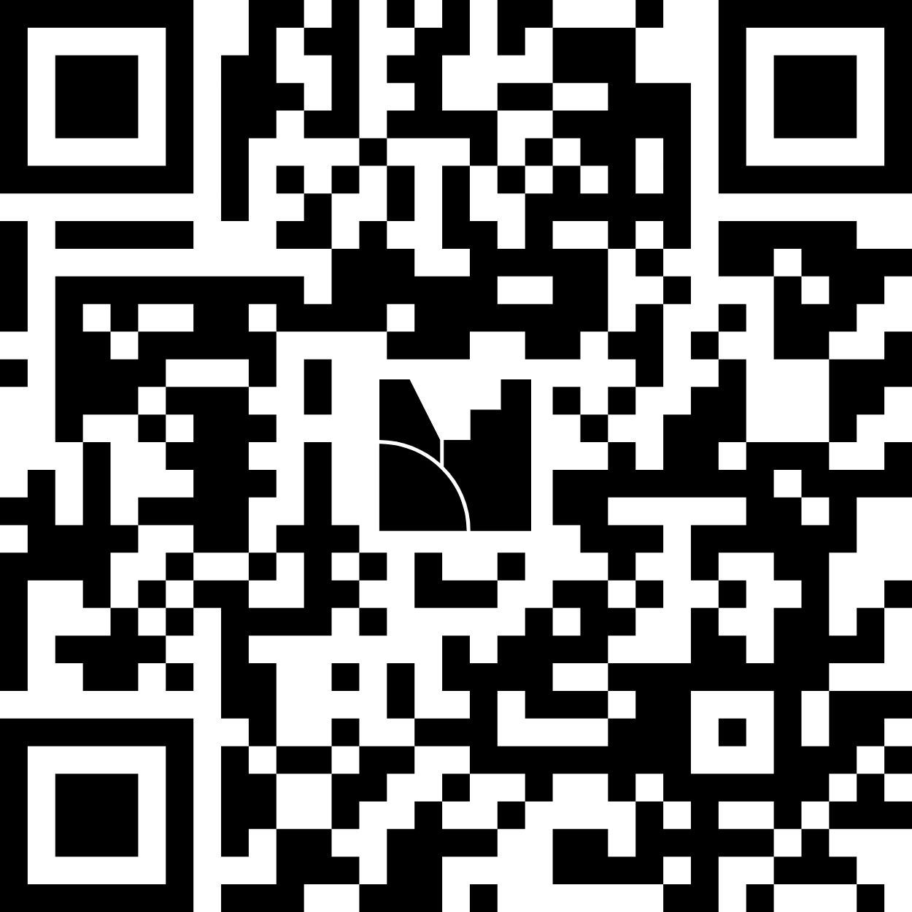
Quick Activity

Slide 3
What to Expect Today
Today, we’ll dive into
The AI Landscape
Building Trust & Ethics in AI.
Future Trends & Tools.

Slide 4
What is an ethical AI?

Slide 5



AI Today – The Gap
80% use AI
Smarter Models
Only 1% mastered it
Agentic workflows
$4.4 trillion opportunity
Trust Gap

Slide 6
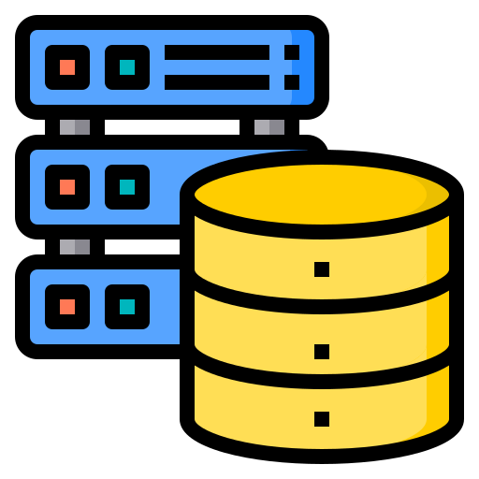


Why Your AI Project Fails: Common Barriers
Bad Data = Bad Models
No Domain Data
Only 5% see ROI
Skills Gaps
Privacy & Compliance
MIT Study (Aug 2025)

Slide 7







Real Consequences
Trustworthy AI Framework
Lawful
Why Projects Get Killed?
Can’t explain decisions
Quit Facial Recognition (2020)
Ethical
Robust
Legal blocks deployment
Paused Police Use
Users abandon features
Documentary on AI Bias

Slide 8





Why Companies Should Care
User Adoption
Legal Costs
Trust = Revenue
Bias lawsuits = $Millions
Regulatory Penalties
Reputation Damage
€35M fines are real
Kills products overnight

Slide 9








Ethics In Ghana Context
Why People Ignore This?
Anonymization
Pressure to ship fast
ROI over responsibility
Consent
Representation
Don't know how
Transparency

Slide 10

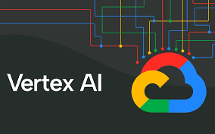





EXPLAINABLE AI (XAI)
THE BLACK BOX PROBLEM
XAI Solution
Natural language explanations
Audit trails for compliance
Debug model behavior
Users don't trust
Legal won't approve
Can't debug

Slide 11







Regulatory Frameworks + Accountability
EU AI Act
Accountability
Ethics Guidelines
Humane Tech
AI Alliance
€35M penalty
AI Principles
Human Rights
Human Wellbeing
Open Innovation
Risk classification
Transparency
Impact Assessment
Attention Economy
Safe AI Development
Context
Data Protection Act 2012
WHO ENFORCES?
Data Protection Commission
Fines + imprisonment
No AI-specific regulation yet
PENALTIES?
dataprotection.org.gh
Adopt frameworks proactively
REPORT?

Slide 12


Operationalizing Ethics in Your Pipeline
Human Oversight
Fairness
Transparency
Privacy
Safety
Accountability
CI/CD

Slide 13

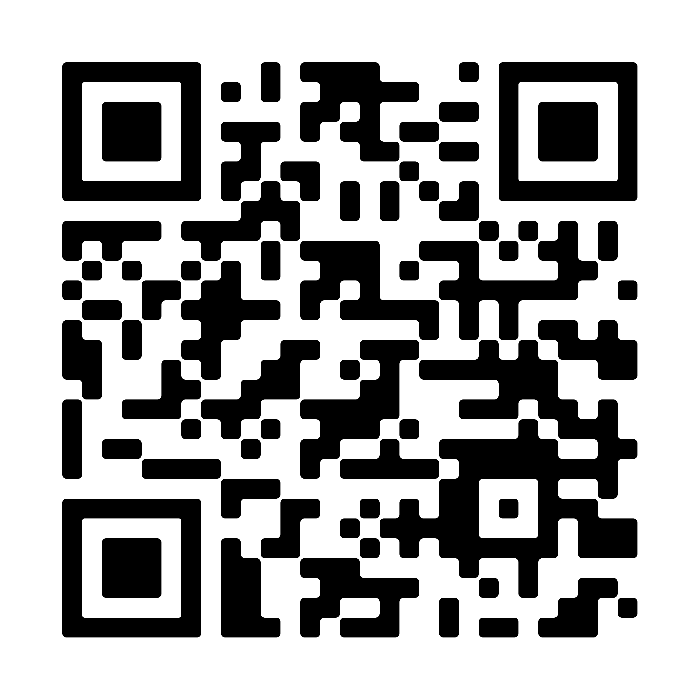








TOOLS + CALL TO ACTION
Resources
Policy Obsevatory
ALTAI Checklist
Build AI Ghanaians Can Trust
Readiness Assessment
Test on diverse Ghanaian data
Implement explainability day one
Follow privacy best practices
Open-source Toolkits
Socials
@yawoseii
adjeiyawosei@gmail.com
Yaw Osei Adjei
www.yawosei.me

