Slide 1
EEG-Based Mental Stress Detection
Binary classification of stress states from EEG recordings
using machine learning
Yoana Agafonova • Iliana Hristova
Data Science Capstone Project
IMC University of Applied Sciences Krems

Slide 2
Problem Overview
What is the problem?
Healthcare
Mental stress impairs health, performance and well-being
Traditional assessment relies on self-reports — subjective and unreliable
Physiological signals offer an objective alternative
EEG captures direct neural correlates of cognitive and emotional states
Early detection of burnout and anxiety
Workplace Safety
Monitor operator stress in critical settings
Our approach:
Train a binary classifier (stress / non-stress) on features extracted from 5-channel EEG recordings captured during controlled experiments.
Stress Management
Biofeedback and intervention systems

Slide 3
Problem Definition
Data
112 EDF files • 5 experimental conditions
5 EEG channels: AF3, T7, Pz, T8, AF4
Sampling rate: 128 Hz
Split into non-overlapping 10-second windows → 3,507 samples
75 features per window (15 per channel)
EDF Files
Filter
0.5-45 Hz
Window
10 sec
Extract
75 features
Classify
STRESS
NON-STRESS
CMPS • Horror
SCWT • TMCT
Relaxing Music
Input space:
x ∈ ℝ⁷⁵ → y ∈ {0 = non-stress, 1 = stress}
Class balance: 86.6% stress • 13.4% non-stress → Imbalanced problem

Slide 4
Objectives
Explore and understand the EEG dataset and its structure
Train and compare multiple machine learning models
1
5
Define stress and non-stress classes based on experimental conditions
Evaluate models using metrics suitable for imbalanced classification
2
6
Preprocess EEG signals and select relevant channels
Analyze limitations and potential improvements of the final model
3
7
Extract statistical and frequency-domain features from EEG windows
4

Slide 5
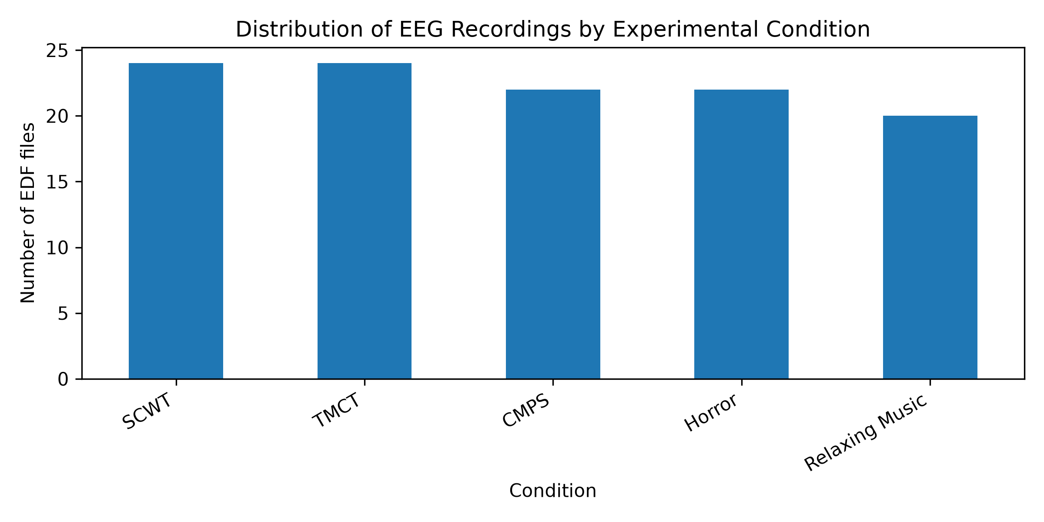
Dataset & Exploratory Analysis
112
22-24
EDF recordings
files per stress condition
20
128 Hz
non-stress files
sampling frequency
Condition | Files | Class
CMPS | 22 | Stress
Horror Video | 22 | Stress
SCWT | 24 | Stress
TMCT | 24 | Stress
Relaxing Music | 20 | Non-stress

Slide 6
Literature Review
Healey & Picard (2005)
Physiological signals can objectively detect stress during real-world tasks — basis for sensor-based monitoring.
Alberdi et al. (2016)
EEG is among the most informative signals for stress; frequency-domain features outperform time-domain.
Saeed et al. (2020)
Long-term stress classification from EEG using ML achieves competitive results with band power features.
Friedman (2001)
Gradient Boosting builds additive models stage-wise — effective for tabular feature data in biomedical settings.
Success criteria: Macro F1-score ≥ 0.55 under file-independent evaluation

Slide 7
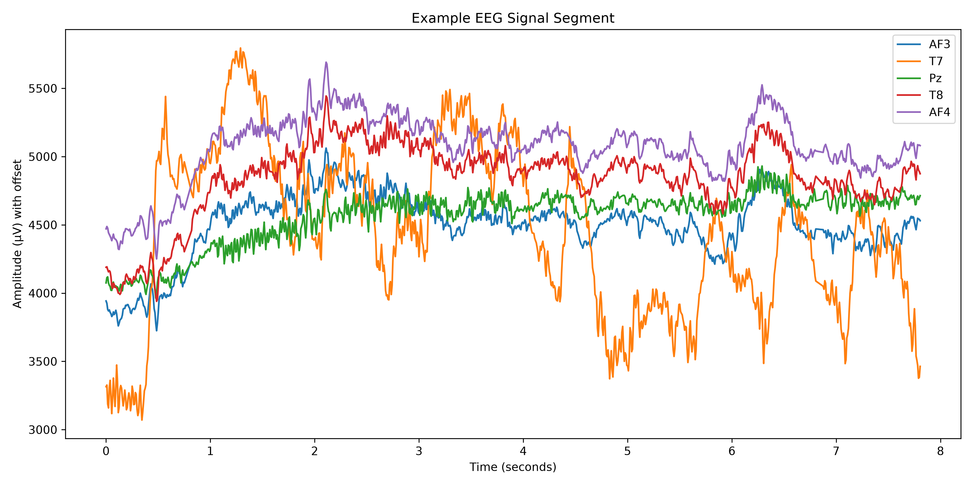
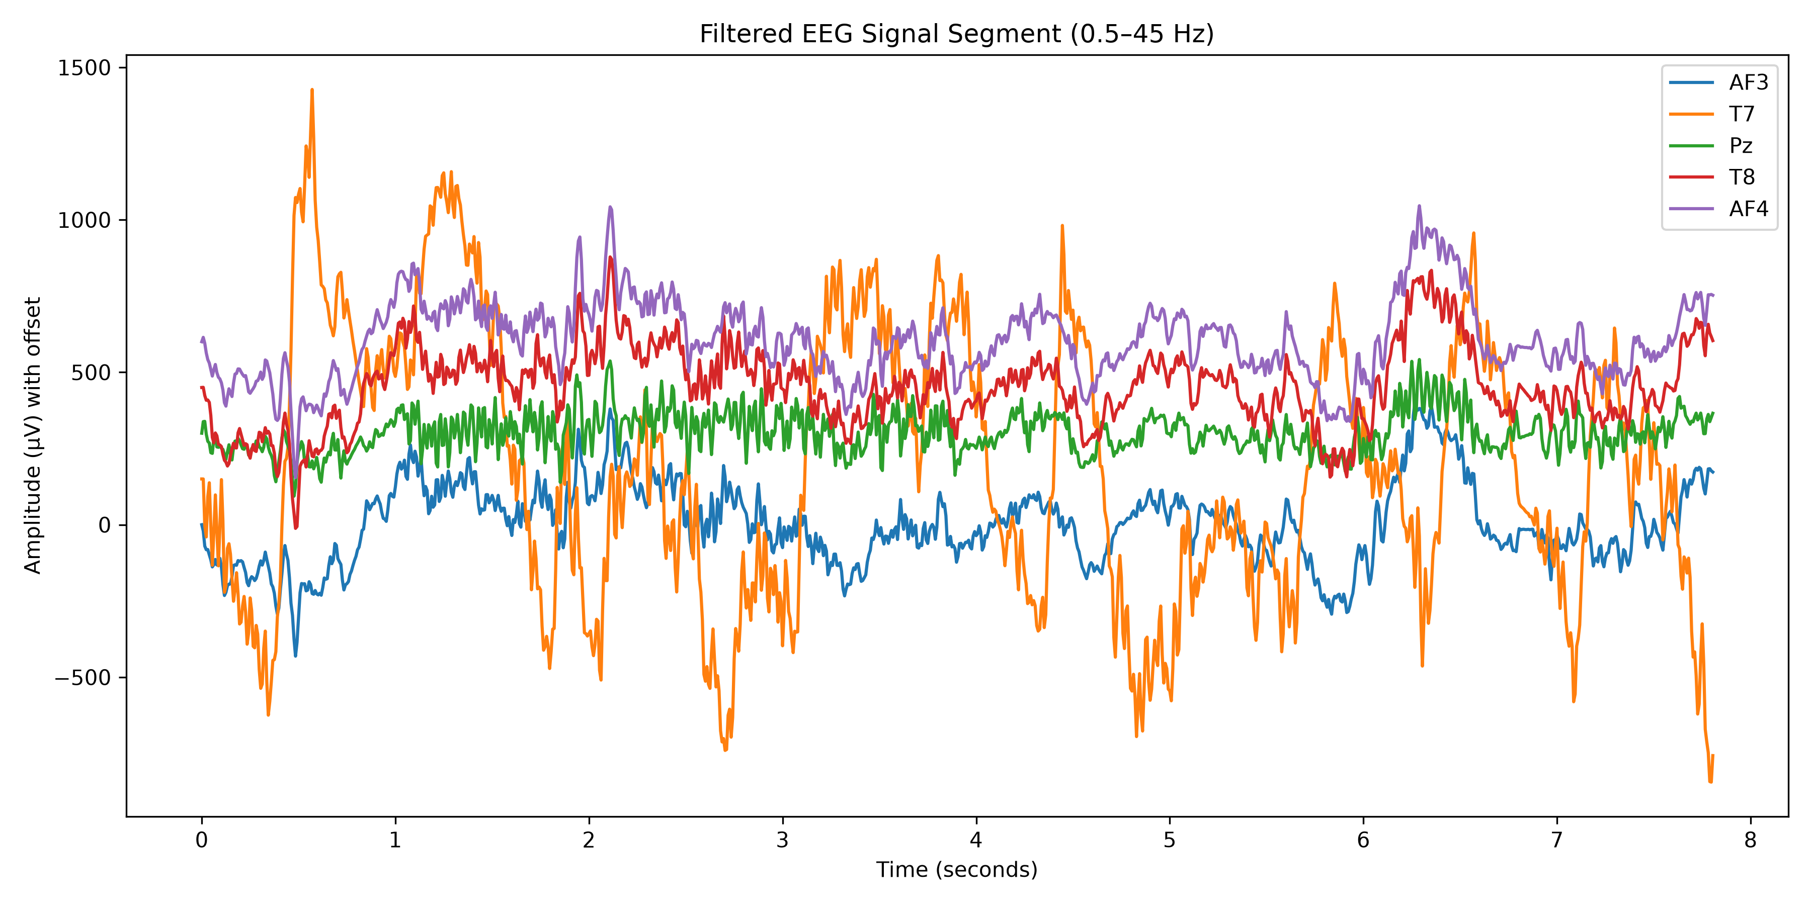
Signal Preprocessing
1
Load EDF
MNE library
112 files, 31 channels each
2
Select Channels
AF3, T7, Pz, T8, AF4
(frontal + temporal + parietal)
3
Bandpass Filter
0.5–45 Hz
Removes drift & high-freq noise
4
10-sec Windows
1,280 samples/window
3,507 windows total

Slide 8
Feature Extraction
75 features per window = 5 channels × 15 features per channel
Statistical Features
Frequency Band Power
(10 per channel)
(5 per channel, via Welch PSD)
Mean
Delta
0.5–4 Hz
Standard deviation
Variance
Theta
4–8 Hz
Min / Max
Median
Alpha
8–13 Hz
Skewness
Beta
13–30 Hz
Kurtosis
Signal energy
Gamma
30–45 Hz
Shannon entropy

Slide 9
Models & Validation Strategy
Five Models Compared
StratifiedKFold (5-fold)
Logistic Regression
Randomly assigns windows to folds
Windows from same EDF can be in BOTH train and test
⚠ Data leakage → optimistic / inflated results
Random Forest (n=300)
SVM with RBF kernel
K-Nearest Neighbors (k=5)
GroupKFold (5-fold, by EDF file)
Gradient Boosting
All windows from one EDF file stay in one fold
No leakage between correlated windows
✓ Stricter, more realistic evaluation
All wrapped in: StandardScaler → Classifier pipeline

Slide 10
Evaluation Metrics
Why standard accuracy is misleading here:
A model that predicts Stress for every window achieves 86.6% accuracy — without learning anything.
Balanced Accuracy
Treats both classes equally regardless of frequency. A random classifier scores 0.5.
(Recall_stress + Recall_non-stress) / 2
Macro F1-Score
Penalizes models that ignore the minority class. Used as primary selection criterion.
Mean of F1 for each class (unweighted)
Accuracy
Reported for reference but not used for model selection.
Correct / Total

Slide 11
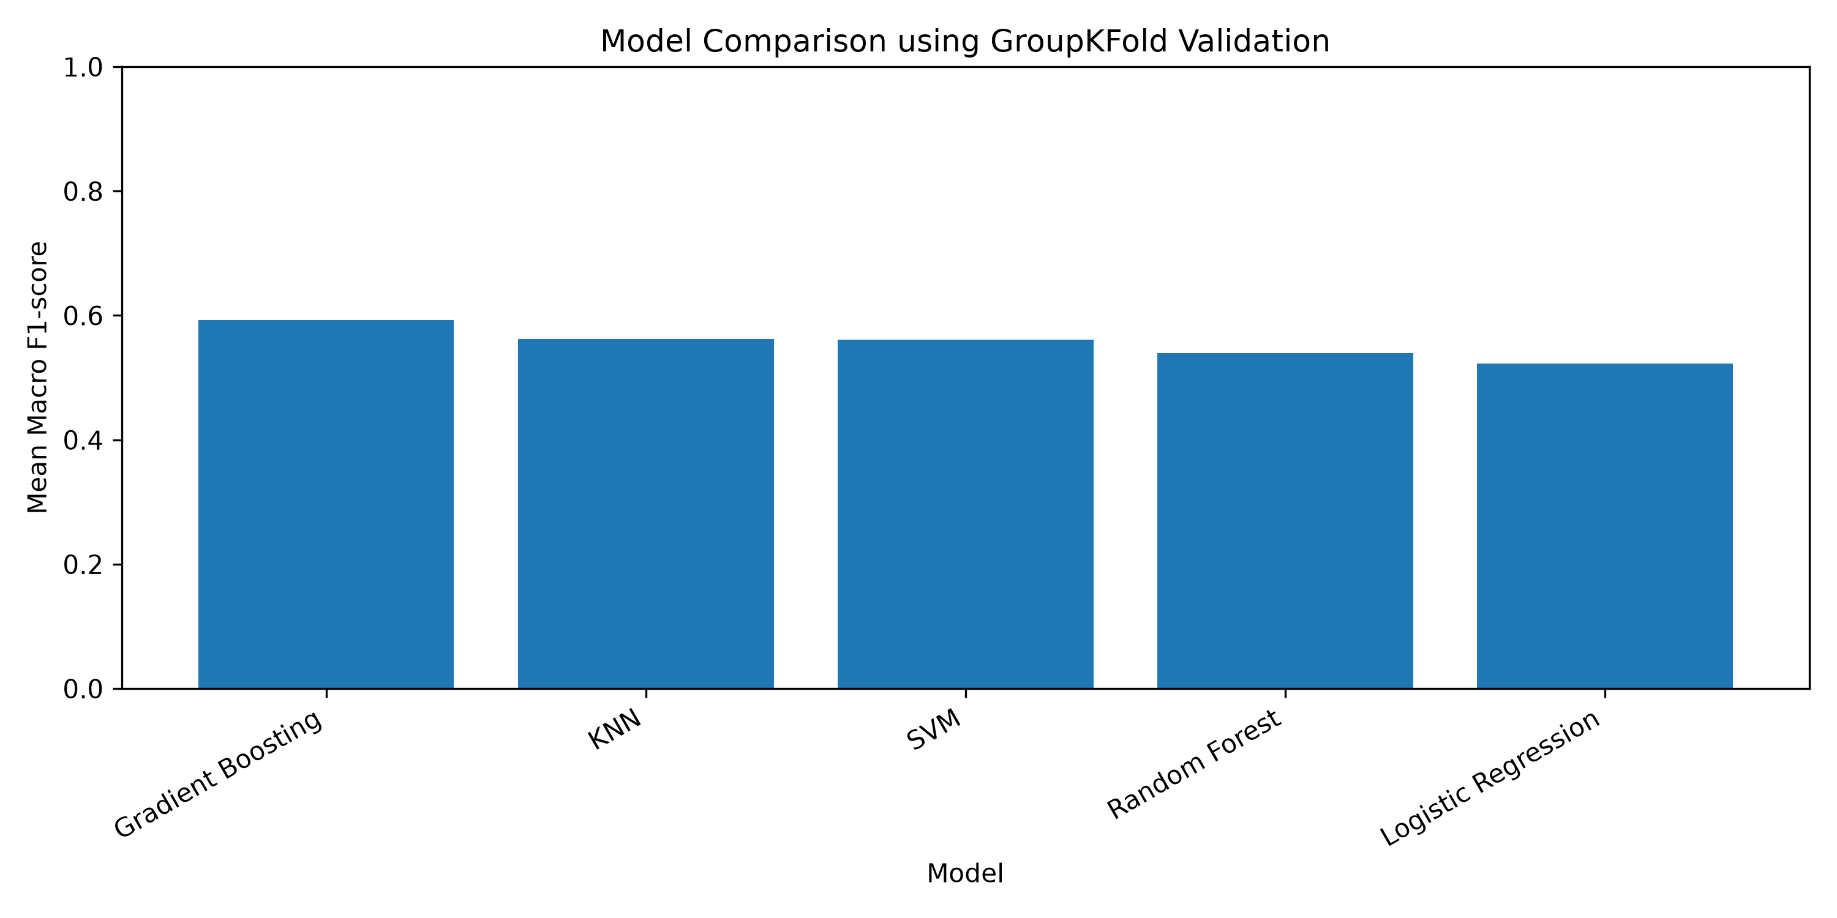
Model Comparison Results
Model | Acc. | Bal. Acc. | F1
Gradient Boosting ★ | 0.865 | 0.581 | 0.593
KNN | 0.835 | 0.556 | 0.562
SVM | 0.703 | 0.643 | 0.561
Random Forest | 0.839 | 0.539 | 0.540
Logistic Regression | 0.654 | 0.620 | 0.522
GroupKFold Validation (Macro F1-score)
⚠ Data Leakage Effect
Random CV: RF Macro F1 = 0.86
GroupKFold: RF Macro F1 = 0.54
Difference: −0.32 (inflated by leakage)

Slide 12
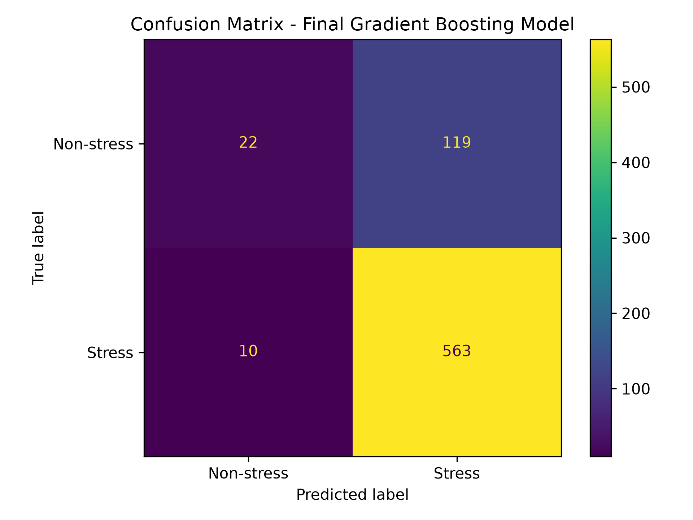
Final Model: Gradient Boosting
Classification Report
Class
Precision
Recall
F1
Non-stress
0.69
0.16
0.25
Stress
0.83
0.98
0.90
Macro avg
0.76
0.57
0.58
Overall accuracy: 0.82 • 714 test windows
⚠ Non-stress recall = 0.16: the model detects only 16% of non-stress windows. Root cause: severe class imbalance (86.6% stress).

Slide 13
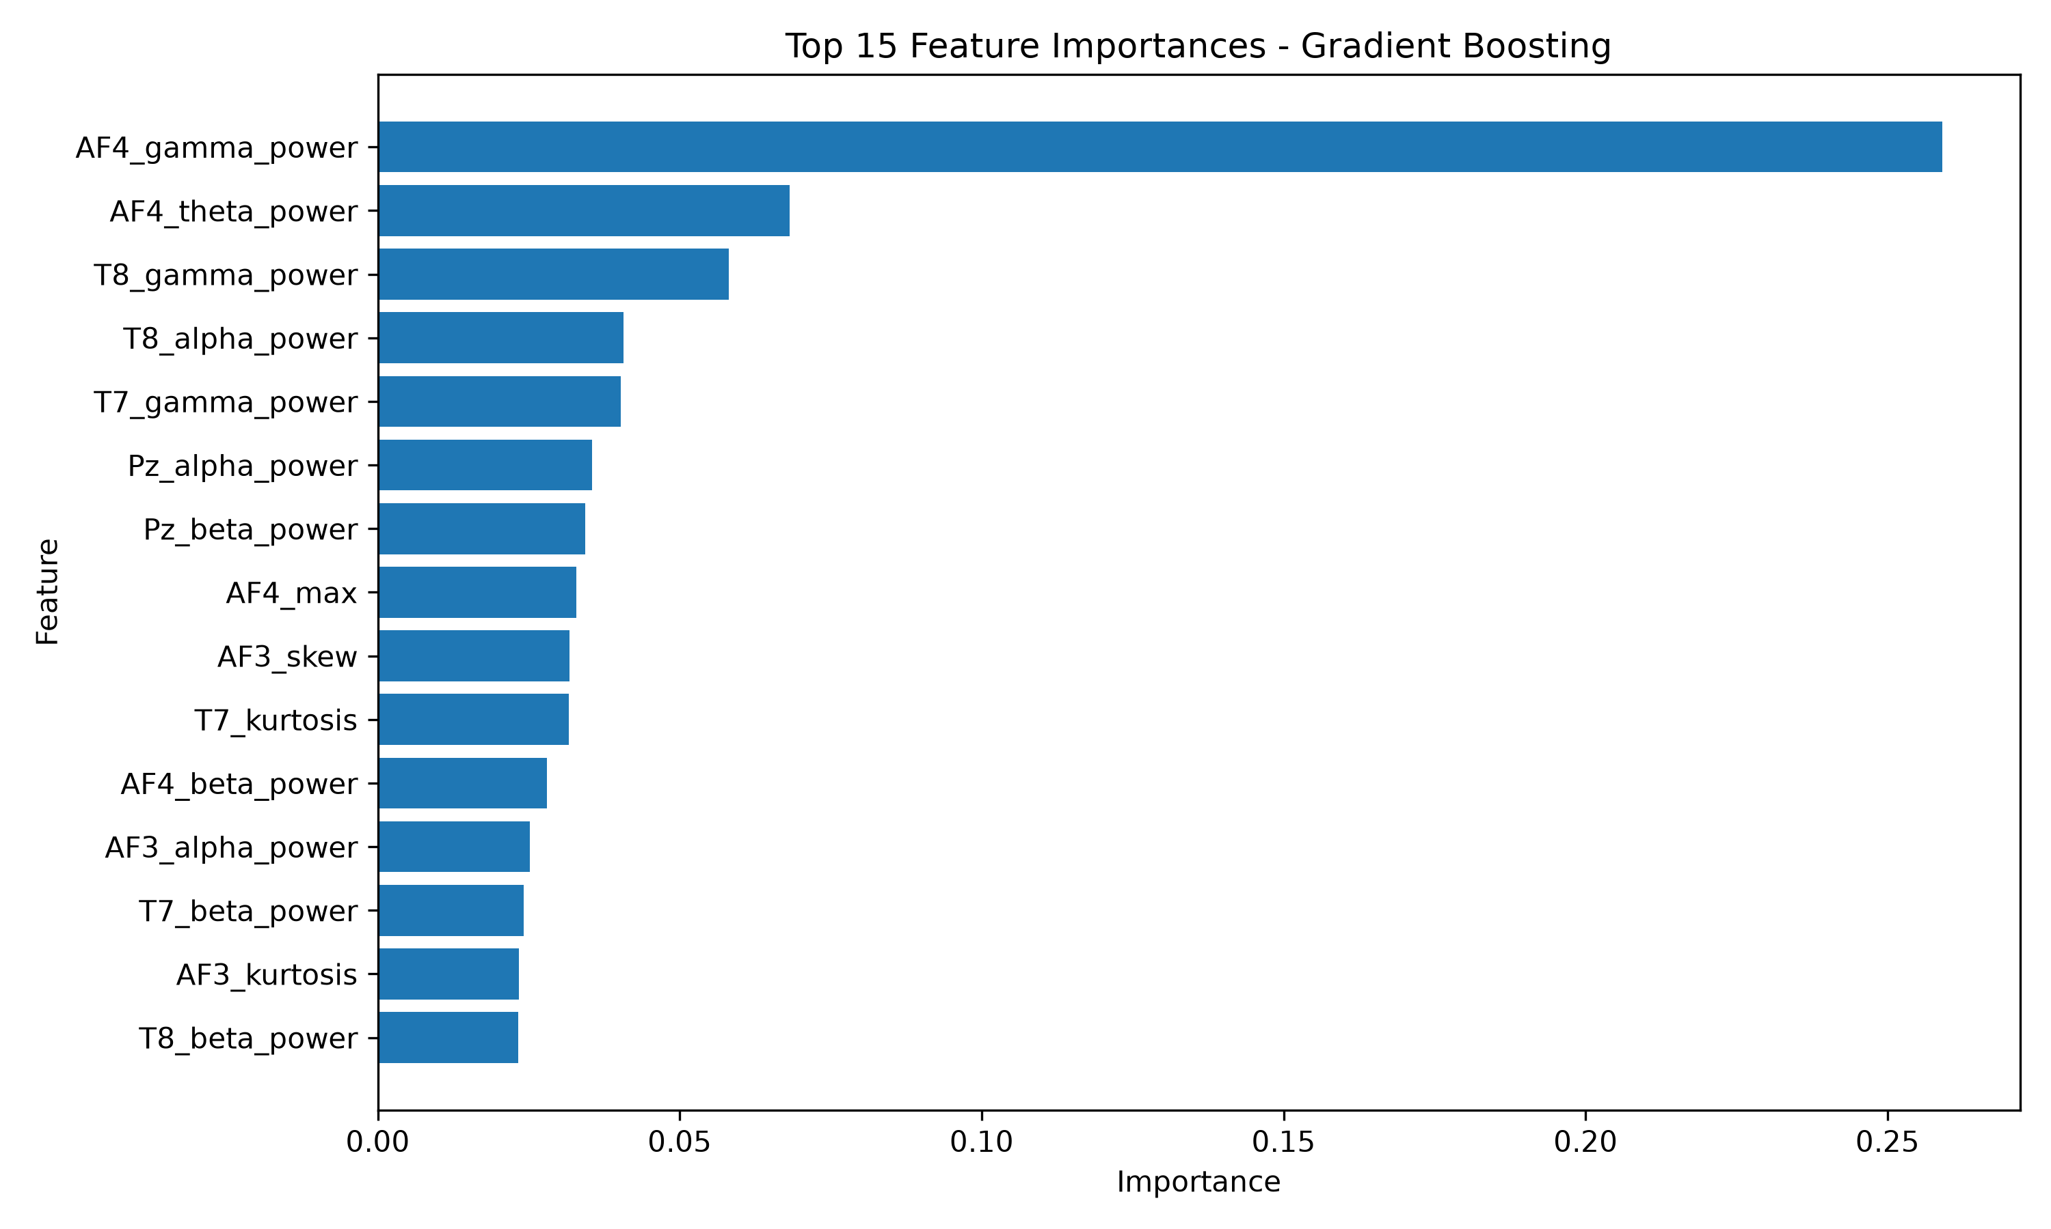
Feature Importance
Key Findings:
AF4 Gamma power dominates (26% importance)
Frequency-domain features rank above statistical features
T8 and T7 gamma/alpha also prominent — temporal lobes active
Skewness and kurtosis (AF3) reflect non-Gaussian distributions

Slide 14
Discussion
GroupKFold vs. StratifiedKFold Gap
Class Imbalance is the Core Problem
The >0.30 F1 difference reveals data leakage when correlated windows from the same recording are split across folds. GroupKFold is the correct approach.
Non-stress recall = 0.16. The model defaults to predicting stress. Requires SMOTE or cost-sensitive learning to resolve.
Gamma-Band Dominance
Macro F1 = 0.58 Meets Success Criterion
AF4 gamma power = 26% importance. May reflect high-frequency cognitive arousal OR residual muscle artifacts. ICA would clarify.
Target was ≥ 0.55 under file-independent evaluation. Gradient Boosting (0.593) meets this, showing EEG features have genuine discriminative power.

Slide 15
Limitations & Future Work
Current Limitations
Potential Improvements
No oversampling to address class imbalance (SMOTE not applied)
Apply SMOTE or class-weighted Gradient Boosting
No artifact rejection or ICA — muscle/eye artifacts may affect features
ICA-based artifact removal before feature extraction
Default hyperparameters only — no optimization
Nested cross-validation for hyperparameter tuning
All stress conditions grouped into one class — internal heterogeneity
Deep learning on raw windows (CNN / LSTM)
No subject-level split — may not generalize across subjects
Subject-independent evaluation and cross-dataset validation

Slide 16
Conclusions
01
EEG features extracted from 10-second windows carry meaningful information for binary stress classification — Macro F1 = 0.59 under strict GroupKFold evaluation.
02
GroupKFold is essential for EEG window datasets — random CV inflates F1 by >0.30 due to within-file window correlation (data leakage).
03
Class imbalance (86.6% stress) is the dominant bottleneck — non-stress recall = 0.16 without oversampling or cost-sensitive training.
04
Gamma-band and alpha/beta frequency features are the most predictive — consistent with the EEG stress detection literature.

