Slide 1


FrAudvisor
Car Insurance Fraud Detection
Data Science Final Project
Presented by Yoan Liu
An end-to-end business case: from raw insurance claims to fraud-risk decisions, explainability and deployment.

Slide 2
Table of Contents
━
01
Problem & Business Context
04
Threshold & Business Impact
02
EDA & Preprocessing
05
Explainability & Demo
03
Modeling, Prediction & Evaluation
06
Summary, Takeaways & Conclusions
02
FrAudvisor – Final Project Presentation

Slide 3
BUSINESS PROBLEM
This is not just a probability score
From model output to business action
The real question is: which claims deserve human attention first?
1
2
3
A fraud model only creates value when it changes the claims workflow.
Claim
new case
Risk score
fraud probability
Review queue
human triage
• Insurance fraud is operational: investigators have limited time.
• A missed fraudulent claim can be more expensive than reviewing a false alarm.
• The output must be understandable enough to support action.
Goal: a practical decision-support system for fraud triage.
03
FrAudvisor – Final Project Presentation

Slide 4
BUSINESS PROBLEM
Project Objective
━
Build an end-to-end fraud detection workflow that balances model performance and business cost.
Raw claims
data
Cleaning
& EDA
Feature
engineering
Model
training
Threshold
policy
Explainability
Streamlit
demo
04
FrAudvisor – Final Project Presentation

Slide 5
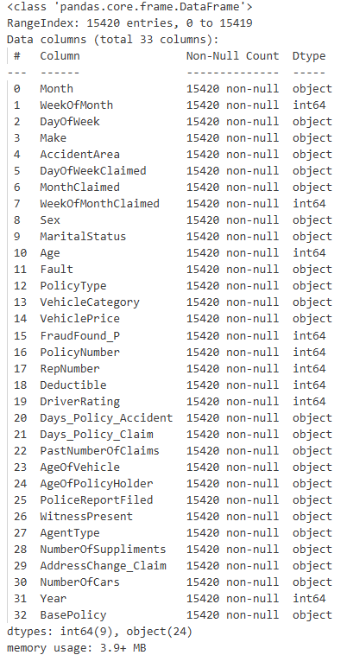
EDA & Preprocessing
Dataset
Item | Value
Rows | 15,420 insurance claims
Original features | 33 columns
Target | FraudFound_P: 1 = Fraud 0 = No Fraud
Task | Binary classification
Data type mix | Mostly categorical
No missing values and no duplicate rows in the raw data
05
FrAudvisor – Final Project Presentation

Slide 6
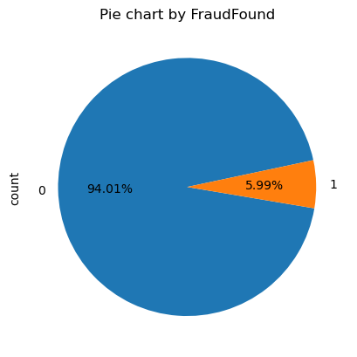
EDA & Preprocessing
Dataset
━
14,497
923
non-fraud claims
class 0
fraud claims
class 1
The target is heavily imbalanced: most claims are not fraudulent.
Fraud represents about 6% of all claims.
Why accuracy is not enough
• Predicting “not fraud” almost always would already be 94% accurate. • But that would fail the business goal. • So recall for class 1 became the primary metric.
06
FrAudvisor – Final Project Presentation

Slide 7
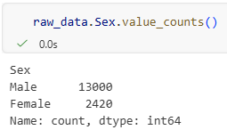
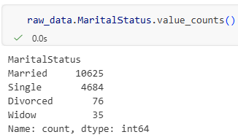
EDA & Preprocessing
Preprocessing
Type | Examples | Treatment
Numeric | Age, Year | distribution, outliers, scaling
Binary categorical | Sex, Fault, AccidentArea | Label Encoding
Multi-class categorical | Make, BasePolicy, Marital Status | One Hot Encoding
Identifier only, noise, unnecessary | Jan, Feb, Mar | Drop
07
FrAudvisor – Final Project Presentation

Slide 8
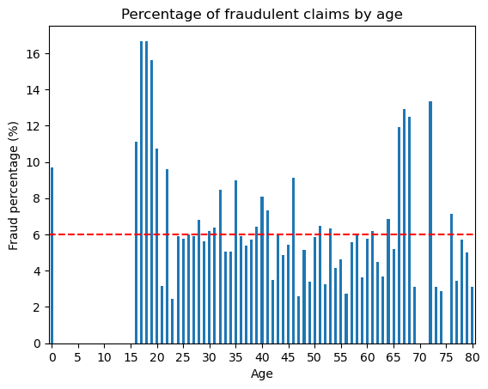
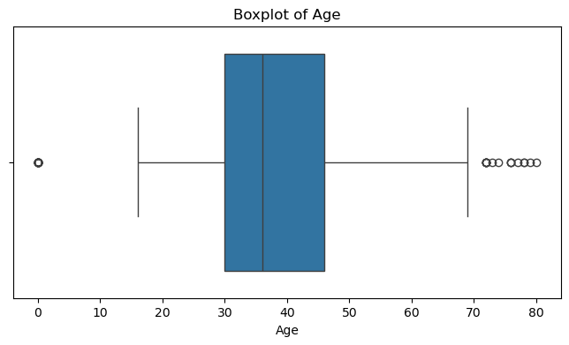
EDA & Preprocessing
AgeOfPolicyHolder was removed because it duplicates the information in Age.
Age = 0 appeared in 320 claims, including 31 fraud cases. Not a real age; imputed with median. Dropping these rows could remove useful minority-class examples
Median imputation was chosen because it is more robust to outliers.
Univariate Analysis - Age
08
FrAudvisor – Final Project Presentation

Slide 9
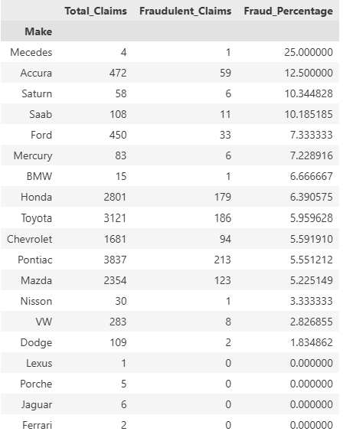
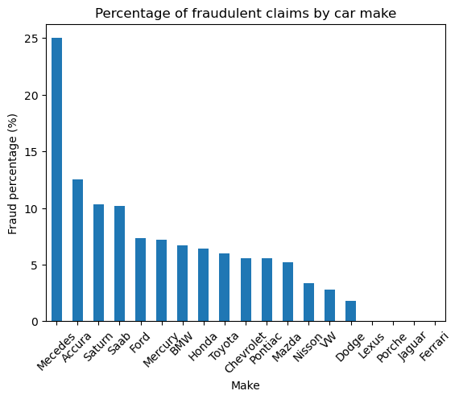
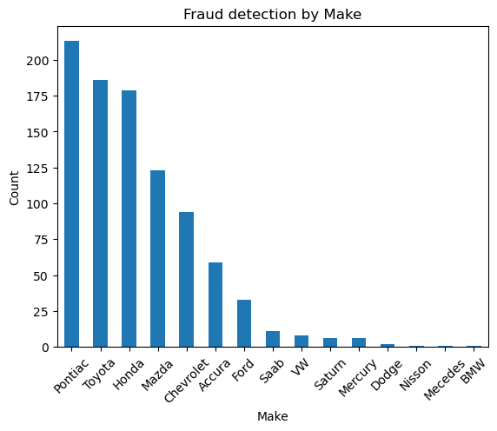
EDA & Preprocessing
Univariate Analysis - Make (Brand)
A high fraud rate is not automatically a reliable finding when the category has very few claims.
In a business setting, this should trigger review, not blind automation.
09
FrAudvisor – Final Project Presentation

Slide 10
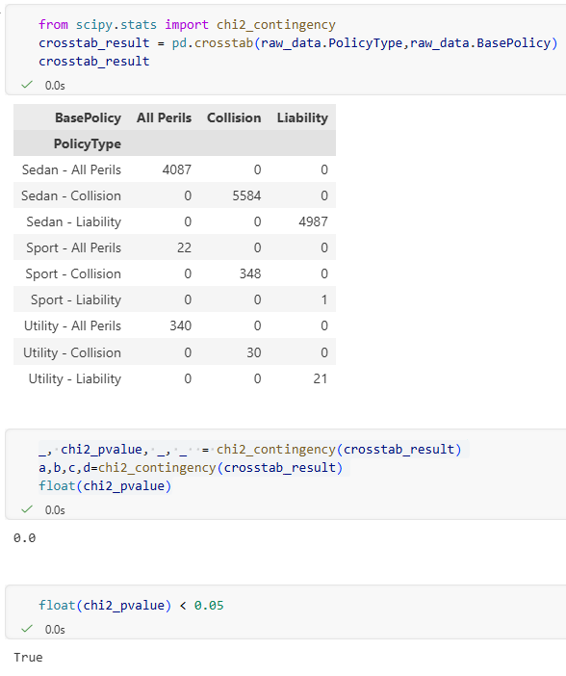
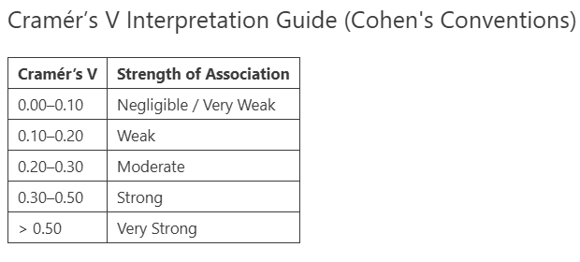
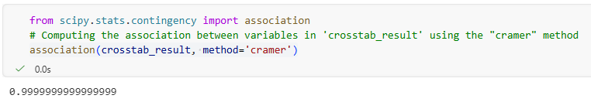
EDA & Preprocessing
Bivariate Analysis - BasePolicy vs PolicyType
Chi-Square Test
PolicyType - Strong overlap with BasePolicy.
Final decision: drop
10
FrAudvisor – Final Project Presentation

Slide 11
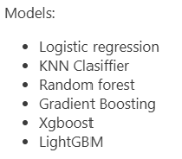
Modeling, Prediction & Evaluation
Modeling roadmap
Scenario | Purpose
1. Default models | Establish a baseline
2. Class weight balanced | Improve fraud recall
3. Randomized Search CV | Tune hyperparameters
4. Top features | Simplify and explain
The story is not “which model wins by accuracy?” but “which model catches fraud with an acceptable operational cost?”
11
FrAudvisor – Final Project Presentation

Slide 12
Modeling, Prediction & Evaluation
Evaluation strategy
False Negative
The model says “No Fraud” but the claim is actually fraudulent.
High cost → prioritize recall.
False Positive
The model says “Fraud” but the claim is legitimate.
Lower cost → manage with precision and threshold.
Primary metric: fraud-class recall. Secondary metrics: precision and F1 score.
12
FrAudvisor – Final Project Presentation

Slide 13
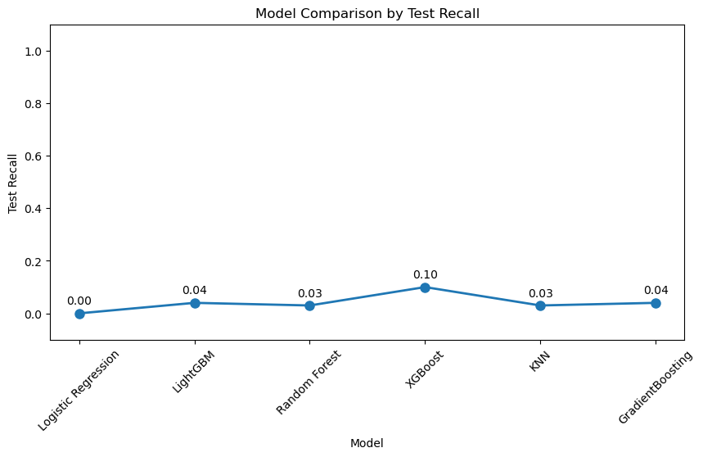
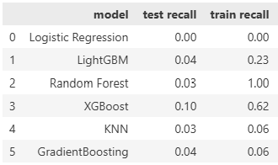
Modeling, Prediction & Evaluation
Scenario 1 — Default algorithms
Key insight
Without imbalance handling, most models produced very low fraud recall.
13
FrAudvisor – Final Project Presentation

Slide 14
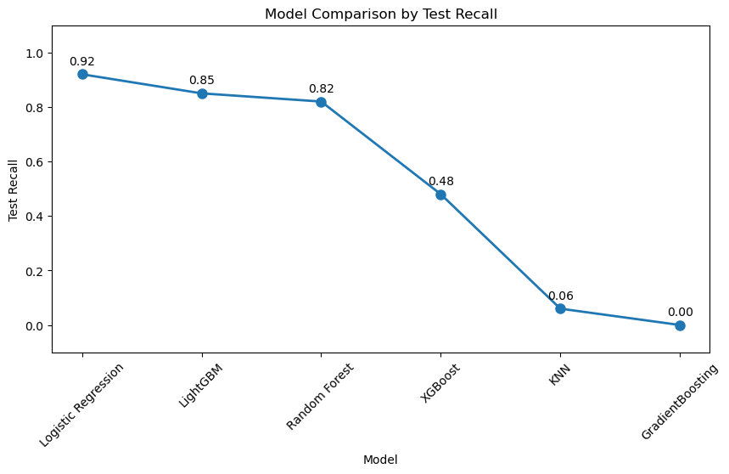
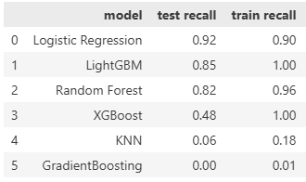
Modeling, Prediction & Evaluation
Scenario 2 — Hyperparameter
Logistic Regression, LightGBM and Random Forest became strong recall candidates.
14
FrAudvisor – Final Project Presentation

Slide 15
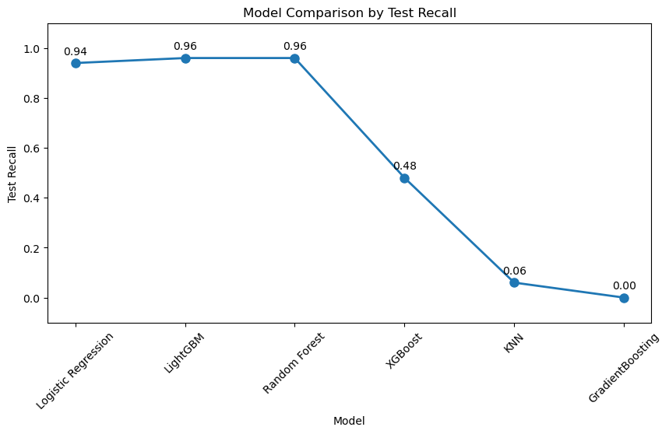
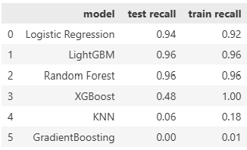
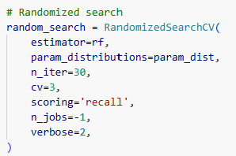
Modeling, Prediction & Evaluation
Scenario 3 — Randomized Search Cross-Validation
Several models reached high recall, but interpretability and operational simplicity still mattered.
15
FrAudvisor – Final Project Presentation

Slide 16
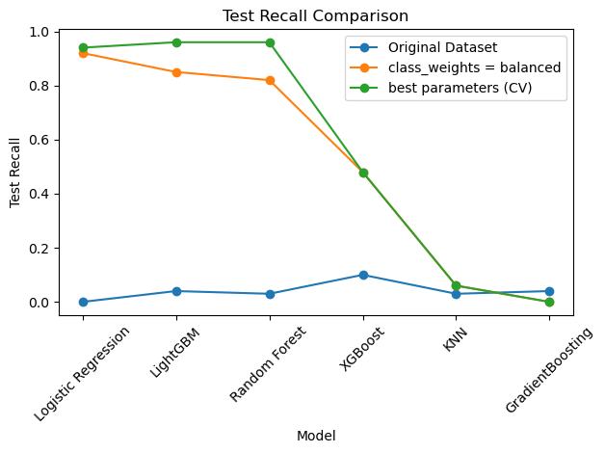
Modeling, Prediction & Evaluation
Selection of the best model
Candidate | Why it matters
Random Forest | Strong recall, interpretable feature importance, good SHAP support
Logistic Regression | Simple and explainable, but more limited non-linearity
LightGBM | High recall, but potentially harder to explain to non-technical users
Final direction: Random Forest as an explainable fraud-support model.
16
FrAudvisor – Final Project Presentation

Slide 17
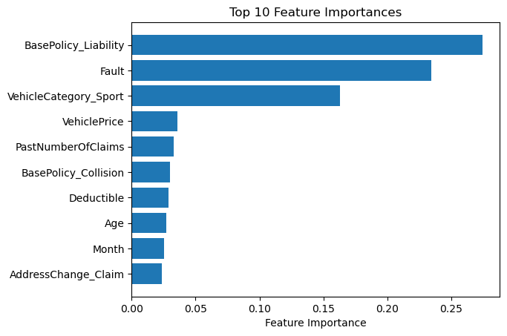
Modeling, Prediction & Evaluation
Most important features
✓
BasePolicy
✓
Fault
✓
VehicleCategory
✓
PastNumberOfClaims
✓
VehiclePrice
These features became the bridge between performance and explainability.
17
FrAudvisor – Final Project Presentation

Slide 18
Modeling, Prediction & Evaluation
Scenario 4 (Final) — Top 5 features
Metric | Final Random Forest
Test Recall | 0.94
Train Recall | 0.92
Features | Top 5 most important
Interpretation
The model is intentionally recall-oriented: it catches many fraud cases, then threshold tuning controls review volume.
Key insight
Although the recall score is lower than the estimate from the previous scenario (Random Forest: 0.96), we will use this model because of its interpretability
18
FrAudvisor – Final Project Presentation

Slide 19
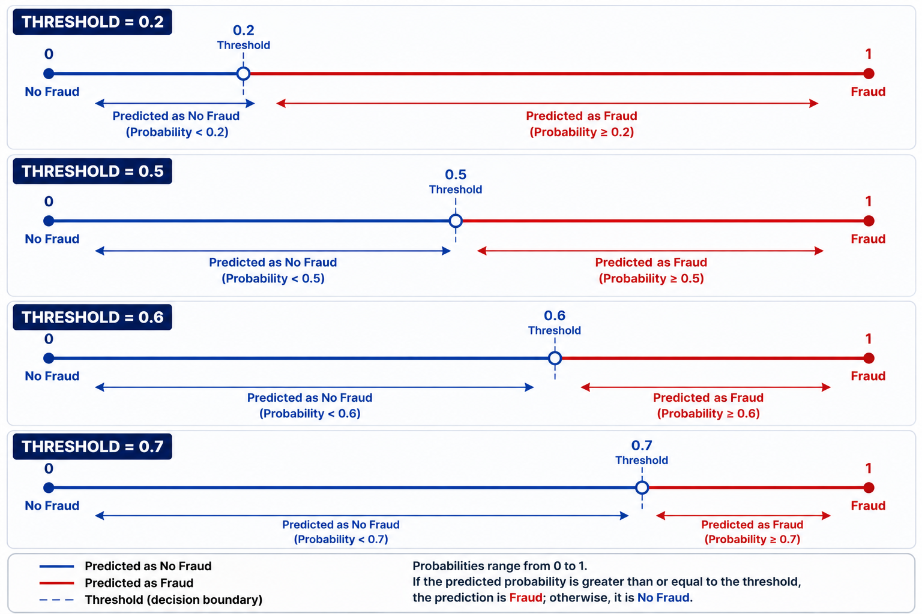
Threshold & Business Impact
Thresholds turn probabilities into business decisions
Lower threshold → more claims flagged → higher recall, lower precision.
Higher threshold → fewer reviews → lower false positives, but more missed fraud.
19
FrAudvisor – Final Project Presentation

Slide 20
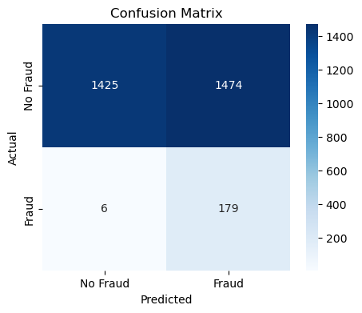
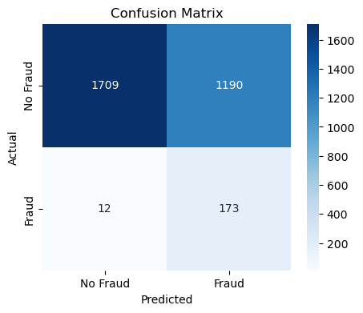
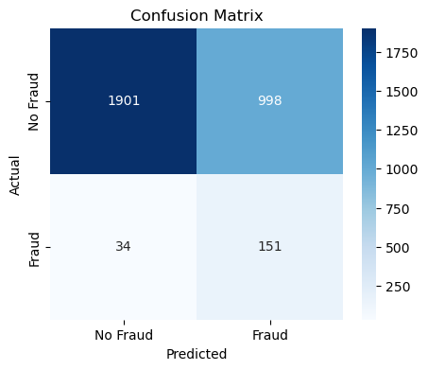
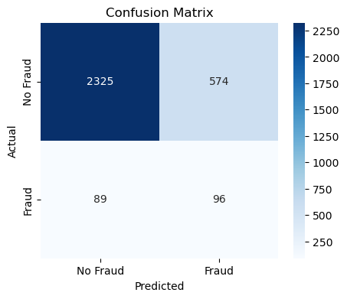
Threshold & Business Impact
Threshold comparison
Threshold | FN | FP | Reading
0.2 | 6 | 1,474 | highest recall, many reviews
0.5 | 12 | 1,190 | default rule
0.6 | 34 | 998 | balanced operationally
0.7 | 89 | 574 | fewer reviews, more missed fraud
20
FrAudvisor – Final Project Presentation

Slide 21
Threshold & Business Impact
Business impact: expected cost
3084*100 + 100*3000=
Hypothetical scenario: By manually reviewing all claims, only 100 cases of fraud are detected. That means 3,084 claims will be reviewed, and there will be 85 false negatives.
608,400
Threshold | False negatives | False positives | Estimated cost
0.2 | 6 | 1,474 | €165,400
0.5 | 12 | 1,190 | €155,000
0.6 | 34 | 998 | €201,800
0.7 | 89 | 574 | €324,400
Assumptions
False positive review:
€100
False negative missed fraud: €3,000
The threshold is therefore a business decision, not only a modeling parameter.
21
FrAudvisor – Final Project Presentation

Slide 22
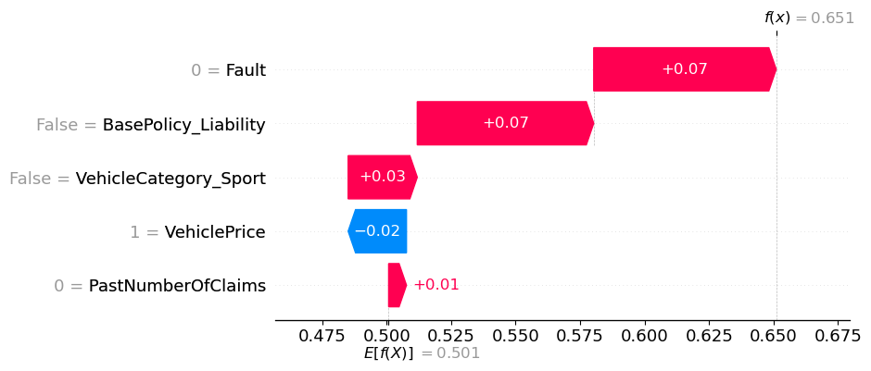
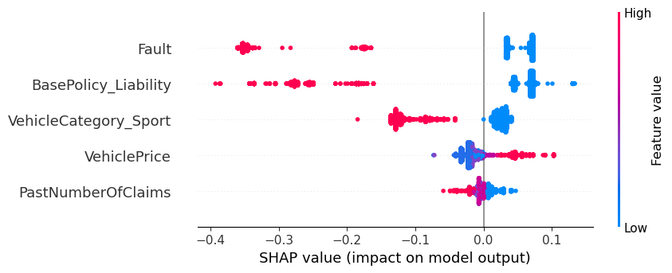
Explainability & Demo
Explainability with SHAP
Global explanations show which features consistently move predictions toward or away from fraud.
22
FrAudvisor – Final Project Presentation

Slide 23
Explainability & Demo
Streamlit
Cmd -> streamlit run app.py
23
FrAudvisor – Final Project Presentation

Slide 24
Summary
━
The project starts from a real business problem: missed fraud is much more expensive than extra review.
Class weights and hyperparameter tuning improved fraud recall substantially.
A Random Forest model with top features offered a strong mix of recall, simplicity and explainability.
Threshold tuning connected model performance to estimated business cost.
24
FrAudvisor – Final Project Presentation

Slide 25
Key Takeaways
━
1. Think in business decisions
A probability is useful only when it supports an action.
2. Choose metrics from risk
Recall matters because false negatives are expensive.
3. Balance performance and trust
Explainability matters when people must act on model results.
4. Tune the threshold, not only the model
Operational cost can change the optimal decision rule.
The final product is a decision-support system, not just a prediction exercise.
25
FrAudvisor – Final Project Presentation

Slide 26
Conclusions
FrAudvisor identifies suspicious claims with a recall-oriented Random Forest model.
The project translates technical results into review policy and cost impact.
The next step would be validating the threshold with real claim costs, reviewer capacity and historical fraud outcomes.
━
Final message
The model should help humans prioritize investigations faster, not replace expert judgment.
26
FrAudvisor – Final Project Presentation

Slide 27
THANKS
FrAudvisor — Car Insurance Fraud Detection
Presented by Yoan Liu

