Slide 1


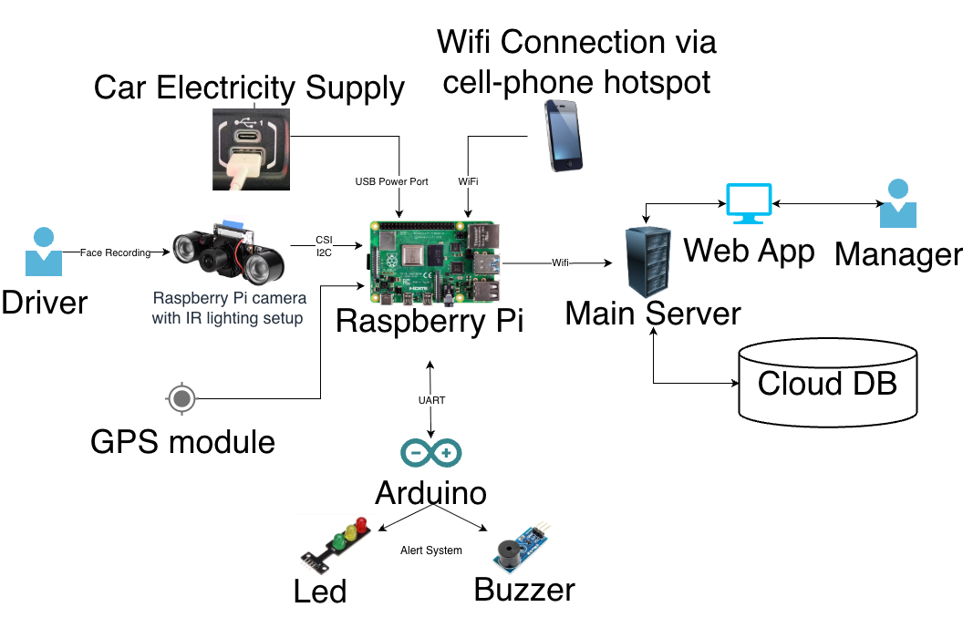
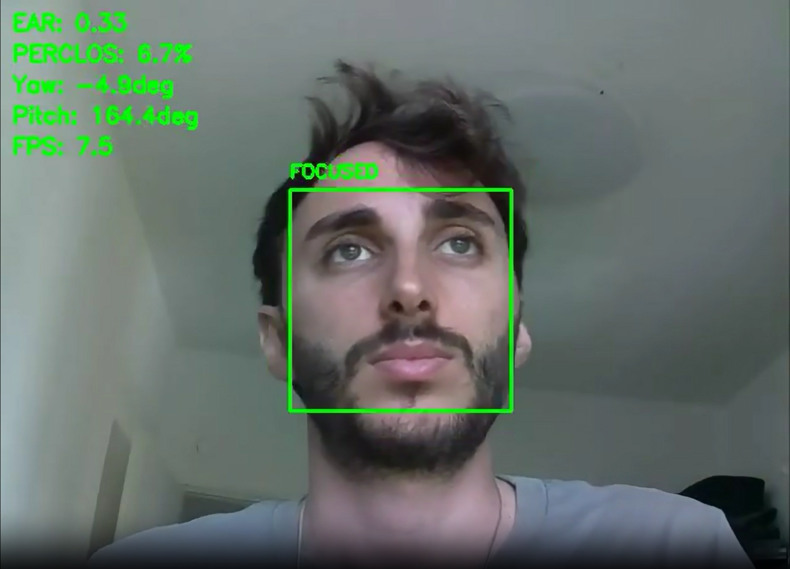
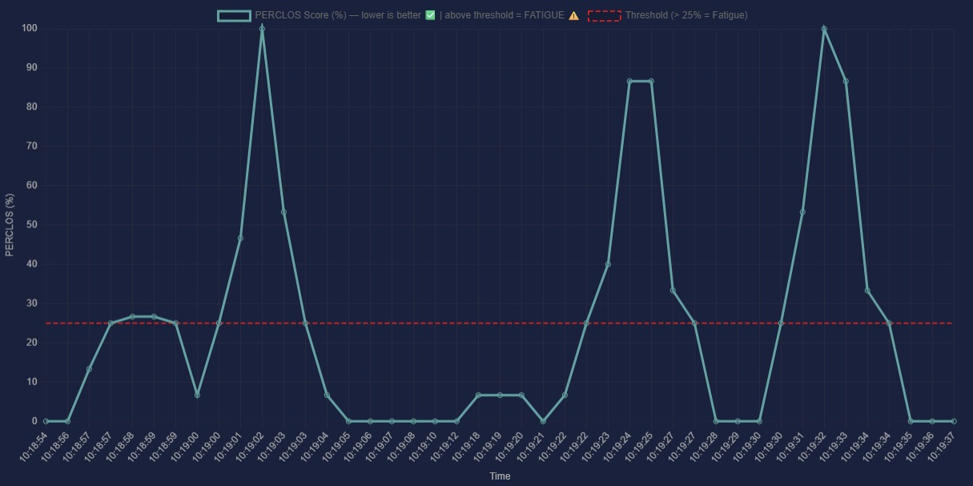




WakeUp! - Real-Time Driver Fatigue & Distraction Monitoring System
Project Number: 25-1-1-3398 | Yoav Dychtwald | Roy Sarafov | Advisor: Mr Asi Barak
Background & Objective
The Problem: Driver fatigue and distraction cause over 25% of fatal road accidents globally , yet millions of older cars lack integrated safety monitoring.
The Solution: WakeUp is a low-cost, retrofittable edge-computing system. It continuously monitors the driver's face using a camera and computer vision.
The Action: Triggers immediate Arduino-controlled buzzer alerts upon detecting dangerous behavior (zero manual interaction) and provides data-driven telemetry to review habits over time.
System Architecture
Results
Capture Video & GPS
Detect drivers face
Compare stats to thresholds
Compute stats: EAR, PERCLOS & POSE
Alert driver via buzzer
Upload telemetry to cloud server
< 1 Sec Alert latency
85% Daylight Success Rate
75% Night Success Rate
Conclusion
Low-Cost Edge Computing: Executes high-accuracy, reliable driver monitoring entirely on a Raspberry Pi 4.
Zero Latency: Requires no internet connection, ensuring instant, life-saving alerts.
Universal Scalability: Offers an affordable, retrofittable safety solution easily installable in any existing vehicle.

