Slide 1
Two-Dimensional Bi-Directional Object Layout
Yoav Zibin
The Technion—Israel Institute of Technology
Joint work with: Yossi Gil
Notes:
Hi
My name is Yoav Zibin,
I’m from the …
Today I will present an object layout technique for multiple inheritance which we call …
Our technique improves upon previously known techniques,
and with such improvements, new language designers might consider adding support for multiple inheritance
This is joint work …

Slide 2
Object Layout in C++: single inheritance
Add your fields to the layout of your supertype
Legend
A
class A { … };
h
VPTR
h
A
B
class B: public A { … };
h
A
B
C
class C: public B { … };
h
A
B
C
Notes:
Let’s first consider the object layout in C++,
Starting from the single inheritance case.
The rule is simple:
…
For example, we have a class A,
And this is its layout.
The h denotes the pointer to the virtual table of A,
h can be seen as a type-identifier.
Class B inherits from A,
So we take the layout of the supertype, and add the fields of B.
Class C inherits from B,
So again we take the layout of the supertype and add the fields of C.

Slide 3
Object Layout in C++: simple multiple inheritance
class A { … };
Legend
h
A
VPTR
h
A
B
class B { … };
h
B
C
class C: public A, public B { … };
h
A
h
B
C
Objects may have several VPTRs
this-adjustment when calling methods of B
Notes:
Now consider the simple multiple inheritance case.
Class C inherits from A and B.
So we first take the layout of A, then the layout of B, and then add the fields of C.
We see that an object may have several VPTRs.
We also note that when calling methods of B we have to adjust the this-pointer
(which is more than a simple addition,
since we also need to check for the case of a null pointer).

Slide 4
Object Layout in C++: virtual inheritance
Legend
h
VPTR
class A { … };
A
VBPTR
h
A
v
v
class B: public virtual A { … };
B
C
h
B
h
A
class C: public virtual A { … };
D
h
C
h
A
D has a single copy of A
class D: public B, public C { … };
h
B
h
C
D
h
A
Objects may have several VBPTRs
Accessing a field in A requires 2 loads (dereferences)
Notes:
Finally, let’s consider the case of virtual inheritance.
Class B virtually inherits from A.
That means that the B will contain a pointer to the A sub-object which is called a Virtual base pointer.
Similarly class C virtually inherits from A.
Now class D inherits from B and C.
Since the inheritance was virtual D will have a single copy of A.
First we take the layout of B, then the layout of C, then the fields of D, and finally the virtual base A.
Observe that Objects may have several VBPTRs,
And that accessing a field in A requires 2 loads

Slide 5
Standard Layout Schemes
C++
  Pros: incremental, 1-2 loads for field access
  Lot’s of optimizations (many are propriety),
  often require whole program analysis
  Cons: requires psychic programmers,
  this-adjustment in some castings and method calls,
  object size overhead (many VPTRs, VBPTRs)
Java: single inheritance (no fields in interfaces)
Cecil & Dylan: field dispatching technique
  Encapsulate fields in accessor methods
  Pros: simple, incremental
  Cons: dispatching is slow, memory overhead can be significant
Field access ≡ method dispatch
Notes:
So to conclude, the technique of C++ is incremental and requires only 1 or 2 loads for field access.
There are also …
However, it requires psychic programmers,
There is a runtime overhead due to this-adjustment,
And there is space overhead due to VPTRs and VBPTRs.
Java on the other hand has single inheritance since it doesn’t permit to declare fields in interfaces.
Cecil and Dylan advocate the fields dispatching technique,
Where we encapsulate fields in accessor methods.
That means the instead of performing field access we perform method dispatch.
This technique is simple and incremental,
However it is slow and memory overhead …

Slide 6
Fixed-offsets technique
[Pugh & Weddell ‘90]
Assign each field a fixed offset
(either positive or negative ≡ Bi-Directional)
  Pros: 1 load for accessing all fields
  Cons: objects may have holes,
  requires knowing the whole hierarchy at compile time
We generalize this technique

Slide 7
Fixed-offsets (2/3)
A
A:
B:
C:
D:
h
A
h
A
B
B
C
h
A
C
B
B and C are
in conflict
h
A
?
D
D
C
A hole in objects of class C
A:
B:
C:
D:
h
A
h
A
B
Uni-directional
h
A
C
h
A
B
C
D

Slide 8
Fixed-offsets (2/3)
A
A:
B:
C:
D:
h
A
h
A
B
B
C
h
A
C
B
B and C are
in conflict
h
A
?
D
D
C
A:
B:
C:
D:
h
A
B
h
A
Bi-directional
h
A
C
B
h
A
C
D
How can we determine if there exists a Bi-dir layout without holes?
Notes:
How do we decide in which side to place each type?
Like 2-coloring

Slide 9
Fixed-offsets (3/3)
Definition: Types X and Y are in conflict iff
(i)i X and Y have a common descendant , and
(ii) X and Y are independent, i.e., neither is a subtype of the other
Inheritance hierarchy
Conflict graph
A
A
B
B
C
D
B
B
C
C
D
E
E
F
G
H
E
F
F
G
H
I
J
I
J

Slide 10
Fixed-offsets (3/3)
Definition: Types X and Y are in conflict iff
(i)i X and Y have a common descendant , and
(ii) X and Y are independent, i.e., neither is a subtype of the other
Inheritance hierarchy
Conflict graph
Layout scheme
A
A
A
-2
-1
0
1
2
3
4
F
B
E
I
C
h
A
B
B
C
C
D
B
C
D
D
G
D
H
J
E.g., J:
E
E
F
F
G
G
H
E
F
G
H
H
I
J
I
J
I
J

Slide 11
Fixed-offsets (3/3)
Definition: Types X and Y are in conflict iff
(i)i X and Y have a common descendant , and
(ii) X and Y are independent, i.e., neither is a subtype of the other
Inheritance hierarchy
Conflict graph
Layout scheme
A
A
A
A
-2
-1
0
1
2
3
4
A
F
B
E
I
C
C
h
A
A
B
B
C
C
C
D
D
D
G
G
D
D
H
H
J
B
C
J
C
D
D
E.g., J:
E
E
F
F
G
G
G
H
H
E
F
G
H
G
H
H
G
C
h
A
D
H
J
I
J
I
J
I
J
J
J
J

Slide 12
Fixed-offsets (3/3)
Lemma [Pugh & Weddell ‘90]:
There exists a bi-directional layout without holes iff
the conflict graph is 2-colorable
Inheritance hierarchy
Conflict graph
Layout scheme
A
A
A
-2
-1
0
1
2
3
4
F
B
E
I
C
h
A
B
B
C
C
D
B
C
D
D
G
D
H
J
E
E
F
F
G
G
H
E
F
G
H
H
I
J
I
J
I
J
Notes:
A graph G is 2-colorable iff G is bipartite
Easy to check in linear time

Slide 13
Our solution: 2D Bi-dir layout
What happens if the graph is not 2-colorable ?
  Pugh & Weddell answer:
  Leave holes in some objects (using a heuristic)
  Our answer:
  2-Dimensional Bi-directional layout (2D Bi-dir)
  E.g., if the graph is 6-colorable we use 3 layers:

Slide 14
2D Bi-dir
All objects use the same basic layout scheme
  Layers are Bi-directional
  Can be empty
  #layers = ⎡#colors / 2⎤
Independently discovered by Pugh & Weddell [Tech report ’93]
Scheme
Layout of A
Layout of B
Layout of C
Notes:
Dusty technical report

Slide 15
Mapping 2D Bi-dir to linear memory
Using an array of pointers to the layers origins
Scheme:
Example:

Slide 16
Layout optimization
Sharing an array of offsets (instead of pointers)
1 load for fields in the first layer (colors 1 & 2)
  3 loads for the other layers
Scheme:
Example:
h
h
+8
+7

Slide 17
Experiments
Data set: 28 hierarchies with 49,379 types
  Large hierarchies used in real life programs
  Taken from eight different programming languages
  Resemble trees
  67 ≤ #types ≤ 8,793
  #colors ≤ 24 ⇒ #layers ≤ 12
We compared 2D Bi-dir with:
  Fixed-offsets [Pugh & Weddell ‘90]
  Standard C++
  Optimized C++: Simple-inline, Aggressive-inline [Gil & Sweeney ‘99, Eckel & Gil ‘2000]

Slide 18
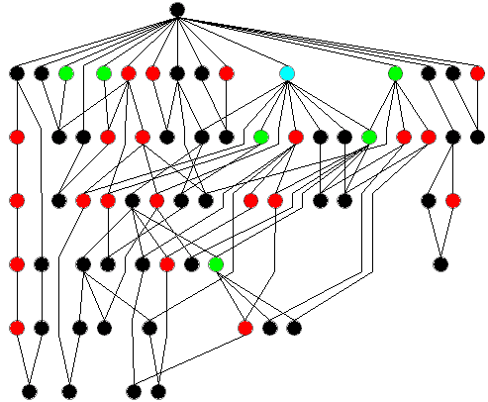
E.g., Core of Flavors hierarchy (1/3)
7 classes require 3 loads
60 classes require 1 load

Slide 19
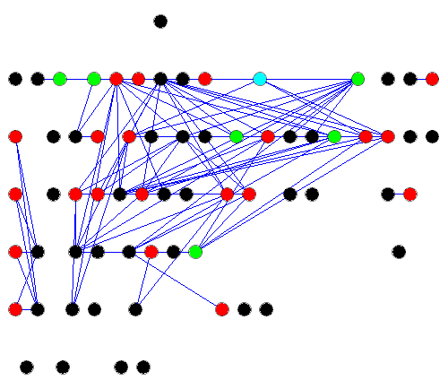
E.g., Flavors conflict graph (2/3)
The conflict graph is usually more close to linear than quadratic

Slide 20
E.g., Flavors cont. (3/3)
Object size overhead
  2D Bi-dir: 1 type-identifier
  C++ techniques: 2.4 – 3.4 VPTRs
  Fixed-offsets: 6% holes
Access Efficiency:
percentage of accesses that require 1 load
  2D Bi-dir: 81%
  C++ techniques : 50-77%
  Fixed-offsets: 100%

Slide 21
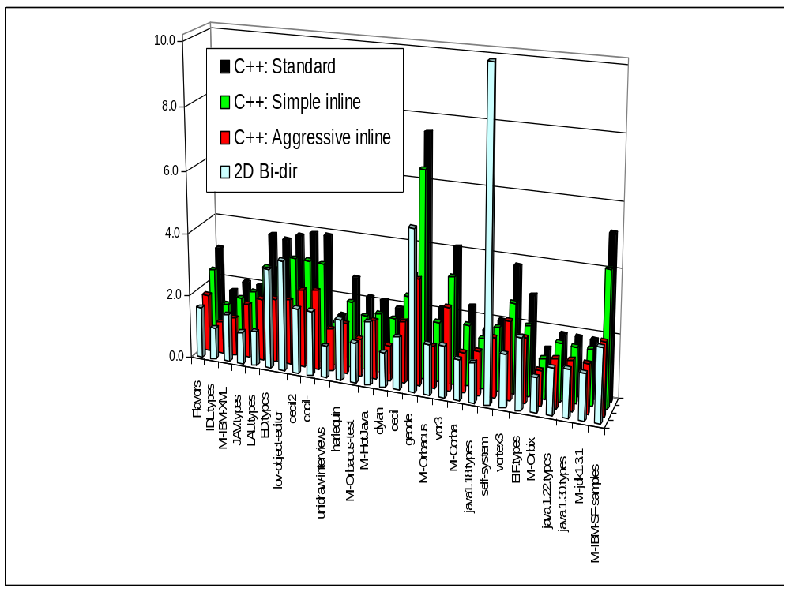
Avg. #layers in different hierarchies
Avg. #layers
Notes:
Self has a unique topology, and we lose to C++.
However, an object has on average 21 VPTRs
Out of 28 hierarchies, we lost to standard C++ in one hierarchy,
To simple-inline in 5 hierarchy,
And to aggressive-inline in 11 hierarchy.

Slide 22
Summary: Advantages of 2D Bi-Dir
Dynamic memory overhead (per object)
  A single type-identifier
Static memory overheads (per type)
  | array of offsets | ≤ 11 bytes
Field access efficiency (run-time)
  1 or 3 load instructions to access a field
  (on average, 82% of field accesses require 1 load)
Time for computing the layout (compile-time)
  usually 10-50 mSec, worst case 400mSec
  13 micro-seconds / type

Slide 23
Comparison with 2D Bi-dir
Dynamic memory overhead
Incremental
#load instructions
Field dispatching
0

3
Fixed-offsets
holes
×
1
C++
VPTRs & VBPTRs

1 - 2
2D Bi-dir
0
×
1 or 3
Notes:
We developed a probabilistic model
C++ requires this adjustment

Slide 24
Future Research
Empirical study of field access frequencies
Further reducing the static memory overheads
Incremental algorithms

Slide 25
The End
Any questions?

Slide 26
Object Layout in C++
Legend
h
VPTR
class A { … };
VBPTR
h
A
A
class B: public A { … };
v
v
h
A
B
class C { … };
E
F
B
C
h
C
class D: public B,public C { … };
G
D
h
A
B
h
C
D
class E: public virtual A { … };
h
E
h
A
G has a single copy of A
class F: public virtual A { … };
h
F
h
A
class G: public E,public F { … };
h
E
h
F
G
h
A

Slide 27
Inheritance hierarchy
Conflict graph
Layout scheme
A
A
A
-2
-1
0
1
2
3
4
F
B
E
I
C
h
A
B
B
C
C
D
B
C
D
D
G
D
H
J
E.g., J:
E
E
F
F
G
G
H
E
F
G
H
H
I
J
I
J
I
J

Slide 28
Inheritance hierarchy
Conflict graph
Layout scheme
A
A
A
-2
-1
0
1
2
3
4
F
B
E
I
C
h
A
B
B
C
C
D
B
C
D
D
G
D
H
J
E.g., J:
E
E
F
F
G
G
H
E
F
G
H
H
I
I
J
I
J
J

Slide 29
A

