Slide 1
Object and Reference Immutability using Java Generics
Yoav Zibin, Alex Potanin(*), Mahmood Ali, Shay Artzi, Adam Kiezun, and Michael D. Ernst
MIT Computer Science and Artificial Intelligence Lab, USA
* Victoria University of Wellington, New Zealand

Slide 2
Immutability – What for?
Program comprehension
Verification
Compile- & run-time optimizations
Invariant detection
Refactoring
Test input generation
Regression oracle creation
Specification mining
Modelling
<number>/23

Slide 3
Immutability varieties
Class immutability
  No instance of an immutable class can be mutated after creation (e.g., String, Integer)
Object immutability
  The same class may have both mutable and immutable instances
Reference immutability
  A particular reference cannot be used to mutate its referent (but other aliases might cause mutations)
<number>/23
Notes:
Object immutability - Immutable instances may not be mutated, while mutable instances (of the same class) may

Slide 4
Previous work
Access rights
  Java with Access-Control (JAC)
    readnothing < readimmutable < readonly < writeable
  Capabilities for sharing
    Lower-level rights that can be enforced at compile- or run- time
Reference immutability:
  Universes (ownership + reference immutability)
  C++’s const
  Javari
<number>/23
Notes:
No typing rules for object immutability
A mode system for read-only references in Java. Mats Skoglund and Tobias
Wrigstad. FTFjP 2001.

Slide 5
IGJ - Immutability Generic Java
Class immutability
  All instances are immutable objects
Object immutability:
  An object: mutable or immutable
Reference immutability:
  A reference: mutable, immutable, or readonly
<number>/23

Slide 6
IGJ syntax
1: // An immutable reference to an immutable date;
// Mutating the referent is prohibited, via this or any other reference.
Date<Immutable> immutD = new Date<Immutable>();
2: // A mutable reference to a mutable date;
// Mutating the referent is permitted, via this or any other reference.
Date<Mutable> mutD = new Date<Mutable>();
3: // A readonly reference to any date;
// Mutating the referent is prohibited via this reference.
Date<ReadOnly> roD = ... ? immutD : mutD;
Java syntax is not modified:
One new generic parameter was added
Some method annotations were added (shown later)
<number>/23
Notes:
Syntax is the same, but not the typing rules!
Line 3 s
Start mentioning the co-variance problem in java:
Date<Immutable> is not a subtype of Date<ReadOnly> in Java.

Slide 7
IGJ design principles
Transitivity
  Transitive (deep) immutability protects the entire abstract state from mutation
  Mutable fields are excluded from the abstract state
Static
  No runtime representation for immutability
Polymorphism
  Abstracting over immutability without code duplication
Simplicity
  No change to Java’s syntax; a small set of typing rules
<number>/23

Slide 8
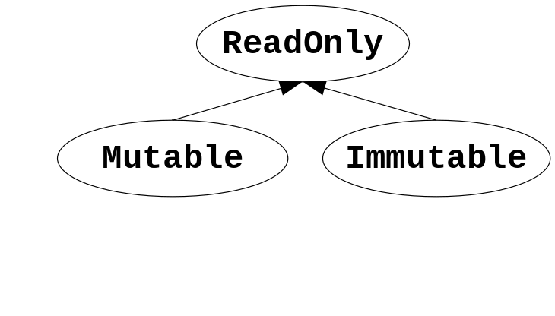
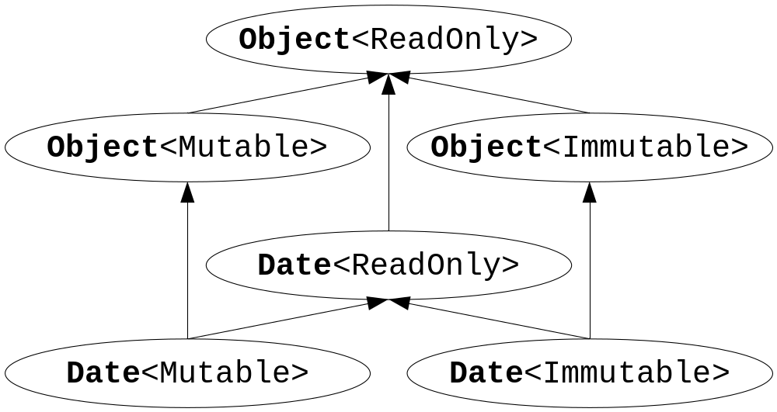
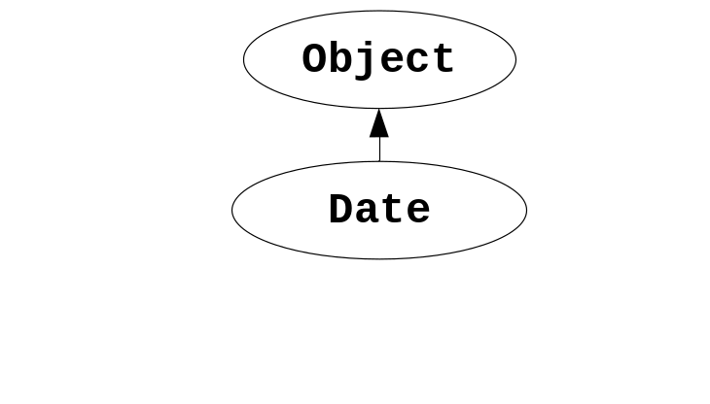
Hierarchies in IGJ
Immutability parameters hierarchy
The subclass hierarchy for Object and Date
The subtype hierarchy for Object and Date
<number>/23

Slide 9
Covariance problem and immutability
void foo(ArrayList<Object> a) { … }
foo(new ArrayList<Object>()); // OK
foo(new ArrayList<String>()); // Compilation error!
void foo(Object[] a) { a[0] = new Integer(1); }
foo(new Object[42]); // OK, stores an Integer in an Object array
foo(new String[42]); // Causes ArrayStoreException at runtime
IGJ’s Solution:
  ReadOnly, Immutable – allow covariance
  Mutable – disallow covariance
List<ReadOnly,String> is a subtype of List<ReadOnly,Object>
List<Mutable,String> is NOT a subtype of List<Mutable,Object>
<number>/23

Slide 10
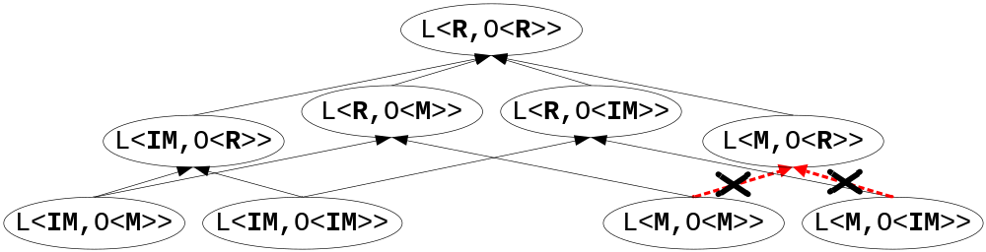
IGJ subtype hierarchy
Example: A list of objects
Legend:
L = List
O = Object
R = ReadOnly
IM = Immutable
M = Mutable
For example:
L<R,O<M>> means List<ReadOnly,Object<Mutable>>
<number>/23

Slide 11
IGJ typing rules
There are several typing rules
(next slides)
  Field assignment
  Immutability of this
  Method invocation
Let I(x) denote the immutability of x
  Example:
  Date<Mutable> d;
  I(d) is Mutable
<number>/23

Slide 12
Field assignment rule
o.someField = …;
is legal iff I(o) = Mutable
Example:
  Employee<ReadOnly> roE = …;
  roE.address = …; // Compilation error!
<number>/23

Slide 13
Immutability of this
this immutability is indicated by a method annotation
  @ReadOnly, @Mutable, @Immutable
We write I(m.this) to show the context of this
Example:
  @Mutable void m() {... this ...}
  I(m.this) = Mutable
<number>/23
Notes:
this immutability depends on the context
is the same as the method immutability

Slide 14
Method invocation rule
o.m(...)
is legal iff I(o) is a subtype of I(m.this)
1: Employee<Mutable> mutE = ...;
2: mutE.setAddress(...); // OK
3: mutE.getAddress(); // OK
4: Employee<ReadOnly> roE = mutE;
5: roE.setAddress(...); // Compilation error!
<number>/23

Slide 15
Reference immutability (ReadOnly)
1 : class Edge<I extends ReadOnly> {
2 : long id;
3 : @Mutable Edge(long id) { this.setId(id); }
4 : @Mutable void setId(long id) { this.id = id; }
5 : @ReadOnly long getId() { return this.id; }
6 : @ReadOnly Edge<I> copy() { return new Edge<I>(this.id); }
7 : static void print(Edge<ReadOnly> e) {... }
8 : }
10: class Graph<I extends ReadOnly> {
11: List<I,Edge<I>> edges;
12: @Mutable Graph(List<I,Edge<I>> edges) { this.edges = edges; }
13: @Mutable void addEdge(Edge<Mutable> e) { this.edges.add(e);}
14: static <X extends ReadOnly>
15: Edge<X> findEdge(Graph<X> g, long id) { ... }
16: }
<number>/23
Notes:
Using only Mutable&ReadOnly (no Immutable)
The bold is the new additions for immutability. Without them it is normal java code.
A class can pass its immutability parameter to:
its fields (line 11), parameters (line 12), return type, and locals
Line 12: Deep transitivity - in an immutable Graph the field l will contain an immutable list of immutable edges

Slide 16
Object immutability: Motivation
Compile- & run-time optimizations
Program comprehension
Verification
Invariant detection
Test input generation
...
Example: Immutable objects need no synchronization
@ReadOnly synchronized long getId() { return id; }
@Immutable long getIdImmutable() { return id; }
<number>/23

Slide 17
Object immutability: Challenge
1: class Edge<I extends ReadOnly> {
2: private long id;
3: @????????????? Edge(long id) { this.setId(id); }
4: @Mutable void setId(long id) { this.id = id; }
Challenge: How should the constructor be annotated?
  @Mutable ?
    A mutable alias for this might escape
  @Immutable or @ReadOnly ?
    Cannot assign to any field, nor call this.setId
<number>/23

Slide 18
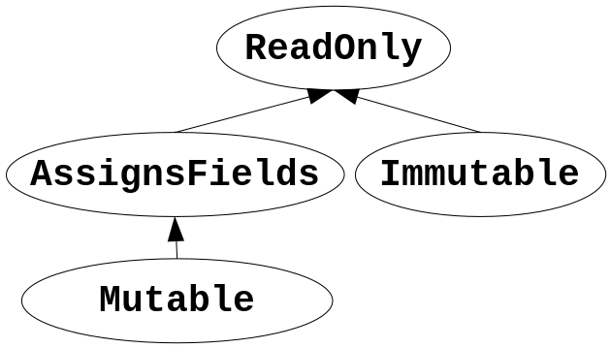
Object immutability: Solution
1: class Edge<I extends ReadOnly> {
2: private long id;
3: @AssignsFields Edge(long id) { this.setId(id); }
4: @AssignsFields void setId(long id) { this.id = id; }
5: Edge<I> e;
6: @Mutable void foo(long id) { this.e.id = id; }
@AssignsFields
  Can only assign to the fields of this,
  i.e., it is not transitive
  Private: cannot write Date<AssignsFields>
  Conclusion: this can only escape as ReadOnly
<number>/23

Slide 19
Object creation rule
new SomeClass<X,…>(…)
is illegal iff the annotation Y of the constructor satisfies:
  Y=@Mutable and X≠Mutable
  Y=@Immutable and X≠Immutable
Examples:
  When Y=@AssignsFields, you can create both Mutable and Immutable instances, e.g.,
    new Edge<Mutable>(this.id);
    new Edge<I>(this.id);
  When Y=@Mutable, you can create only Mutable instances
  When Y=@Immutable, you can create only Immutable instances
<number>/23

Slide 20
Case studies
IGJ compiler
  Small and simple extension of javac
  Using the visitor pattern for the AST
  Modified isSubType according to IGJ’s covariant subtyping
Case studies:
  Jolden benchmark, htmlparser, svn client
  328 classes (106 KLOC)
  113 JDK classes and interfaces
<number>/23
Notes:
AST = Abstract Syntax Tree

Slide 21
Case studies conclusions
Representation exposure errors
  In htmlparser: constructor takes an array and assigns it to a field, without copying; an accessor method also returns that array
Conceptual problems
  In Jolden: an immutable object is mutated only once immediately after it creation.
  We refactored the code, inserting the mutation to the constructor
  Found both immutable classes and objects
  Date, SVNURL, lists
<number>/23
Notes:
AST = Abstract Syntax Tree

Slide 22
See the paper for ...
CoVariant and NoVariant type parameters
Method overriding
Mutable and assignable fields
Inner classes
Circular immutable data-structures
Formal proof (Featherweight IGJ)
<number>/23
Notes:
IGJ is powerful enough to handle circularity
Field initializers
Exceptions
Reflection
Arrays

Slide 23
Conclusions
Immutability Generic Java (IGJ)
  Both reference, object, and class immutability
  Simple, intuitive, small, no syntax changes
  Static – no runtime penalties (like generics)
  Backward compatible, no JVM changes
  High degree of polymorphism using generics and safe covariant subtyping
Case study proving usefulness
Formal proof of soundness
<number>/23
Notes:
Field initializers
Exceptions
Reflection
Arrays

Slide 24
Future work
Add default immutability
class Graph<I extends ReadOnly default Mutable>
An alternative syntax
(in JSR 308 for Java 7)
new @mutable ArrayList<@immutable Edge>(...)
Runtime support (e.g. down-cast)
<number>/23

