Slide 1
Efficient Subtyping Tests with
PQ-Encoding
Jan Vitek
University of Purdue
work of: Yoav Zibin and Yossi Gil
Technion—Israel Institute of Technology
Notes:
This work is about a new technique for subtyping tests.
The technique based on a tool borrowed from graph theory.
I present this research for Yossi and Yoav who could not be here.
I will do my best to answer questions, but some of the more detailed questions will be forwarded.

Slide 2
Outline
Subtyping tests
Previous work
The PQ Permutation Tree and PQ encoding
Results
Conclusions & Future Research
Notes:
The outline of this presentation is as follows:
I will first define the problem of subtyping tests.
Then I will mention some of the prior research.
Then, we have the graph theoretical technique: The PQ tree which is a tree for representing permutations, and how to use it for subtyping.
Next we will present the results.
Finally, I will mention open problems and directions for future research.

Slide 3
Subtyping tests
Is Sylvester a Mammal ?
Catch:
  Sylvester is a Feline
  a Feline is a Mammal
Given a hierarchy (T,≺)
  T is a set of types, |T|=n
  ≺ is a partial order over T (reflexive, transitive and anti-symmetric) called subtype relation
Encode the hierarchy so that the query, a ≺ b, can be answered efficiently.
Mammal
Feline
Canine
?
Notes:
Here is an example of a subtyping test.
You are given an object, say a cat named “Sylvester”, and a class, say Mammal.
The subtyping test is to determine whether the object belongs to a class, or to any of its subclasses.
In this case, the answer is yes, since
1) Sylvester is a Feline, and
2) Feline is a sublcass of Mammal, so every Feline is a Mammal.
Usually, the first step is easy: to find the class of an object.
In this case determining that Sylvester is a Feline is easy.
What is more difficult, and especially in complex, multiple inheritance hierarchies, is to determine that Feline is a direct or indirect subclass of Mammal.
Formally, we are given a hierarchy.
A hierarchy is a partial order whose elements are the types in T,
the cardinality of T is n.
The partial order over T is called the subtype relation
which is reflexive, transitive and anti-symmetric.
What we are looking for is an “encoding” of the hierarchy so that the query,
is a subtype of b, can be answered efficiently.
Now, we need to understand what we mean by saying “efficient” in this case.

Slide 4
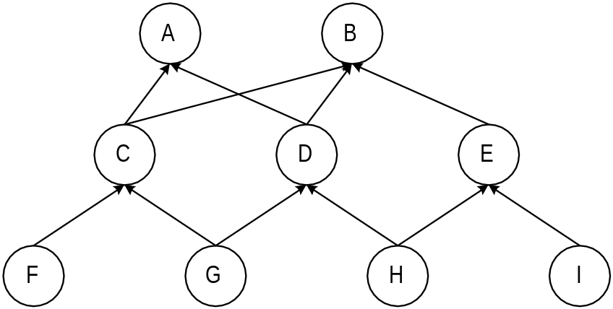
Efficiency Metrics
Encoding of a hierarchy: a data structure representing the hierarchy which supports subtyping tests.
Metrics:
  Test time: answer if a ≺ b quickly
    preferably in constant time
  Space: achieve the smallest encoding length
    Measured in the average number of bits per type
  Encoding creation time
The problem is most interesting for
multiple inheritance hierarchies.
Notes:
Formally, an encoding is a data structure which stores the hierarchy and supports subtyping queries.
We have three major efficiency metrics for this data structure:
test time, space and encoding creation time.
The test time is the time which takes to answer a subtyping test.
It should be small.
In fact it would be a couple, 4 or 5 machine instructions, irrespective of the size of the hierarchy.
The space consumed by the encoding should be as small as possible.
To normalize the space with the size of the hierarchy,
we measure the encoding length, which is
the average number of bits per type.
Since the encoding is created at link time, encoding creation should be fast,
say, at most one second.
The problem becomes quite difficult when we need to deal with multiple inheritance hierarchies.
Here is an example of such hierarchy.
It will serve as our running example.
Note also that there is usually a tradeoff between these three metrics.
For example, if you spend more time in creating the encoding,
then you might be able to achieve a more compact representation

Slide 5
Obvious encodings
Binary matrix (BM)
  Optimal for arbitrary hierarchies
    Test time is constant
    For n=5500 the BM size is 3.8MB
Closure-encoding
  Stores the ancestors lists
    uses M•log n space, but test time is O(log n)
    M is the number of both direct and indirect inheritance relations.
DAG-encoding
  Stores the parents lists
    only m•log n space, but test time is O(n)
    m is the number of direct inheritance relations.
Notes:
Here are three obvious encodings which show the tradeoff
between the space and test time.
The most obvious representation as a binary matrix gives constant test time,
but the space consumed is quadratic.
For a hierarchy with fifty five hundred types,
the binary matrix size is 3.8 MB.
In practice the binary matrix is very sparse, and therefore susceptible to massive optimizations.
Closure encoding stores the full list of all ancestors for each type,
thus reducing the space to the size of the subtype relation times log n,
but the test time is no longer constant but log n.
DAG encoding stores only the parents list of each type,
reducing the space even further at the cost of
increasing the test time to n.
BM-, Closure- and DAG-encoding are not very appealing techniques.
Previous contributions included many sophisticated encoding
schemes which come close to DAG-encoding in space, while
keeping the test time constant or ``almost'' constant.

Slide 6
Previous Work
Constant encodings for tree hierarchies (single inheritance)
  Relative numbering [Schubert ’83]
  Cohen's algorithm [Cohen ’91]
Constant encodings for general hierarchies (multiple inheritance)
  Packed Encoding (PE) - generalization of Cohen's algorithm [Krall, Vitek and Horspool ’97] (best time results)
Non-constant encodings for general hierarchies
  Bit-vectors [Krall, Vitek and Horspool ’97a] (best space results)
  And many more, e.g., range-compression, modulation, sparse-terms, and representation using union of interval orders
Notes:
There was a lot of work on efficient algorithms for subtyping tests.
We can only mention a few of these.
Famous encodings for tree hierarchies are Schubert’s relative numbering and Cohen’s algorithm.
For general hierarchies we have Krall, Vitek and Horspool Packed Encoding.
Packed encoding gives the fastest query time.
There are also encodings in which a subtyping query is not answered in constant time, but still very quickly.
For example, Bit-Vector encoding for which the best results are due to Krall, Vitek and Horspool.
We mention this since Bit Vector encoding is VERY space efficient.
It requires less space than Packed Encoding.
There are many more non-constant encodings, such as modulation, sparse-terms,
and representation using union of interval orders.
Our PQ encoding gives better space than Bit-Vector encoding and comparable time results to Packed Encoding.

Slide 7
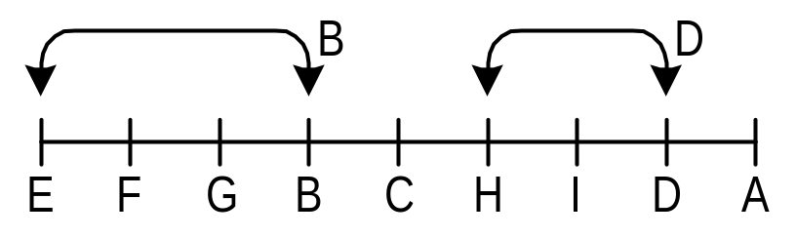
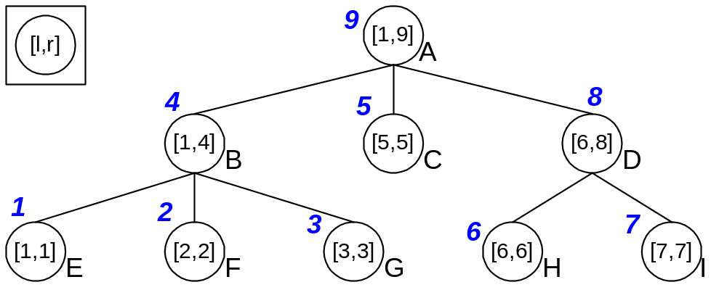
Relative numbering (for trees only)
Apply postorder numbering
  The ordinal of b in the postorder is denoted r_{b}
  All descendants of b have consecutive numbers, this interval is denoted [l_{b} , r_{b}]
  a ≺ b ⇔ l_{b} ≤ r_{a} ≤ r_{b}
Notes:
Relative numbering is achieved by visiting the tree in post order.
The nodes of the tree are numbered in the order they are visited.
Node E is given the number 1, F is 2, G is 3, B is 4 (traverse with mouse or pointer),
C is 5, H is 6, I is 7, D is 8 and A is 9.
The main thing to notice is that all descendants of a node
have consecutive numbers.
For example, the descendants of B (E,F,G, and B) define the interval [1,4].
We therefore, store at each node an interval: [lb, rb].
Also each node has its own number in the ordering which is always rb, so it is does not need to be stored again.
To check if a is a subtype of b, you check if r_{a} is inside the interval of b.
For instance, H is a subtype of A since 6 is inside the interval [1,9].
Relative numbering guarantees both
optimal encoding length of log n bits,
and constant time subtyping tests.
However, these achievements are only possible in a tree hierarchy.

Slide 8
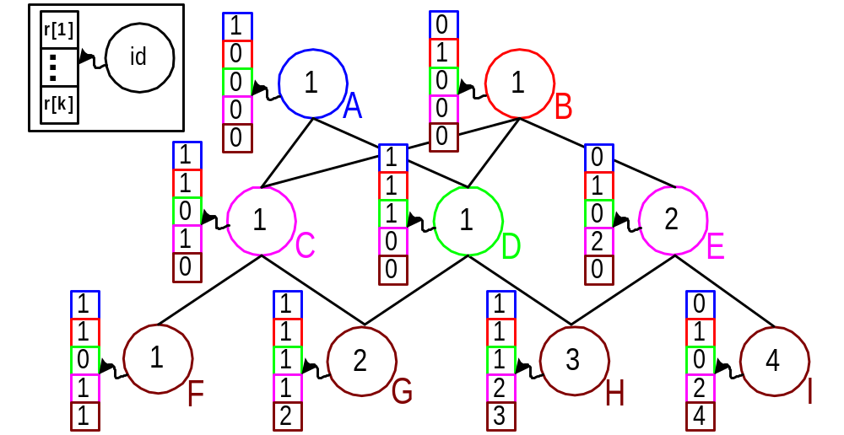
Packed encoding (PE)
Partition the hierarchy into the smallest number of slices
  Two types in a slice do not have a common descendant
  NP-complete, good heuristic by Vitek et al. 1997
  a ≺ b ⇔ r_{a}[s_{b}] = id_{b}
Notes:
Packed Encoding tries to partition the hierarchy into the smallest number of slices. (this is the term we use here… not buckets as in the orginal paper.)
A slice a set of types which have some property.
In Packed Encoding, two types in a slice do not have a common descendant.
Finding the minimal number of slices is NP-complete, but Vitek et al. found good heuristics
which comes close to the optimum.
The slice of type b is denoted s_{b}
In the running example we divided the hierarchy into five slices,
each slice has a different color.
The brown slice has nodes F, G, H and I.
These nodes have no descendants, therefore they could not have
any common descendant.
The violet slice has nodes C and E, and again we see that they
no common descendents.
The blue slice is the node A by itself.
The green slice is just the node D, and
the red slice is just the node B.
We give Ids to the nodes in each slice.
In the diagram, the ID is written inside the node.
The ID of all nodes in a slice are distinct, but nodes in
different slices could have the same ID.
For example, nodes A, B, C, D and F are all give the ID 1. (point with mouse)
The brown slice uses Ids 1, 2, 3 and 4, which are all different. (point with mouse).
We have 5 slices, so each node has an array with five entries, one for each slice.
What is stored in this array?
Consider the node I, and its ancestors.
It may have ancestors from all slices.
However, it cannot have more than one ancestor from any slice, since the slice
was selected in such a way that there is no common descendant to its nodes.
In the blue entry, we will write the ID of the ancestor from the blue slice.
There is no such ancestor, so we write zero.
In the red entry, we write the ID of the ancestor from the red slice.
This ancestor is B.
The ID of B in its slice 1.
So we store 1 in the red entry.
In the green entry we write 0 since there is no ancestor of I from the green slice.
In the violet entry we store 2 which is the ID of E, the ancestor from the violet slice.
We think of each node as being an ancestor of itself.
Therefore, the brown entry we store 4, the ID of I.
Subtyping check is now very simple:
Suppose that we need to check whether I is a subtype of E.
E is a violet node. Its ID is 2.
We go to the violet entry of the array of I and see that the ID written there is also 2.
Therefore, I is a subtype of E.
Now, suppose that we need to check whether I is a subtype of D.
D is a green node.
Therefore, we go to the green entry of array of I and see that the ID there is a zero.
The ID of D is 1. Therefore D is not a supertype of I.

Slide 9
Our Technique: PQ encoding (PQE)
Combine the ideas of Relative Numbering with slicing as used in Packed Encoding
  Partition the nodes into slices.
  Each slice S_{i} has an ordering π_{i.}of all nodes in the hierarchy.
  Slicing property: the descendants of each node b∈S_{i} are consecutive in π_{i}.
Notes:
(Simply read the slide.)
Let us look at the drawing:
In relative numbering we had a single ordering, which was the postorder of the tree.
The descendants of each type appear consecutively,
as can be seen for types A and B.
In PQE we have several such orderings.
Each type belongs to some slice (or ordering).
In this ordering, its descendants appear consecutively.
Type A belongs to the first slice, and B to the second slice.
To check if a is a subtype of b (point to the subtyping test),
we go to the ordering of b,
find the position of a in it,
and check that it appears inside the interval of b.
The slices (and the orderings) are created using PQ-trees
(which are described next).

Slide 10
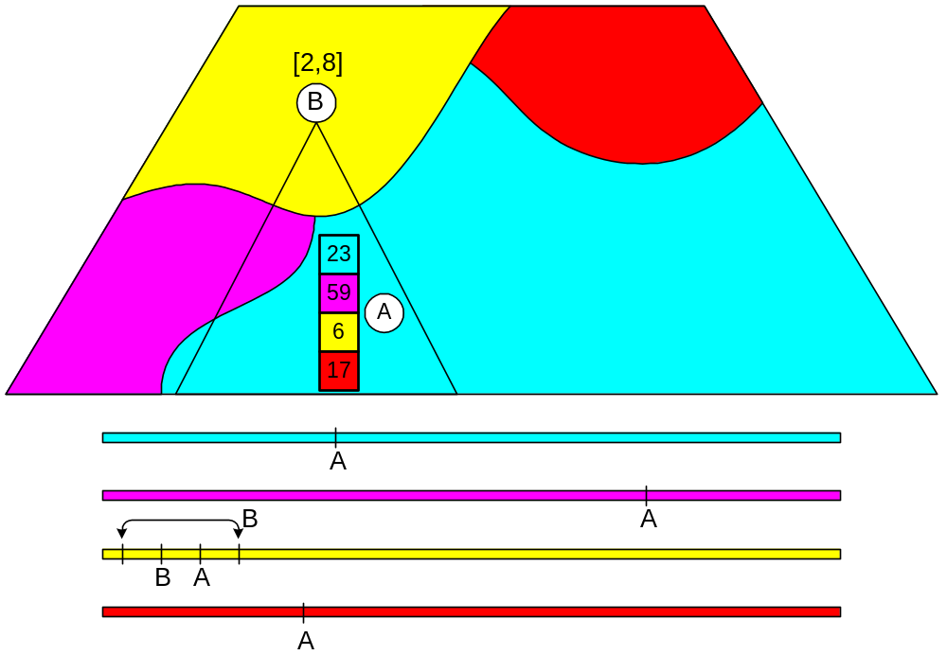
Visualizing PQ Encoding
Notes:
Here is a sketch of how the encoding works.
In this hierarchy, we have four slices: red, yellow, blue and violet.
Each slice imoses an ordering of all nodes in the hierarchy.
Here is the yellow ordering for example. (Point with mouse)
The node A for example, will appear, but in different places in the blue, the violet, the yellow and the red orderings.
Each node has an array that stores its number in each of the ordering.
For example, see the array of node A.
In the blue entry, we have 23, which is the number of A in the blue ordering.
In the violet entry, we have 59 which is the number of A in the violet ordering.
In the yellow entry, we have 6, which is the number of A in the yellow entry.
Similarly for 17 is the number of A in the red ordering.
Now, examine the descendants of B.
The main slicing property is that all these descendants show as a consecutive interval in yellow ordering.
The descendants of B could have numbers two through eight in the yellow numbering.
So we store the interval 2, 8 with B.
To check whether A is a descendent of B we do the following:
1. Find that B is in the yellow slice.
2. Find the number of A in the yellow numbering, which is 6.
3. We check that the number 6 is contained in the interval of B.

Slide 11
Pseudo code for subytping test
Procedure IsSub(A,B) // return true if A < B
c ← slice_of(B)
id ← array_{A}[c]
[α,β] ← interval of descendants of B
if (id ∈ [α,β])
return true
else
return false
End
The above can be encoded in 4-5 machine instructions

Slide 12
Finding a Good PQ Encoding?
Main objective: minimize the number of slices.
  Each slice adds an entry to each one of the arrays.
The main difficulty: the slicing property, i.e., that there is a consecutive ordering of all descendants of nodes in a slice.
  Each node in a slice imposes a constraint on the ordering.
Tool: PQ-trees – a data structure which saves all the orderings which satisfy a set of such constraints.

Slide 13
PQ-trees
Invented by Booth and Leuker, 1976
  Used to test for the consecutive 1's property in binary matrices of size r×s, in time O(k+r+s) where k is the number of 1's in the matrix.
  It is called PQ tree, since it has nodes of two kinds, P- and Q-nodes.
  Enabled the first linear time algorithm for recognizing interval graphs (using the maximal cliques matrix)
  Used also to recognize (doubly) convex bipartite graphs
  Later used for other graph-theoretical problems
    on-line planarity testing
    maximum planar embeddings
A PQ-tree Ρ represents a set of orderings, denoted consistent(Ρ).

Slide 14
Constructing a PQ-tree
U is the set of all nodes.
A constraint is a set I⊆U which must appear together.
Let ϕ⊆2^{U} be a set of constraints.
Let Π(ϕ) be the collection of all orderings U such which satisfy all the constraints in ϕ.
Theorem (Booth-Leuker (1976))
  For every ϕ exists a PQ-tree Ρ, and for every Ρ exists ϕ such that Π(ϕ)=consistent(Ρ)
Generating Ρ from ϕ:
  Ρ ← Ρ_{u}
    Ρ_{u} is the universal PQ-tree
  Ρ ←reduce(Ρ,I) for every I∈ϕ
    reduce conducts a bottom-up traversal, at each step applying one of standard eleven PQ-tree transformation
Notes:
The following theorem established the relationship between PQ-trees
and a set of constraints.
Each constraint is simply a set of leaves which must occur consecutively.
... (Read the theorem)
Given a set of constraints,
the PQ-tree satisfying those constraints can be built incrementally:
We start from a universal PQ-tree, with ...
That means that all orderings are legal.
Then we perform reduce for each constraint I.
reduce conducts ...

Slide 15
Creation algorithm
κ←1 ; S[κ]←Ρ_{u}
For all a∈T do // Find a PQ-tree consistent with type a
For s=1,...,κ do
reduce(S[s],descendants(a))
exit loop if reduce succeeded
s_{a}←s
If s=κ then // Start a new slice
κ←κ+1 ; S[κ]←Ρ_{u}
Notes:
The creation algorithm for PQ encoding:
We start with a single slice, which is a universal PQ-tree.
k is the current number of slices, plus one.
For each type in the hierarchy we try to find a slice it can join to.
We do this by demanding that its descendants appear consecutively.
(If reduce fails, the PQ-tree is not changed).
If we used the last slice, then we start a new one.
Thus the invariant is that S[k] is an unused slice.
At the end of the algorithm, the slices are given in the array S.

Slide 16
Data-set
13 non-tree hierarchies used in real life programs
  66-5,438 types (over 18,500 types in total)
  PQ works so nicely, since even dense MI hierarchies are tree like in many ways
  Average number of parents is always less than 2.
  Average number of ancestors can be high (30 in Self)
  Height is similar to that of balanced binary tree.
Hierarchies can be broken into a core + bottom trees
  A type is in the core if it has a descendant with more than one parent.
  The median core size is 21%.
core
height
Notes:
To benchmark different algorithms,
we collected twelve non-tree hierarchies used in real life programs.
This data-set represents an array of large hierarchies drawn from various
Object Oriented Languages, and includes all hierarchies used in previous studies.
Eckel and Gil studied topological properties of those hierarchies
and found that they are similar to those of balanced trees.
This makes it possible to find more efficient encoding for hierarchies used in practice.
The first column of the table is the name of the hierarchy followed by its size,
which ranges between 66 and almost 5500.
The next column is the average number of parents
which is always less than 2.
The average number of ancestors is large,
in Self hierarchy a type has in average almost 30 ancestors!
The next columns are the height of the hierarchy, which is the maximal level,
and log n.
Comparing them shows that the hierarchies are shallow;
their height is similar to that of a balanced binary tree.
The last column shows the relative size of the core.
A type is in the core if it has a descendant with more than one parent.
In most hierarchies the core is rather small, typically less than half the number
of types.
Encoding is easier if the core is considered first,
and the bottom trees of T\T' are
added to the encoding later.
The right figure shows how a typical hierarchy looks like.

Slide 17
Optimizations
Improving all 3 metrics: test time, space, creation time
Not graph theoretic
  Encoding the core, and adding the bottom-trees later
  Specialization
  Length optimization and pseudo arrays
  Heterogeneous encoding
  Inlining
  Coalescing
    This optimization sometimes reduces space, albeit increases test time
    The new encoding is called CPQE
Notes:
There are many ways in which the basic algorithm can be optimized,
Improving all three metrics: test time, space and creation time.
The first technique which was first used with PE is to encode the core separately and then add the bottom trees.
Some of the other techniques are specialization, pseudo arrays, inlining. The details are in the paper.
An important technique is called coalescing. It may reduce spaces, but increases the test time.

Slide 18
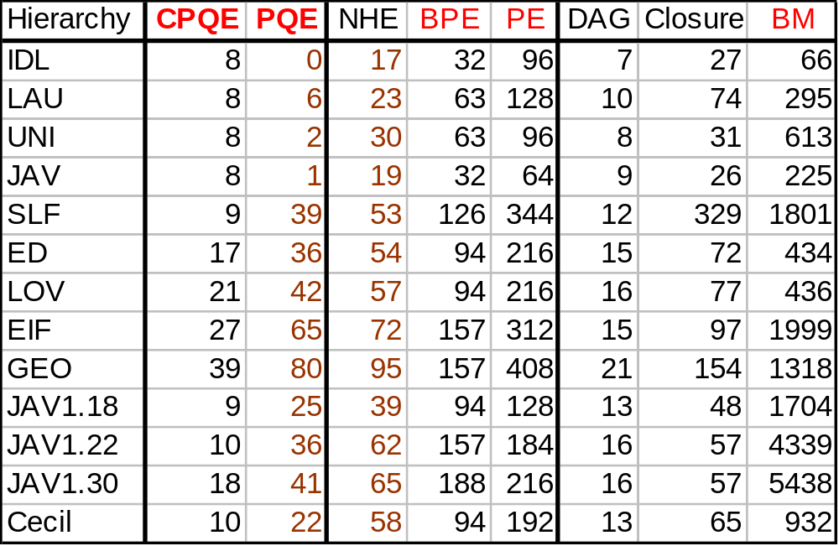
Results (Space Metric)
Encoding length of different algorithms
  CPQE and BPE are variants of PQE and PE, respectively.
Notes:
This table compares the encoding length ...
The first columns show the results of our new encoding schemes.
Next we see the more sophisticated previous encodings,
followed by the obvious encoding schemes.
The constant encodings are:
CPQE, PQE, 2-Dim, BPE, PE and BM.
NHE is in practice almost constant, while Closure and DAG are far from being constant.
One could see that PE and BPE greatly improves upon the BM.
Our new encodings improves the encoding length even further.
The gain is especially noticeable in large hierarchies which heavily use MI.
When comparing PQE with the non-constant bit-vector encoding, NHE,
we see that there is a great improvement there also.
The average improvement is 49%, while the median improvement is 36%.
Comparing PQE with 2-Dim we see that PQE outperforms 2-Dim.
However, by using MMX technology 2-Dim can be implemented faster.
A subtyping test can be executed in 4 machine instructions,
which is currently the best bound for subtyping tests,
This bound is also achieved by BM and PE.
CPQE improves PQE by a factor ranging between 2 to 4.2

Slide 19
Conclusions & Future Research
PQE improves encoding length, creation time and test time of NHE (details in the paper)
The CPQE variant, tailored for object layout like the one in C++, further reduces the encoding length.
Future work
  Incremental encoding

Slide 20
The END

Slide 21
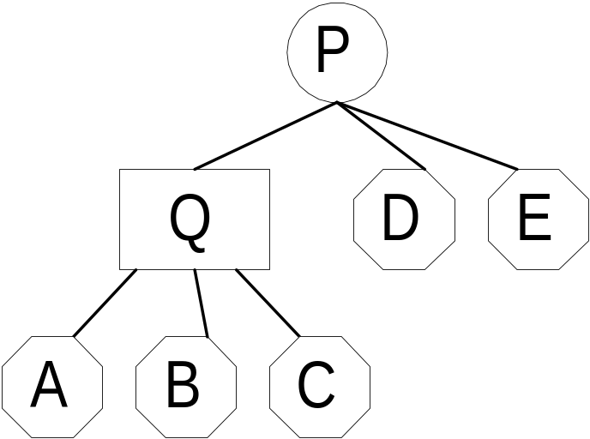
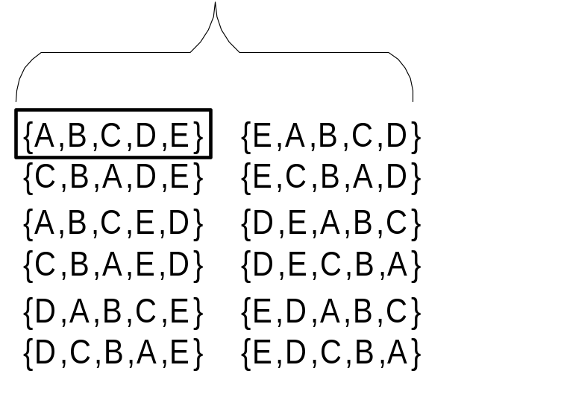
PQ-trees cont.
A PQ-tree has three kinds of a nodes
  a leaf which represents a member of a given set U
  a Q-node which represents the constraint that all of its children must occur in the order they occur in the tree or in reverse order
  a P-node which specifies that its children must occur together, but in any order
consistent(Ρ)
frontier(Ρ)
Notes:
A PQ-tree has three kinds of a nodes:
leaves, Q-nodes and P-nodes.
...
In the figure we see a PQ-tree whose leaves are {A,B,C,D,E}.
This tree has one P-node and one Q-node.
There are twelve consistent orderings:
The children of the Q-node can appear either from left to right,
or from right to left.
The children of the P-node can appear in any order,
which means there are 6 legal orders.
The frontier of a tree is the ordering of the leaves
obtained by a DFS traversal.
In this example, the frontier is {A,B,C,D,E}.

Slide 22
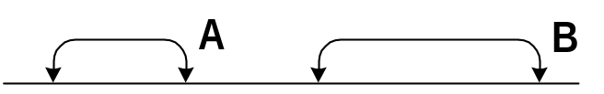
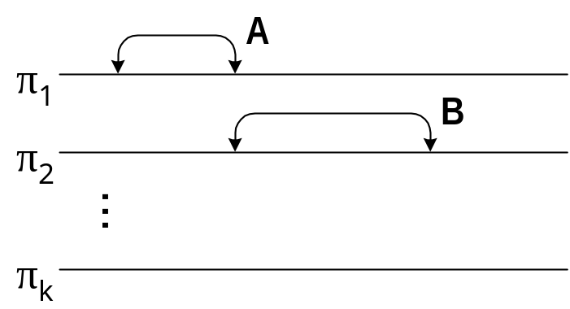
  This interval is denoted [l_{b} , r_{b}]
  The ordinal of a in π_{i} is denoted id_{a}[i]
  Thus, a ≺ b ⇔ l_{b} ≤ id_{a}[s_{b}] ≤ r_{b}
a ≺ b ⇔ l_{b} ≤ id_{a}[s_{b}] ≤ r_{b}
Relative numbering
PQE
postorder

Slide 23
Previous work - Summary
Encoding | Test time | Encoding length
Relative numbering | O(1) | log n
Cohen's algorithm | O(1) | (|≺|•log n)/n
BM | O(1) | n
Closure | O(log n) | (|≺|•log n)/n
DAG | O(n) | (|≺_{d}|•log n)/n
PE | O(1) | ≥Closure
Bit-vectors | ≈O(1) | ?
Range-compression | ? | ≈O(1)
Only for SI
Obvious encodings
Needs to be compared on the data-set
Notes:
To summarize the results of previous works we created this table
which compares the test time and encoding length of different encoding schemes.
For tree hierarchies, relative numbering is optimal.
Among the obvious encodings, the most popular one is the binary matrix,
since the test time is constant.
In CACAO JIT complier the BM is used to encode
the Java interface hierarchy, while Relative numbering is used
for the class hierarchy.
DAG encoding is also popular, since it is simple and space efficient.
The main drawback of DAG encoding is its test time,
which can be as high as the maximal number of ancestors.
Among the more sophisticated encodings, the only constant one is PE,
but its encoding length is high.
Empirical studies showed that bit-vectors achieved almost constant test time
and range-compression (which was not described here) achieved
almost constant encoding length.
Our two new algorithms are constant, as PE, but achieve an encoding length
smaller than PE and bit-vectors.

Slide 24
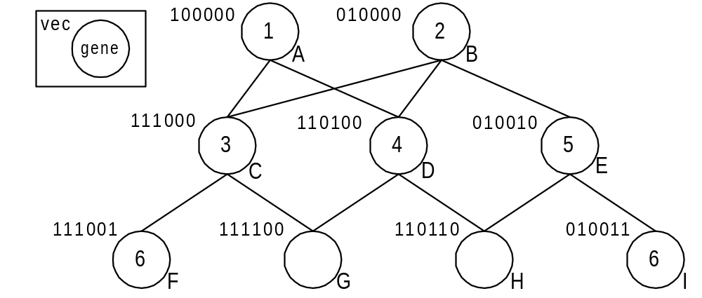
Bit-vectors
Embeds the hierarchy in the lattice of subsets of {1...k}, each subset is represented as a bit-vector
  NP-hard to find minimal k, best heuristic is NHE
  a ≺ b ⇔ vec_{b} ∧ vec_{a} = vec_{b}
{1,2,3}
{1,2,3,6}
Notes:
In Bit-vector encoding we try to embed the hierarchy
in the lattice of subsets of {1...k},
each subset is represented as a bit-vector.
In the running example, k equals 6.
The subset of F is {1,2,3,6}, and the corresponding bit-vector is 111001.
Each subset is the union of ancestors' genes.
The test time is non-constant since it depends on the size of the bit-vector.
It is NP-hard to find the minimal k.
Currently, the best heuristics is Near-optimal Hierarchical Encoding (or NHE).
vec_{a} is the bit-vector associated with type a.
a is a subtype of b if and only if the subset of a contains the subset of b,
which can be checked by masking vec_{b} with vec_{a}.
For instance, H is a subtype of E, and if we mask the bit-vector of E
with that of H, we get the bit-vector of E.

Slide 25

⇔ ≤ ≥ ≺_{d} ≺ π ≤ ∈ ∧∨
  ≤ ≥ ≺_{d} ≺ ⊆
    ≤ ≥ ≺_{d} ≺ π ≤_{u} ∈
Notes:
If a ≺ b holds then
a is a subtype of b
b is a supertype of a
a and b are comparable
We assume that the supertype b is known at compile time
Explicit
o2 ?= o1; --In Eiffel
o2 = dynamic_cast<B> o1; // In C++
Implicit
if (o1 instanceof B) ... // In Java
o1 isKindOf: B // In SmallTalk
The static type of o1 is A, and of o2 is B.
The dynamic type of o1 could be A or B, thus the explicit assignment could either succeed or fail. This could only be determined in runtime using a subtyping test.
Maybe also add instruction count and explain the notion of uniformity.
For each slice S_{i} we store the entire information required to answer
queries of the sort a < b, aT and bS_{i}, i.e.,
queries in which the supertype is drawn from S_{i}.
for 2-dim:
Two types are in the same equivalence class
a  b iff ancestors(a)S = ancestors(b)S

Slide 26
Definitions
≺_{d} is the transitive reduction of ≺
  ≺ is the transitive closure of ≺_{d}
  Formally, a ≺_{d} b iff a ≺ b and there is no c such that
  a ≺ c ≺ b, a≠c≠b.
Also,
  ancestors(a)≡{b∈T| a ≺ b}, descendants(a)≡{b∈T| b ≺ a}
  parents(a)≡{b∈T| a ≺_{d} b}, children(a)≡{b∈T| b ≺_{d} a}
  roots≡{a∈T| parents(a)=∅}, leaves≡{a∈T| children(a)=∅}
  level(a)≡1+max{level(b)| b∈parents(a)}
Single inheritance (SI) vs. multiple inheritance (MI)
  In SI, for each a∈T, |parents(a)|≤1
Notes:
There is an example next.

Slide 27
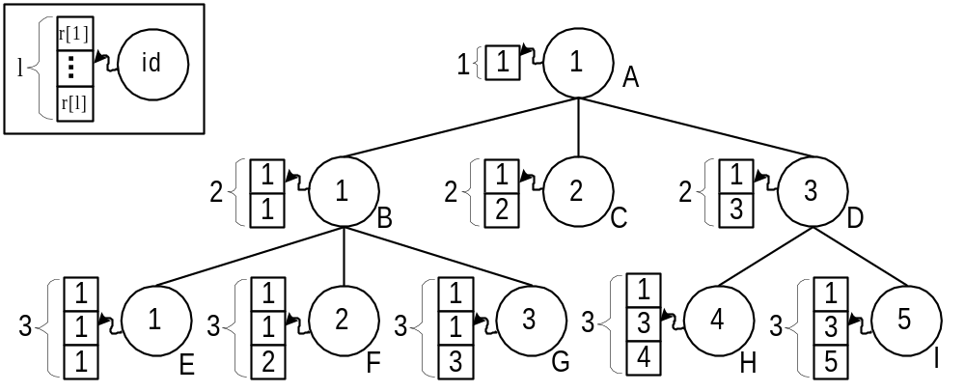
Cohen's algorithm
Partition the hierarchy into levels
  a ≺ b ⇔ l_{b} ≤ l_{a} and r_{a}[l_{b}] = id_{b}
  l_{b} is level(b), id_{b} is a unique identifier within the level
Notes:
The array boundary check can be eliminated.
The id's can be of different sizes, hence @

Slide 28
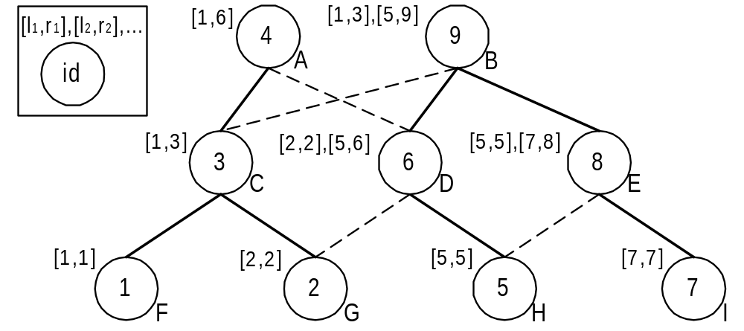
Range compression
Apply postorder on some spanning forest
  a ≺ b ⇔ l_{b}[i] ≤ id_{a} ≤ r_{b}[i] , for some i
{1,2,3}
{2,5,6}
Notes:
Type b is represented by the intervals created by the ordinals of its descendants in the postorder.

Slide 29
Optimizations
Creation time
  Encoding the core, and inserting the bottom-trees later
Encoding length
  Length optimization
    reduces the range needed for the ids.
    Thus, all slices (except the first) only uses a single byte.
  Heterogeneous encoding
    uses BM representation for slices whose size is smaller than 8.
  Specialization
    Emitting values which depend only on the supertype into the test code, e.g., l_{b} and r_{b}.
    Also improves test time (saves load instructions).

Slide 30
Inlining optimization
Uses the freedom the compiler have in placing the runtime representation of the types
The first slice is inlined
  Instead of using id_{a}[1] we use the pointer to the runtime representation
  Reduces 16 bits from the encoding length
  Saves one load if the supertype is from the first slice
    The first slice constitutes 90% of the types
Using this technique in relative-numbering reduces the encoding length to zero.

Slide 31
Coalesced PQ-encoding (CPQE)
When C++ had only SI, the runtime information was stored before the VTBL
In MI there could be many VTBLs
Implementers can either duplicate or share
  Sharing is done by another level of indirection
In CPQE types can share their id array
  Since the first slice was inlined, some arrays can be coalesced
  The number of distinct arrays is always lower than the size of the core

Slide 32
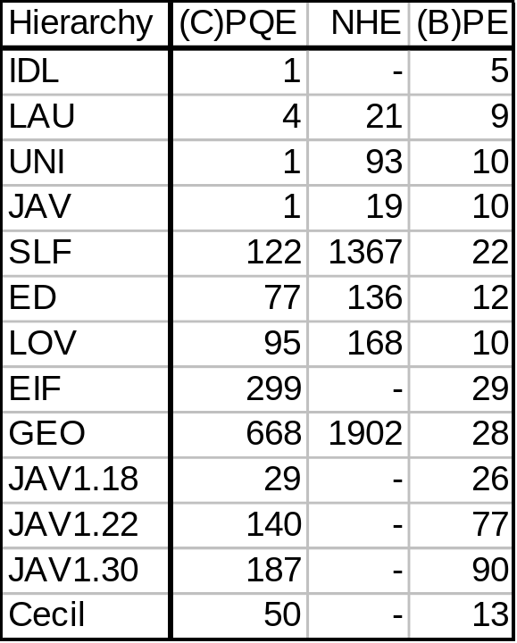
Results cont.
Encoding creation time in milliseconds
  (C)PQE on 266 Mhz Pentium II
  NHE on 500 Mhz 21164 Alpha
  (B)PE on 750 Mhz Pentium~III, user time in Linux

Slide 33
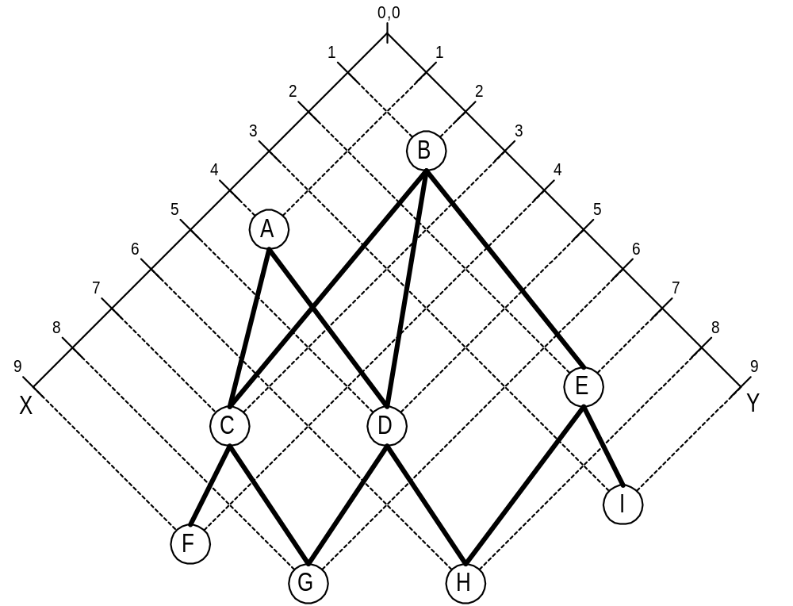
2-Dim encoding
Idea: embed the hierarchy in the plane
  If not possible, use multiple slices
  a ≺ b ⇔
  X_{a}[s_{b}] ≥ X_{b}[s_{b}]
  and
  Y_{a}[s_{b}] ≥ Y_{b}[s_{b}]
2-Dim encoding using one slice
Notes:
2-Dim encoding tries to embed the hierarchy in the plane
If this is not possible, then multiple slices are used.
In the figure on the right we see the 2-Dim encoding of the running example.
In this case a single slice suffice.
Each type has two coordinates, X and Y.
Type a is a subtype of b if both coordinates of a are higher than those of b.
For example, H is a subtype of E since the coordinates of H, <6,8>,
are higher than those of E, <2,7>.
Notice how the rectangle of H contains its ancestors {H,D,E,A,B}, and only them.
In 2-Dim encoding each slice has two orderings, X and Y.
To check if a is a subtype of b,
the coordinates in the slice of b are compared.
Thus, a slice is only responsible to queries, is a a subtype of b,
where b belongs to the slice.
Which brings us to the definition of pseudo two-dimensional embeddings.

Slide 34
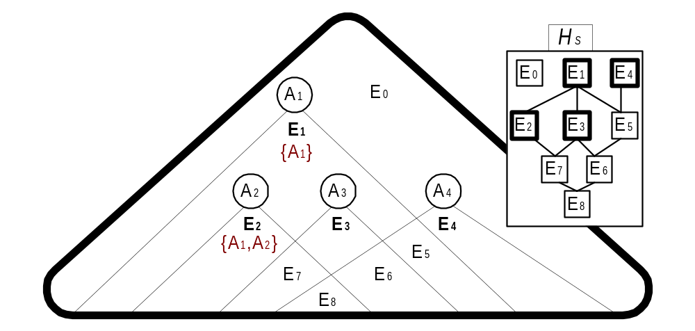
Encoding creation
A slice S has a pseudo 2-dimensional embedding if we
can embed the hierarchy so that queries a ≺ b, b∈S, are answered correctly
Theorem: A slice S has a pseudo 2-dimensional embedding iff dim(H_{S})=2
Notes:
...
For example, consider a slice S whose elements are {A₁,A₂,A₃,A₄}.
This slice partition the types into equivalence classes.
Each equivalence class is a subset of S, e.g.,
E₇ is {A₁,A₂,A₃}.
H_{S} is a poset defined by set containment over the equivalence classes.
For example, E₇ is lower than E₂ since {A₁,A₂,A₃} is contained in {A₁,A₂}.
The right to left side of the theorem is easy to prove.
If H_{S} has any kind of encoding,
than each type uses the encoding of his equivalence class.
Thus, queries where b belongs to S are answered correctly.
Trotter's stack operation can be used to prove the other side of the theorem.
The complete encoding creation is similar to that of PQE.
Instead of performing reduce, we check if we can add another type to the slice
while maintaining the property that the slice has a pseudo 2-dimensional embedding.

