Slide 1
Fast Algorithm for Creating Space-Efficient Dispatching Tables with Application to Multi-Dispatching
Yoav Zibin
Technion—Israel Institute of Technology
Joint work with: Yossi (Joseph) Gil
Notes:
The topic of this lecture is dynamic message dispatching.
I will present an algorithm for solving the dispatching problem
which is both fast and space efficient.
This algorithm can also be used for multi-dispatching.
My name is Yoav Zibin,
I’m from the Technion - Israel institute of technology
Dr. Yossi Gil is my PhD advisor.

Slide 2
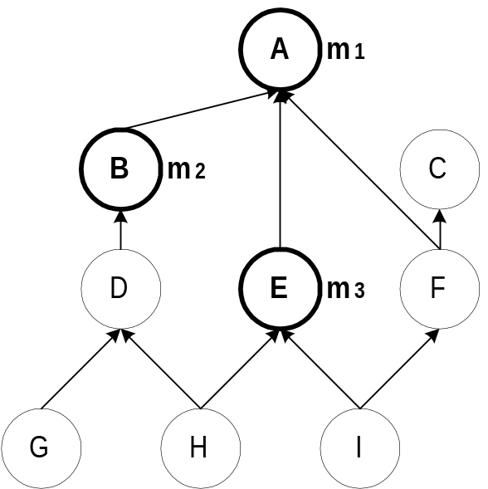
Dispatching
Object o receives message m
  Depending on the dynamic type of o,
  one implementation of m is invoked
Examples:
A dispatching query returns a type
  Type A → invoke m₁ (type A)
  Type F → invoke m₁ (type A)
  Type G → invoke m₂ (type B)
  Type I → invoke m₃ (type E)
  Type C → Error: message not understood
  Type H → Error: message ambiguous
    Static typing → ensure that these errors never occur
Solving ambiguities
  Tie breakers - auxiliary method implementations
  Linearization - Choosing some order for traversing the parents
Notes:
Important: runtime problem, dispatching query, Message, Method family
I will start by describing what dynamic dispatching is.
Consider some object o which receives a message m.
…

Slide 3
The Dispatching Problem
Encoding of a hierarchy: a data structure representing the hierarchy and the method families which supports dispatching queries.
Metrics:
  Space requirement of the data structure
  Dispatch query time
  Creation time of the encoding
Our results:
  Space: superior to all previous algorithms
  Dispatch time: small, but not constant
  Creation time: almost linear
Notes:
Incremental variant described in the journal version
The dispatching problem is building an encoding of hierarchy.
That means a data structure …
We measure the quality of different algorithms
according to three metrics:…
I will now briefly state our results.
The space requirement of our data structure is …
However, the dispatch query time is …
Finally, the creation time is …

Slide 4
Problem Variations
Single vs. Multiple Inheritance (SI vs. MI)
  SI: a type has at most one direct supertype
  (tree/forest topology)
  MI: otherwise
    Java: SI class hierarchy, MI type hierarchy.
Batch vs. Incremental
  Batch (e.g., Eiffel)
  the whole hierarchy is given at compile-time
  Incremental (e.g., Java)
  the hierarchy is built at runtime
Statically vs. Dynamically typed languages
Our setting: MI, Batch, Dynamically typed
Notes:
The dispatching problem has several variations.
First, the hierarchy can be either a single inheritance hierarchy
or a multiple inheritance hierarchy.
We use the abbreviations SI and MI in our slides.
In single inheritance a type …
That means that the hierarchy has a tree or forest topology.
In a multiple inheritance hierarchy there is no such limitation.
In Java, for example, we have a SI class hierarchy and a MI type hierarchy.
Second, the runtime environment can be either batch or incremental.
In a batch environment, as in Eiffel, the whole hierarchy is given at compile-time.
In an incremental environment, as in Java, the hierarchy is built in runtime,
one type after another.
Finally, the language can be either statically typed or dynamically typed.
We assumed the following setting:
MI, batch, and dynamically typed.
Assuming MI and Dynamically typed only made life harder on us.
Our algorithm will of course work for SI and statically typed languages as well.
However, by assuming a batch environment we made our lives easier.
An incremental variant is described in the journal version.

Slide 5
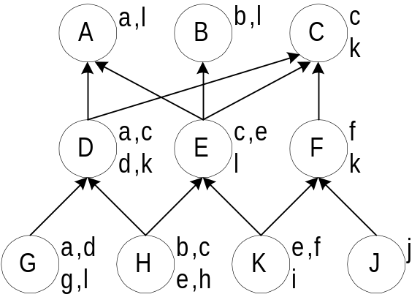
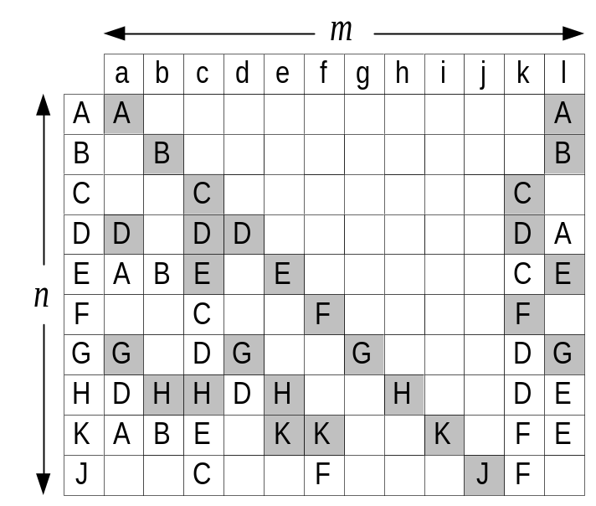
Compressing the Dispatching Matrix
Dispatching matrix
Problem parameters:
  n = # types = 10
  m = # different messages = 12
  l = # method implementations = 27
  w = # non-null entries = 46
Duplicates elimination vs. Null elimination
l is usually 10 times smaller than w
Notes:
The most obvious solution to the dispatching problem is
building a dispatching matrix.
The matrix stores the outcomes of all possible dispatching queries.
The rows correspond to types,
and the columns to messages.
For example, the result of dispatching on type E and message a is type A.
An empty cell in the matrix means the type doesn’t understand the message.
For example, type B and message a is type A.
in a~$\nTypes \times \nMessages$
dispatching matrix, storing the outcomes of all possible dispatching queries.
In the matrix representation queries are answered by a quick indexing operation.
However, the space consumption is inhibitivly large, e.g.,~512MB for the dispatching matrix
in the largest hierarchy in our benchmarks (8,793 types and~14,575 messages).
Null elimination can be achieved by storing each column as a sorted dictionary, i.e.,
a sorted array of (key,value)-pairs.
In this implementation, the query time is logarithmic in the number of non-null
entries in each column. Space is linear in this number.
Dynamic perfect hashing is theoretically
better than sorted dictionaries.
In this algorithm each column (or the entire matrix for that matter)
is stored as a hash table.
Indices (or their concatenation) serve as keys.
The space requirement is linear in~$\nNonNull$.
More importantly, query time is constant!
The more sophisticated previously published practical algorithms, try, and in most cases achieve
complete, or almost complete null elimination with no hidden constants and constant search time.
It is not difficult to come close to full duplicates elimination,
with a simple representation of the hierarchy as a graph where types are
nodes and immediate inheritance relations are edges.
The cost is of course the search time, which becomes~$O(\nTypes)$
Our challenge in this paper is therefore to come as close as possible to
optimal duplicates elimination, i.e.,
space linear in the number of implementations~$\nMethods$, while still maintaining small,
preferably constant, query time.

Slide 6
Previous Work
Null elimination
  Virtual Function Tables (VFT)
    Only for statically typed languages
    In SI: Optimal null elimination
    In MI: tightly coupled with C++ object model.
  Selector Coloring (SC) [Dixon et al. '89]
  Row Displacement (RD) [Driesen '93, '95]
    Empirically, RD comes close to optimal null elimination (1.06•w)
    Slow creation time
Duplicates elimination
  Compact dispatch Tables (CT) [Vitek & Horspool '94, '96]
  Interval Containment, only for single inheritance (SI)
    Linear space and logarithmic dispatch time
Notes:
RD, SC, and CT need to be amended in dynamically typed languages (almost doubling their space)

Slide 7
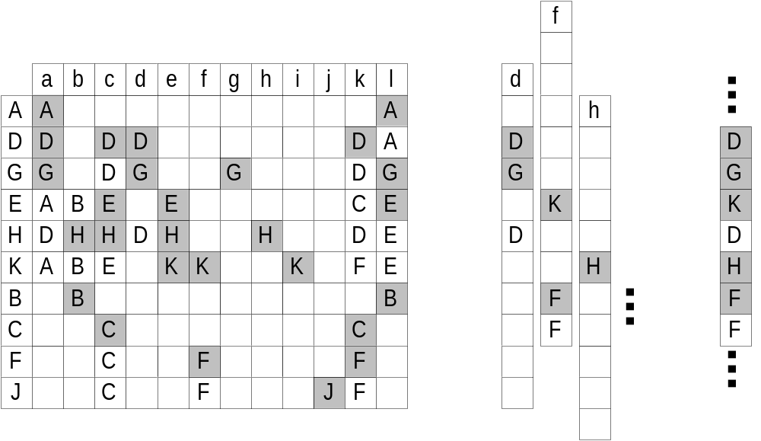
Row Displacement (RD)
Displace the rows/columns of the dispatching matrix by different offsets, and collapse them into a master array.
Dispatching matrix with a new type ordering
The columns with different offsets
The master array
Notes:
First re-orders the messages/types
Best results: displacing the columns with a DFS ordering of types

Slide 8
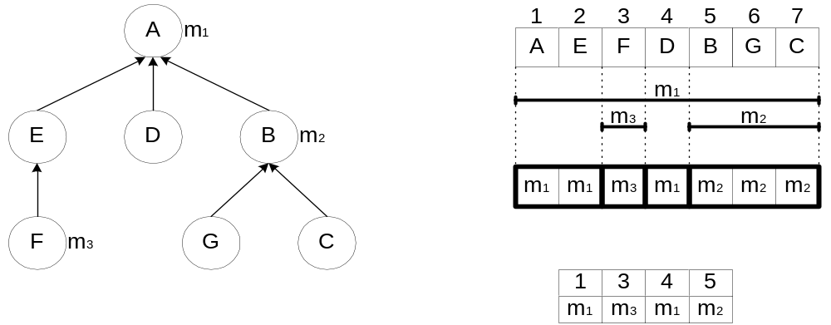
Interval Containment (for SI only)
Creation Process:
  Preorder numbering of types: ∀ t , descendants(t) define an interval
  f_{m} = # of different implementation of message m
  A message m defines f_{m} intervals ⇒ at most 2f_{m}+1 segments
  Optimal Space: O(l)
  Dispatch time: binary search O(log f_{m}),
  van Emde Boas data structure O(log log n)
f_{m} is on average 6

Slide 9
Our Technique: Type Slicing (TS)
Generalizes Interval Containment
Idea (more details later)
  Partition the hierarchy into κ slices
  Apply interval containment in each slice
Dispatch process:
  Retrieve the slice of the receiver
  Jump to the appropriate Interval Containment procedure
    For example, a binary search in logarithmic time
Space: O(κ l)
Median value of κ is 6.5; average is 7.3; maximum is 19
In practice, the space is much smaller (next slides)

Slide 10
Data-set
Large hierarchies used in real life programs
  Greatly resemble trees → κ tends to be small
  35 hierarchies totaling 63,972 types
    16 single inheritance (SI) hierarchies with 29,162 types
    12 multiple inheritance (MI) hierarchies with 27,728 types
    7 multiple dispatch hierarchies with 7,082 types
  Degenerate (singleton) method families removed
  Properties:
    Average number of methods in a type ≈ 6.5
    Average f_{m} ≈ 5.9 (≈3 conditionals)
    Null elimination compression factor ≈ 21.6
    Duplicates elimination compression factor ≈ 203.7
Notes:
To benchmark different algorithms,
we collected twelve non-tree hierarchies used in real life programs.
This data-set represents an array of large hierarchies drawn from various
Object Oriented Languages, and includes all hierarchies used in previous studies.
Eckel and Gil studied topological properties of those hierarchies
and found that they are similar to those of balanced trees.
This makes it possible to find more efficient encoding for hierarchies used in practice.
The first column of the table is the name of the hierarchy followed by its size,
which ranges between 66 and almost 5500.
The next column is the average number of parents
which is always less than 2.
The average number of ancestors is large,
in Self hierarchy a type has in average almost 30 ancestors!
The next columns are the height of the hierarchy, which is the maximal level,
and log n.
Comparing them shows that the hierarchies are shallow;
their height is similar to that of a balanced binary tree.
The last column shows the relative size of the core.
A type is in the core if it has a descendant with more than one parent.
In most hierarchies the core is rather small, typically less than half the number
of types.
Encoding is easier if the core is considered first,
and the bottom trees of T\T' are
added to the encoding later.
The right figure shows how a typical hierarchy looks like.

Slide 11
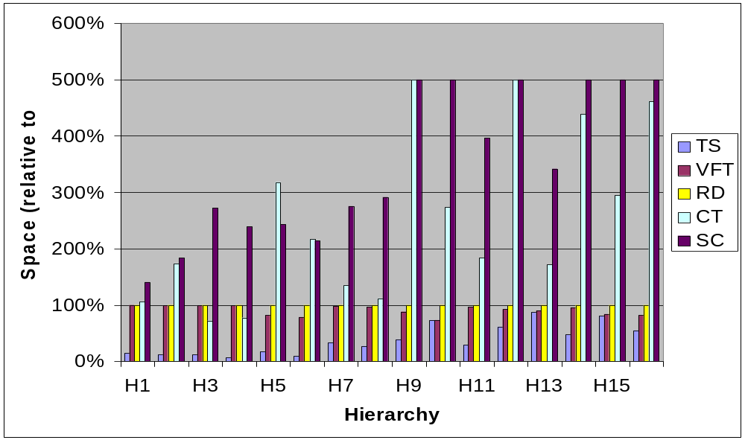
Space in SI hierarchies
Notes:
Space Metric:
RD is slightly better than our main TS algorithm in three out of~35 hierarchies:
TS however always wins against CT, VFT, SC, and against RD in all other hierarchies,
sometimes by factors as large as~30.
For instance, in the \VORTEX hierarchy, RD uses~1.24MB, an optimal null elimination scheme will use~1.22MB,
while TS uses~40KB!
The average improvement of TS over RD (considered the best for MI-hierarchies) is by a factor of~4.6,
while the median improvement is by
a factor of~2.6.
Creation time:
TS is consistently better than RD,
sometimes by a factor of hundreds.
The average improvement of TS over RD is by a factor of~37.4, while the median is~6.3.
Dispatch time:
The average number of such conditionals in the~35 hierarchies
ranged between~0.6 and~3.4; the median value being~2.5.

Slide 12
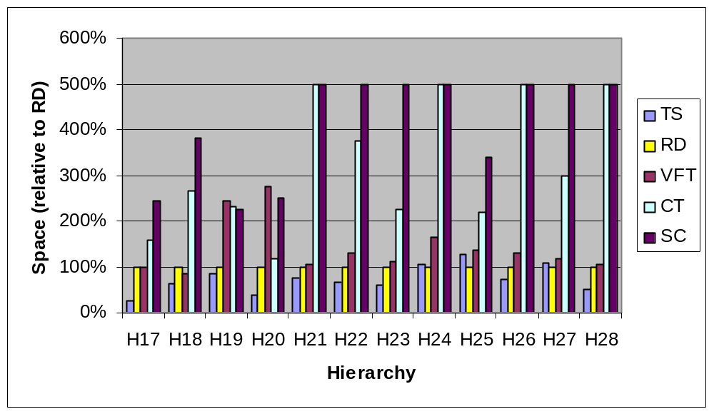
Space in MI hierarchies
Notes:
TS is usually much better than RD,
In the 3 hierarchies where RD wins it is by a small factor.

Slide 13
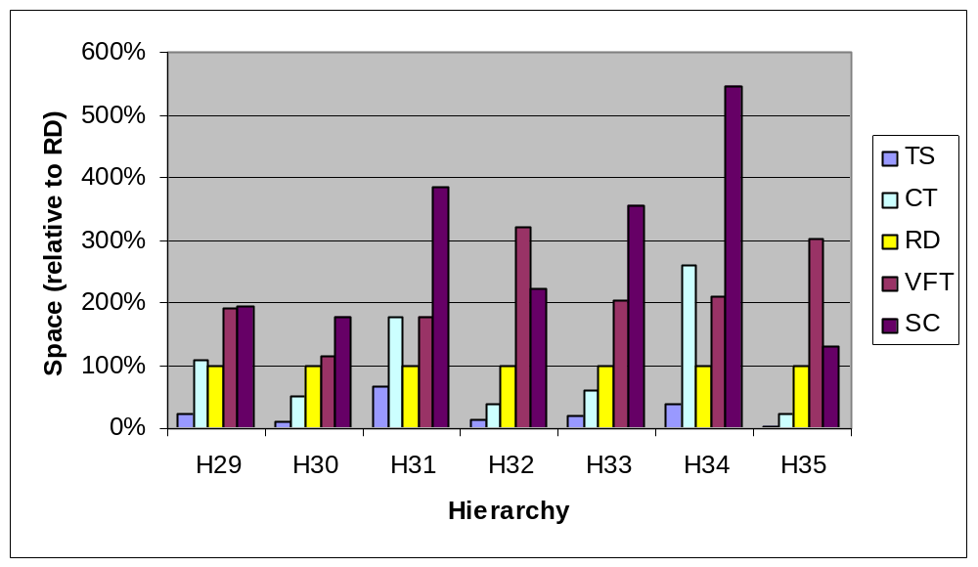
Space in Multiple Dispatch Hierarchies

Slide 14
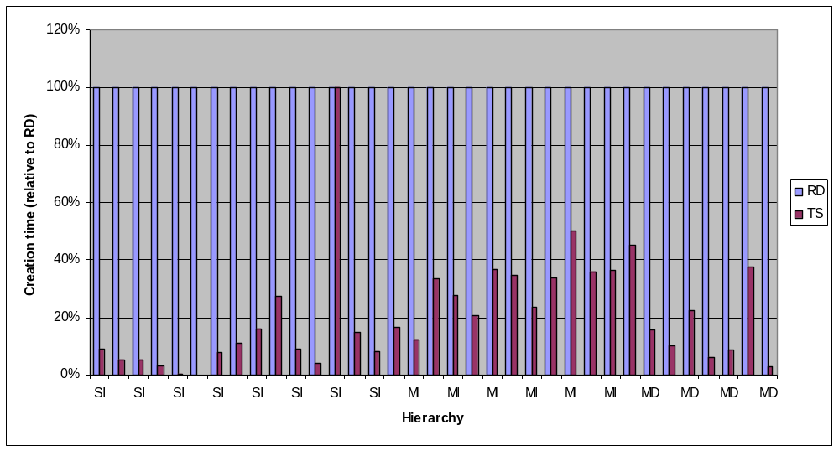
Creation time: TS vs. RD
Notes:
TS vs. RD
Average improvement = 37.4
Median improvement = 6.3

Slide 15
Dispatching using a binary search
Dispatch time (in TS)
  0.6 ≤ average #conditionals ≤ 3.4; Median = 2.5
SmallEiffel compiler, OOPSLA’97: Zendra et al.
  Binary search over x possible outcomes
  Inline the search code
  When x ≤ 50: binary search wins over VFT
Used in previous work
  OOPSLA’01: Alpern et al.
  Jalapeño – IBM JVM implementation
  OOPSLA’99: Chambers and Chen
  Multiple and predicate dispatching
  ECOOP’91: Hölzle, Chambers, and Ungar
  Polymorphic inline caches

Slide 16
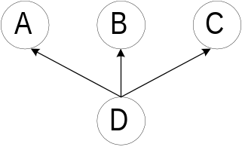
The Type Slicing Technique
In SI: descendants of t are consecutive in a preorder of the hierarchy
In MI: we cannot make all descendants of t consecutive, for example:
Partition the types in T into disjoint slices T₁ … T_{κ}
Find an ordering for each of the slices
Slicing property:
Descendants of t in each slice are consecutive in the ordering of that slice

Slide 17
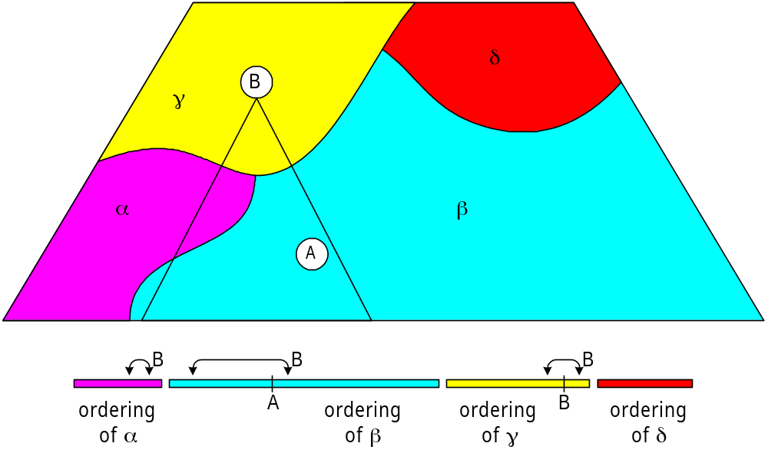
Visualizing Type Slicing
The main algorithm: partition the hierarchy into a small number of slices

Slide 18
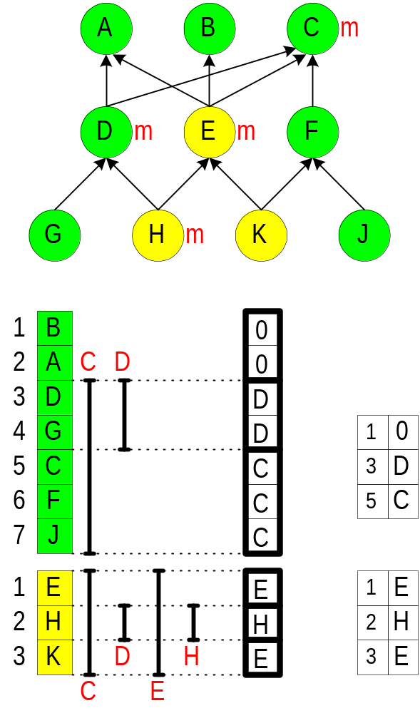
Small example of TS
The hierarchy is partitioned
into 2 slices: green & yellow
There is an ordering of each
slice such that
descendants are consecutive
Apply Interval Containment
in each slice
Example:
  Message m has 4 methods
  in types: C, D, E, H
  Descendants of C are: D-J, E-K

Slide 19
Multiple Dispatching
Dispatching over several arguments
  Useful, e.g., drawing a shape over some canvas
  Huge space required since the dispatching matrix is multi-dimensional
Mono-dispatch stage
  c regular dispatching queries for a multi-method whose arity is c
  We compare TS with optimal null elimination (w)
Resolution stage
  Using other, specialized techniques (SRP or CNT)

Slide 20
Conclusions & Future Research
TS improves the space and creation time of RD
Dispatch: binary search rather than array lookups
Future work
  Exploring the dynamic model
    Allow insertion of types (along with their accompanying methods) as leaves (Journal version)
    Allow insertion of methods to existing types
    Allow deletions
  Explore Linearizations to solve ambiguities
    Mainly in dynamically typed languages
    Also appears in exception handling
  Constant time dispatching scheme (POPL’03)

Slide 21
The End
Any questions?

Slide 22
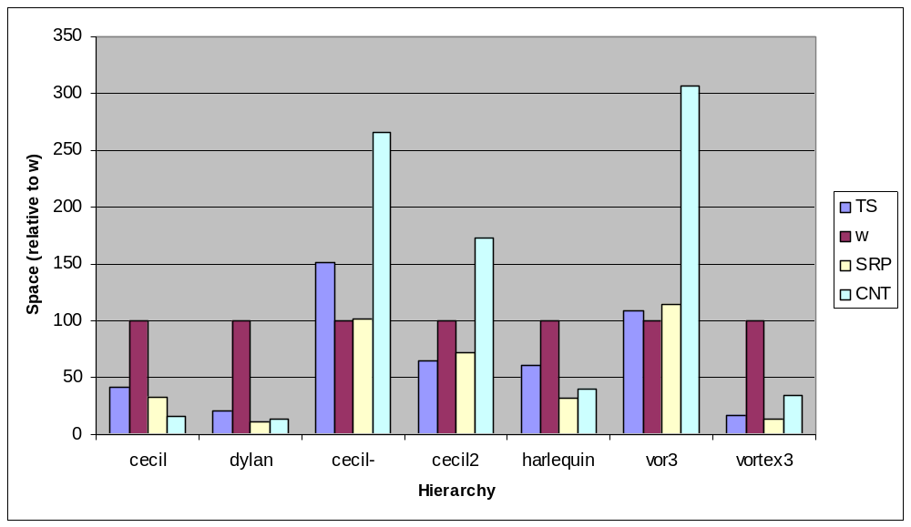
Space: arity 2
Notes:
SRP is better than CNT as the arity increases
Mono-dispatch stage dominates the resolution stage
TS improves over w

Slide 23
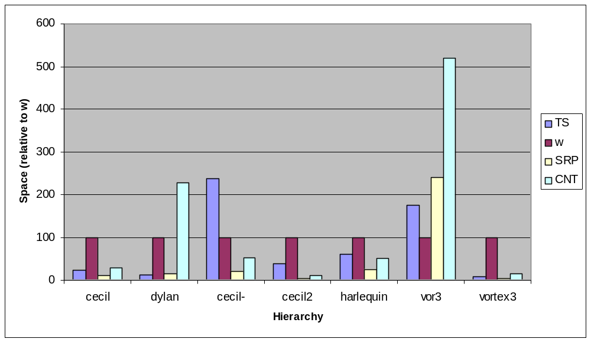
Space: arity 3

Slide 24
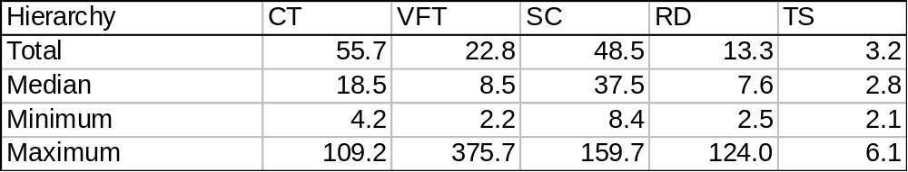
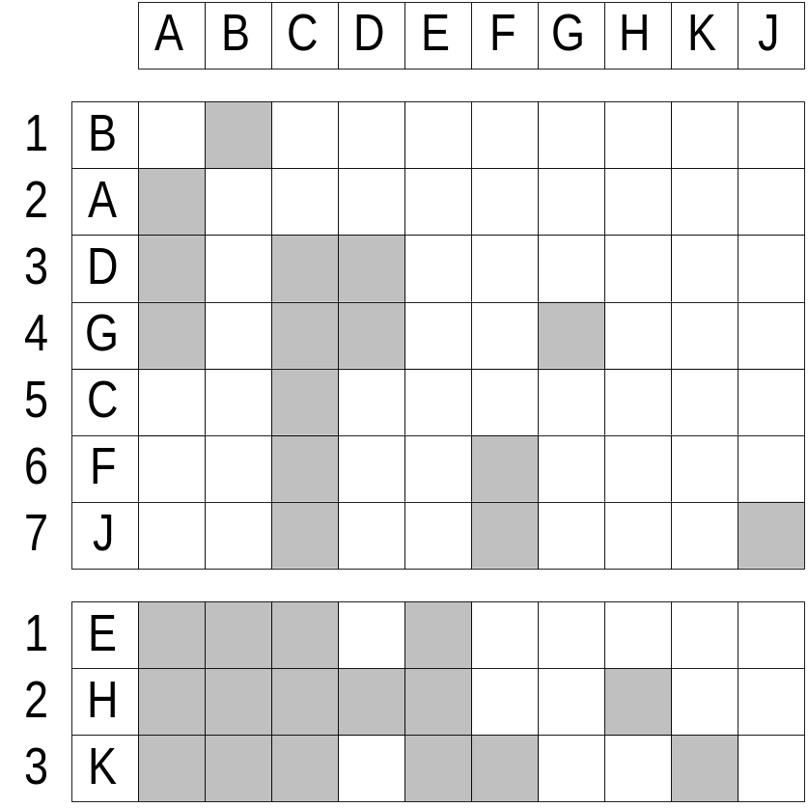
junk
The subtyping matrix
sliced and reordered according to the slicing property

Slide 25
Outline
The dispatching problem
Previous work
Type Slicing
Results
Multiple Dispatching
Conclusions & Future Research
Notes:
The outline of this presentation is as follows:
I will first define the problem of subtyping tests.
Then I will mention some of the prior research.
Then, we have the graph theoretical technique: The PQ tree which is a tree for representing permutations, and how to use it for subtyping.
Next we will present the results.
Finally, I will mention open problems and directions for future research.

Slide 26
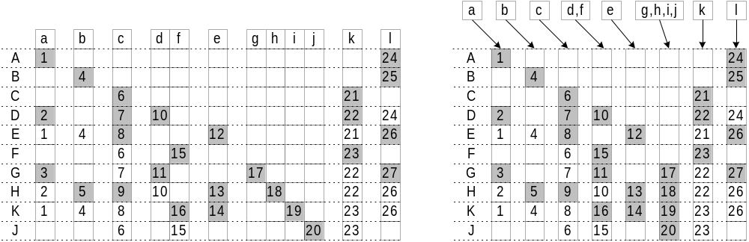
Selector Coloring (SC)
Partition the messages into the smallest number of slices
  Two messages in a slice do not have a type which recognizes both
The eight slices of the dispatching matrix
SC representation

Slide 27
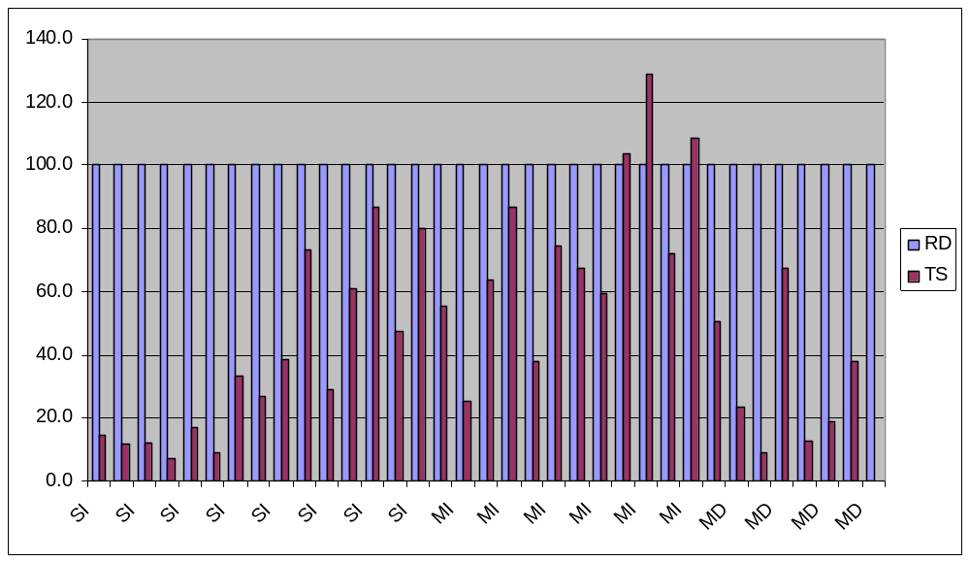
Space: TS vs. RD

Slide 28
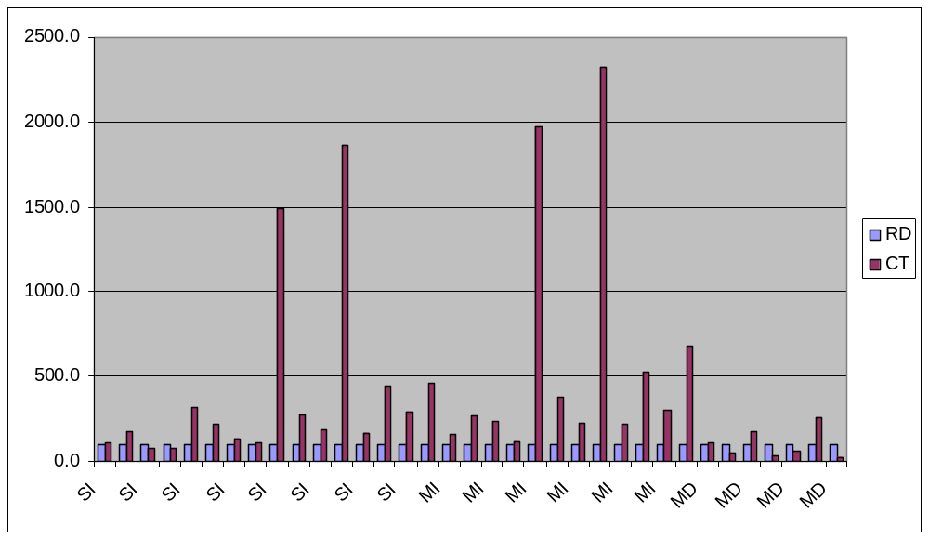
Space: CT vs. RD

Slide 29
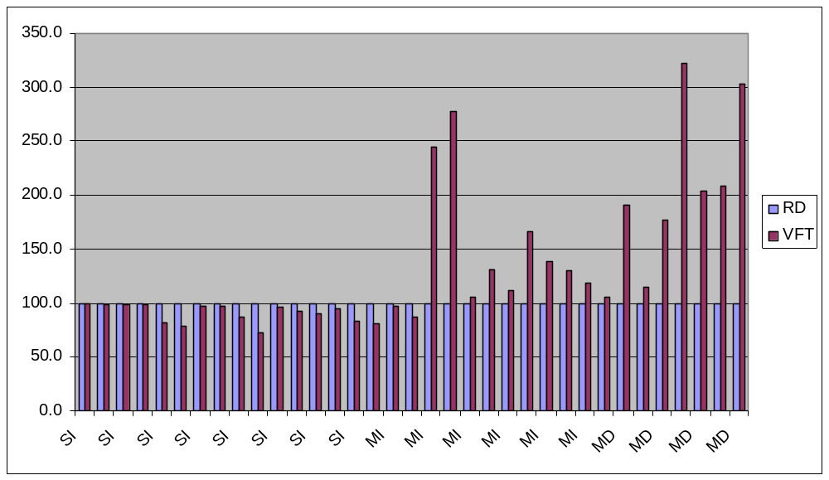
Space: VFT vs. RD

Slide 30
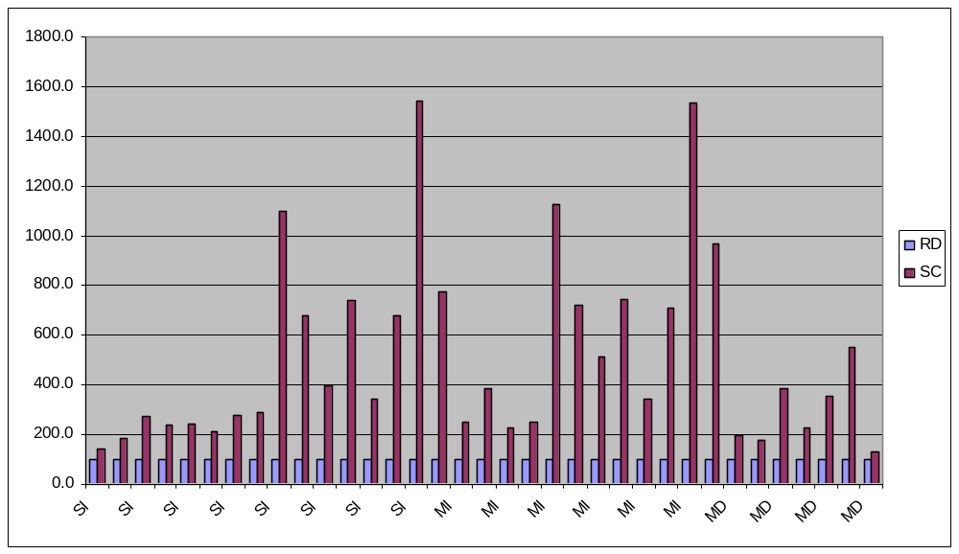
Space: SC vs. RD

Slide 31
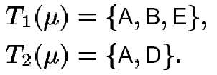
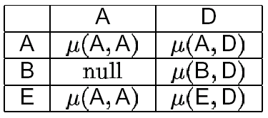
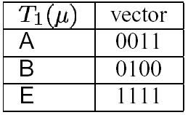
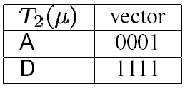
Multiple Dispatching
Dispatching over several arguments
Mono-dispatch stage
Resolution stage
CNT
SRP

Slide 32
Practical techniques: CNT & SRP
Given a call m(a,b)
Mono-dispatch stage
  T1 = L.C.A of all results of m(a,?)
  T2 = L.C.A of all results of m(?,b)
Resolution stage
  SRP
    S1 = all relevant implementation under T1
    S2 = all relevant implementation under T2
    Compute S1∩S2 in a bitvector implementation
  CNT
    Multi-dispatch in T1xT2

Slide 33
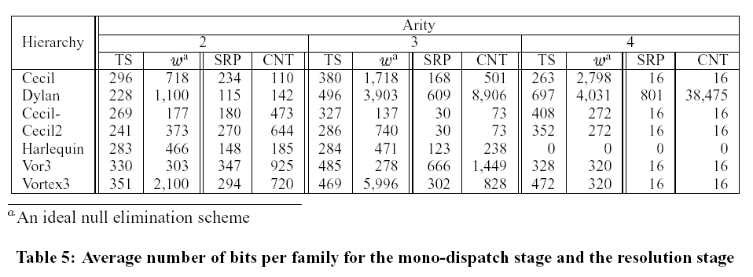
Multiple Dispatching: space required
Mono-dispatch stage: TS vs. optimal null elimination
Resolution stage: SRP vs. CNT

