Slide 1
Incremental Algorithms for Dispatching in
Dynamically Typed Languages
Yoav Zibin
Technion—Israel Institute of Technology
Joint work with: Yossi (Joseph) Gil (Technion)

Slide 2
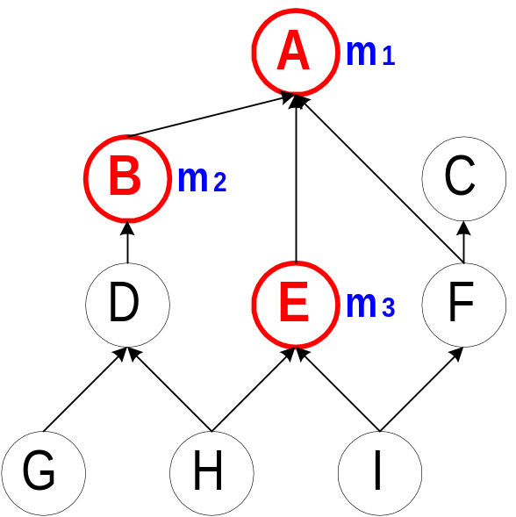
Dispatching (in Object-Oriented Languages)
Object o receives message m
  Depending on the dynamic type of o,
  one implementation of m is invoked
Method family F_{m} = {A,B,E}
Examples:
  Type A → return type A (invoke m₁)
  Type F → return type A (invoke m₁)
  Type G → return type B (invoke m₂)
  Type I → return type E (invoke m₃)
  Type C → Error: message not understood
  Type H → Error: message ambiguous
    Static typing → ensure that these errors never occur
A dispatching query returns a family member or an error message
Notes:
The dispatching problem stands in the heart of OO programming.
…
This is for example the case in C++ virtual functions, or every method call in Java!
On the right we see a hierarchy,
And three implementations of a message m.
If the dynamic type of the object is F, for example, we invoke m1.

Slide 3
The Dispatching Problem and Variations
Encoding of a hierarchy: a data structure representing the hierarchy and the method families which supports dispatching queries.
Metrics: space vs. dispatch query time
Variations
  Single vs. Multiple Inheritance
  Statically vs. Dynamically typed languages
  Batch vs. Incremental
    Batch (e.g., Eiffel)
    the whole hierarchy is given at compile-time
    Incremental (e.g., Java)
    the hierarchy is built at runtime

Slide 4
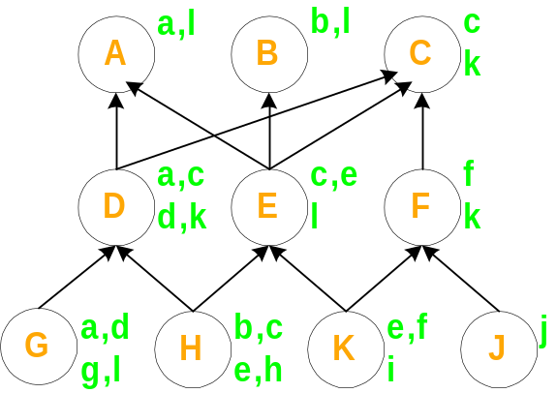
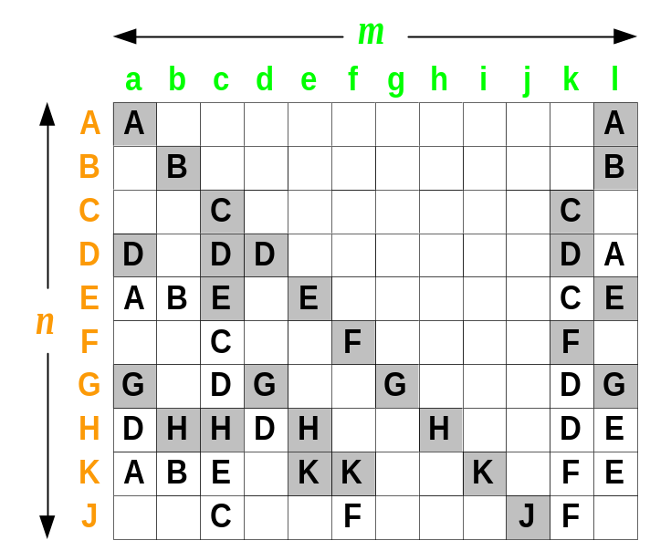


Compressing the Dispatching Matrix
Dispatching matrix
Problem parameters:
  n = # types = 10
  m = # different messages = 12
  = # method implementations = 27
  w = # non-null entries = 46
Duplicates elimination vs. Null elimination
is usually 10 times smaller than w

Slide 5
Previous Work
Null elimination (w)
  Selector Coloring, Row Displacement
  Virtual Function Tables
    Only for statically typed languages
    Not suited for Java’s invokeinterface instruction
    In single inheritance: optimal null elimination
    In multiple inheritance: tightly coupled with C++ object model
Duplicates elimination ( )
  Interval Containment and Type Slicing
    Non-constant dispatch time
  Compact dispatch Tables (CT) [Vitek & Horspool '94, '96]
    Constant dispatch time!
    But what is the space complexity?
Notes:
Selector Coloring [Dixon et al. '89],
Row Displacement [Driesen '93, '95]
We generalize CT into CT_{d} and provide a theoretical foundation

Slide 6
Results
Analysis of the space complexity of CT
Generalize CT into CT_{d}
  CT_{d} performs dispatching in d dereferencing steps,
  while using less space (as d increases)
  CT₁ = Dispatching matrix
  CT₂ = Vitek & Horspool CT
Incremental CT_{d} algorithm in single inheritance
Empirical evaluation
Notes:
(with an analytically found slice size)

Slide 7
Data-set
Large hierarchies used in real life programs
35 hierarchies totaling 63,972 types
  16 single inheritance hierarchies with 29,162 types
  19 multiple inheritance hierarchies with 34,810 types
    Still, greatly resemble trees
  Compression factor of null elimination (w) ≈ 21.6
  Compression factor of duplicates elimination ( ) ≈ 203.7
Notes:
Degenerate (singleton) method families removed
To benchmark different algorithms,
we collected twelve non-tree hierarchies used in real life programs.
This data-set represents an array of large hierarchies drawn from various
Object Oriented Languages, and includes all hierarchies used in previous studies.
Eckel and Gil studied topological properties of those hierarchies
and found that they are similar to those of balanced trees.
This makes it possible to find more efficient encoding for hierarchies used in practice.
The first column of the table is the name of the hierarchy followed by its size,
which ranges between 66 and almost 5500.
The next column is the average number of parents
which is always less than 2.
The average number of ancestors is large,
in Self hierarchy a type has in average almost 30 ancestors!
The next columns are the height of the hierarchy, which is the maximal level,
and log n.
Comparing them shows that the hierarchies are shallow;
their height is similar to that of a balanced binary tree.
The last column shows the relative size of the core.
A type is in the core if it has a descendant with more than one parent.
In most hierarchies the core is rather small, typically less than half the number
of types.
Encoding is easier if the core is considered first,
and the bottom trees of T\T' are
added to the encoding later.
The right figure shows how a typical hierarchy looks like.

Slide 8
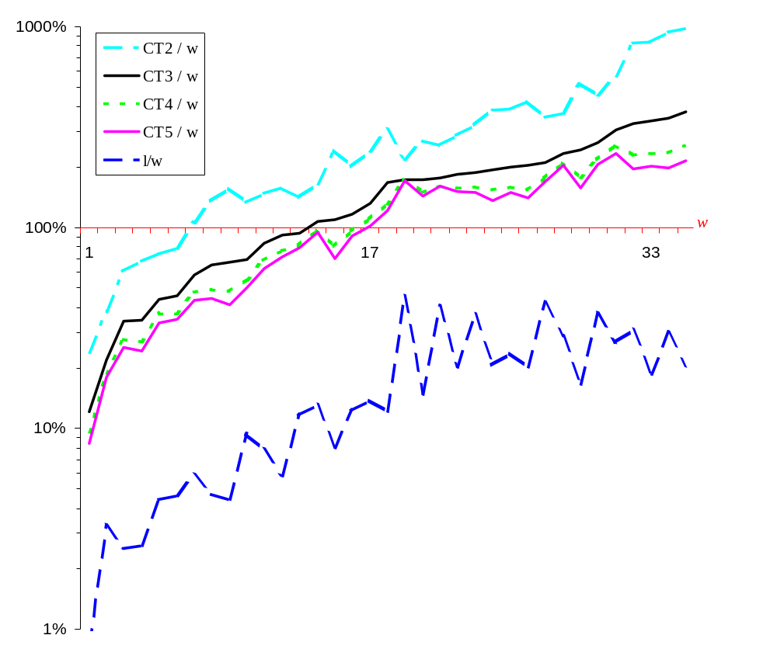

Memory used by CT₂, CT₃, CT₄, CT₅, relative to w in 35 hierarchies
optimal null elimination
optimal duplicates elimination
Notes:
This graph shows the memory used by the different CT techniques relative to W,
that is optimal null elimination.
We measured the memory in 35 different hierarchies.
Observe that we used a logarithmic scale.
Let’s start by comparing duplicates elimination with null elimination.
We see in the first hierarchy that duplicates elimination used
only 1 percent of the memory of used by null elimination,
On average it is 10 time better.
Next, let’s compare CT3 (the black line) with null elimination.
In 14 hierarchies CT3 improves on null elimination, and in the rest 20 hierarchies it performs worse.
Recall that achieving optimal null elimination is quite hard.
Finally let’s compare the CT schemes among themselves.
We see that we can save a lot space by switching form CT2 to CT3.
However, we save less by switching from CT3 to CT4, and much less from CT4 to CT5.
This fact is supported by the theoretical analysis.

Slide 9
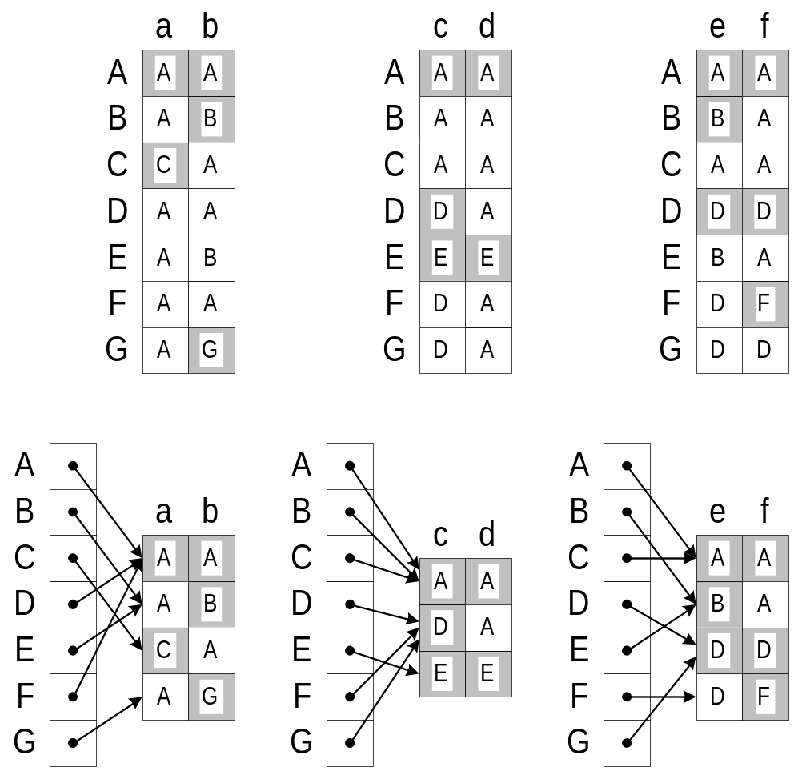
Vitek & Horspool’s CT
Partition the messages
into slices
Merge identical rows
in each chunk
In the example: 2 families per slice
Magically, many many rows are
similar, even if the slice size is 14
(as Vitek and Horspool suggested)
No theoretical analysis

Slide 10
Our Observations
It is no coincidence that rows in a chunk are similar
The optimal slice size can be found analytically
  Instead of the magic number 14
The process can be applied recursively
Details in the next slides

Slide 11
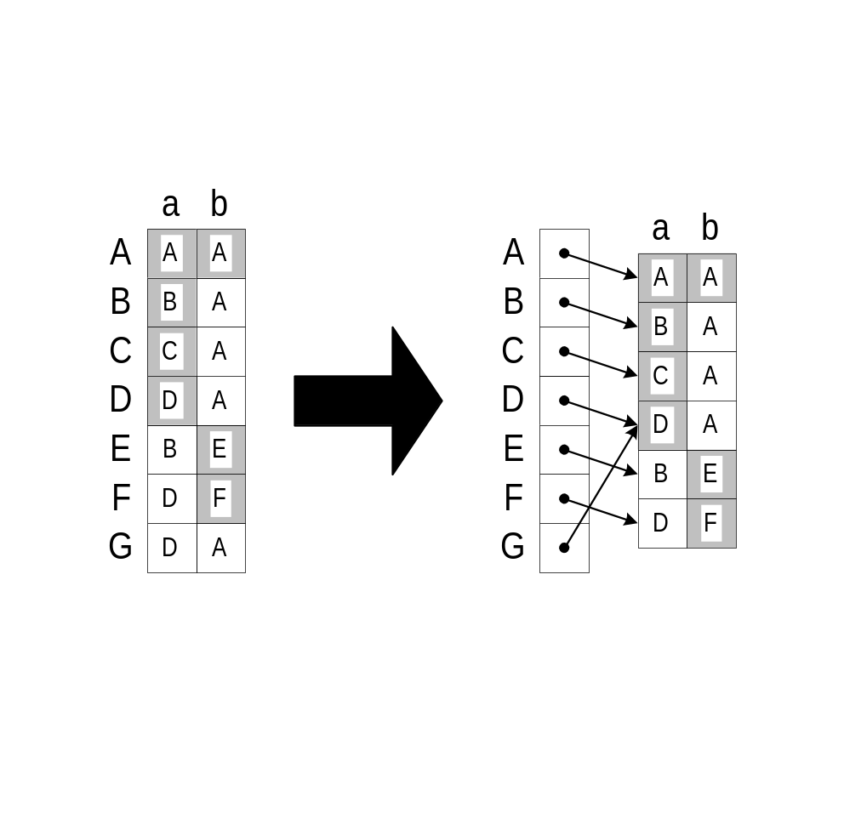
Observation I: rows similarity
Consider two families F_{a}={A,B,C,D}, F_{b} ={A,E,F}
What is the number of distinct rows in a chunk?
  ≤ n_{a} x n_{b} , where n_{a}=|F_{a}| and n_{b}=|F_{b}|
  For a tree (single inheritance) hierarchy: ≤ n_{a} + n_{b}
∇F_{a}
∇F_{b}
∇(F_{a} F_{b} )
A
A
A
B
B
E
E
C
C
D
F
F
D
Notes:
(for multiple inheritance it depends on the topology)

Slide 12
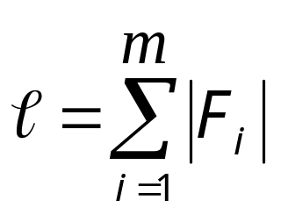

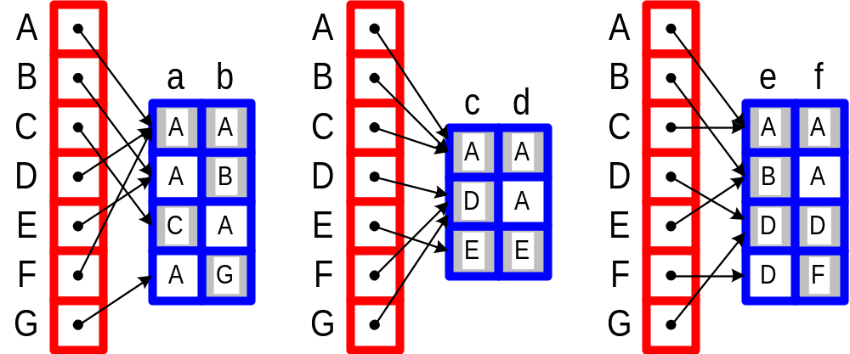
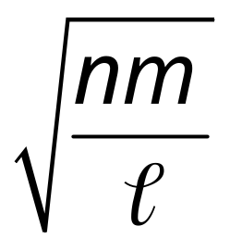
Observation II: finding the slice size
n=#types, m=#messages, = #methods
Let x be slice size. The number of chunks is (m/ x)
Two memory factors:
  Pointers to rows: decrease with x
  Size of chunks: increase with x (fewer rows are similar)
  We bound the size of chunks (using |F_{a}|+|F_{b}| idea):
x_{OPT} =
n(m/x)

Slide 13
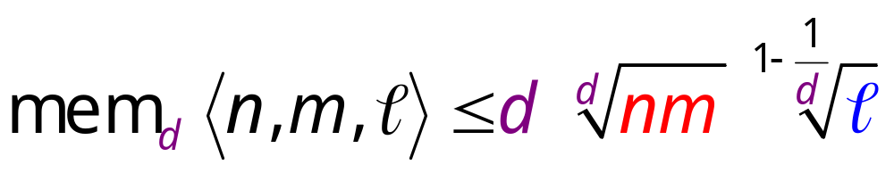
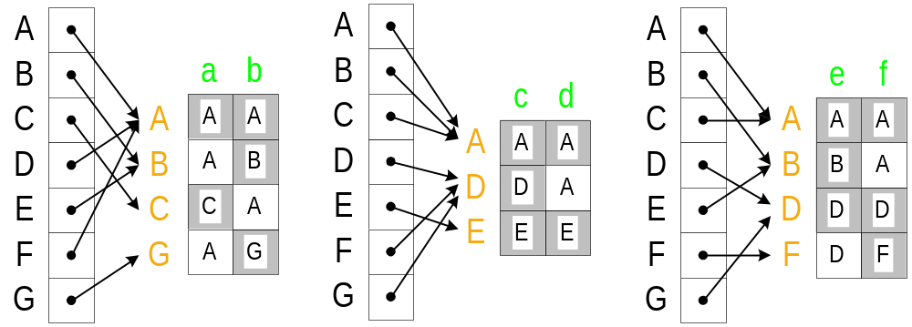
Observation III: recursive application
Each chunk is also a dispatching matrix and can be recursively compressed further

Slide 14
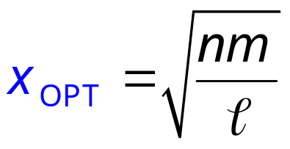
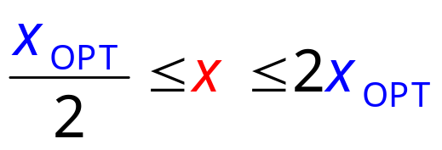
Incremental CT₂
Types are incrementally added as leaves
Techniques:
  Theory suggests a slice size of
  Maintain the invariant:
  Rebuild (from scratch) whenever invariant is violated
  Background copying techniques
  (to avoid stagnation)

Slide 15
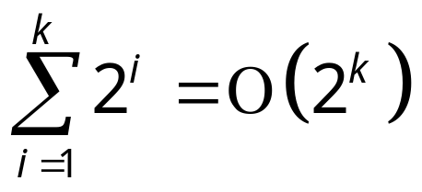

Incremental CT₂ properties
The space of incremental CT₂ is at most twice the space of CT₂
The runtime of incremental CT₂ is linear in the final encoding size
  Idea:
  Similar to a growing vector, whose size always doubles,
  the total work is still linear since
  One of n, m, or always doubles when rebuilding occurs
Easy to generalize from CT₂ to CT_{d}

Slide 16
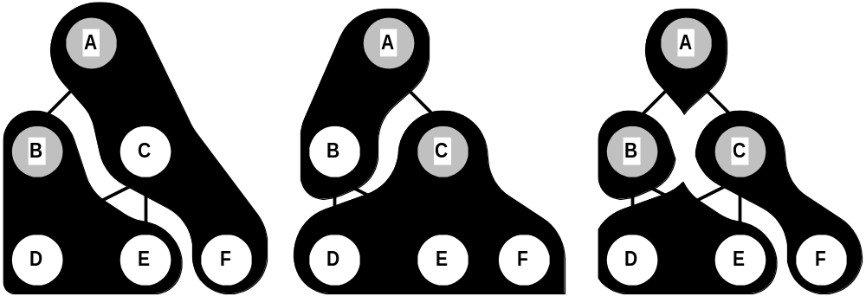
Family Partitionings in Multiple Inheritance
∇F is the partitioning of the hierarchy according to the generalized dispatching results
Lemma: ∇(F ₁  F ₂) = overlay(∇F ₁ , ∇F ₂)
∇{A,B}
∇{A,C}
∇{A,B,C}

Slide 17
Conclusions and Open problems
We gave the first theoretical analysis of space complexity in constant time dispatching techniques
  Both in single- and multiple- inheritance
We described an incremental algorithm for single inheritance which is truly incremental
  i.e., the same complexity as the batch variant
Open Problems
  An incremental algorithm for multiple inheritance
    There are some subtle issues in this generalization
  A real implementation
    Fine tuning many parameters

Slide 18
The End
Any questions?

Slide 19
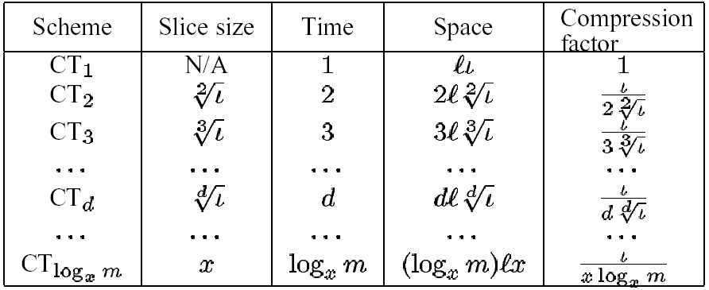

Slide 20
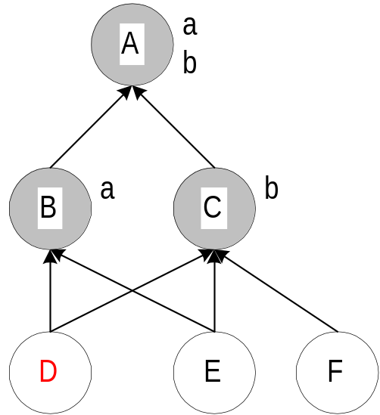
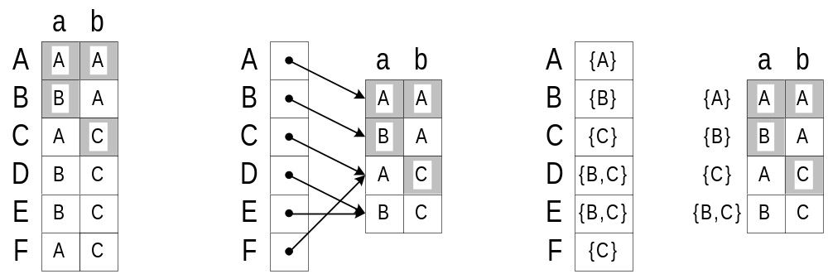
CT in multiple inheritance
Example:
  F_{a} = {A,B}
  F_{b} = {A,C}
  Master-family
  F ' = F_{a} F_{b} = {A,B,C}
  Normal dispatch:
  dispatch(F ',D) = Error: message ambiguous
  Generalize dispatch:
  g-dispatch(F ',D) = {B,C}

Slide 21
CT reduction in multiple inheritance
Same as before:
  Partition the method families into slices of size x
  Create the master-family of each slice
  Solve the problem (recursively) for the master-families
The only difference:
  For each master-family F ' = F₁ …  F_{x} create a matrix of size x |∇F '| for converting the generalized-dispatching results
  In single inheritance: |∇F '| = |F '|
  In multiple inheritance: |∇F '| ≤ 2κ |F '|
  [in the paper]
Conclusion: the space of CT_{d} increases by (2κ)^{1-1/d}

Slide 22
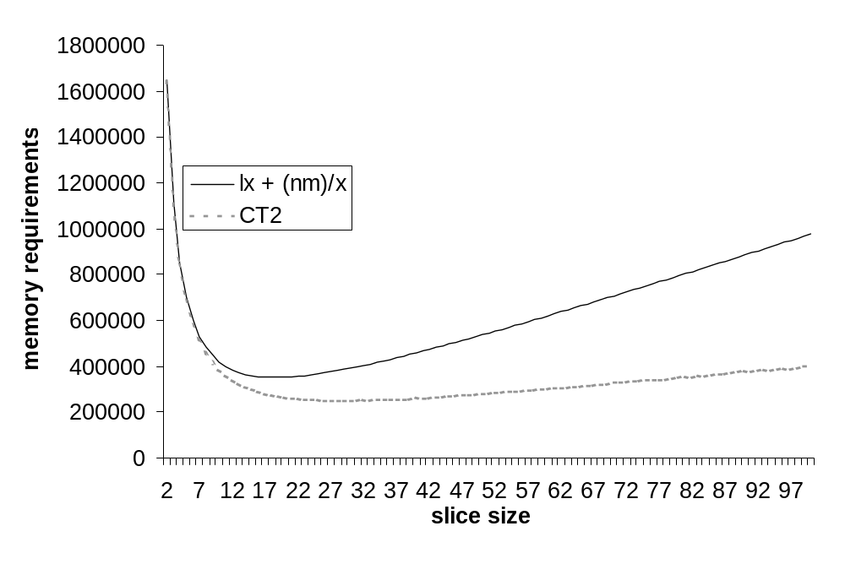
Theory vs. Practice (in Digitalk3)

Slide 23

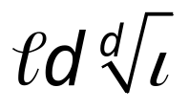
Our Theoretical Results
CT_{d} performs dispatching in d dereferencing steps
  CT₁ = Dispatching matrix
  CT₂ = Vitek & Horspool CT (with slice size= )
Space in single inheritance:
Incremental variant
  Twice the space of CT_{d}
  Insertion time is optimal
Space in multiple inheritance increases
by a factor of (2κ)^{1-1/d}
  κ is a metric of the complexity of the hierarchy topology
  In our data set: Median(κ )=6.5, Average(κ )=7.3
Notes:
Maximum(κ )=19

Slide 24
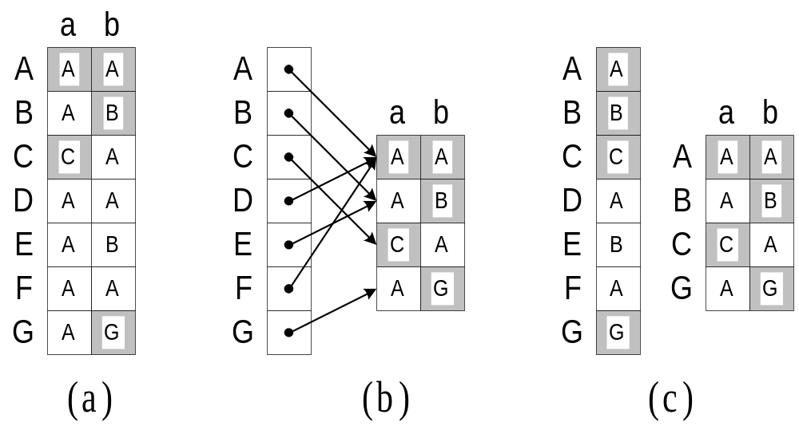
CT in single inheritance
Consider two columns with n_{a} and n_{b} distinct values
What is the number of distinct rows?
  ≤ n_{a} x n_{b}
  However, since the underlying structure is a tree hierarchy:
  ≤ n_{a} + n_{b}
Example:
  F_{a} = {A,C}
  F_{b} = {A,B,G}
  Master-family
  F ' = F_{a} F_{b} =
  {A,B,C,G}
| F ' | ≤ | F_{a} | + | F_{b} |

Slide 25
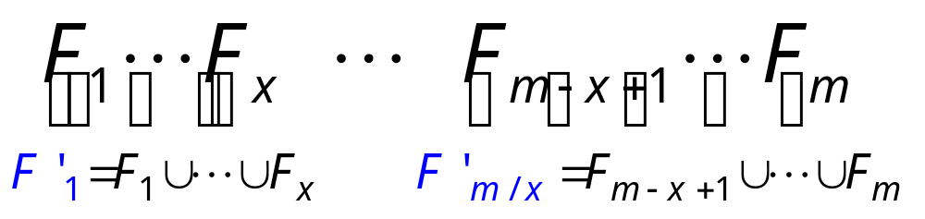
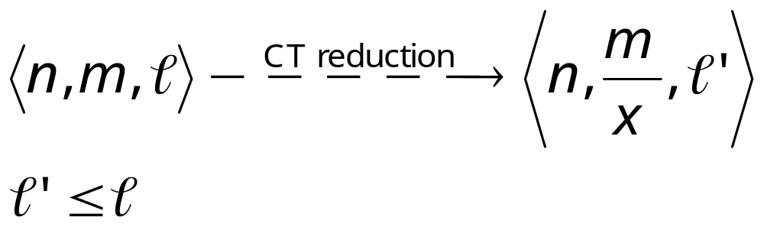

CT reduction
Partition the method families into slices of size x
Create the master-family of each slice
Solve the dispatching problem (recursively) for the master-families
For each master-family F ' = F₁ …  F_{x} create a matrix of size x |F '| for converting the results
(since methods can only “disappear” during the union)
The size of all matrices is

Slide 26

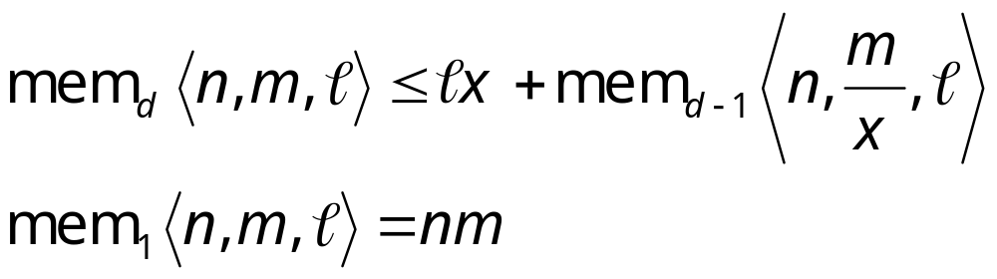
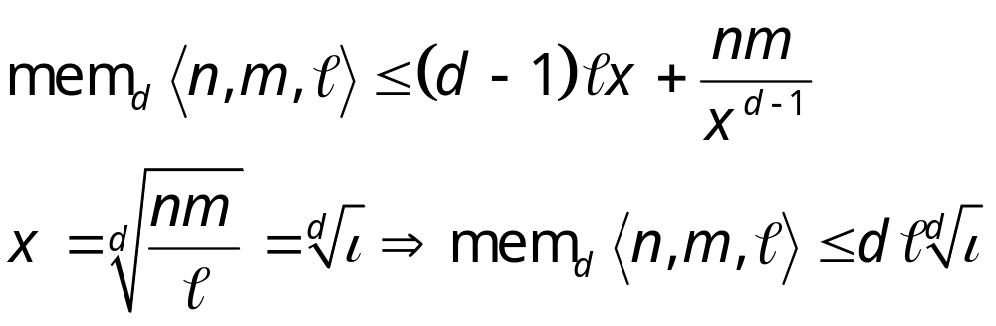
Some math…
The costs of the CT reduction are
  An extra dereferencing step at runtime
  The matrices whose size
Then:
And:

Slide 27
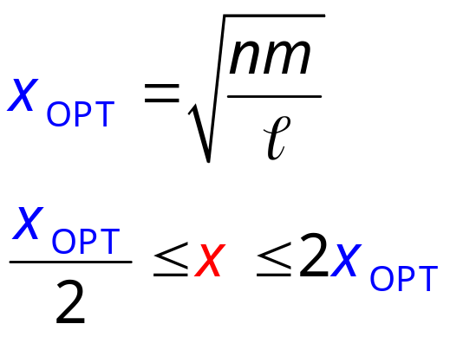
Incremental CT₂ in single inheritance
The matrices created in the CT reduction are dispatching matrices
  “Easy” to maintain a dispatching matrix incrementally
    A new type copies the row of its parent
    Overrides the entries of redefined methods
    Perhaps extends the row to accommodate for new messages
  The cost: an array overflow check
Catch: how to determine x (the slice size)?
Theory suggests:
We maintain:
Otherwise, rebuild everything from scratch!

Slide 28

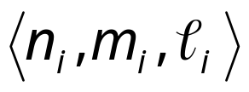

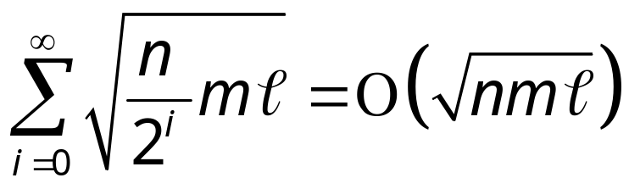
Incremental CT₂ properties
Lemma 1: the space of incremental CT₂ is at most twice the space of CT₂ (which is )
Lemma 2: the runtime of incremental CT₂ is linear in the final encoding size
  Let be the problem parameters when rebuilding for the i^{th} time.
  The cost of the i^{th} rebuilding is
  Lemma 3:
  Lemma 4:
Similar to a growing vector
Easy to generalize from CT₂ to CT_{d}

