Slide 1
Efficient Algorithms for
Isomorphisms of Simple Types
Yoav Zibin
Technion—Israel Institute of Technology
Joint work with:
Joseph (Yossi) Gil (Technion)
Jeffrey Considine (Boston University)

Slide 2
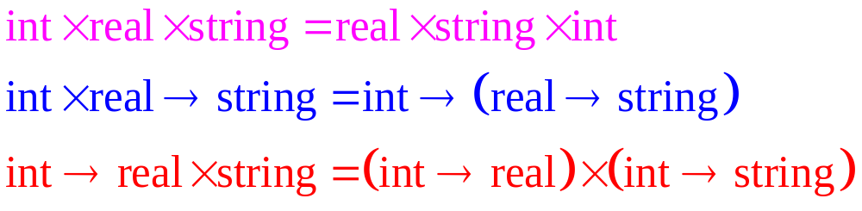
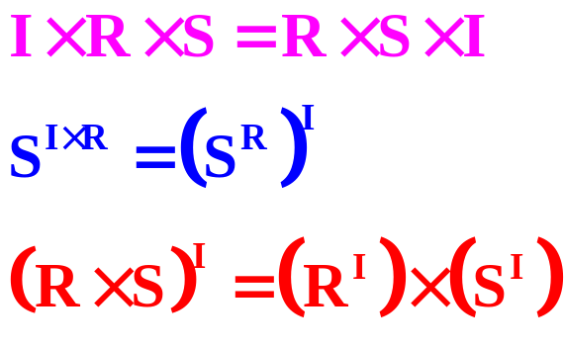
Type Isomorphism
Two types are isomorphic iff there is a one-to-one mapping between their values, for example
Easier to grasp in arithmetical notation
(Associative & Commutative)
(Currying)
(Distributive)

Slide 3
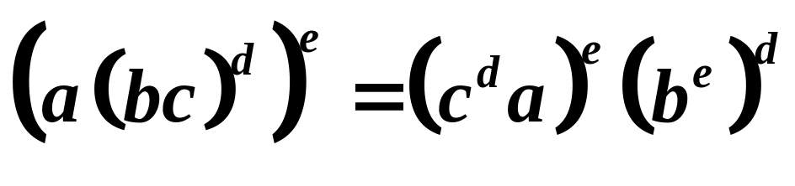
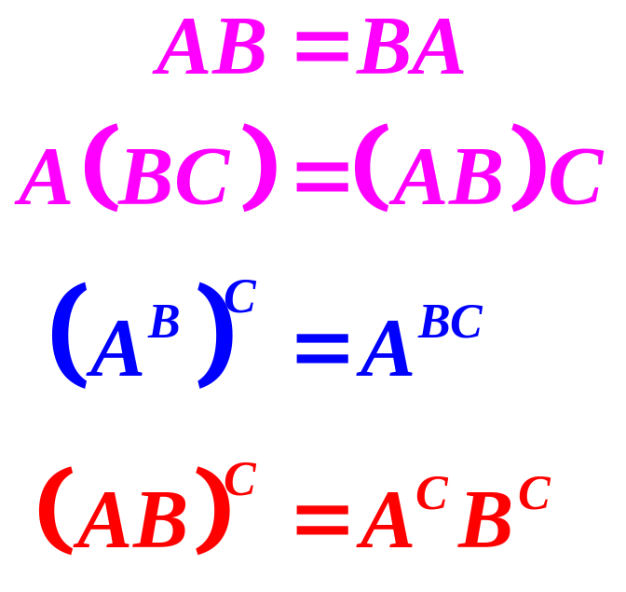
First Order Ishomorphism
Tarski’s High-School Algebra Problem [1951]:
The following axioms
are complete if the
expressions involve
only products and
exponentiations
[Soloviev’83]
?

Slide 4
The problem and Our results
Input: two types of size ≤ n, given as expression trees
Output: are the types isomorphic?
Key idea: solve the problem for all sub-expressions of the two types
  Input: a collection of types whose total size ≤ n
  Output: a partitioning into equivalence classes
Variant | time | space
First order isomorphism | n² log n ⇒ n log² n | n² ⇒ n
Linear isomorphism (without the distributive axiom ) | n log n ⇒ n | n ⇒ n

Slide 5
Practical Motivation
Search for a function in a large library,
using its type as a key
  Functions with isomorphic types are returned
Example (using second order isomorphism)
  We only deal with first order isomorphism
Language | Name | Type
ML of Edinburgh CAML | itlist list_it | (`a→`b→`b)→`a list→`b→`b
Haskell | foldl | (`b→`a→`b)→`b→`a list→`b
SML of New Jersey | fold | (`a × `b→`b)→`a list→`b→`b
The Edinburgh SML Library | fold_left | (`a × `b→`b)→`b→`a list→`b

Slide 6
Linear Isomorphism
Without the distributive axiom
Essence of previous algorithms
  Stage 1: bring types to a normal form
  Stage 2: sort the terms of product types
  Stage 3: compare the resulting structures
Our Observation: Sorting ⇒ Multi-set equality
Time: O(n log n) ⇒ O(n)
Example:
  abracadabra = carrabadaba
  Sorting: aaaaabbcdrr
  Multi-set equality: [in the paper]
?

Slide 7
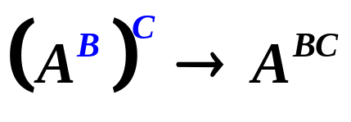
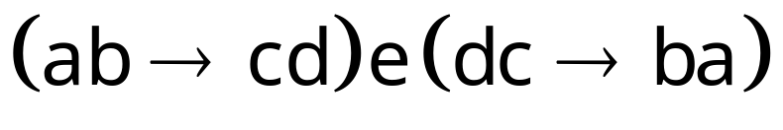
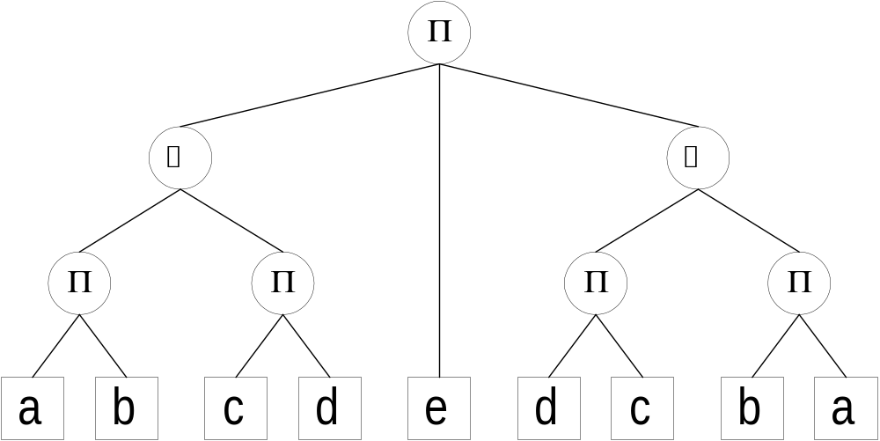
Our Normal form for Linear Isomorphism
Exhaustively apply the rule
  The representation remains linear
Alternating products-functions

Slide 8
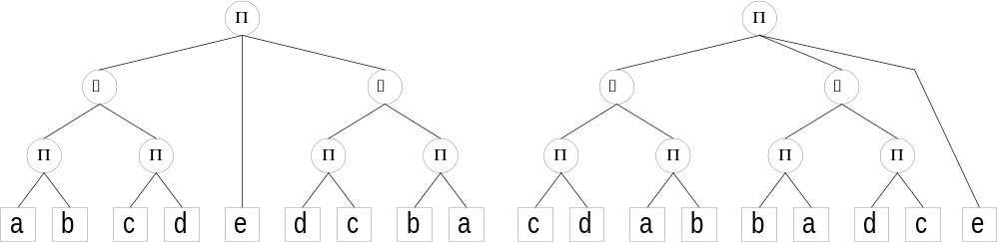
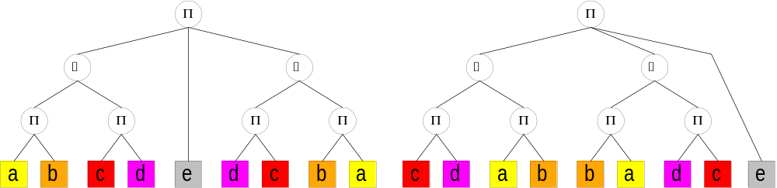
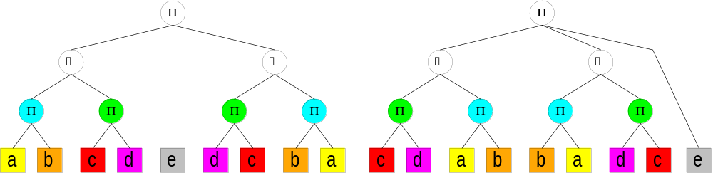
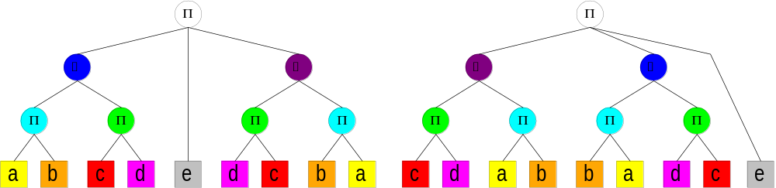

Comparing normal forms
Iterate by height
For height=0: partition primitive types
For odd heights: partition products (as multi-sets)
For even heights: partition functions (as ordered pairs)
The types are isomorphic

Slide 9
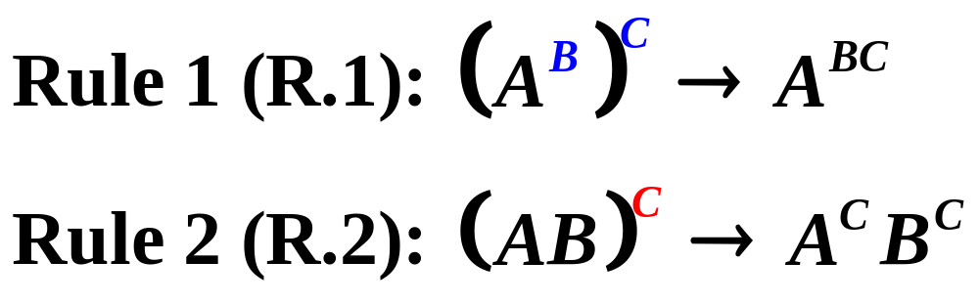
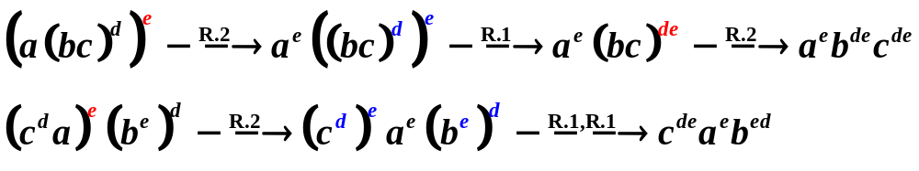
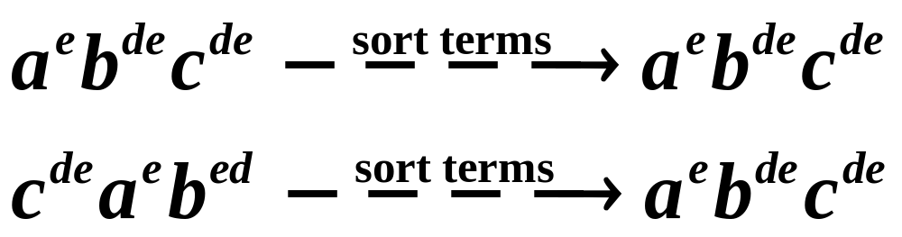
Back to First Order Isomorphism
Exhaustively apply :
Recursively sort the terms of each product
The equality is true

Slide 10

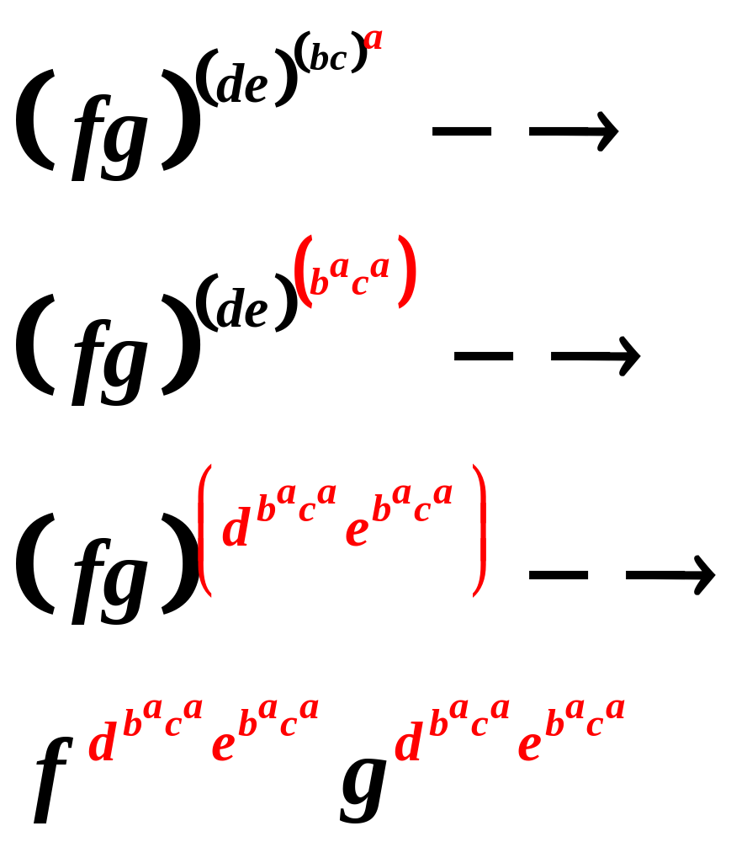
Catch: exponential blowup
Due to the distributive law:
The “C ” sub-expression is duplicated

Slide 11
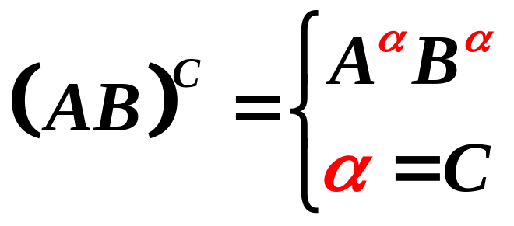
Expression Tree → Graph
Apply instead the “sharing” rule:
The resulting graph is a directed acyclic graph (DAG)
Could still lead to O(n²) space [Next Slide]
  This rule increase the representation by a constant
  It can be applied at most n² times
The “C ” sub-expression is shared

Slide 12
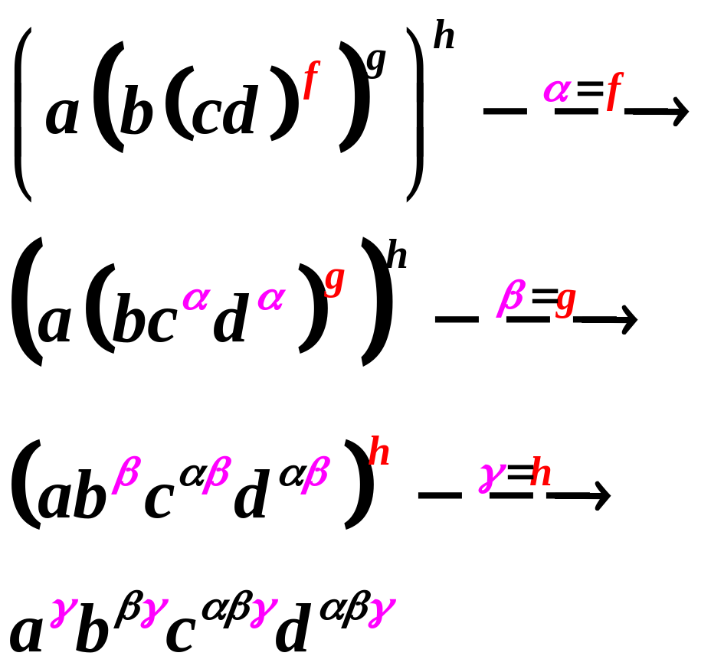
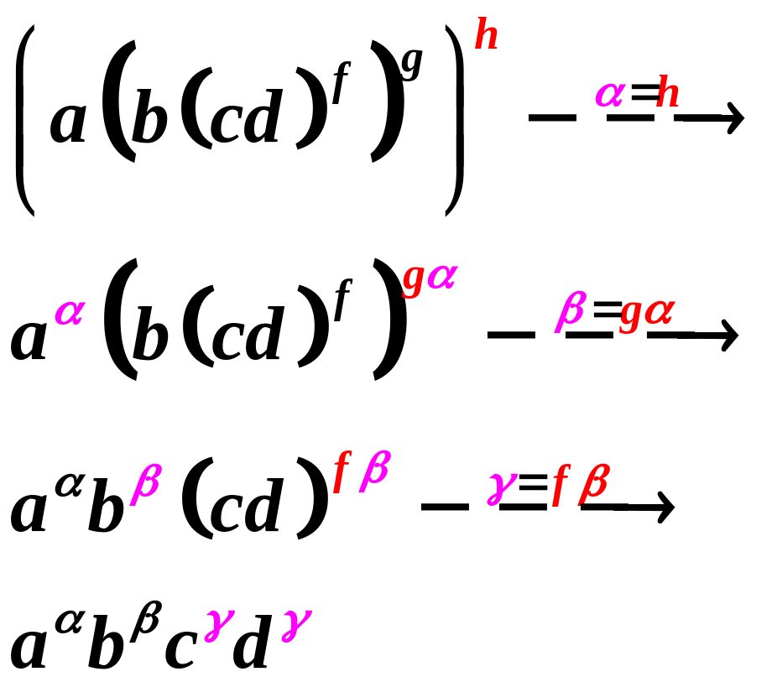
Our observation
Exhaustively apply the sharing rule,
with the “outer-most” opportunity first
inner-most 1st: O(n² ) space
outer-most 1st: O(n) space

Slide 13
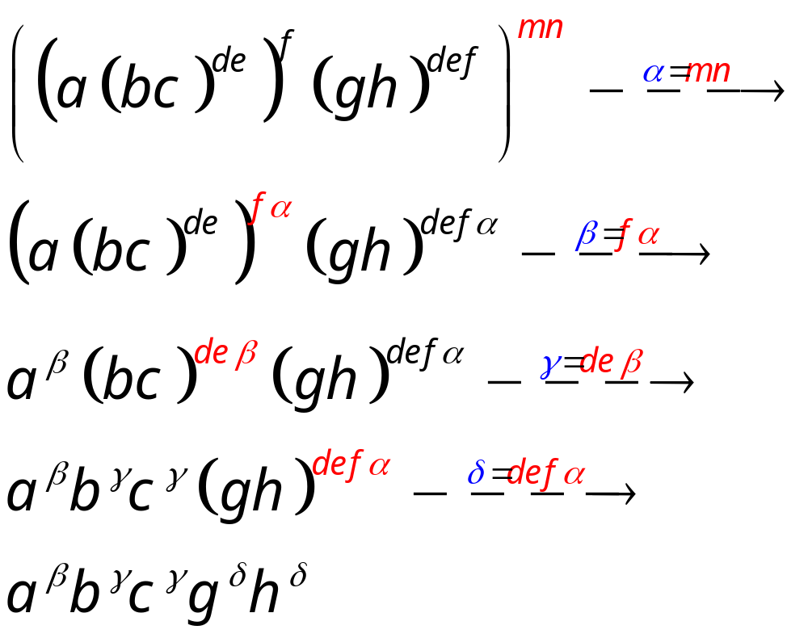
Sharing of terms in products
Sharing forest
γ
d e
β
δ
f
α
d e f
m n

Slide 14
Sharing (cont.)
Products have 3 kinds of terms
  Primitive types: a, b, c, …
  Exponents: X^{Y}
  Shared products: α, β, γ, δ, ε, μ, χ, η, …
Catch question: how to discover that γ and δ are isomorphic?
Naïve solution:
  Calculate the inherited terms
  i-terms(γ)= i-terms(δ)={d,e,f,m,n}
  Requires O(n²) time and space
Tree Partitioning [next slides]
  Requires O(n log² n) time
  and O(n) space
Sharing forest
γ
d e
β
δ
f
α
d e f
m n

Slide 15
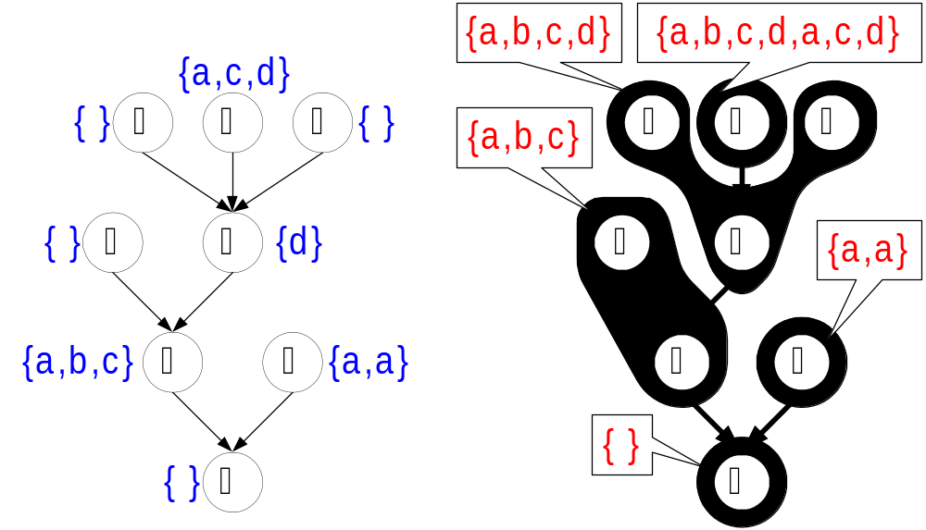
Tree Partitioning
Input: a tree  , and a multi-set terms(v)
for each node v ∈ 
Output: a partitioning of the nodes according to the inherited multi-sets i-terms(v)
terms(η) = {d}
i-terms(η) = {a,b,c,d}

Slide 16
Dual representation
Multi-sets of nodes (products) in which the value (term) occurs
terms(α) = {}
terms(β) = {a,b,c}
terms(γ) = {}
terms(η) = {d}
terms(ε) = {}
terms(μ) = {a,c,d}
terms(χ) = {}
terms(δ) = {a,a}
F_{a} = { β,μ,δ,δ}
F_{b} = { β}
F_{c} = { β,μ}
F_{d} = { η,μ}

Slide 17
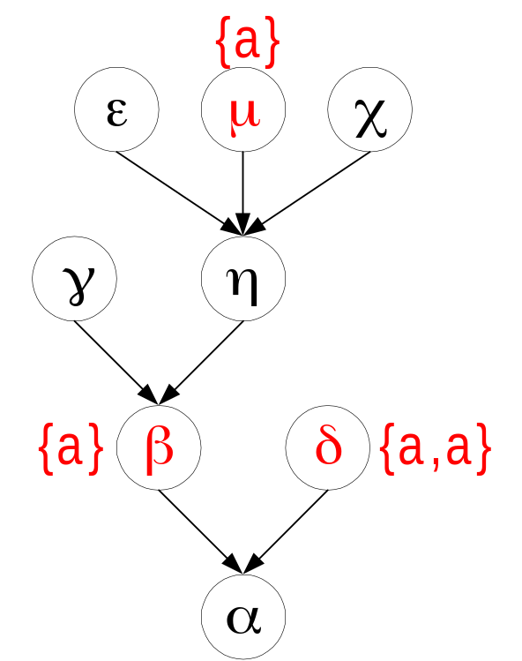
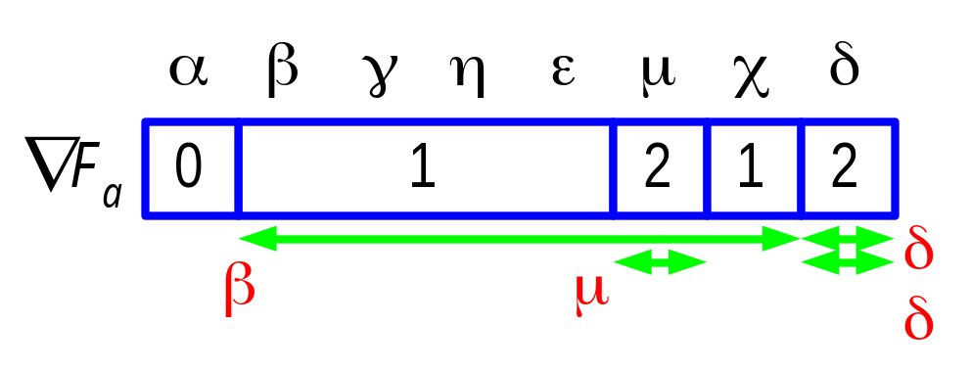
Efficient representation of families
Find a preorder of the tree
  Descendants of a node define an interval
A family F defines |F | intervals,
which partition the preorder
into at most 2|F |+1 segments
Example:
  F_{a} = { β,μ,δ,δ}

Slide 18
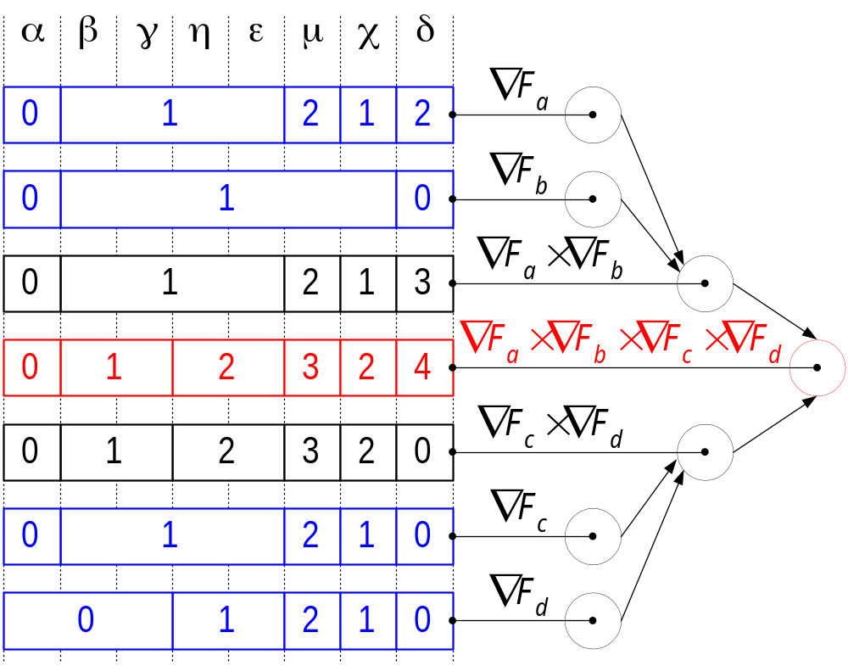
Intersecting all partitions
A solution for the Tree Partitioning problem

Slide 19
Open problems
Our algorithms runs in O(n log² n) time
  Reduce this time
  Obtain lower bounds
Search for a linear-time random algorithm
Our algorithm assumed the input type is represented as an expression tree
  Generalize our algorithm for a DAG representation
A subtyping algorithm

Slide 20
The End
Any questions?

