Slide 1
Efficient Algorithms for the Runtime Environment of Object Oriented Languages
Yoav Zibin
Technion—Israel Institute of Technology
Advisor: Joseph (Yossi) Gil
Notes:
Hi.
My name is Yoav Zibin.
I’m from the Technion …
My PhD advisor is …
I’m scheduled to complete my PhD this year.
My thesis is finding efficient algorithms for the …

Slide 2
OO Runtime Environment
Tasks
  Subtyping Tests
  Single Dispatching
  Multiple Dispatching
  Field Access (Object Layout)
Variations
  Single vs. Multiple Inheritance (SI vs. MI)
  Statically vs. Dynamically typed languages
  Batch vs. Incremental
Notes:
Type hierarchy H=(T,≺)
Type Conformance, Inclusion Polymorphism
Batch (e.g., Eiffel)
the whole hierarchy is given at compile-time
Incremental (e.g., Java)
the hierarchy is built at runtime

Slide 3
Results (1/2)
Subtyping Tests
[OOPSLA’01 and accepted to TOPLAS]
  “Efficient Subtyping Tests with PQ-Encoding”
  Constant time subtyping tests with best space requirements
Single and Multiple Dispatching
[OOPSLA’02]
  “Fast Algorithm for Creating Space Efficient Dispatching Tables with Application to Multi-Dispatching”
  Logarithmic dispatch time & almost linear space
Single Dispatching
[POPL’03]
  “Incremental Algorithms for Dispatching in Dynamically Typed Languages”
  Constant dispatch time: more dereferencing ⇒ less memory

Slide 4
Results (2/2)
Object Layout
[ECOOP’03 and being extended to TOPLAS]
  “Two-Dimensional Bi-Directional Object Layout”
  No this-adjustment, no compiler generated fields, and favorable field-access time
A surprising application of the techniques
[POPL’03 and accepted to MSCS]
  “Efficient Algorithms for Isomorphism of Simple Types”
  For linear isomorphism: n log n ⇒ n
  For first-order isomorphism: n² log n ⇒ n log² n

Slide 5
Task #1/4: Subtyping tests
Explicit
  Java’s instanceof
  Smalltalk’s isKindOf:
Implicit
  Casting
    Eiffel’s ?=
    C++’s dynamic_cast
  Exception handling (in Java)
  Array stores (in Java)
    void f(Shape[] x) { x[1] = new Circle(); }
    f( new Polygon[3] );
With genericity (in Eiffel)
  Queue[Rectangle] is a subtype of Queue[Polygon]

Slide 6
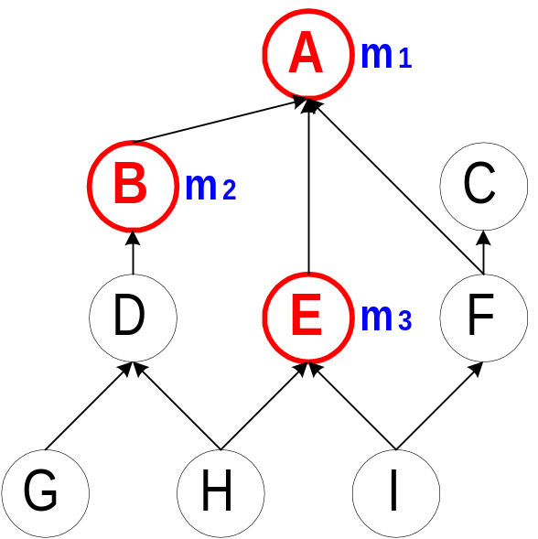
Task #2/4: Single Dispatching
Object o receives message m
  Depending on the dynamic type of o,
  one implementation of m is invoked
Examples:
  Type A → invoke m₁ (type A)
  Type F → invoke m₁ (type A)
  Type G → invoke m₂ (type B)
  Type I → invoke m₃ (type E)
  Type C → Error: message not understood
  Type H → Error: message ambiguous
    Static typing → ensure that these errors never occur
Method family F_{m} = {A,B,E}
A dispatching query returns a type

Slide 7
Task #3/4: Multiple Dispatching
Dispatching over several arguments
Found in many new generation OO languages
  PolyGlot, Kea, CommonLoops, CLOS, Cecil, Dylan
Example: drawing a shape onto some device
  Dispatching both on shape and device
Visitor Pattern
  Emulating multiple-dispatching in single-dispatching languages
  Many draw backs:
    Tedious to the programmer, thus error-prone
    Not as expressive as multiple-dispatching
Let the compiler do it!
Notes:
Different devices ⇒ different drawing methods

Slide 8
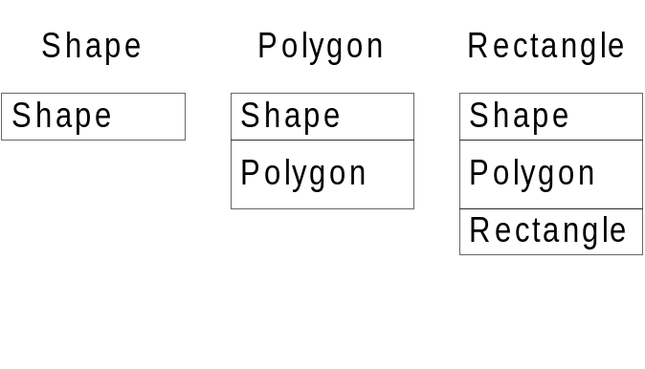
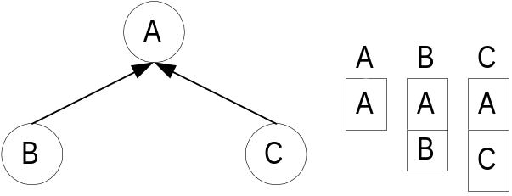
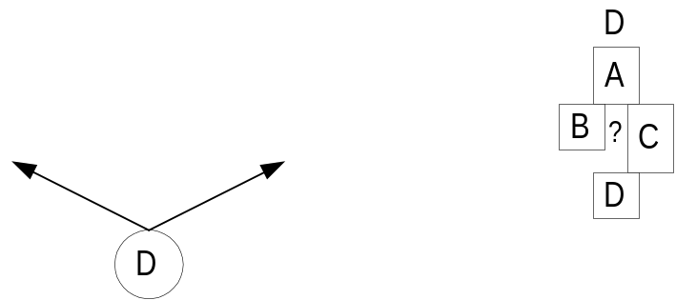
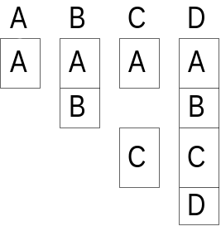
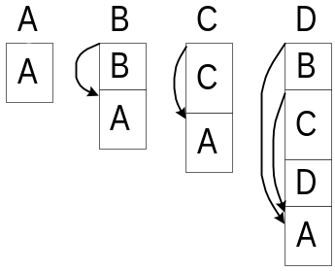
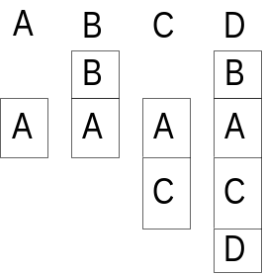
Task #4/4: Object Layout
The memory layout of the object’s fields
How to access a field if the dynamic type is unknown?
  Layout of a type must be “compatible” with that of its supertypes
  Easy for SI hierarchies
    The new fields are added
    at the end of the layout
_{Layout in SI}
  Hard for MI hierarchies
_{The difficulty in MI}
_{Leave holes}
_{C++ layout}
_{BiDirectional layout}

Slide 9
The SI/MI observation
Most problems are easy in SI
  Linear space, good query time, incremental
Subtyping tests
  Schubert’s numbering: constant time
  Can be incremental using ordered list (same bounds)
Single Dispatching
  Interval containment: logarithmic dispatch time
Object layout
  Fields are assigned constant offsets
MI is not a general directed acyclic graph (DAG)
Similar to several trees juxtaposed

Slide 10
The SI/MI observation: Data Set
Large hierarchies used in real life programs
Taken from ten different programming languages
Subtyping Tests
  13 MI hierarchies totaling 18,500 types
Dispatching
  35 hierarchies totaling 63,972 types
    16 SI hierarchies with 29,162 types
    12 MI hierarchies with 27,728 types
    7 multiple-dispatch hierarchies with 7,082 types
Object Layout
  28 MI hierarchies with 49,379 types
Notes:
No runtime measurements
No degenerate method families
v/u ≈ 1.1 , 1/5 ≤ v/u ≤ 2

Slide 11
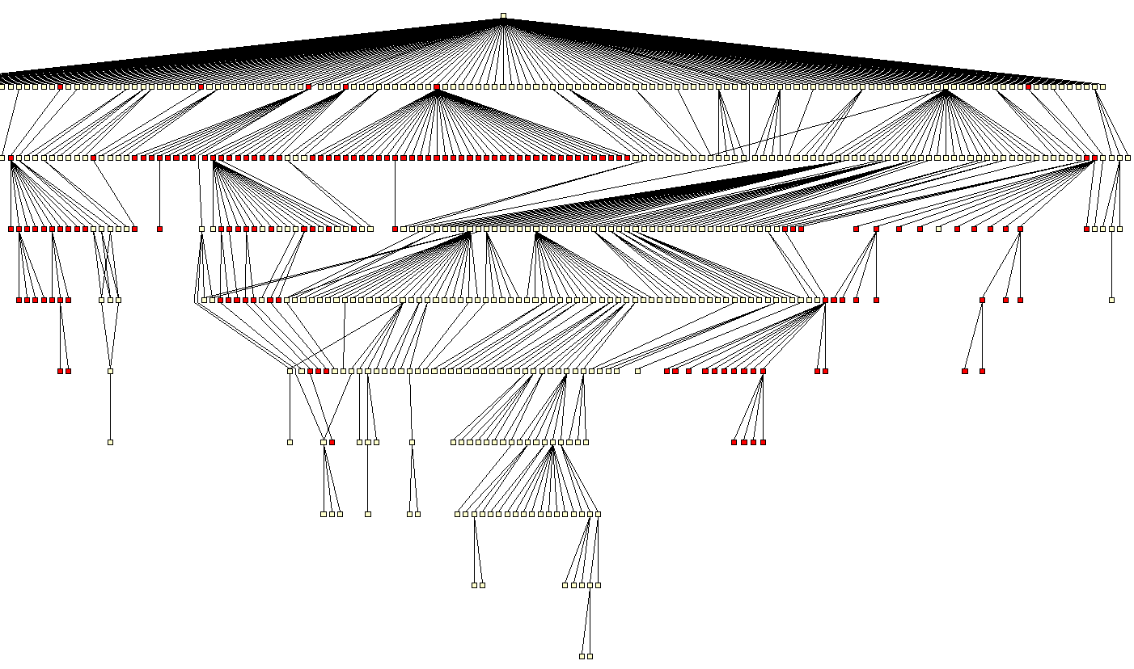
The SI/MI observation:
Unidraw, 614 types, slightly MI hierarchy
Notes:
הררכיה זו נלקחה מאפליקציה שנכתבה ב-
C++
האפליקציה משתמשת קצת במנגנון הירושה המרובה.
בהיררכיה זו ניתן לראות שהנקודות האדומות מרוכזות ביחד.
זוהי הסיבה שטבלת הפונקציות הוירטואליות עובדת בצורה כה טובה.

Slide 12
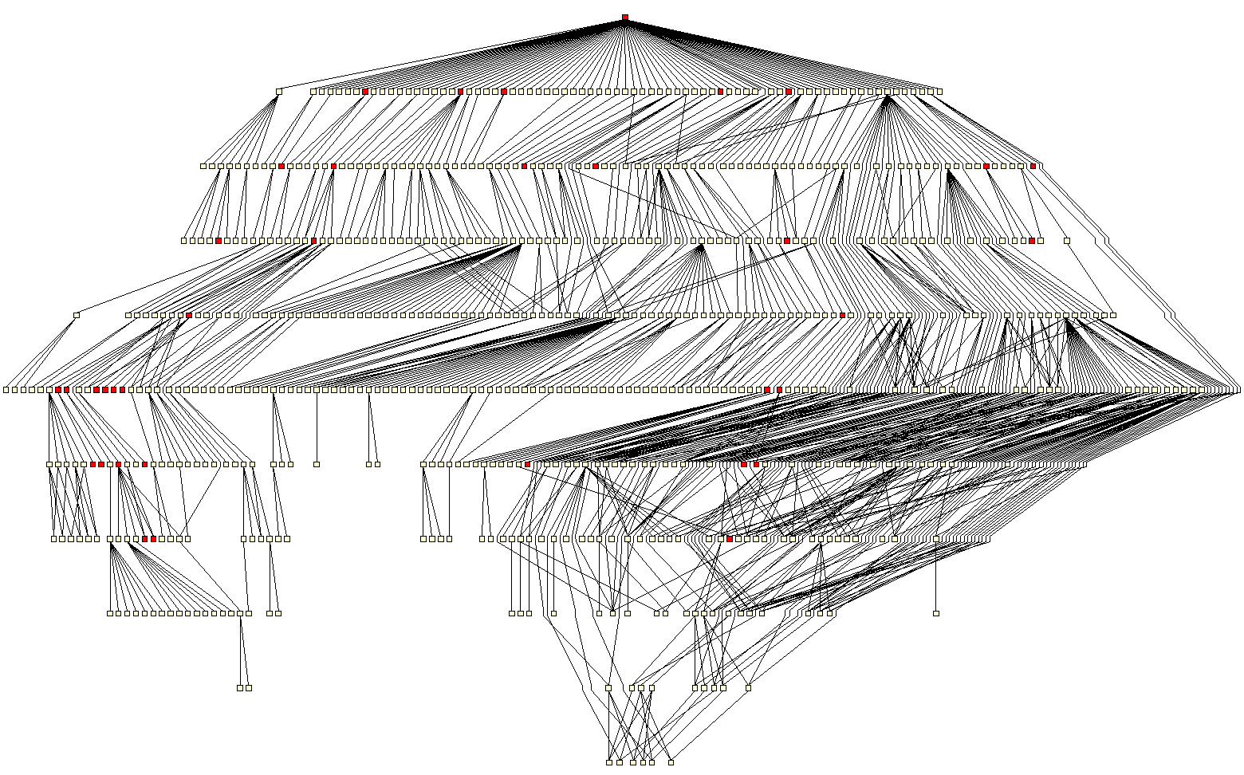
The SI/MI observation:
Harlequin, 666 types, heavily MI hierarchy

Slide 13
New Techniques
Slicing the hierarchy into “SI” components
Re-ordering of nodes
  PQ trees, order-preserving heuristic
Intervals, segments, partitionings
Overlaying / Intersecting partitionings
Dual representation
List algorithms for incremental computation

Slide 14
E.g., Task #2: Single Dispatching
Encoding of a hierarchy: a data structure which supports dispatching queries.
Metrics:
  Space requirement of the data structure
  Dispatch query time
  Creation time of the encoding
Our results in OOPSLA’02:
  Space: superior to all previous algorithms
  Dispatch time: small, but not constant
  Creation time: almost linear
Our results in POPL’03: (if time permits…)
  Dispatch time: a chosen number of dereferencing d
  Space: depends on d (first proven theoretical bounds)
  Creation time: linear
Notes:
Incremental variant described in the journal version
The dispatching problem is building an encoding of hierarchy.
That means a data structure …
We measure the quality of different algorithms
according to three metrics:…
I will now briefly state our results.
The space requirement of our data structure is …
However, the dispatch query time is …
Finally, the creation time is …

Slide 15
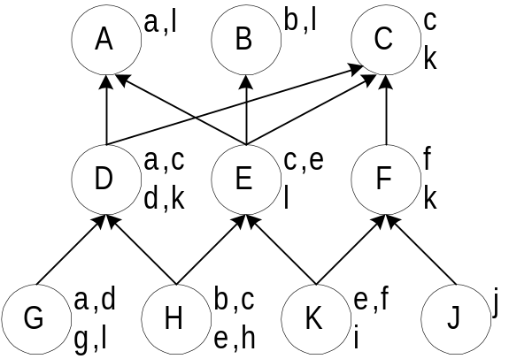
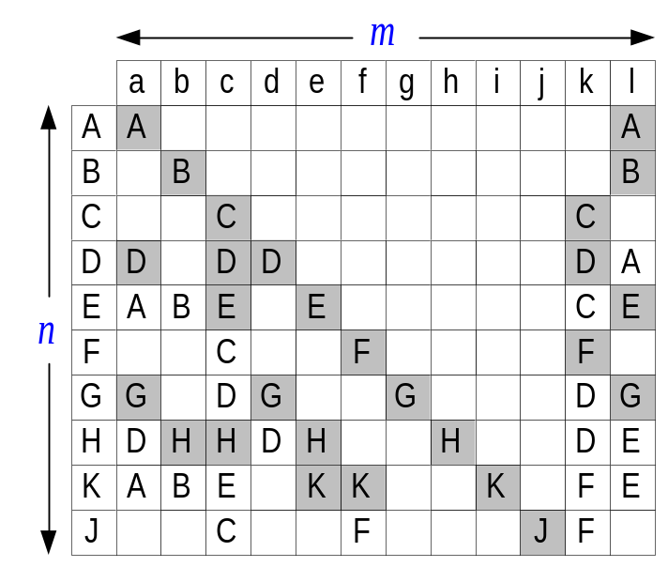
Compressing the Dispatching Matrix
Dispatching matrix
Problem parameters:
  n = # types = 10
  m = # different messages = 12
  l = # method implementations = 27
  w = # non-null entries = 46
Duplicates elimination vs. Null elimination
l is usually 10 times smaller than w
Notes:
The most obvious solution to the dispatching problem is
building a dispatching matrix.
The matrix stores the outcomes of all possible dispatching queries.
The rows correspond to types,
and the columns to messages.
For example, the result of dispatching on type E and message a is type A.
An empty cell in the matrix means the type doesn’t understand the message.
For example, type B and message a is type A.
in a~$\nTypes \times \nMessages$
dispatching matrix, storing the outcomes of all possible dispatching queries.
In the matrix representation queries are answered by a quick indexing operation.
However, the space consumption is inhibitivly large, e.g.,~512MB for the dispatching matrix
in the largest hierarchy in our benchmarks (8,793 types and~14,575 messages).
Null elimination can be achieved by storing each column as a sorted dictionary, i.e.,
a sorted array of (key,value)-pairs.
In this implementation, the query time is logarithmic in the number of non-null
entries in each column. Space is linear in this number.
Dynamic perfect hashing is theoretically
better than sorted dictionaries.
In this algorithm each column (or the entire matrix for that matter)
is stored as a hash table.
Indices (or their concatenation) serve as keys.
The space requirement is linear in~$\nNonNull$.
More importantly, query time is constant!
The more sophisticated previously published practical algorithms, try, and in most cases achieve
complete, or almost complete null elimination with no hidden constants and constant search time.
It is not difficult to come close to full duplicates elimination,
with a simple representation of the hierarchy as a graph where types are
nodes and immediate inheritance relations are edges.
The cost is of course the search time, which becomes~$O(\nTypes)$
Our challenge in this paper is therefore to come as close as possible to
optimal duplicates elimination, i.e.,
space linear in the number of implementations~$\nMethods$, while still maintaining small,
preferably constant, query time.

Slide 16
Previous Work
Null elimination
  Virtual Function Tables (VFT)
    Only for statically typed languages
    In SI: Optimal null elimination
    In MI: tightly coupled with C++ object model.
  Selector Coloring (SC) [Dixon et al. '89]
  Row Displacement (RD) [Driesen '93, '95]
    Empirically, RD comes close to optimal null elimination (1.06•w)
    Slow creation time
Duplicates elimination
  Compact dispatch Tables (CT) [Vitek & Horspool '94, '96]
  Interval Containment, only for single inheritance (SI)
    Linear space and logarithmic dispatch time
Notes:
RD, SC, and CT need to be amended in dynamically typed languages (almost doubling their space)

Slide 17
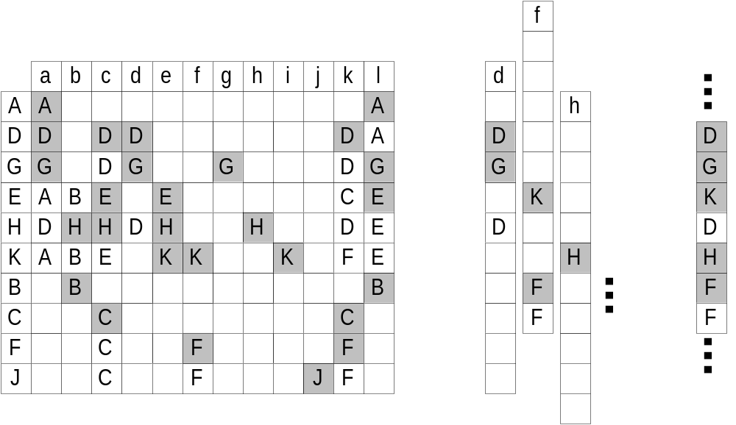
Row Displacement (RD)
Displace the rows/columns of the dispatching matrix by different offsets, and collapse them into a master array.
Dispatching matrix with a new type ordering
The columns with different offsets
The master array
Notes:
First re-orders the messages/types
Best results: displacing the columns with a DFS ordering of types

Slide 18
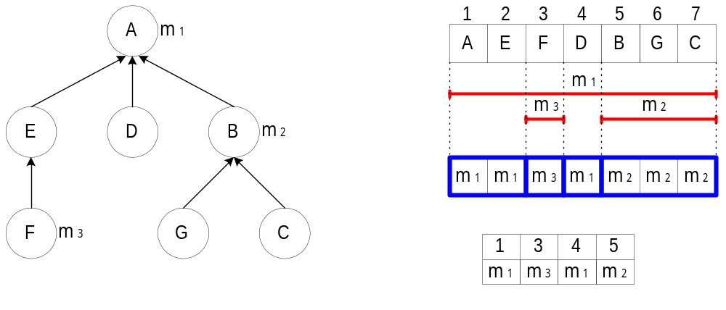
Interval Containment (only in SI)
Encoding Process:
  Preorder numbering of types: ∀ t , descendants(t) define an interval
  f_{m} = # of different implementation of message m
  A message m defines f_{m} intervals ⇒ at most 2f_{m}+1 segments
  Optimal duplicates elimination
  Dispatch time: binary search O(log f_{m}),
  van Emde Boas data structure O(log log n)
f_{m} is on average 6

Slide 19
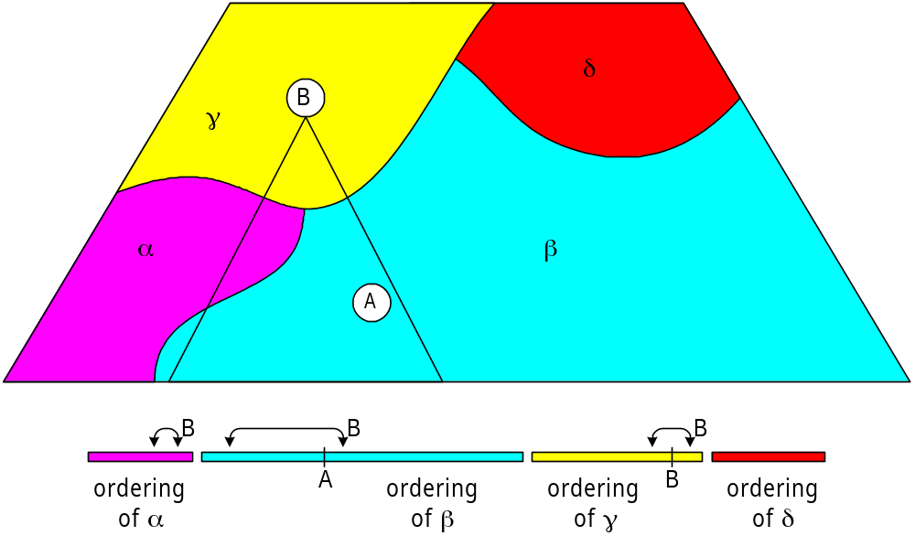
New Technique: Type Slicing (TS)
Slicing Property: ∀ t , descendants(t) in each slice define an interval in the ordering of that slice
The main algorithm: partition the hierarchy into a small number of slices

Slide 20
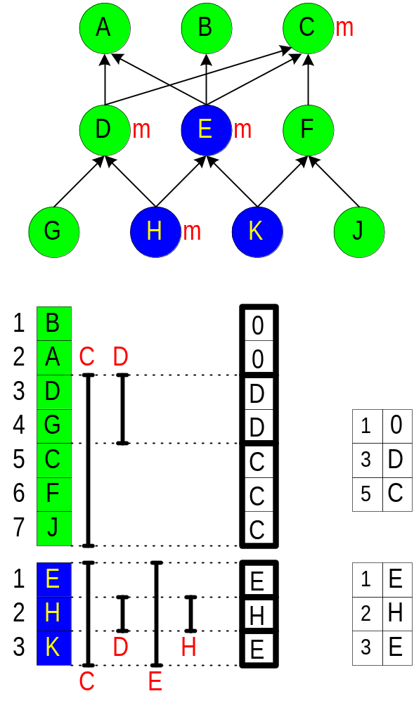
Small example of TS
The hierarchy is partitioned
into 2 slices: green & blue
There is an ordering of each
slice such that
descendants are consecutive
Apply Interval Containment
in each slice
Example:
  Message m has 4 methods
  in types: C, D, E, H
  Descendants of C are: D-J, E-K

Slide 21
Dispatching using a binary search
Dispatch time (in TS)
  0.6 ≤ average #conditionals ≤ 3.4; Median = 2.5
SmallEiffel compiler, OOPSLA’97: Zendra et al.
  Binary search over x possible outcomes
  Inline the search code
  When x ≤ 50: binary search wins over VFT
Used in previous work
  OOPSLA’01: Alpern et al.
  Jalapeño – IBM JVM implementation
  OOPSLA’99: Chambers and Chen
  Multiple and predicate dispatching
  ECOOP’91: Hölzle, Chambers, and Ungar
  Polymorphic inline caches

Slide 22
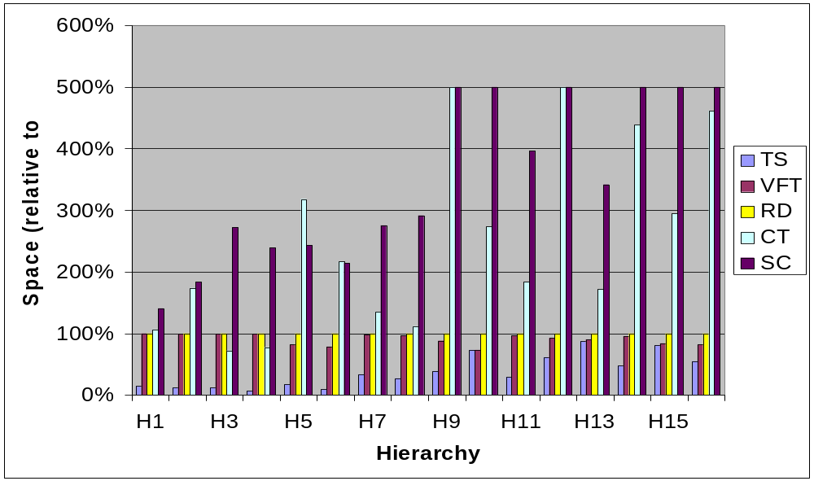
Space in SI hierarchies
…
…
…
…
…
…
Notes:
Space Metric:
RD is slightly better than our main TS algorithm in three out of~35 hierarchies:
TS however always wins against CT, VFT, SC, and against RD in all other hierarchies,
sometimes by factors as large as~30.
For instance, in the \VORTEX hierarchy, RD uses~1.24MB, an optimal null elimination scheme will use~1.22MB,
while TS uses~40KB!
The average improvement of TS over RD (considered the best for MI-hierarchies) is by a factor of~4.6,
while the median improvement is by
a factor of~2.6.
Creation time:
TS is consistently better than RD,
sometimes by a factor of hundreds.
The average improvement of TS over RD is by a factor of~37.4, while the median is~6.3.
Dispatch time:
The average number of such conditionals in the~35 hierarchies
ranged between~0.6 and~3.4; the median value being~2.5.

Slide 23
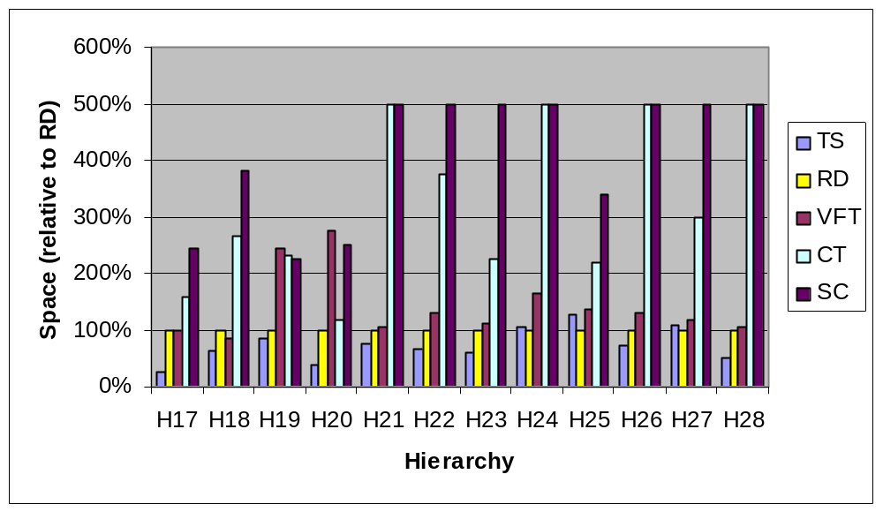
Space in MI hierarchies
…
…
…
…
…
…
…
Notes:
TS is usually much better than RD,
In the 3 hierarchies where RD wins it is by a small factor.

Slide 24
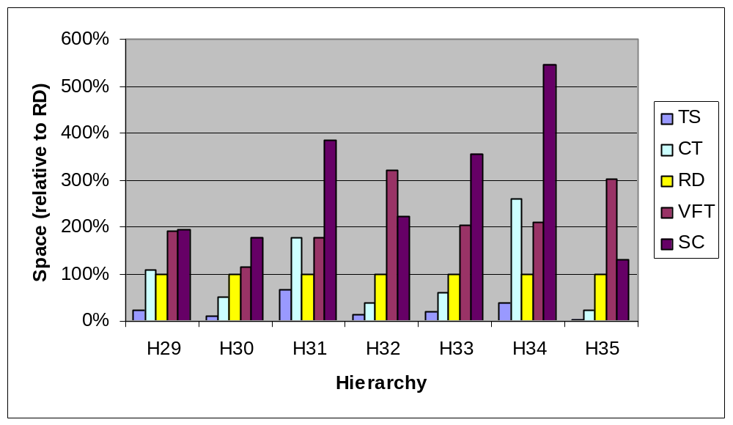
Space in Multiple Dispatch Hierarchies

Slide 25
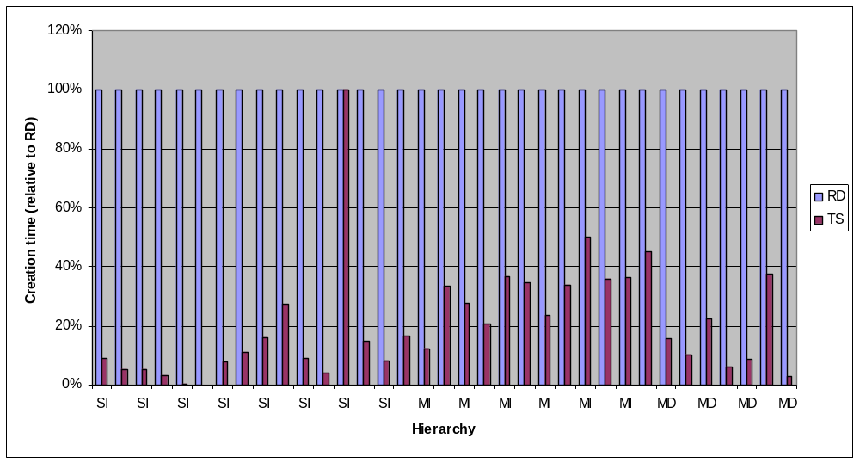
Creation time: TS vs. RD
Notes:
TS vs. RD
Average improvement = 37.4
Median improvement = 6.3

Slide 26
The End
Any questions?

Slide 28
Single Dispatching
TS [OOPSLA’02]:
  Logarithmic dispatch time
CT_{d} [POPL’03]:
  CT_{d} performs dispatching in d dereferencing steps
  Analysis of the space complexity of CT_{d}
  Incremental CT_{d} algorithm in single inheritance
  Empirical evaluation
Notes:
(with an analytically found slice size)

Slide 29
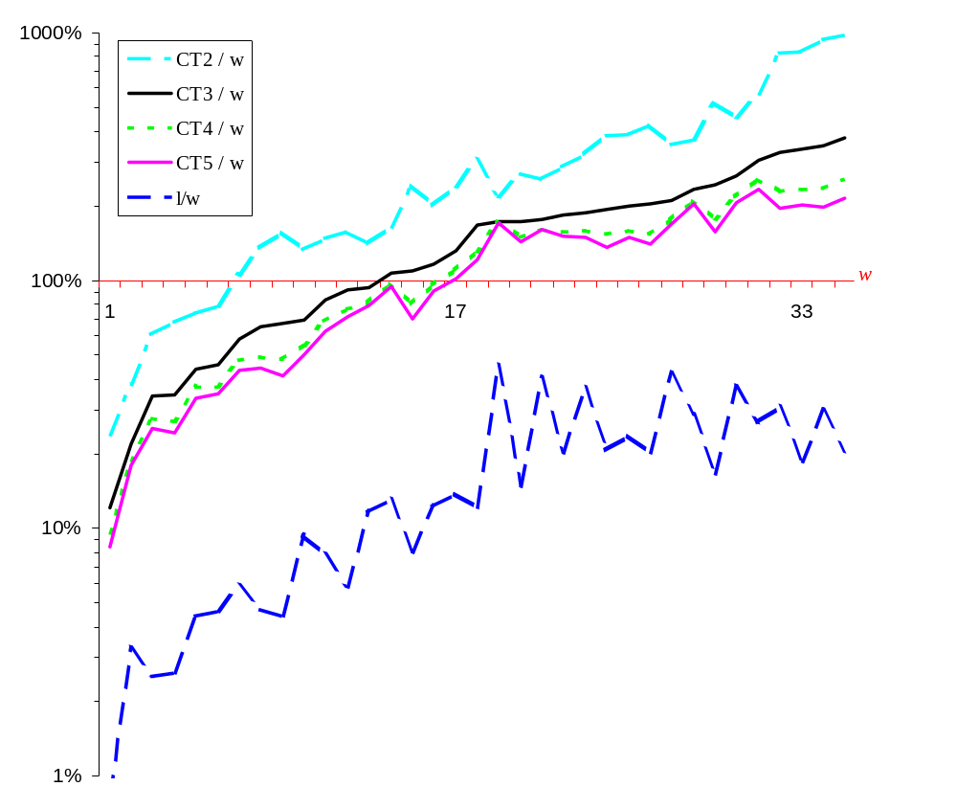


Memory used by CT₂, CT₃, CT₄, CT₅, relative to w in 35 hierarchies
optimal null elimination
optimal duplicates elimination
Notes:
This graph shows the memory used by the different CT techniques relative to W,
that is optimal null elimination.
We measured the memory in 35 different hierarchies.
Observe that we used a logarithmic scale.
Let’s start by comparing duplicates elimination with null elimination.
We see in the first hierarchy that duplicates elimination used
only 1 percent of the memory of used by null elimination,
On average it is 10 time better.
Next, let’s compare CT3 (the black line) with null elimination.
In 14 hierarchies CT3 improves on null elimination, and in the rest 20 hierarchies it performs worse.
Recall that achieving optimal null elimination is quite hard.
Finally let’s compare the CT schemes among themselves.
We see that we can save a lot space by switching form CT2 to CT3.
However, we save less by switching from CT3 to CT4, and much less from CT4 to CT5.
This fact is supported by the theoretical analysis.

Slide 30
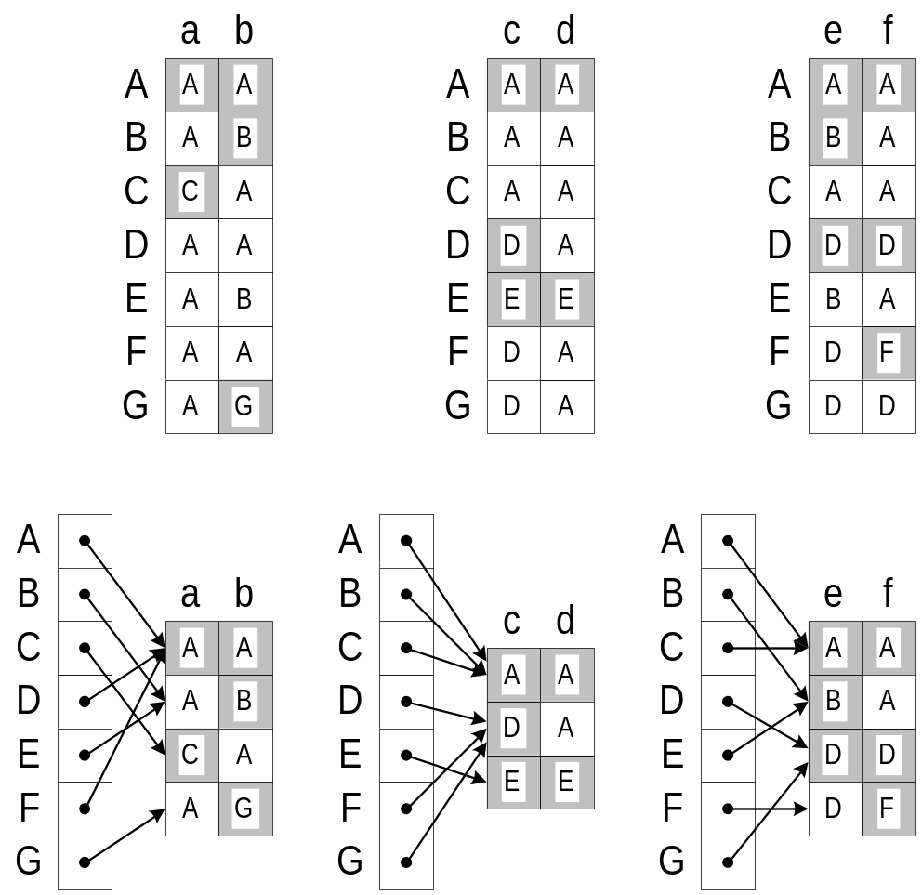
Vitek & Horspool’s CT
Partition the messages
into slices
Merge identical rows
in each chunk
In the example: 2 families per slice
Magically, many many rows are
similar, even if the slice size is 14
(as Vitek and Horspool suggested)
No theoretical analysis

Slide 31
Our Observations
It is no coincidence that rows in a chunk are similar
The optimal slice size can be found analytically
  Instead of the magic number 14
The process can be applied recursively
Details in the next slides

Slide 32
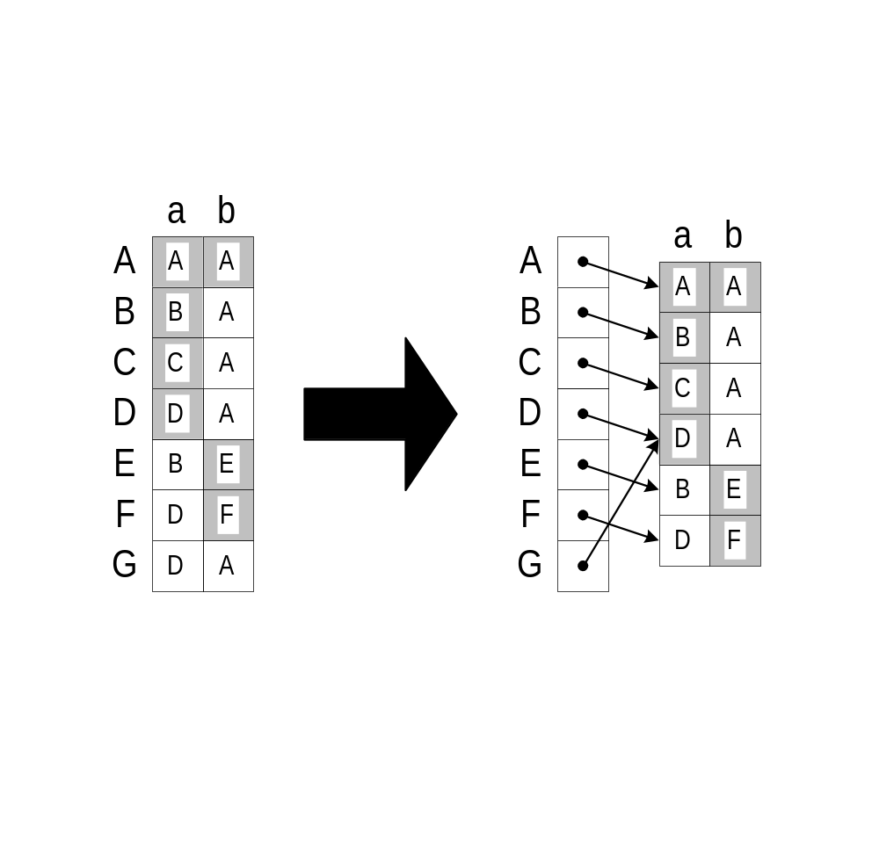
Observation I: rows similarity
Consider two families F_{a}={A,B,C,D}, F_{b} ={A,E,F}
What is the number of distinct rows in a chunk?
  ≤ n_{a} x n_{b} , where n_{a}=|F_{a}| and n_{b}=|F_{b}|
  For a tree (SI) hierarchy: ≤ n_{a} + n_{b}
∇F_{a}
∇F_{b}
∇(F_{a} F_{b} )
A
A
A
B
B
E
E
C
C
D
F
F
D
Notes:
(for multiple inheritance it depends on the topology)

Slide 33
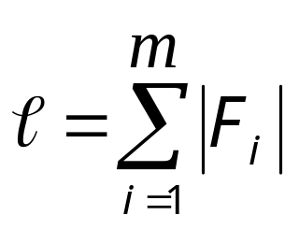

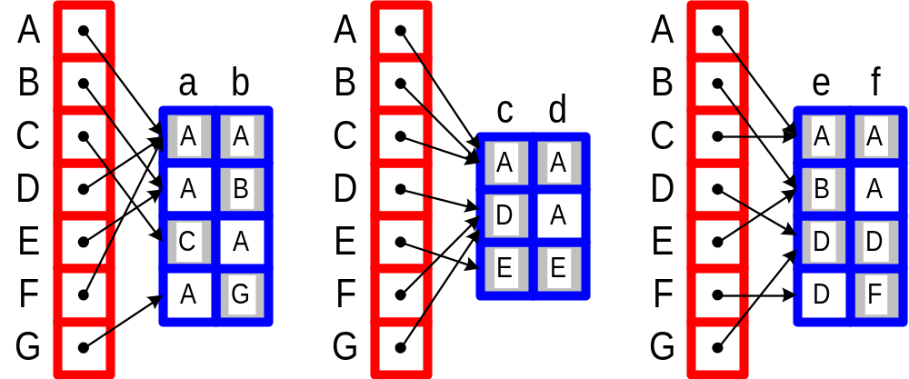
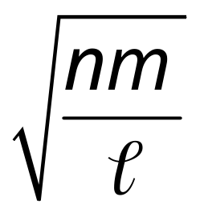
Observation II: finding the slice size
n=#types, m=#messages, = #methods
Let x be slice size. The number of chunks is (m/ x)
Two memory factors:
  Pointers to rows: decrease with x
  Size of chunks: increase with x (fewer rows are similar)
  We bound the size of chunks (using |F_{a}|+|F_{b}| idea):
x_{OPT} =
n(m/x)

Slide 34
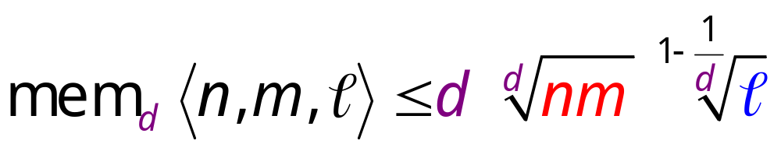
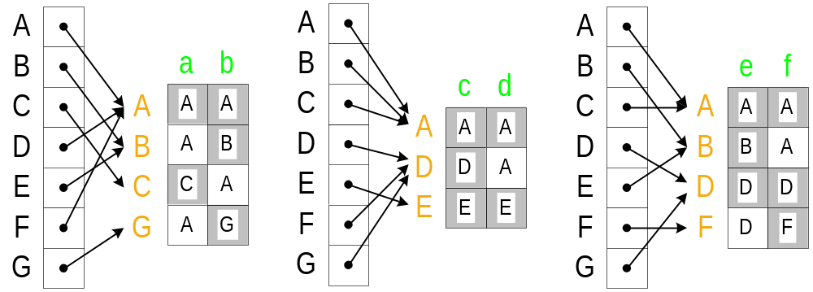
Observation III: recursive application
Each chunk is also a dispatching matrix and can be recursively compressed further

Slide 35
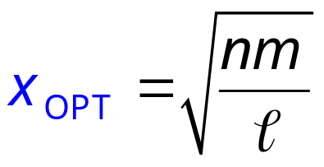
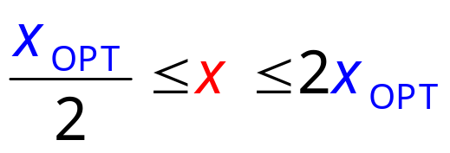
Incremental CT₂
Types are incrementally added as leaves
Techniques:
  Theory suggests a slice size of
  Maintain the invariant:
  Rebuild (from scratch) whenever invariant is violated
  Background copying techniques
  (to avoid stagnation)

Slide 36
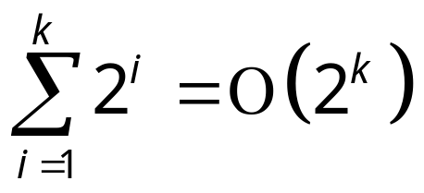

Incremental CT₂ properties
The space of incremental CT₂ is at most twice the space of CT₂
The runtime of incremental CT₂ is linear in the final encoding size
  Idea:
  Similar to a growing vector, whose size always doubles,
  the total work is still linear since
  One of n, m, or always doubles when rebuilding occurs
Easy to generalize from CT₂ to CT_{d}

Slide 37
Really the END
Any questions?

Slide 39
Outline
The four tasks
The SI/MI observation
New techniques for dealing with MI hierarchies
  Demonstrated on Task #2:
  Single Dispatching

Slide 40
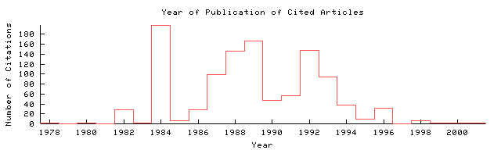
Multiple Inheritance is DEAD
Reasons
  Users: Complex semantics
  Designers: Hard for implementation
  (especially with dynamic class loading)
Proofs
  Industry: Java, .Net
  Academic: Number of papers on “Multiple inheritance”
Searched
“Multiple inheritance”
in citeseer.nj.nec.com/cs
Notes:
Only the first 500 papers (due to system busy)

Slide 41
But we still need it…
Possible solutions
  Single inheritance for classes,
  multiple subtyping for interfaces
    As in Java and .Net
  Decoupling subclassing and subtyping
    D will inherit code from both B and C,
    but D will be a subtype of only B.
    Example: Mixins (next slide)
A
B
C
D

Slide 42
Mixins
class Foo<T> extends T {…}
  Foo is called a mixin
  Not supported in Java1.5
  (See “A First-Class Approach to Genericity” in OOPSLA’03)
Person
Student
Teacher
Teacher<Student>
TeacherAssistant
Notes:
class Person {…}
class Student extends Person {…}
class Teacher extends Person {…}
class TeacherAssistant extends Teacher<Student> {…}

Slide 43
Mixin semantics
Hygienic mixins – no accidental overriding
A
foo₁
class A { void foo() {// foo₁} }
class M<T extends A> extends T {
override void foo() {// foo₂}
void bar() {// bar₁}
}
class B extends A {
override void foo() {// foo₃}
void bar() {// bar₂}
}
foo₃
bar₂
B
M<A>
foo₂
bar₁
M<B>
foo₂
bar₁
// foo₂
// bar₁
// foo₂
// bar₂
M<B> o = new M<B>();
o.foo();
o.bar();
( (B) o).foo();
( (B) o).bar();
Think about super.foo() …

Slide 44
Mixins and subtyping
R
Genericity:
1) A<T> extends B<T> =>
for all T: A<T> <: B<T>
2) T1<:T2 => A<T1> <: A<T2>
not type-safe (only in Eiffel)
For mixins, (2) is type-safe, but hard to implement.
B<R>
A<R>
A<B<R>>
Simple syntax
class Person {…}
class Student extends Person {…}
class Teacher extends Person {…}
class TeacherAssistant extends Teacher<Student> {…}
Syntax using genericity
class Person<T> extends T {…}
class Student<T extends Person<?>> extends T {…}
class Teacher<T extends Person<?>> extends T {…}
class TeacherAssistant<T extends Teacher<Student<?>> > extends T {…}

