Slide 1
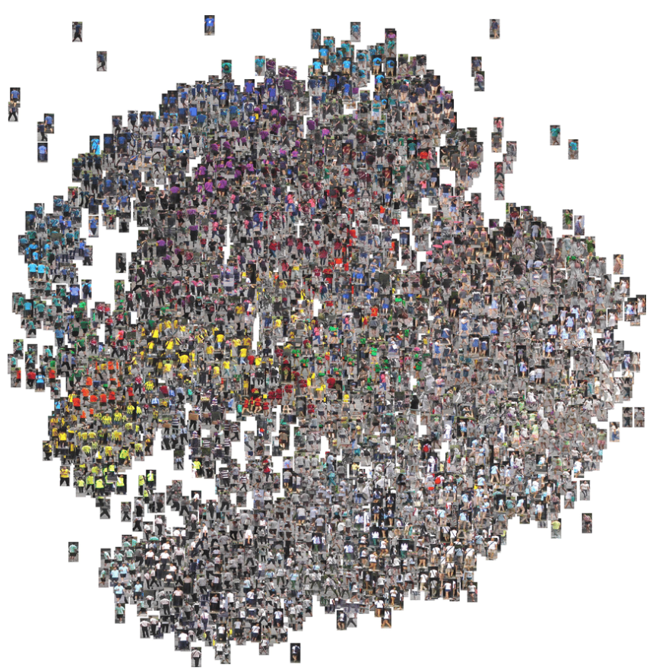
Deep multi-stream convolutional neural networks in human re-id
A new Architecture for improved Human Re-ID

Slide 2
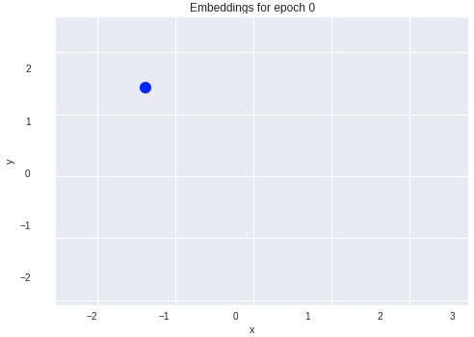
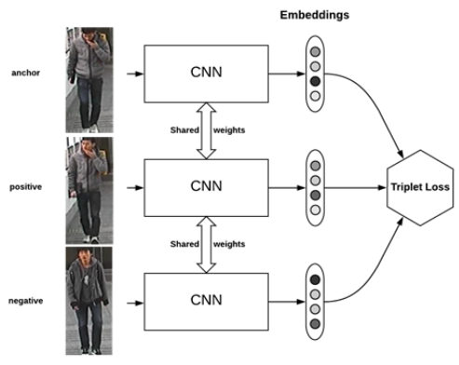
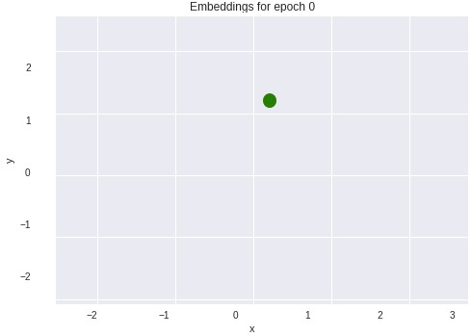
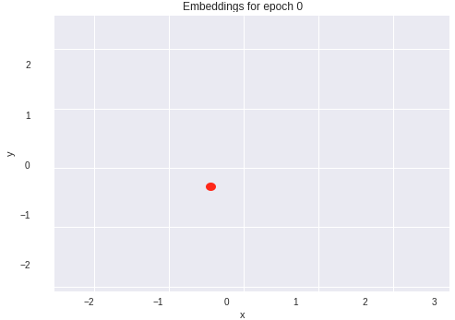
Triplet Loss Recap

Slide 3
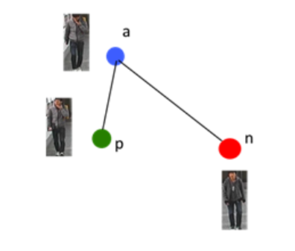
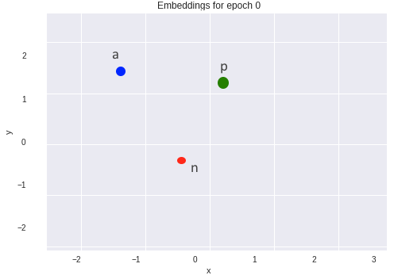
Embeddings (Distance, similarity)

Slide 4
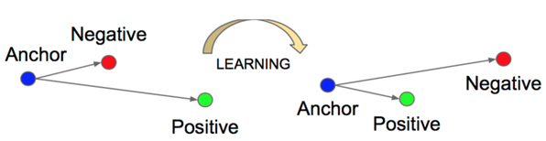
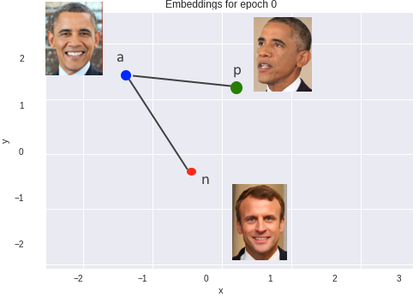




Triplet LOSS

Slide 5
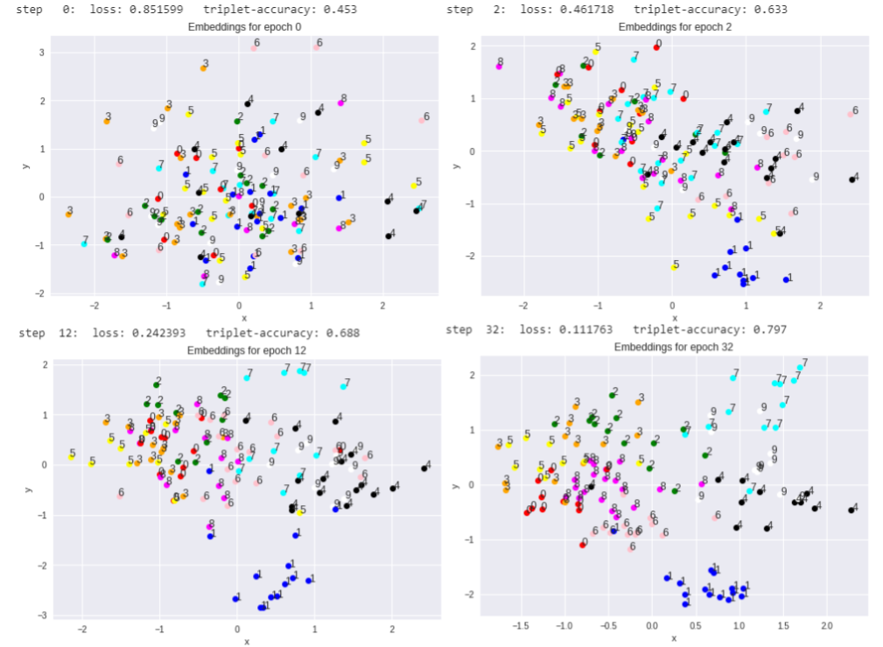
Training of Triplet loss

Slide 6
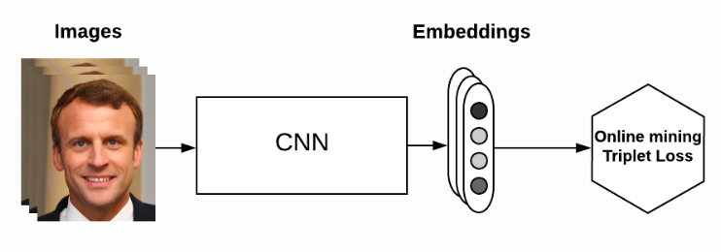
Online Triplets & BATCH ALL
Very cost intensive
Batch means that all possible Triplets are generated

Slide 7
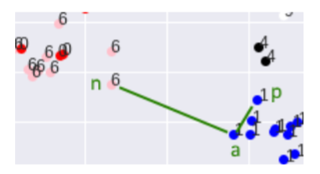
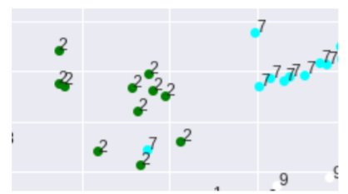
Hard Triplets & Hard Triplet Mining
Easy Triplet
Network doesn’t learn much
Hard Triplet
Network learns faster

Slide 8
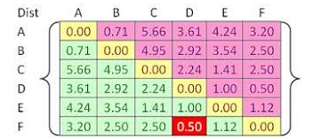
Hard Triplet Mining
- Using distance matrix for all points in a batch (e.g. 128 embeddings) [128,128]
- Taking maximum of rows for each in order to find points which are not in their cluster

Slide 9
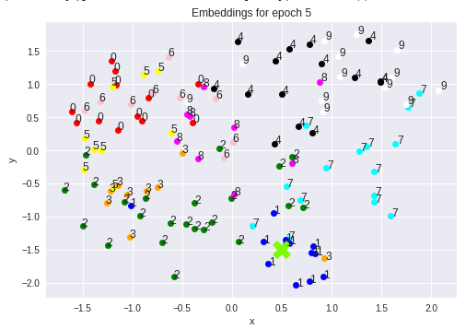
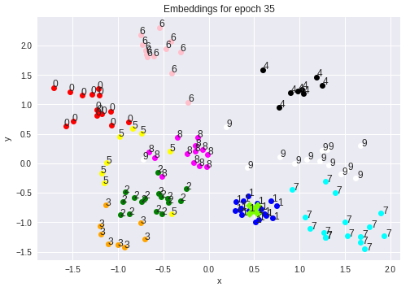
Proposed new Loss FUNCTION
Using center of gravity of each cluster for online training

Slide 10
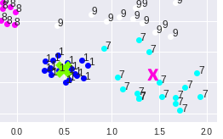
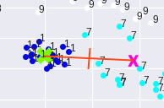
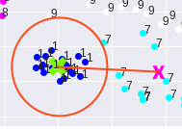
New loss function
1. Get Center of Gravity for each cluster (for each identity/label)
2. Create Distance Matrix just with Center of Gravity
3. Loss function: points of cluster must
be nearer to their Center of Gravity then
To the closest different center of gravity

Slide 11
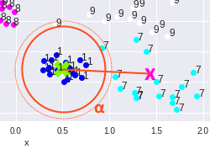

New Loss Function: Center of Gravity
The Average point is less distant from
Its center of gravity R, then from the
Closest other center of Gravity R’
Alpha is the margin

Slide 12


New LOSS FUNCTION

Slide 13
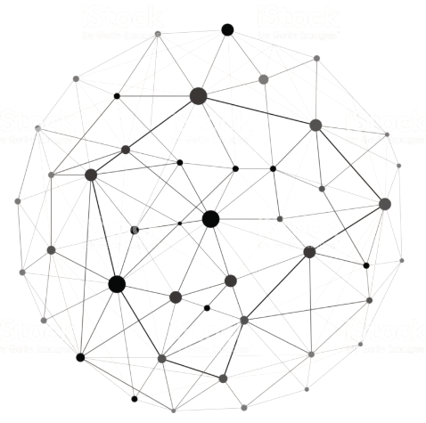
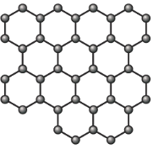


Distance of center factor
Add Factor in order to get equal distance of centers of gravity from each other

