Slide 1





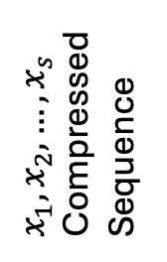

$$c_{1} ,c_{2},…,c_{t−1}$$
$$c_t$$
Arithmetic Coder
Predictor
$x_{1},x_{2},…,x_{s}$ Compressed Sequence
$$p_{1} ,p_{2},…,p_{t}$$
$$c_t$$
$$c_{1} ,c_{2},…,c_{t−1}$$
Arithmetic Decoder
Predictor
$$p_{1} ,p_{2},…,p_{t}$$

Slide 2




$$c_{1} ,c_{2},…,c_{t−1}$$
$$c_t$$
Arithmetic Coder
Predictor 1
Predictor 2
Predictor 3
Predictor 4
aggregator
$$p_{1} ,p_{2},…,p_{t}$$
$x_{1},x_{2},…,x_{s}$ Compressed Sequence
Predictor N
$$c_{1} ,c_{2},…,c_{t−1}$$
Arithmetic Decoder
$$c_t$$
Predictor 1
Predictor 2
Predictor 3
Predictor 4
aggregator
$$p_{1} ,p_{2},…,p_{t}$$
Predictor N

