Slide 1
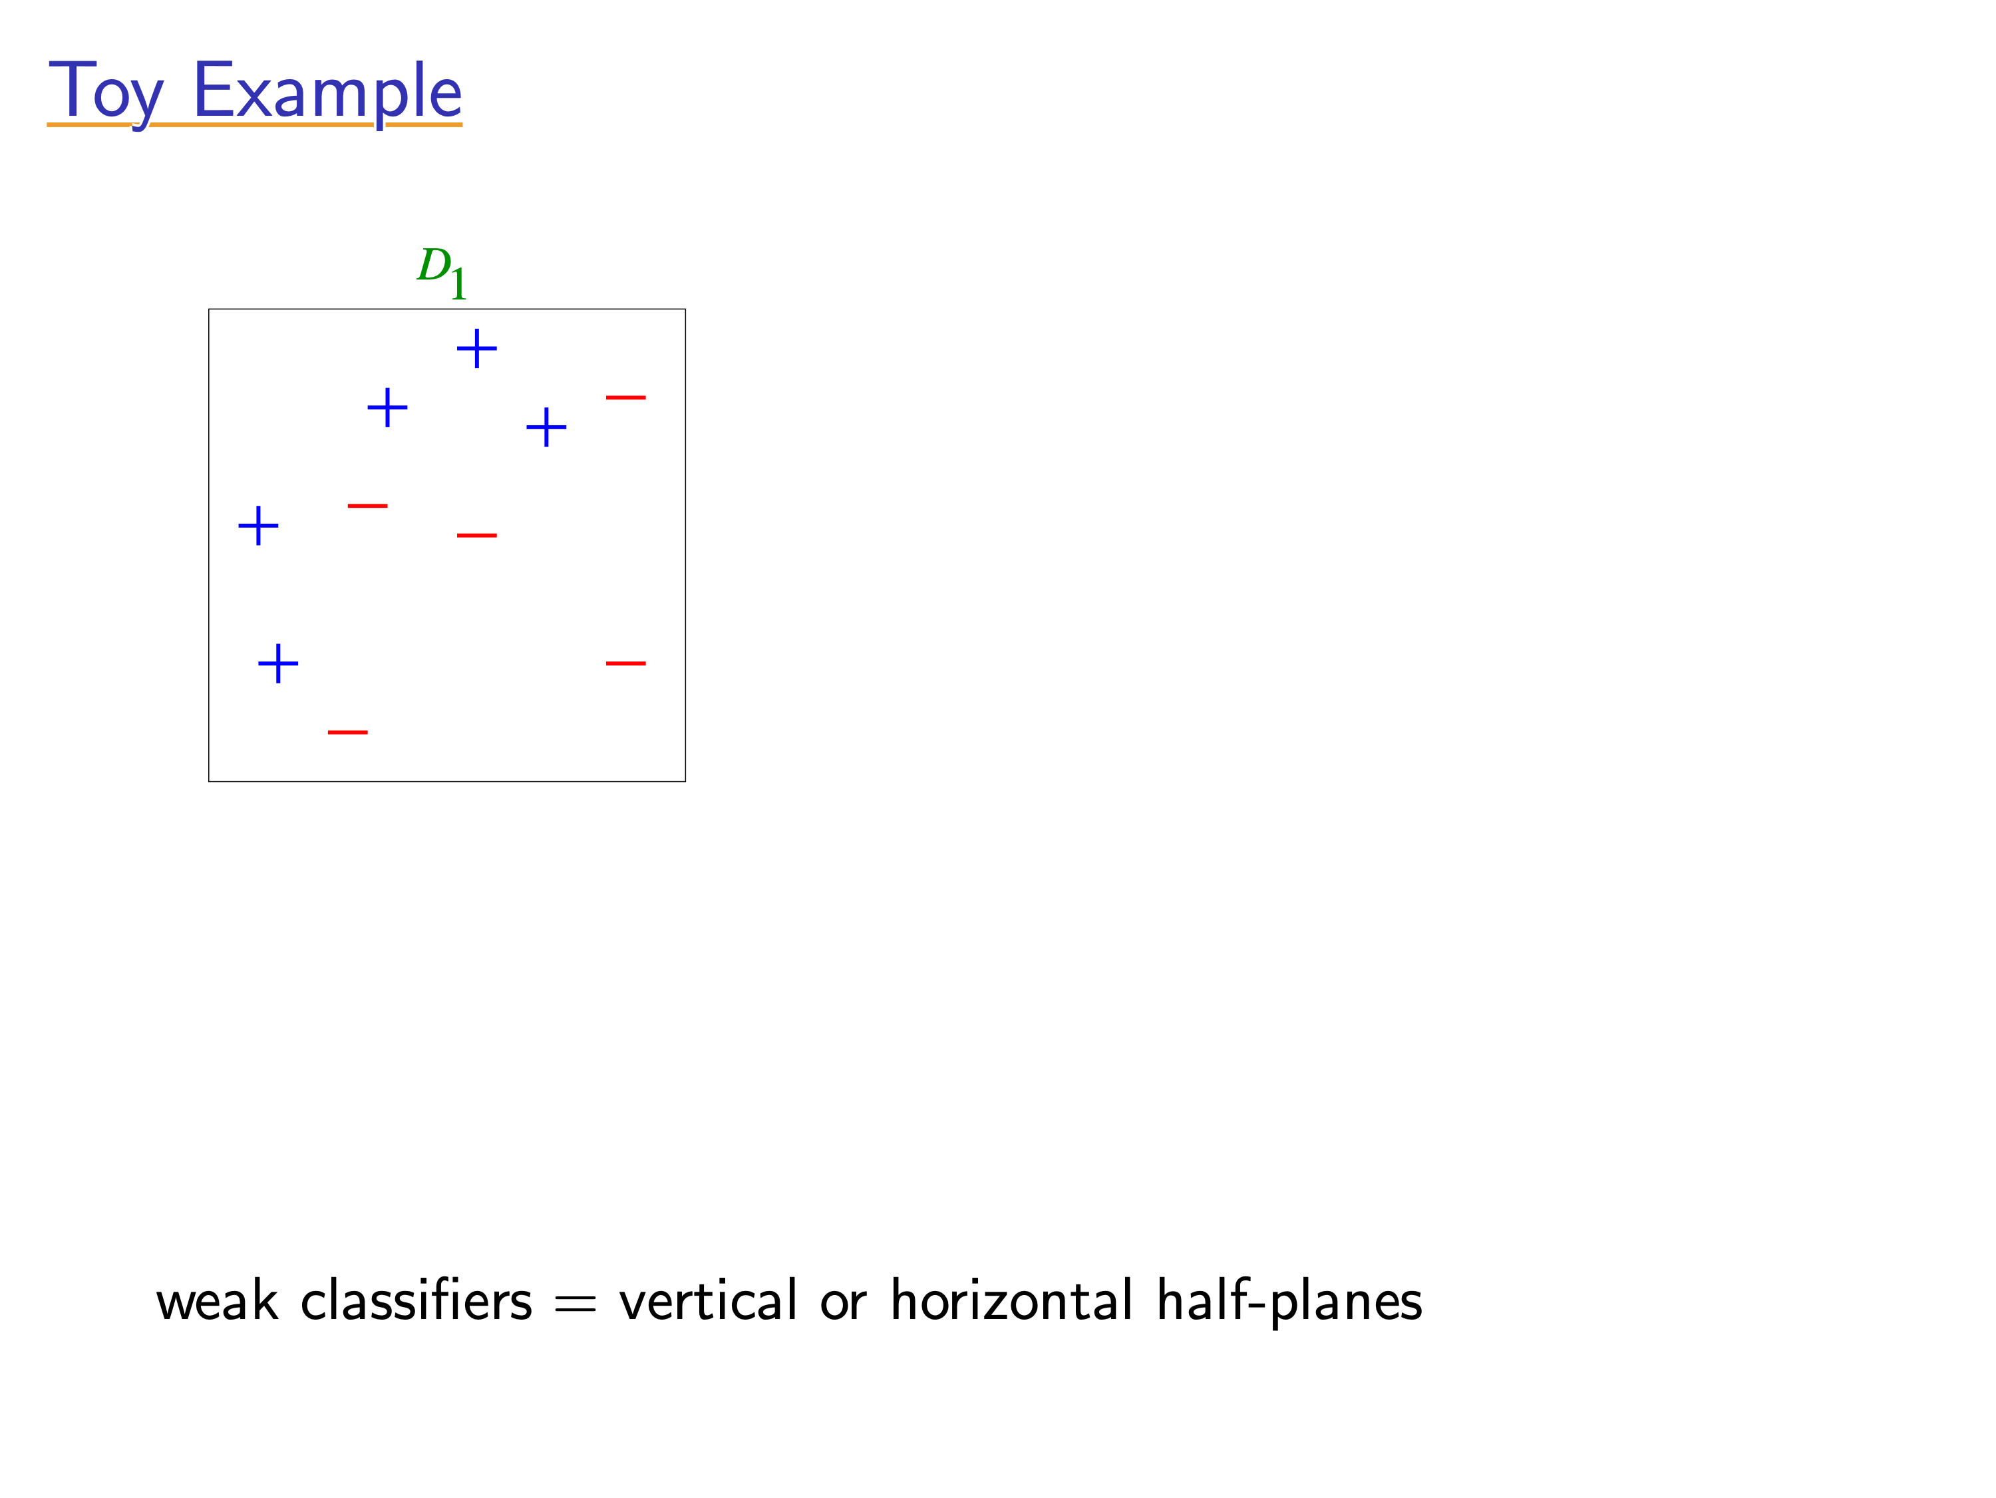
[Slides from Rob Schapire]

Slide 2
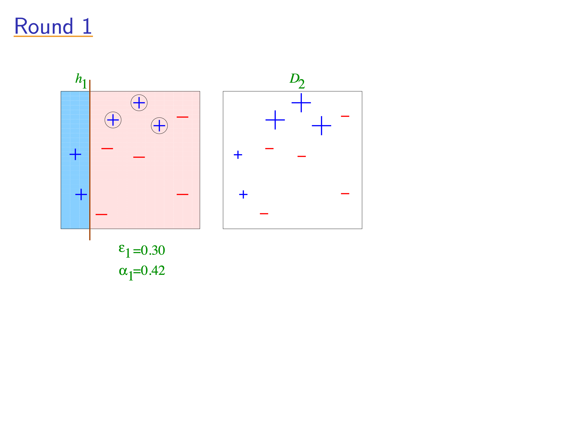
[Slides from Rob Schapire]

Slide 3
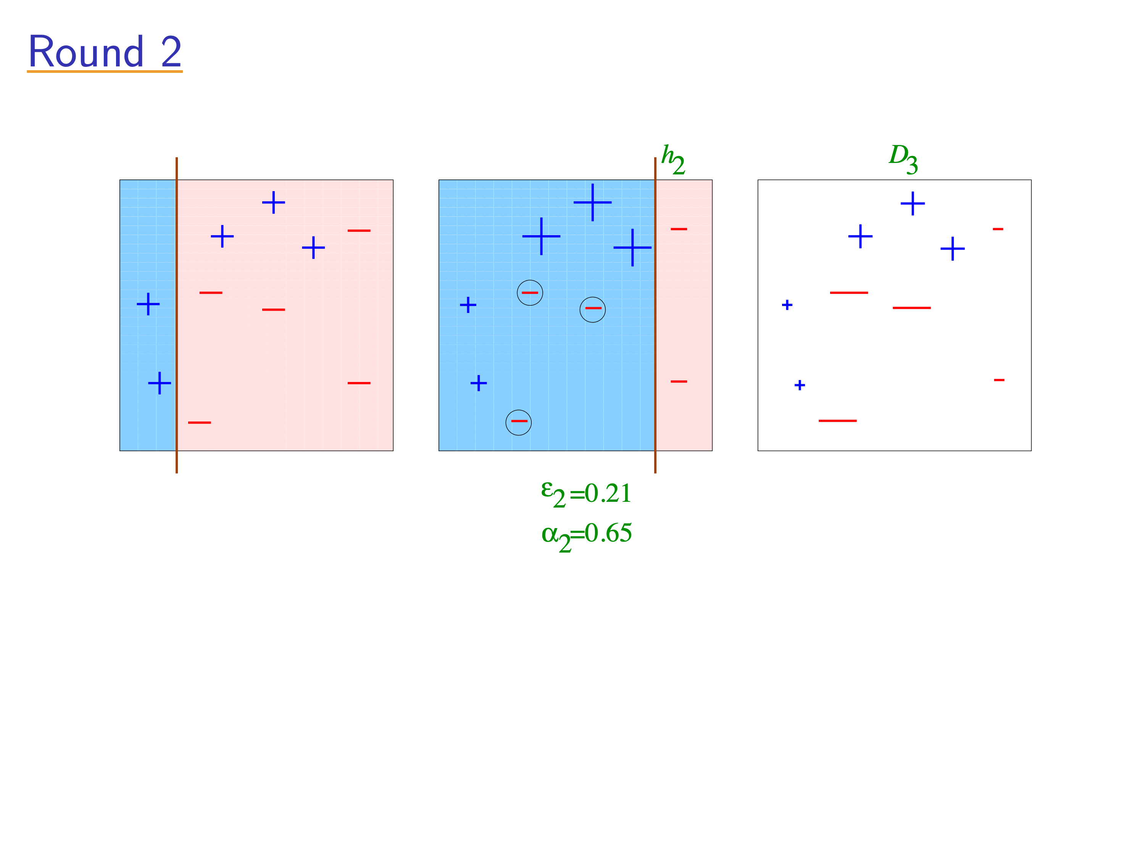
[Slides from Rob Schapire]

Slide 4
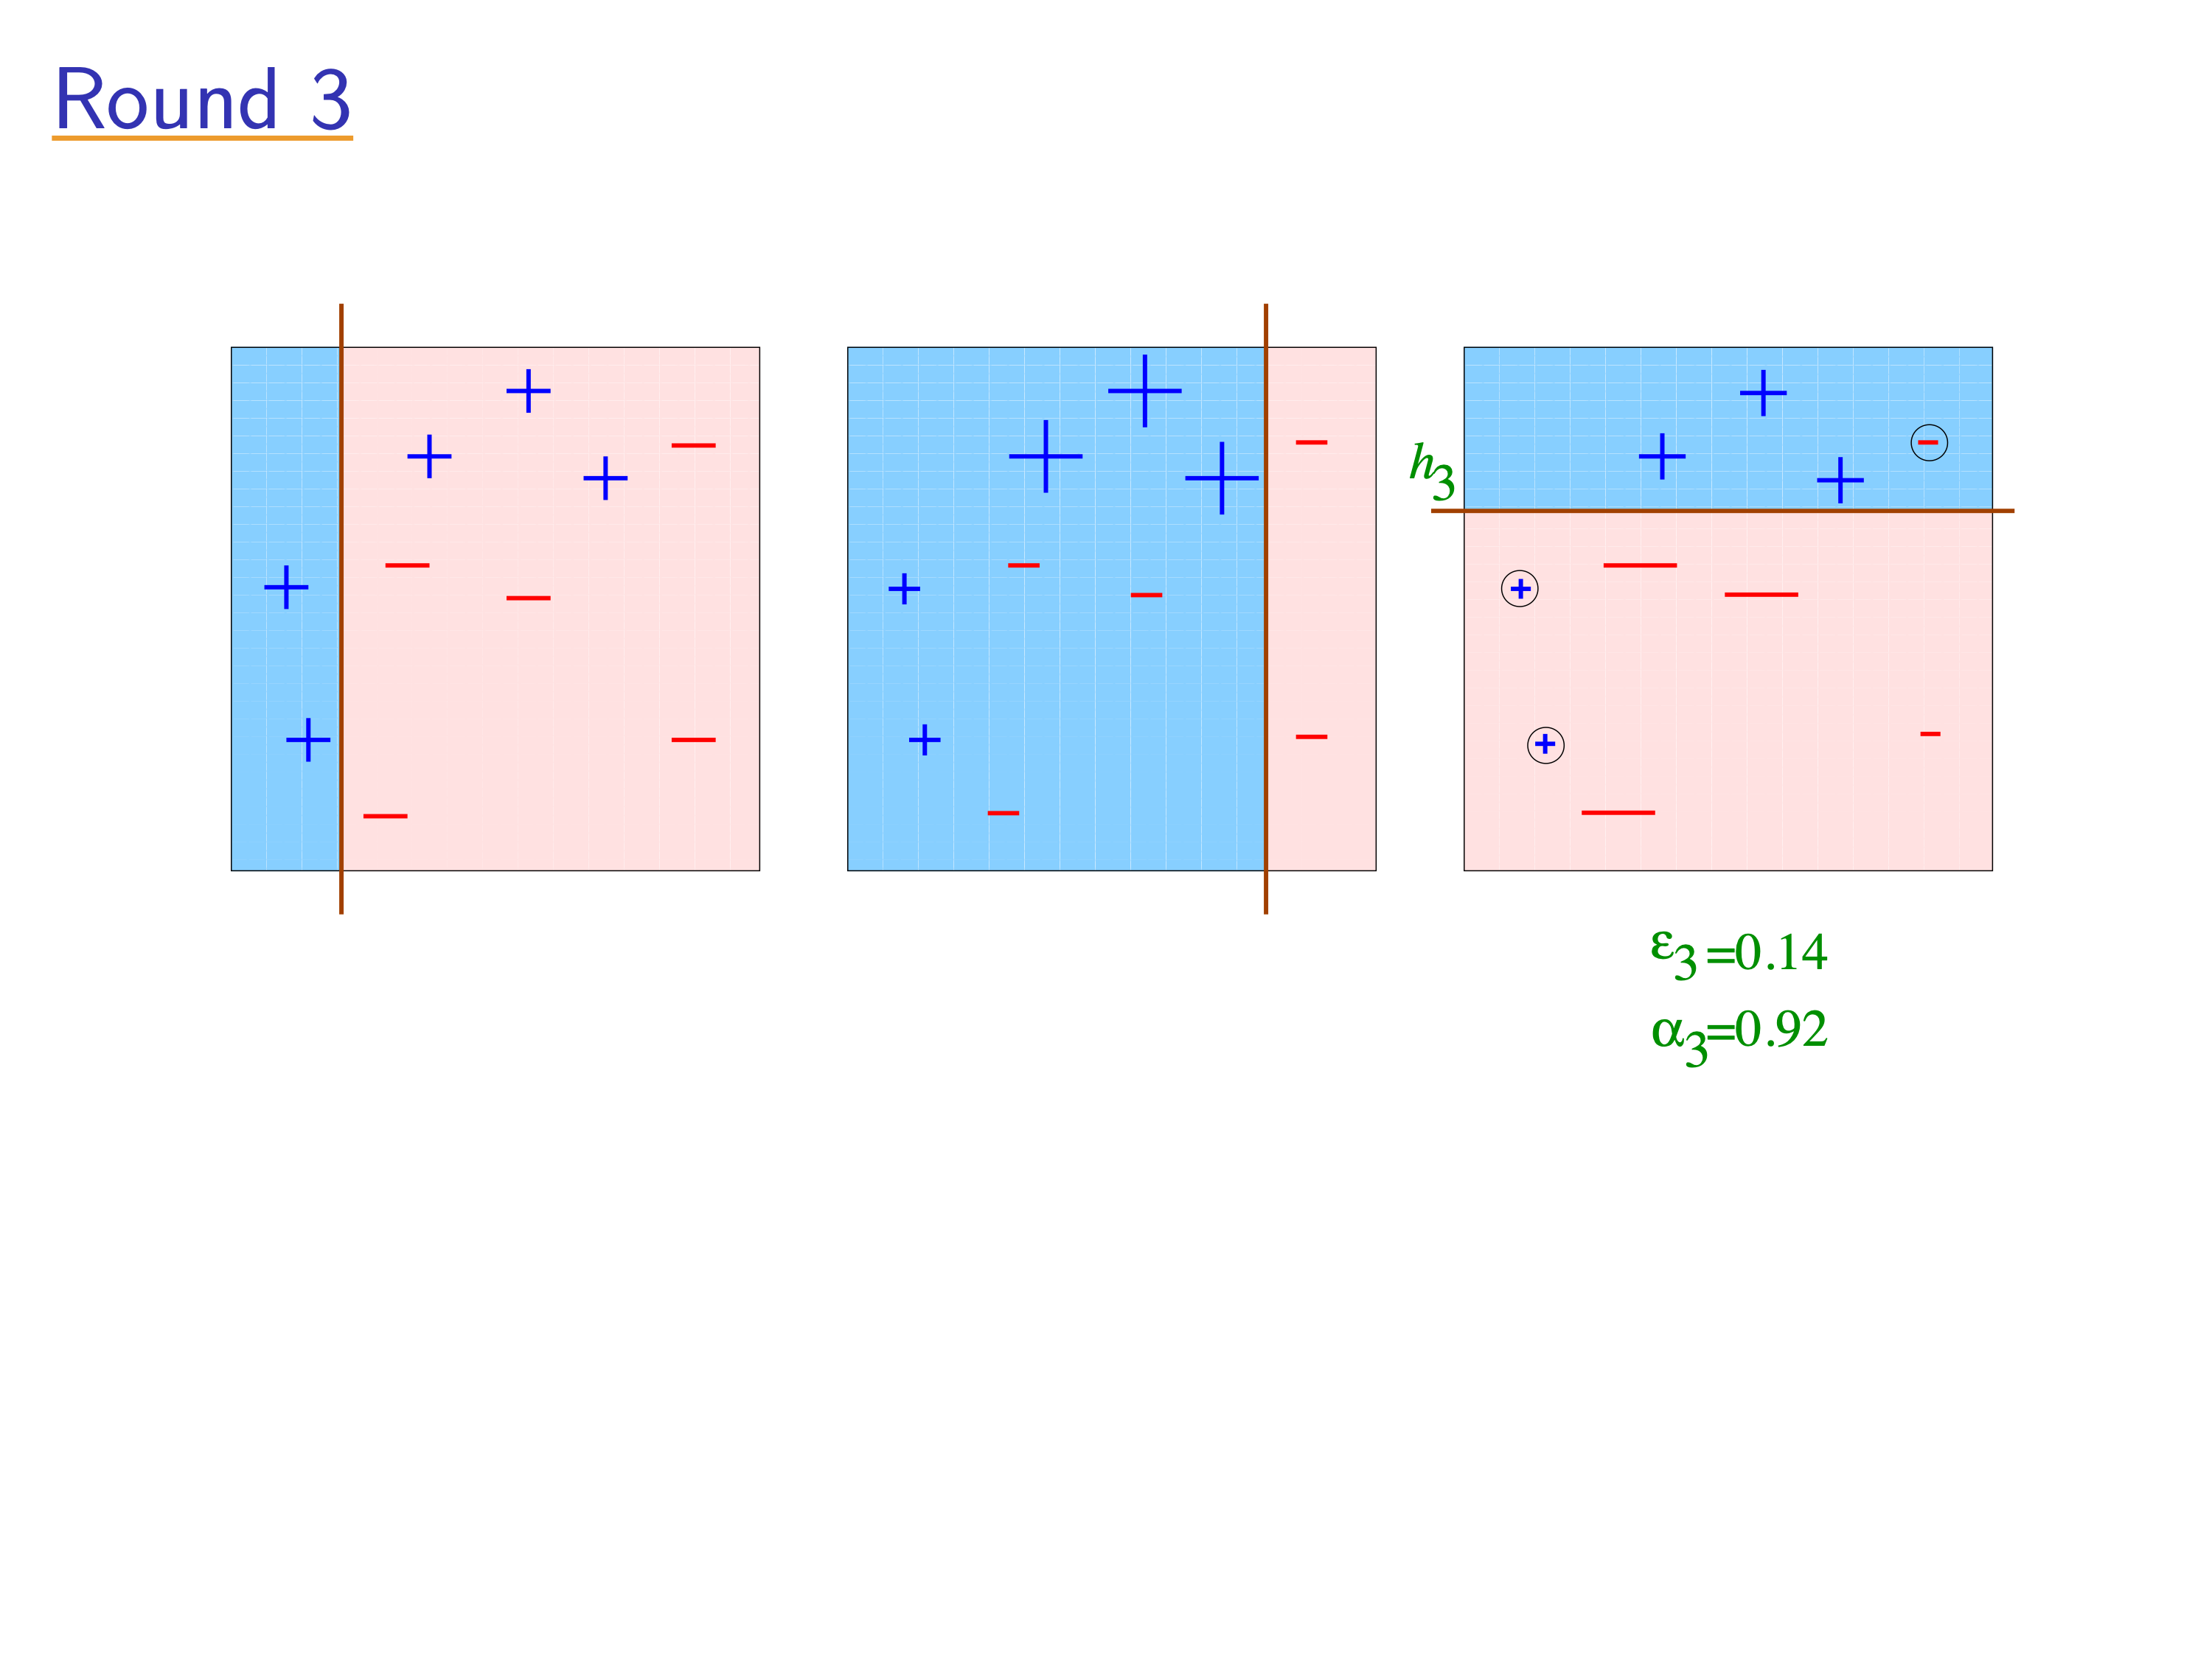
[Slides from Rob Schapire]

Slide 5
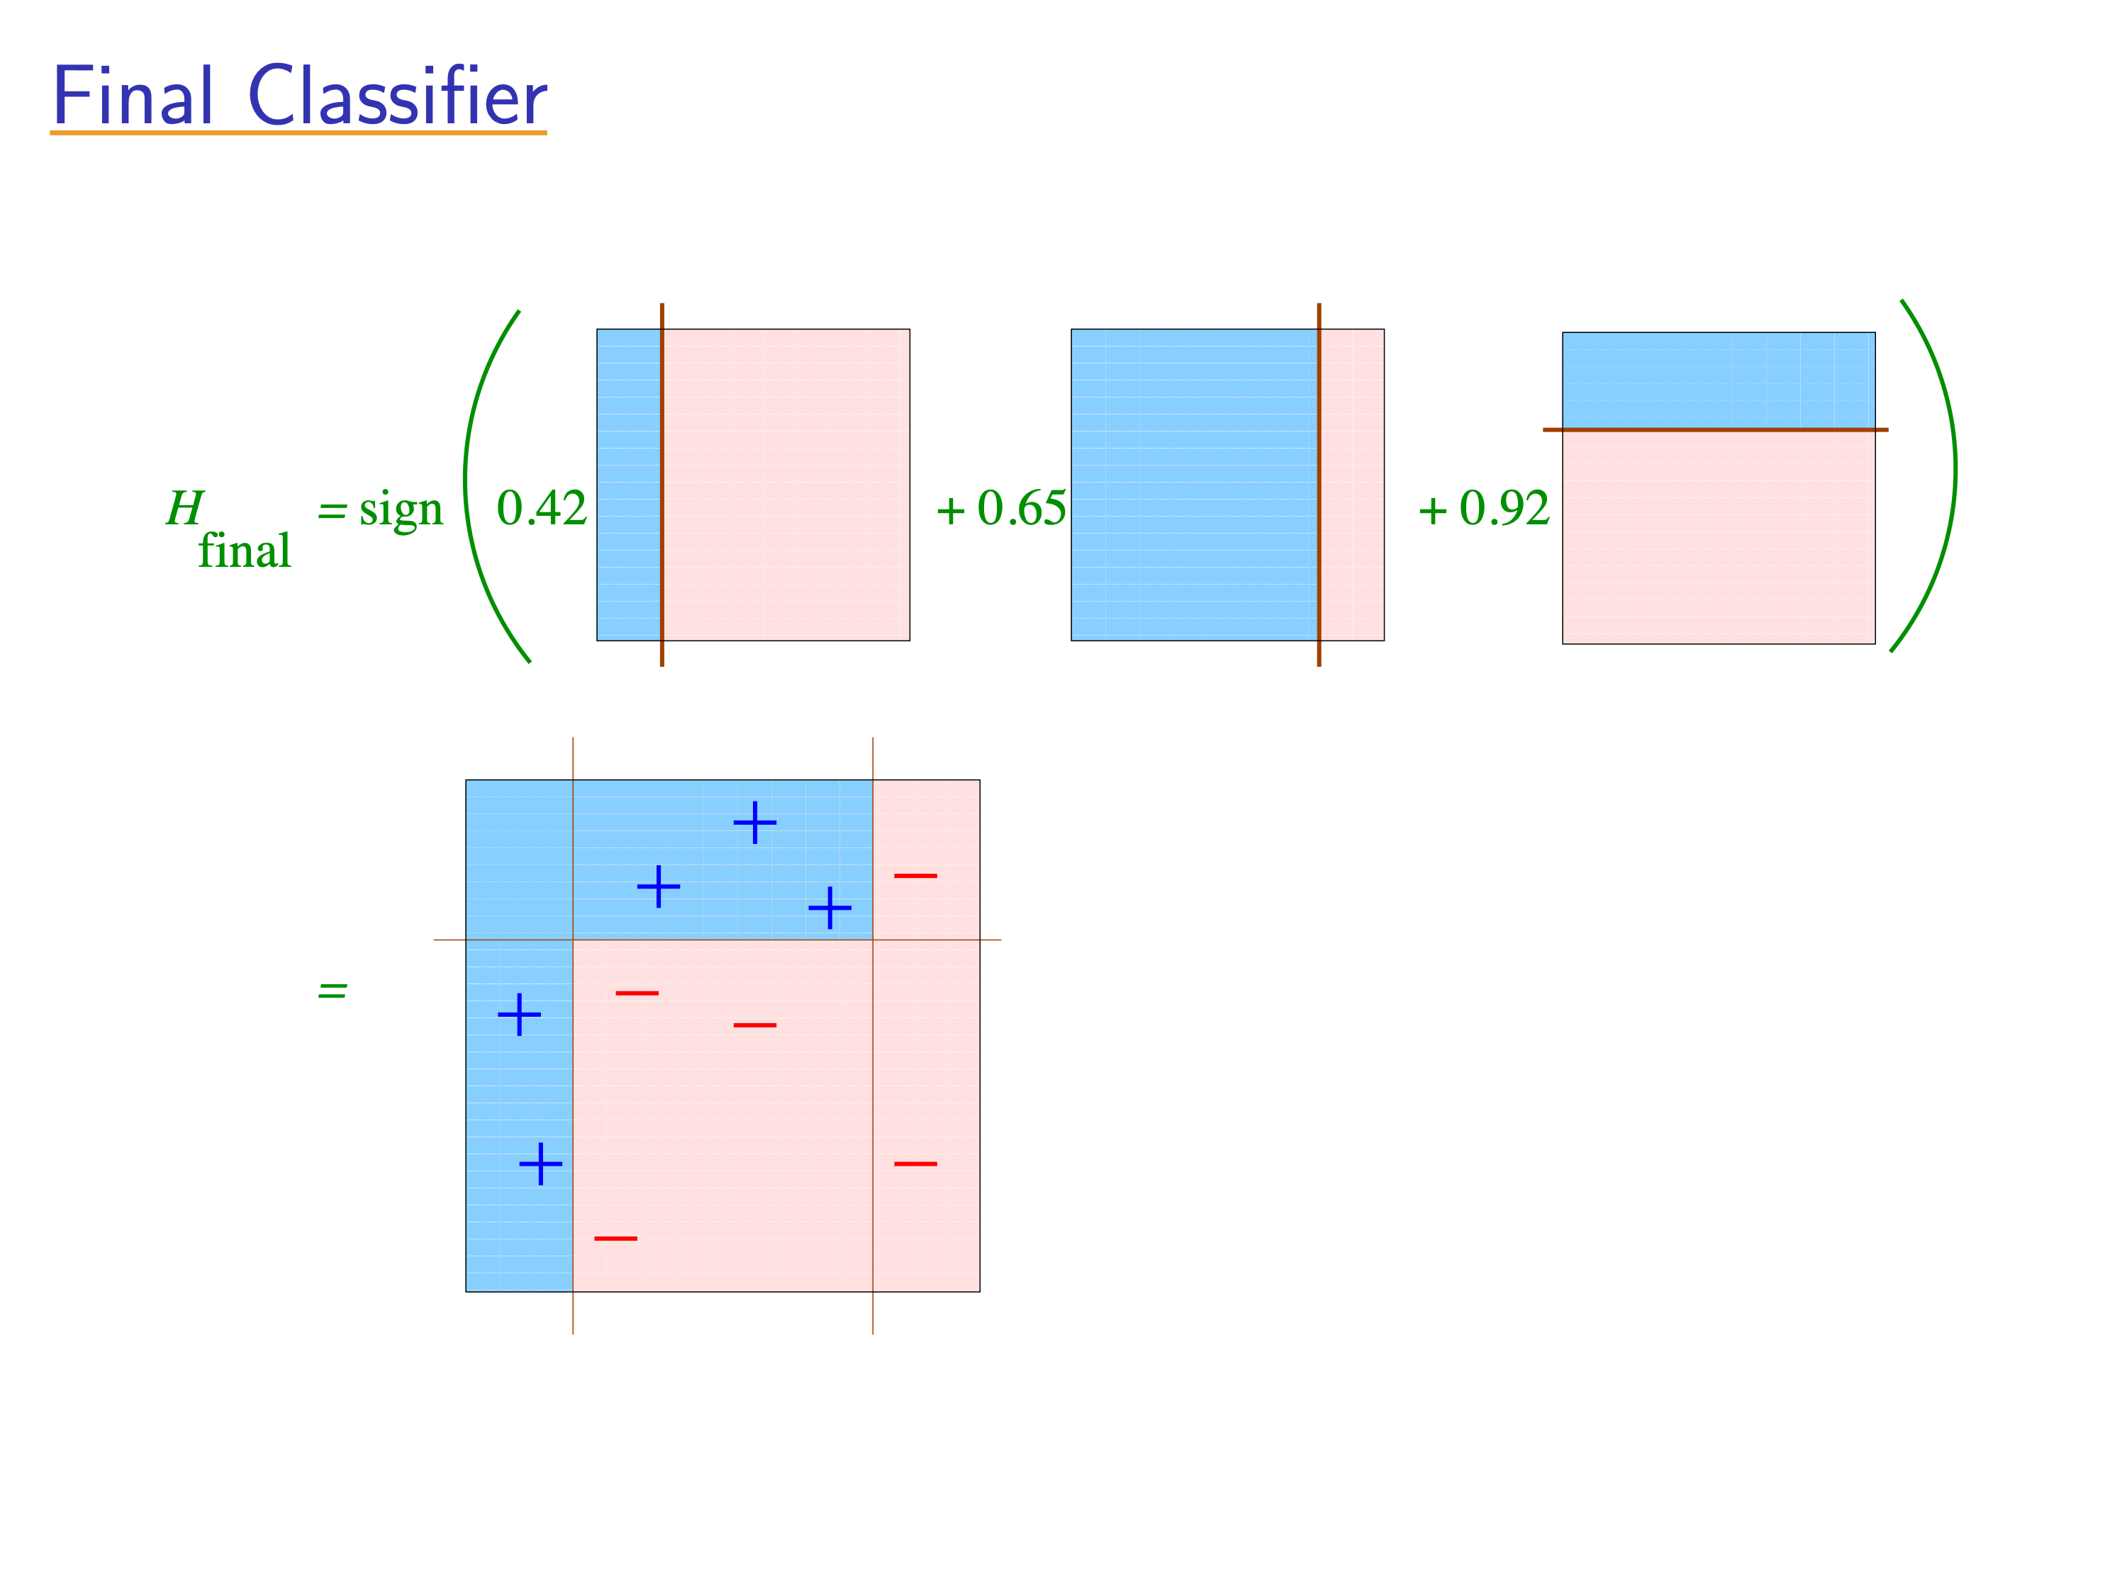
[Slides from Rob Schapire]

Slide 6
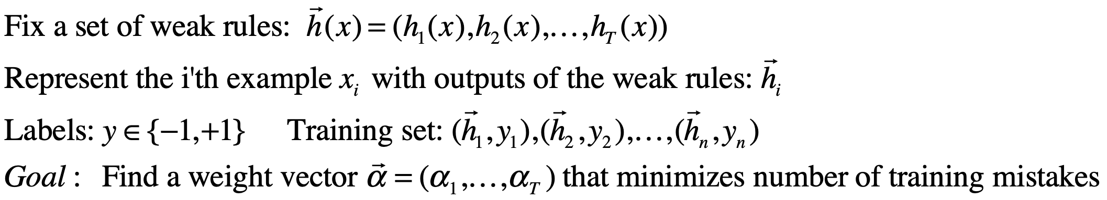

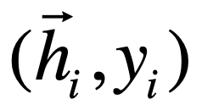
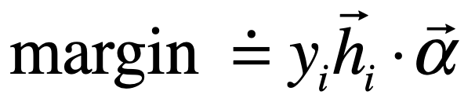
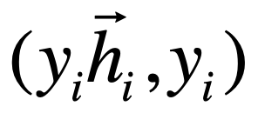
Margins
-
-
+
+
+
-
-
+
+
+
-
-
+
-
-
reflect
Correct
+
+
Cumulative # examples
-
+
+
Project
Mistakes
Correct
-
+
Mistake
+
-
-
-
+
-
-
-
Margin

Slide 7
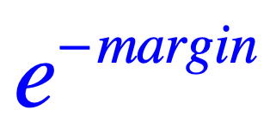
Boosting as gradient descent
Adaboost :
Loss
0-1 loss
Margin
Mistakes
Correct

Slide 8
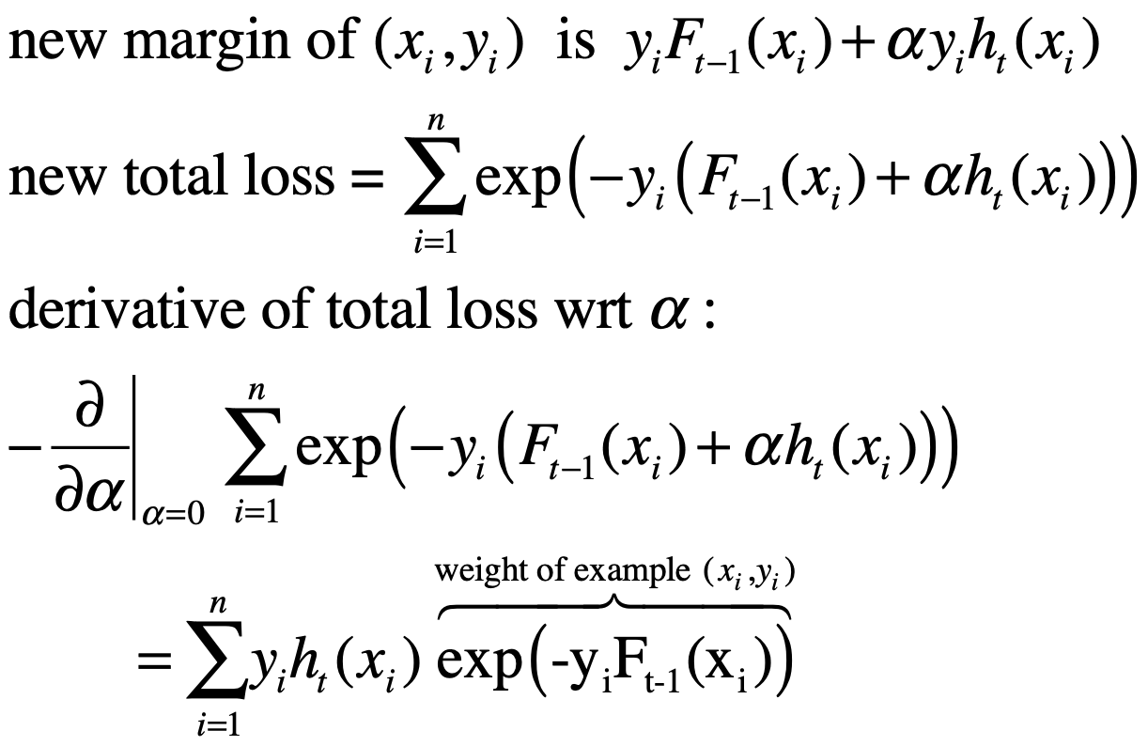


Adaboost as gradient descent
Weak rules are added one at a time.
Fixing the alphas for 1..t-1, find alpha for the new rule (ht)
Weak rule defines how each example would move = increase or decrease the margin.
0-1 loss
Margin
Mistakes
Correct

Slide 9
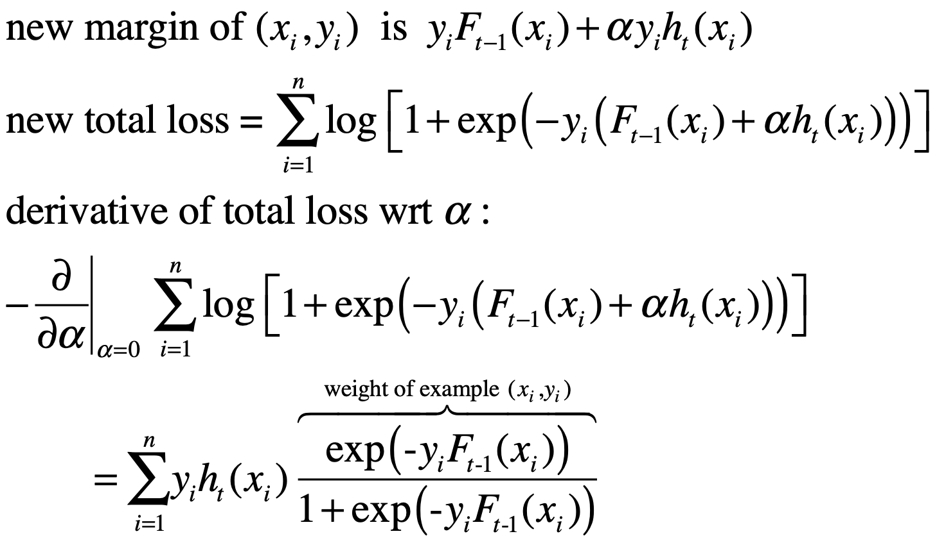
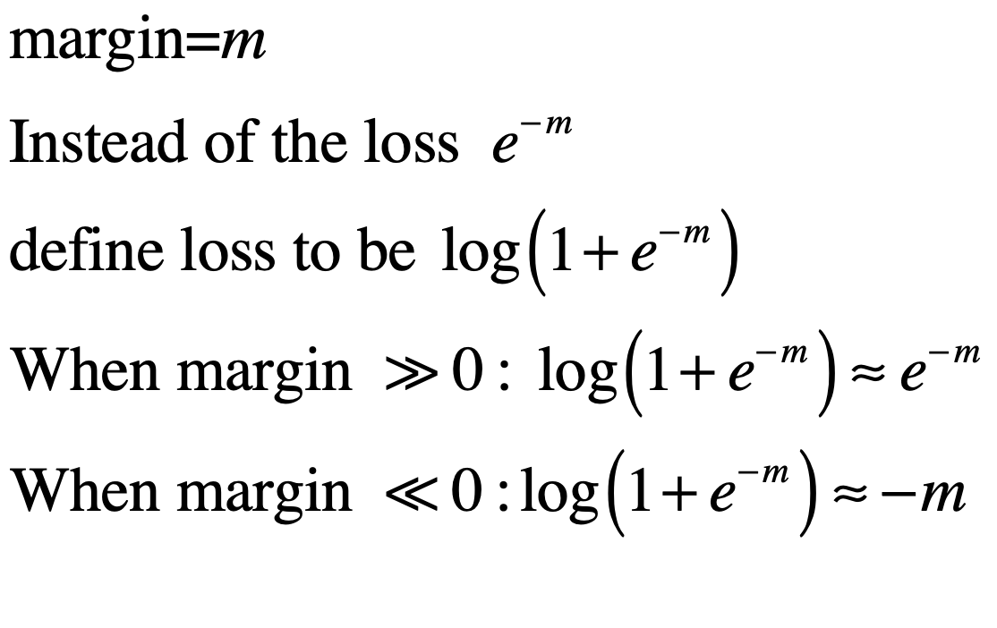
Logitboost as gradient descent
Also called Gentle-Boost and Logit Boost, Hastie, Freedman & Tibshirani
Logitboost loss
Adaboost (loss and weight)
Logitboost weight
Margin
Mistakes
Correct

Slide 10
Boost by Majority as gradient descent
Logitboost potential
Adaboost (potential and weight)
BBM Potential
Margin
Mistakes
Correct

