Slide 1
DSC 180A · PAPER PRESENTATION
Large Margin Classification Using the Perceptron Algorithm
Yoav Freund & Robert E. Schapire · Machine Learning, 1999
Section 2: the perceptron and the voted perceptron
Presented by Andrew
Notes:
Today I'm covering Section 2 of Freund and Schapire's 1999 paper: the classic perceptron, and their voted perceptron. I'll walk through both with one running example about horse racing.

Slide 2
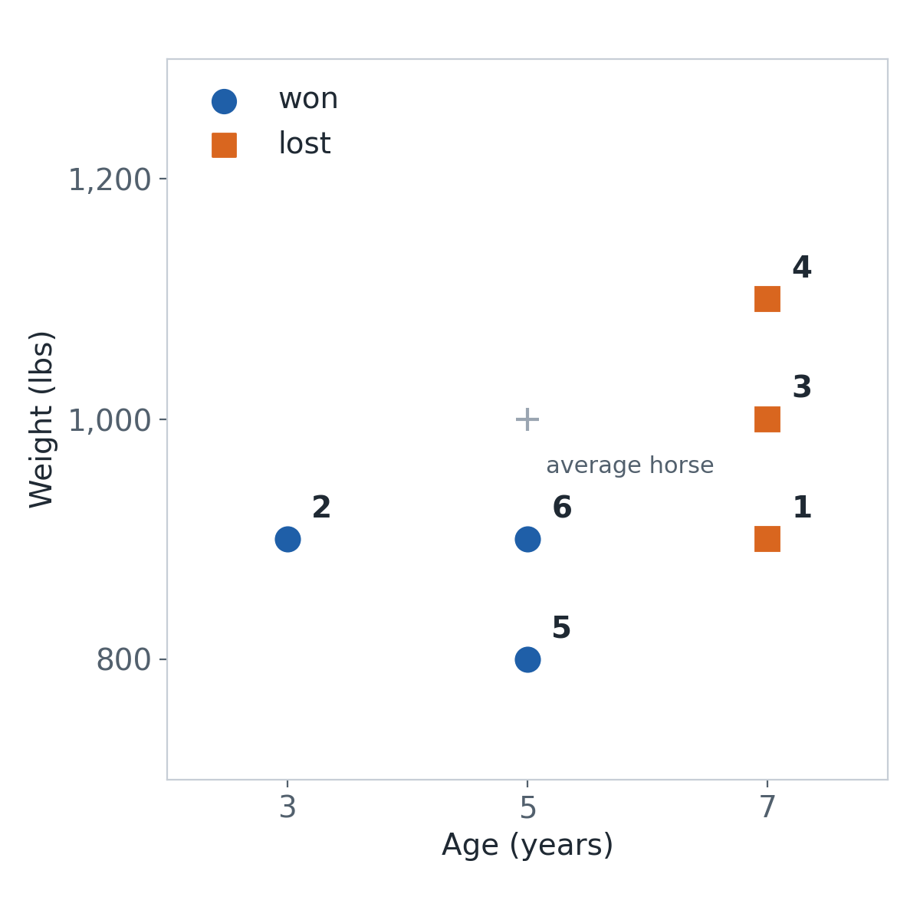
RUNNING EXAMPLE
Will this horse win?
# | Horse | Age | Weight | Result | x
1 | Iron Duke | 7 | 900 | Lost | (2, −1)
2 | Little Comet | 3 | 900 | Won | (−2, −1)
3 | Old Timer | 7 | 1,000 | Lost | (2, 0)
4 | Big Ben | 7 | 1,100 | Lost | (2, 1)
5 | Featherweight | 5 | 800 | Won | (0, −2)
6 | Swift Kid | 5 | 900 | Won | (0, −1)
x = (age − 5, (weight − 1,000) ÷ 100)
Each horse is measured relative to the average horse (5 years, 1,000 lbs).
Pretend each result is independent, and that age and weight really matter.
Notes:
Our running example. We want to predict whether a horse wins from two features, its age and its weight. For the sake of the argument, pretend each horse's result is independent, even though only one horse can win a real race, and pretend age and weight really matter. We have six past horses: three won and three lost. One detail: the paper's perceptron has no intercept, so we measure every horse relative to the average horse, 5 years old and 1,000 lbs. So Iron Duke, 7 years and 900 lbs, becomes x = (2, -1). Looking at the plot, the winners are the younger, lighter horses, and the perceptron has to discover that.

Slide 3
PERCEPTRON
Guess, check, and only change when you're wrong
1 Guess
Will it win? Predict
sign(v · x)
+ means win
2 Check
Did it win?
y = +1 won
y = −1 lost
3 Fix only if wrong
v ← v + y·x
Right? Change nothing.
Then go to the next horse. Keep cycling through all the horses until a full pass has no mistakes.
Reading v: v = (age weight, weight weight), one number per feature. A negative number means smaller is better. v = (−2, −1) means younger and lighter horses win, and age matters twice as much.
Notes:
The perceptron looks at one horse at a time. It guesses using the sign of v dot x: positive means win, negative means lose. Then it checks against what actually happened, with y equal to +1 for a win and -1 for a loss. If the guess was right, nothing changes. If it was wrong, it updates v by adding the horse's x if the horse won, or subtracting it if the horse lost. v is just two numbers, one per feature. A negative number means smaller is better: a negative age weight means younger horses are favored.

Slide 4
PERCEPTRON
Pass 1, horse by horse
Start with v = (0, 0)
Horse | x | y | v · x | Guess | Right? | v after
1 Iron Duke | (2, −1) | −1 | 0 | tie | ✗ | (−2, 1)
2 Little Comet | (−2, −1) | +1 | 3 | win | ✓ | (−2, 1)
3 Old Timer | (2, 0) | −1 | −4 | lose | ✓ | (−2, 1)
4 Big Ben | (2, 1) | −1 | −3 | lose | ✓ | (−2, 1)
5 Featherweight | (0, −2) | +1 | −2 | lose | ✗ | (−2, −1)
6 Swift Kid | (0, −1) | +1 | 1 | win | ✓ | (−2, −1)
Update rule
v ← v + y·x
Horse 1 lost (y = −1)
(0, 0)
− (2, −1)
= (−2, 1)
Horse 5 won (y = +1)
(−2, 1)
+ (0, −2)
= (−2, −1)
Pass 2: with v = (−2, −1), all 6 horses are right, so stop.
Orange rows are mistakes. Only those two rows change v.
Notes:
Here is the whole run. We start with v = (0, 0), so the first score is a tie at zero, which counts as a mistake. Iron Duke lost, so we subtract his x, and v becomes (-2, 1): younger wins, heavier helps. That rule gets the next three horses right, so nothing changes. Featherweight scores -2, a predicted loss, but she won, so we add her x, and v becomes (-2, -1): younger and lighter win. Swift Kid is right. In pass 2 we check all six horses again with v = (-2, -1). All six are right, so the algorithm stops. Two mistakes total.

Slide 5
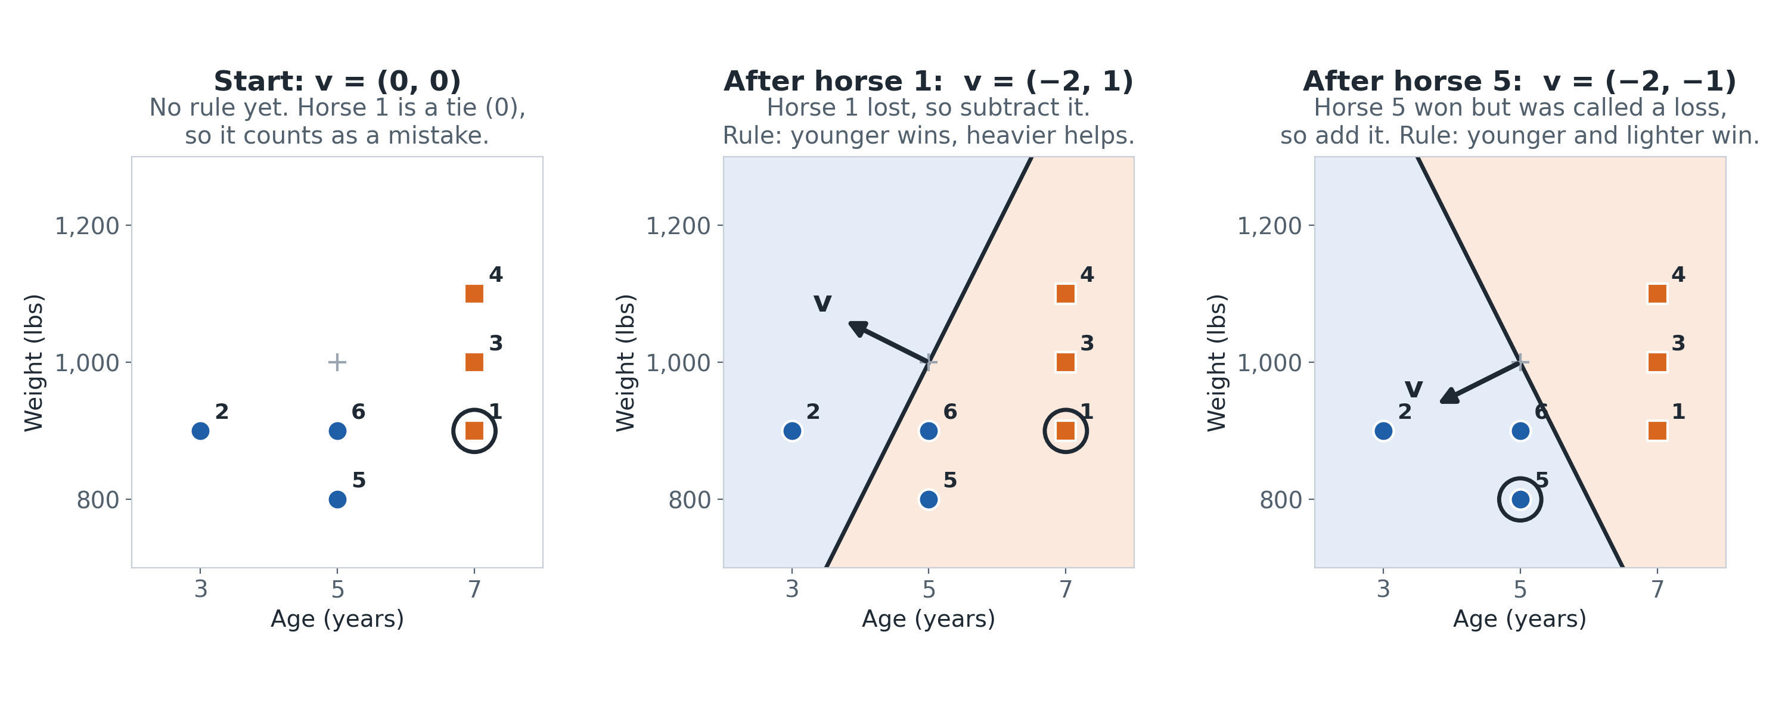
PERCEPTRON
How v shifts on each mistake
Blue side = predicted win. The circled horse is the mistake that moves the line.
Notes:
The same run as pictures. Blue shading is where the current rule predicts a win, and v always points into the win side. At the start there's no rule, so Iron Duke is a tie and counts as a mistake. Subtracting him gives the middle picture: the line now favors young horses, but it thinks heavier is better, so Featherweight, a light winner, lands on the losing side. Adding her rotates the line to the right picture, where every winner is on the blue side. The line only ever moves when a horse is on the wrong side.

Slide 6
PERCEPTRON
How it runs, and what it's good and bad at
1
2
3
4
5
6
Next pass
Stop after a pass with no mistakes
One horse at a time, in order, all the way to the end. Then repeat.
Pros
Very simple: a few lines of code
Each step is cheap: one dot product
Learns as data arrives, nothing to tune
Cons
Only finishes if a separating line exists
Can take many passes if classes are close
Keeps only the last v, with no margin
Notes:
To sum up: the perceptron walks through the horses one at a time, in order, all the way to the last one, then starts another pass, and stops after a pass with no mistakes. Pros: a few lines of code, each step is one dot product, and it can learn as new races come in, with nothing to tune. Cons: it only finishes if some line separates winners from losers. If they're mixed close together, it can take many passes. And it keeps only the last v, with no margin, which is exactly what the voted perceptron changes.

Slide 7
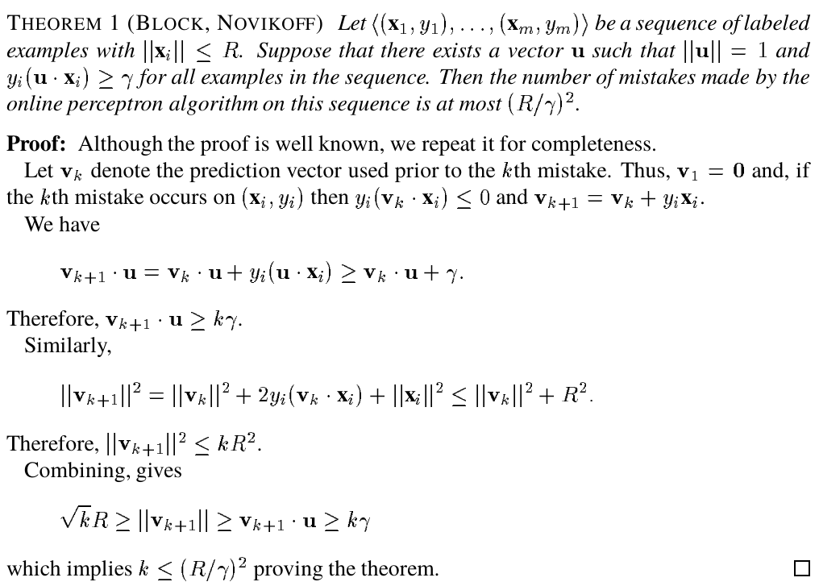
PERCEPTRON · THEOREM 1 (BLOCK, NOVIKOFF)
The classic perceptron's mistakes are bounded
mistakes ≤ (R / γ)²
if some line separates the data
Notes:
This is Theorem 1 from the paper, by Block and Novikoff. The previous slide said the perceptron only finishes if a separating line exists. This says that when one does, the number of mistakes is capped at R over gamma, squared. R is the size of the biggest data point, gamma is the margin, the gap between the separating line and the closest point. The proof tracks two things after each mistake. One: v lines up with the true separator u by at least gamma per mistake, so after k mistakes v dot u is at least k gamma. Two: the length of v grows slowly, at most R squared per mistake in squared length, because on a mistake the middle term is never positive. So the length is at most root k times R. Alignment can't exceed length, so k gamma is at most root k R, which gives k at most R over gamma squared. Notice the dimension never appears, which is why kernels into huge feature spaces are safe.

Slide 8
VOTED PERCEPTRON
The idea: don't throw the old versions away
Classic perceptron
v1
v2
v3
Keeps only the newest
Voted perceptron
v1
v2
v3
Keeps all of them, and they vote
Same training. The only change is saving every version of v, plus how long it lasted, and letting them vote.
Notes:
Quick transition. In our horse run, the perceptron made three versions of v, but the classic recipe keeps only the last one and throws the others away. Freund and Schapire's idea is small: train exactly the same way, but keep every version, remember how long each one lasted, and let them all vote.

Slide 9
VOTED PERCEPTRON
Analogy: which tipster do you trust on race day?
Each block is one tipster's streak of correct calls.
Tipster 1
Tipster 2
Tipster 3
(newest)
2
12 races
3 races
✗
✗
✗ = a wrong call. That tipster retires, and the next one is the old one plus a correction (v ← v + y·x).
Classic perceptron
Bet only with the newest tipster.
Tipster 3, who has only 3 good calls.
Voted perceptron
Everyone bets. Each vote counts as many times as that tipster's streak.
Votes: 2 + 12 + 3
Notes:
Freund and Schapire open their AdaBoost paper with a gambler betting on horse races using advice from experts. Here is a version of that idea for this paper. You follow a tipster. Every time the current tipster makes a wrong call, you retire them and hire a new one who is the old one plus a small correction. That is exactly v becomes v plus y x. Tipster 1 was right twice and then wrong. Tipster 2 was right 12 times in a row. Tipster 3 is the newest and has been right 3 times so far. The classic perceptron only listens to the newest tipster. The voted perceptron says everyone gets to bet, and each vote counts as many times as that tipster's streak.

Slide 10
VOTED PERCEPTRON
Every version votes, weighted by how long it lasted
v1
v2
v3 (newest)
2
12 steps
3 steps
✗
✗
✗ = a mistake. That version is replaced by v + y·x, and the new one starts counting.
A new horse comes in. Every version makes its call:
Version | Lasted | Says | Vote
v1 | 2 | win | +2
v2 | 12 | lose | −12
v3 | 3 | win | +3
Total |  |  | −7
Classic (v3 only): win
Voted (−7): lose v2's long track record wins
Notes:
Same picture as the tipsters, now in perceptron terms. Training produced three versions of v. v1 lasted 2 steps before a mistake replaced it, v2 lasted 12, and v3 is the newest and has lasted 3 so far. Each version's lifetime becomes its number of votes. A new horse comes in. v1 says win, v2 says lose, v3 says win. Weighted: plus 2, minus 12, plus 3, for a total of minus 7, so the voted perceptron predicts lose. The classic perceptron would only ask v3 and say win. The version with the long track record outvotes the newest one.

Slide 11
VOTED PERCEPTRON
The algorithm (Figure 1)
What's new vs. the perceptron
Training
v = 0; count = 0
for each horse (x, y):
if sign(v·x) == y:
count = count + 1
else:
save (v, count)
v = v + y·x
count = 1
Prediction
score = Σ count_k · sign(v_k·x)
predict sign(score)
1 Training
On a mistake, save the old v and its count.
Output of training: a list of pairs
<(v1,c1), (v2,c2), …, (vk,ck)>
ours: <(v1,2), (v2,12), (v3,3)>
2 Prediction
Every saved v votes win or lose, times its count.
Notes:
This is Figure 1 of the paper, written as code. Training is the normal perceptron loop with one added line: when a mistake happens, save the current v and how long it lasted before replacing it. Prediction asks every saved version for plus or minus one, multiplies by its count, and takes the sign of the total. That's the whole algorithm.

Slide 12
VOTED PERCEPTRON
How it runs, and what it's good and bad at
Weighted vote
Box area = number of votes
Same training as the perceptron. The only change is saving every version and voting.
+
+
v1 × 2
v2 × 12
v3 × 3
Pros
Beats the last-vector perceptron (next slide)
Uses every version, not just the newest
One bad update can't swing the answer
Does well even after one pass
Cons
Has to store every version
Prediction asks every version
Still a bit less accurate than an SVM
Notes:
To sum up the voted perceptron: it trains exactly like the perceptron, one horse at a time, but saves every version of v with its lifetime, and predicts with a weighted vote. Pros: it uses all the versions, not just the newest one, so one unlucky update can't swing the answer, and it does well even after a single pass. Most importantly, in the paper's tables it beats the last-vector perceptron, which the next slide shows. Cons: it has to store every version, prediction has to ask every version, and on the paper's digit benchmark it is still a little less accurate than an SVM.

Slide 13
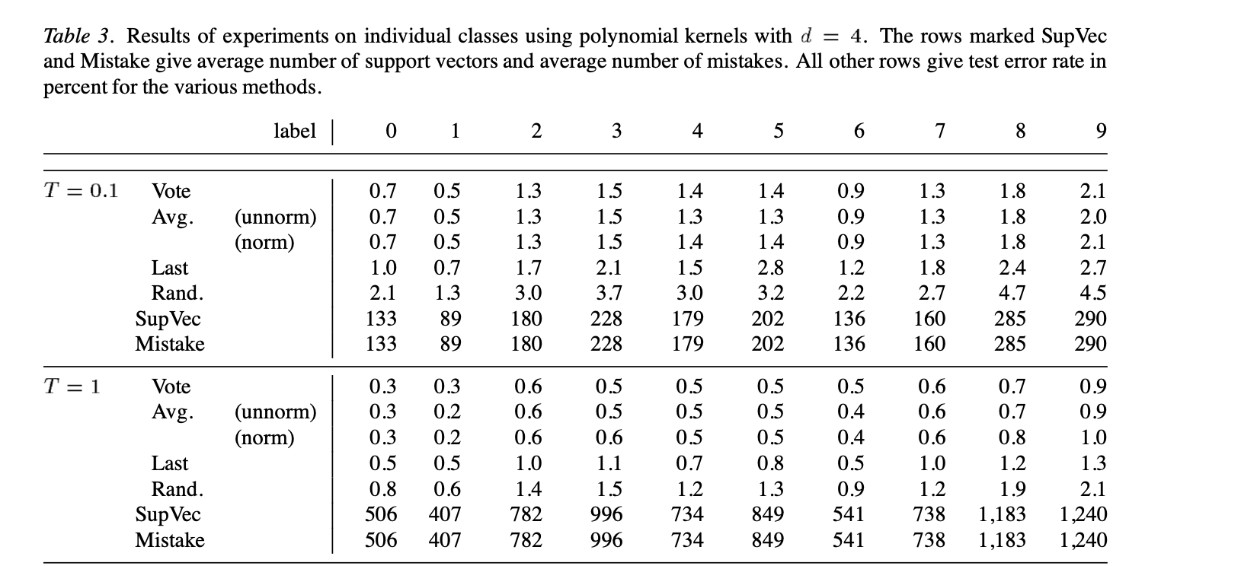
IN THE PAPER · TABLE 3 · TEST ERROR %, LOWER IS BETTER
Vote beats Last, the classic perceptron
Vote
Every saved version votes ±1, weighted by how long it lasted
Avg
Every version's score, weighted by how long it lasted
Last
Only the final version: the classic perceptron
Rand
The version alive at one random step
Notes:
This is Table 3 straight from the paper: ten yes-or-no problems, one per handwritten digit, with a degree-4 polynomial kernel. Every number is test error in percent, so lower is better. Compare the blue Vote rows with the orange Last rows, which is the classic perceptron. After a tenth of an epoch, voting is lower on every digit; on digit 5 it halves the error, 1.4 versus 2.8. After one full pass, voting is lower on nine digits and tied on digit 6.

Slide 14
MY IMPLEMENTATION
The experiment: can it spot malignant tumors?
569
tumors (Kaggle / UCI)
30
measurements of the cell nuclei per tumor
37%
malignant (212), the rest benign
Why this dataset
The paper's questions, on new data
Close to linearly separable, but not perfectly, which is where voting should help
Small and clean: all numeric, no missing values
Each row is one breast mass, sampled with a needle and measured under a microscope
1
Does Vote beat Last?
2
How close is it to an SVM?
3
What does it cost in time?
Setup: malignant = +1, benign = −1. Standardized features, 80/20 train/test split, d = 1, T = 1 and 3, mean of 50 runs.
Notes:
For my implementation I wanted a real dataset that is close to linearly separable but not perfectly, since that is where the paper says voting should help. The Breast Cancer Wisconsin Diagnostic dataset fits. It was collected at the University of Wisconsin in the 1990s: each row is one breast mass, sampled with a fine needle, imaged under a microscope, and described by 30 measurements of the cell nuclei, like radius, texture, and smoothness. 212 of the 569 tumors are malignant. My questions were the paper's questions: does voting beat the last vector here too, how close does it get to an SVM, and what does it cost in time. Setup: malignant is +1 and benign is -1, features are standardized, 80/20 train/test split, linear kernel, one and three passes, and every number is averaged over 50 runs.

Slide 15
MY IMPLEMENTATION
Our run: Breast Cancer Wisconsin (d = 1)
 | Method | Error % (95% CI) | Train (ms) | Predict (µs / tumor) | Kernel evals / prediction
T = 1 | Vote | 3.95 ± 0.41 | 1.26 | 0.3 | 27
 | Avg | 3.77 ± 0.43 | 1.26 | 0.3 | 27
 | Last | 4.84 ± 0.66 | 1.26 | 0.3 | 27
 | Rand | 6.25 ± 0.59 | 1.26 | 0.4 | 27
T = 3 | Vote | 3.72 ± 0.49 | 2.17 | 0.7 | 59
 | Avg | 3.54 ± 0.44 | 2.17 | 0.6 | 59
 | Last | 4.33 ± 0.55 | 2.17 | 0.7 | 59
 | Rand | 5.12 ± 0.44 | 2.17 | 0.7 | 59
SVM | SVC (ref.) | 3.95 ± 1.03 | 2.38 | 1.3 | 34
Vote beats Last (3.95% vs. 4.84% at T = 1, sign test p = 0.017) at no extra prediction cost.
569 tumors, 30 features, 80/20 split, mean of 50 runs. Times measured on my laptop. Kernel evals are machine-independent.
Notes:
I implemented the voted perceptron and ran it on the Kaggle Breast Cancer Wisconsin dataset: 569 tumors, 30 features, an 80/20 train/test split, averaged over 50 runs. Error is the percent of test tumors labeled wrong, so 3.95 percent is about 96 percent accurate, or 4 to 5 tumors out of 114. The voted perceptron beats the last vector at one pass, 3.95 versus 4.84, and a sign test across the 50 runs makes that significant, p = 0.017. It ties the SVM. On speed, voting costs nothing extra: Vote and Last both take 0.3 microseconds per tumor. The kernel-evaluation column is the machine-independent cost: 27 for the perceptron versus 34 support vectors for the SVM. Times are from my laptop.

Slide 16
Conclusions
1
Weight members by performance
2
Learns from streaming data; SVMs retrain
3
Ensembles of weak learners help
Notes:
One: weight members by performance, each version's vote counts as long as it lasted. Two: the voted perceptron learns one point at a time, so it handles streaming data, while a standard SVM retrains on everything. Three: ensembles of weak learners help, voting beat the last version, 3.95 versus 4.84 percent on breast cancer.

