Slide 1



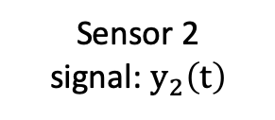
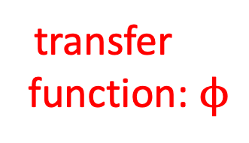


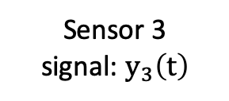
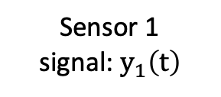

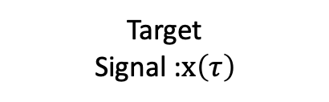

Sensor 2 signal: $y_{2}\left(t\right)$
Sensor 1 signal: $y_{1}\left(t\right)$
transfer function: $ϕ$
Sensor 3 signal: $y_{3}\left(t\right)$
Location$ψ_{2}(τ)$
Location$ψ_{1}(τ)$
Target
Signal :$x\left(τ\right)$
Location$ψ_{3}(τ)$
Location: $θ(τ)$

