Slide 1

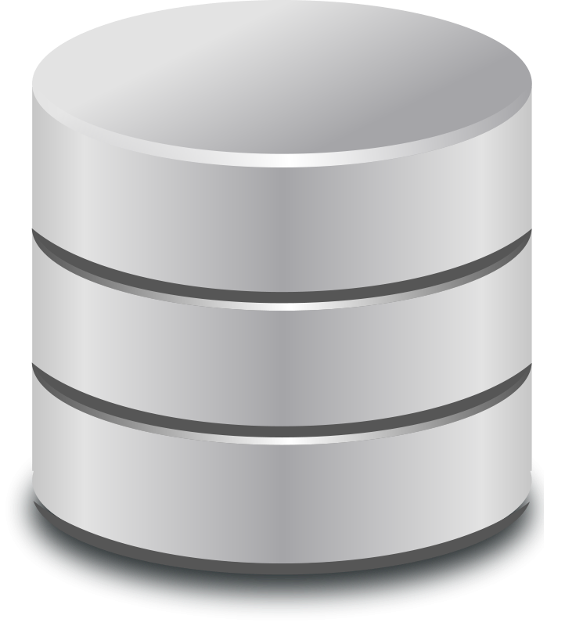
Database-driven Analytics Architecture
Business Intelligence Application Layer
(Cognos, Microstrategy, …)
Q
Logical Query Layer
(SQL, MDX, …)
Query Optimization &
Evaluation
Physical Layer
(DB2, SQL Server, Oracle, …)

Slide 2
Business Intelligence Application Layer
(Cognos, Microstrategy, …)
Q
Logical Query Layer
(SQL, MDX, …)
Query Optimization &
Evaluation
Physical Layer
(DB2, SQL Server, Oracle, …)

