Slide 1


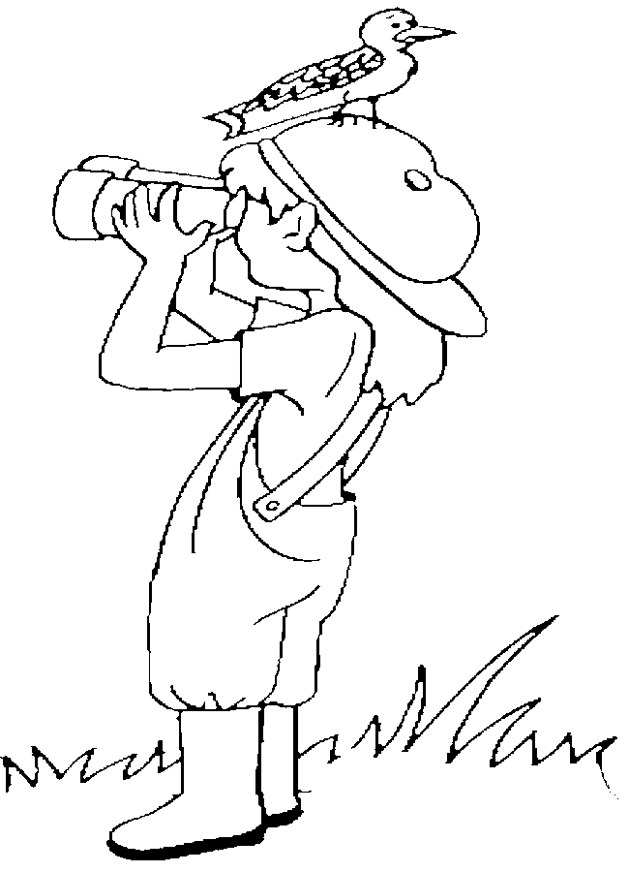
Mental Model
Sensory input

