Slide 1

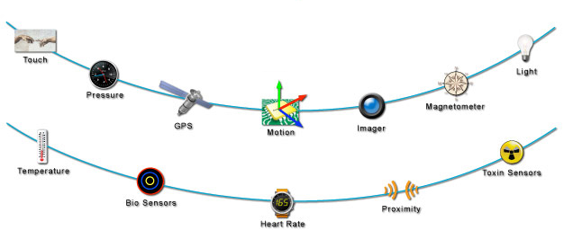
World
Sensors
Raw Data
Signal Processing
Cleaned & compressed data
Plato
Model
Data
A probability distribution
over possible worlds
Reconstructed sensor data
queries

