Slide 1
PART 1 · HOME ASSIGNMENT
E-commerce Product & CRO Manager
Home Assignment
Product thinking, CRO strategy and launch execution for Stripes Beauty.
PREPARED BY
Yoav Gersi
August 2026
ZyG
Stripes BEAUTY

Slide 2
STRIPES GROWTH CASE STUDY
What's inside
Four parts - from understanding the market to launching the hero product, optimizing the funnel, and scaling the work with AI.
01
PART 1
02
PART 2
Market & Competitive Landscape
Hero Product Launch
Who Stripes competes with, and how brands in the category acquire customers.
The creative angle, campaign landing page, funnel and KPIs for The Inside Addition.
03
PART 3
04
PART 4
Funnel Optimization
Agentic Approach
The first A/B experiments I'd prioritize on stripesbeauty.us.
One AI capability I'd build to help the growth team decide what to build next.
ZyG
Stripes BEAUTY

Slide 3
01
Part 1
Understanding the market
Before thinking about growth opportunities, I wanted to understand who Stripes competes with, who it's built for, and how brands in this space acquire customers.
ZyG
Stripes BEAUTY

Slide 4
MARKET OVERVIEW
Who is Stripes really competing with?
THE CATEGORY
THE CUSTOMER
Women's Health
Women experiencing peri- or post-menopause looking for:
↓
Menopause Wellness
Everyday wellness support
Stripes isn't built around solving one symptom. It's built around supporting women throughout menopause.
Non-hormonal solutions
Products that fit naturally into their routine
THE FRAMEWORK
This became the framework I used to decide which brands belonged in the competitive analysis.
ZyG
Stripes BEAUTY

Slide 5
APPROACH
How I selected competitors
CRITERION 1
CRITERION 2
Same customer
Same job to be done
Women experiencing menopause.
Helping women manage menopause-related symptoms.
If a brand met both conditions, it was included.
✓
DIRECT
ADJACENT
Direct competitors
Adjacent competitors
Brands focused primarily on menopause wellness.
Broader wellness brands competing for the same customer.
ZyG
Stripes BEAUTY

Slide 6
WHAT STOOD OUT
What I found
INSIGHT 1
THE EVIDENCE · PAID ACQUISITION BY BRAND
The biggest brands weren't always the closest competitors
BRAND
TYPE
TRAFFIC
PAID SHARE
TOP CHANNEL
Several high-traffic brands came from adjacent wellness categories rather than menopause-focused brands.
O Positiv
5.8M
75%
Display
ADJACENT
Midi
ADJACENT
3.6M
26%
Search
INSIGHT 2
Happy Mammoth
ADJACENT
2.5M
53%
Social
Paid acquisition looks very different across brands
Alloy
ADJACENT
1.7M
39%
Search
Some rely heavily on Search. Others invest more in Display or Social. There isn't a single winning channel.
Bonafide
DIRECT
1.1M
42%
Search
Estroven
DIRECT
253K
59%
Search
INSIGHT 3
Kindra
DIRECT
42K
5%
Display
Even direct competitors don't follow the same playbook
Womaness
DIRECT
41K
17%
Display
Some invest aggressively in paid acquisition. Others appear to rely much more on organic growth.
Paid share = paid search + social + display, as % of traffic. Similarweb + Semrush, Apr–Jun 2026 · estimates, directional.
ZyG
Stripes BEAUTY

Slide 7
WHAT I LEARNED
Three takeaways from the research
01
02
03
Customer fit matters more than category fit
There isn't one winning acquisition strategy
Stripes already has a clear positioning advantage
The closest competitors aren't always menopause brands. They're the brands solving similar problems for the same customer.
Successful brands grow through different channel mixes. There isn't a formula to copy.
Most brands focus on individual symptoms. Stripes can build acquisition around supporting the entire menopause journey.
WHERE I'D FOCUS
Instead of copying competitors, I'd build a growth strategy around Stripes' strongest differentiator: supporting the full menopause journey.
ZyG
Stripes BEAUTY

Slide 8
02
Part 2
Launching the hero product
How I'd bring The Inside Addition to market - the creative angle, the campaign landing page, the funnel, and how I'd measure success.
ZyG
Stripes BEAUTY

Slide 9
PART 2 · LAUNCH STRATEGY
Creative angle
"Your daily addition. Feel like yourself again."
WHY THIS ANGLE?
1
Builds on the product name
"The Inside Addition" becomes part of the story, not just the label.
2
Fits the brand
Positive and supportive, not clinical or fear-based.
Instead of being just another menopause supplement, The Inside Addition becomes a simple daily habit that naturally fits into a woman's routine and supports her from the inside out.
3
Matches the product
Daily menopause symptom support
Hormone-free
Supports daily function
Eases stress, brain fog & hot flashes
4
Stands apart from competitors
Most menopause brands focus on a single symptom. The Inside Addition becomes everyday support through every stage of menopause.
BUILDING ON THE EXISTING BRAND MESSAGE
"Show yourself love from the inside, out."
ZyG
Stripes BEAUTY

Slide 10
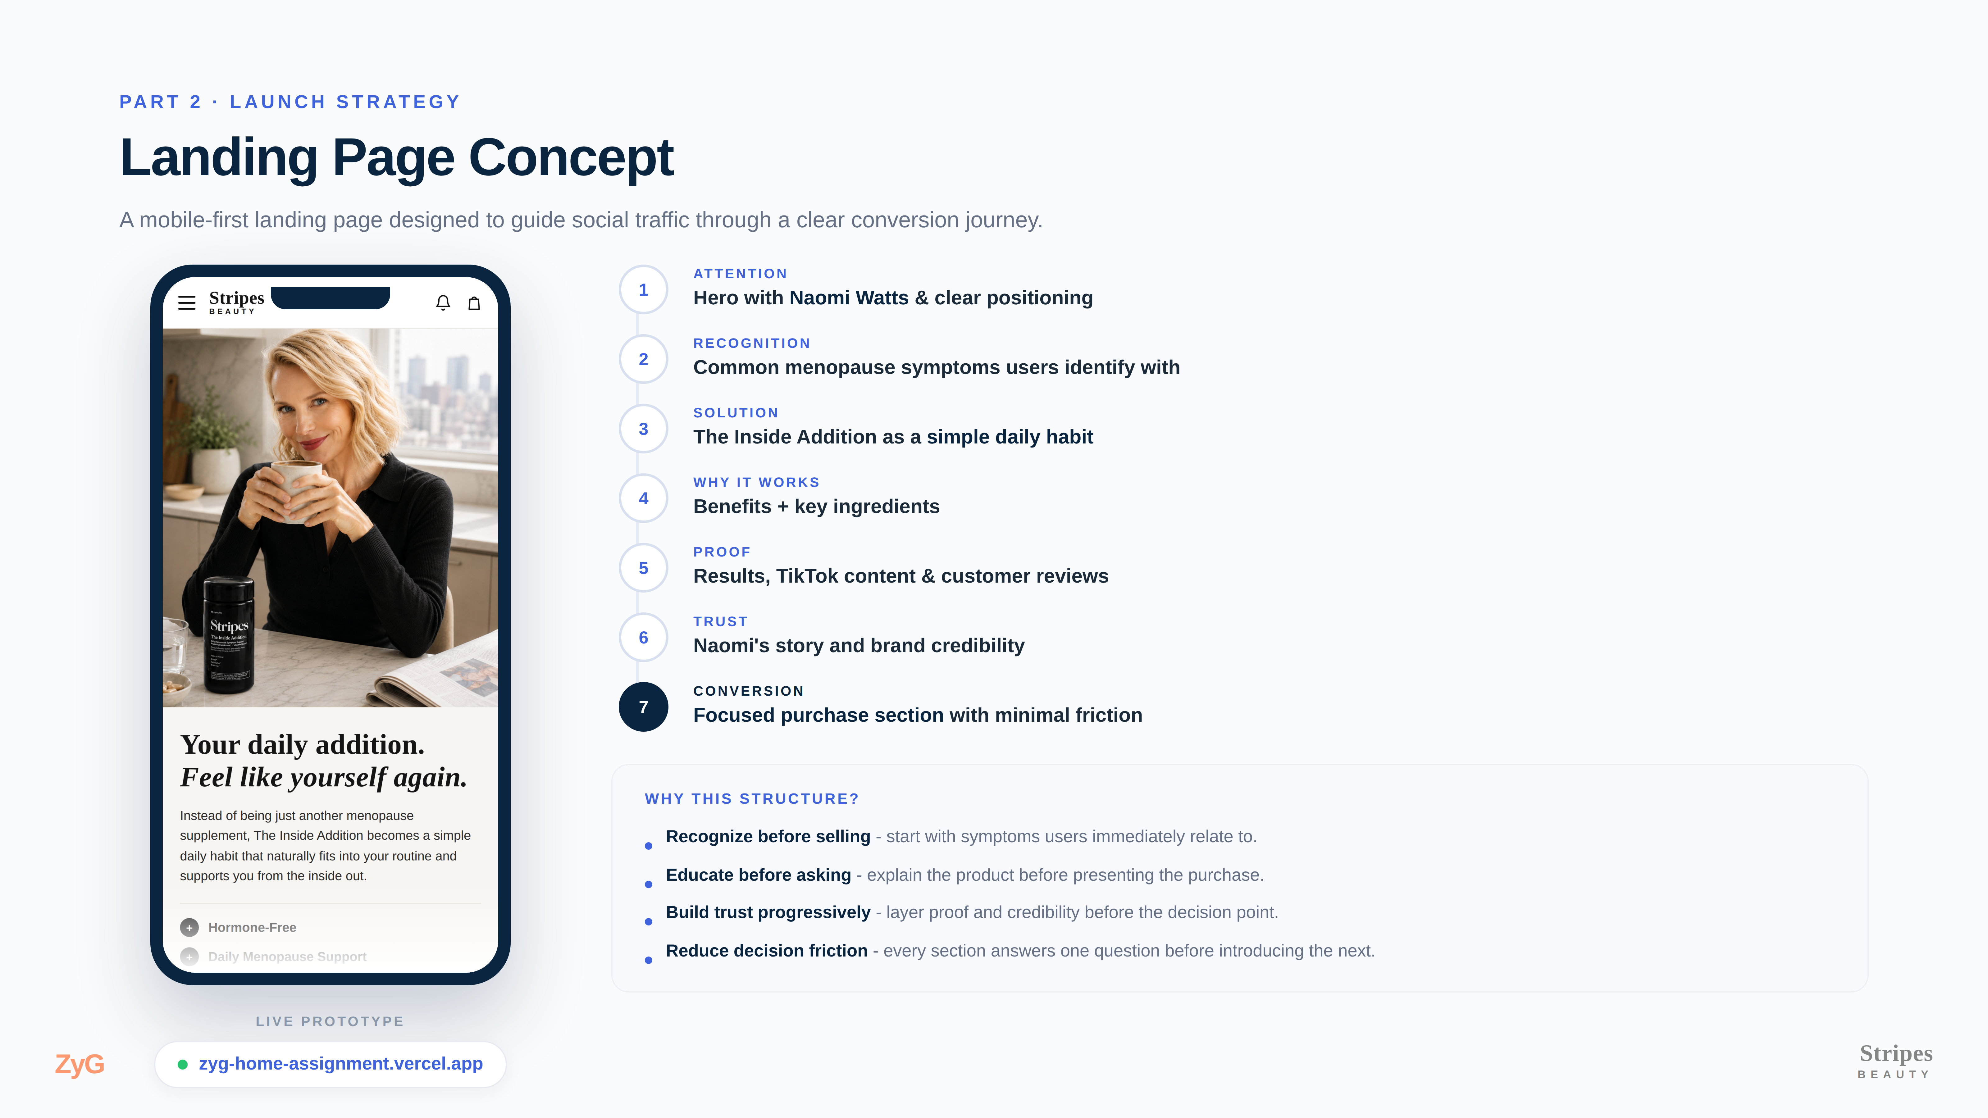

Slide 11
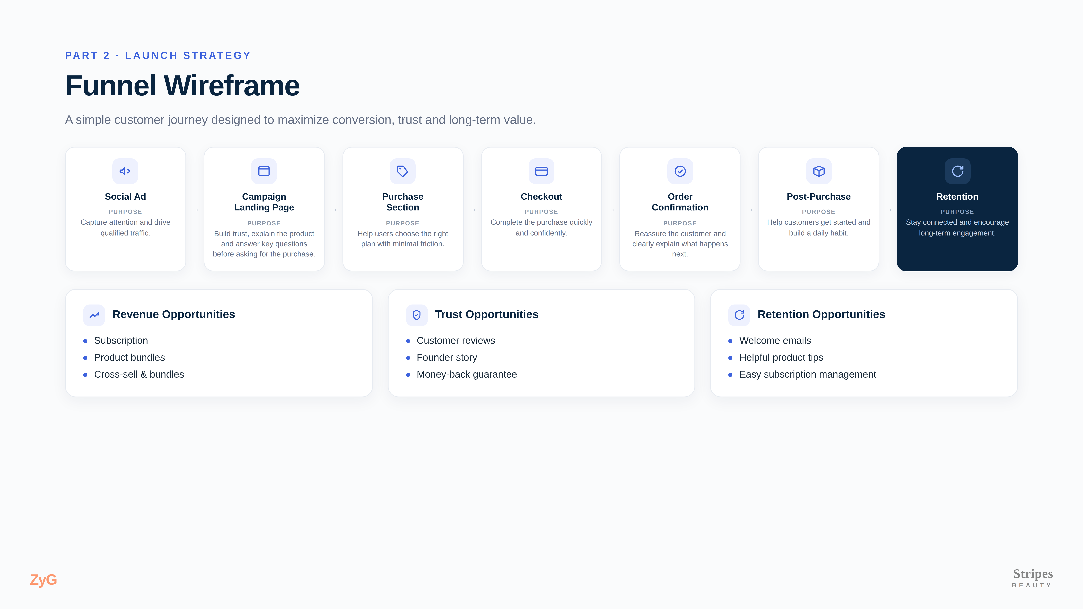

Slide 12
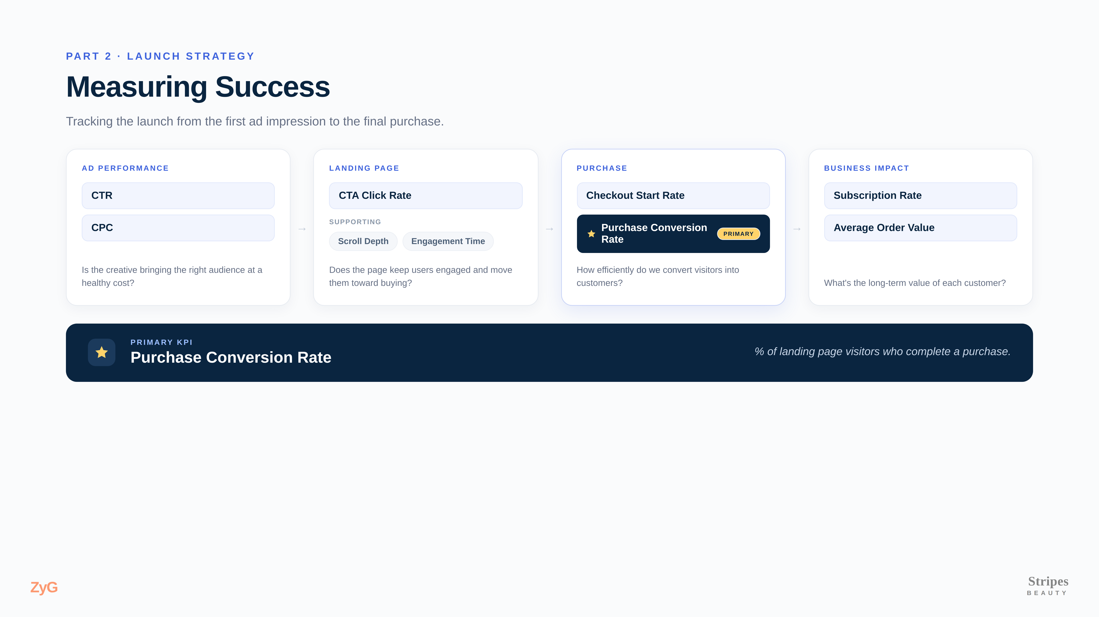

Slide 13
PART 3 · FUNNEL OPTIMIZATION
Optimization strategy
◇
KEY FUNNEL
◎
TRAFFIC SOURCE
Homepage → Product Detail Page
Paid Social (Meta)
✓
APPROACH
1
Prioritize high-impact opportunities before micro-optimizations.
2
With relatively limited traffic, prioritize experiments that maximize learning while targeting meaningful business impact.
3
Build data-driven hypotheses and validate them through A/B testing.
ZyG
Stripes BEAUTY

Slide 14
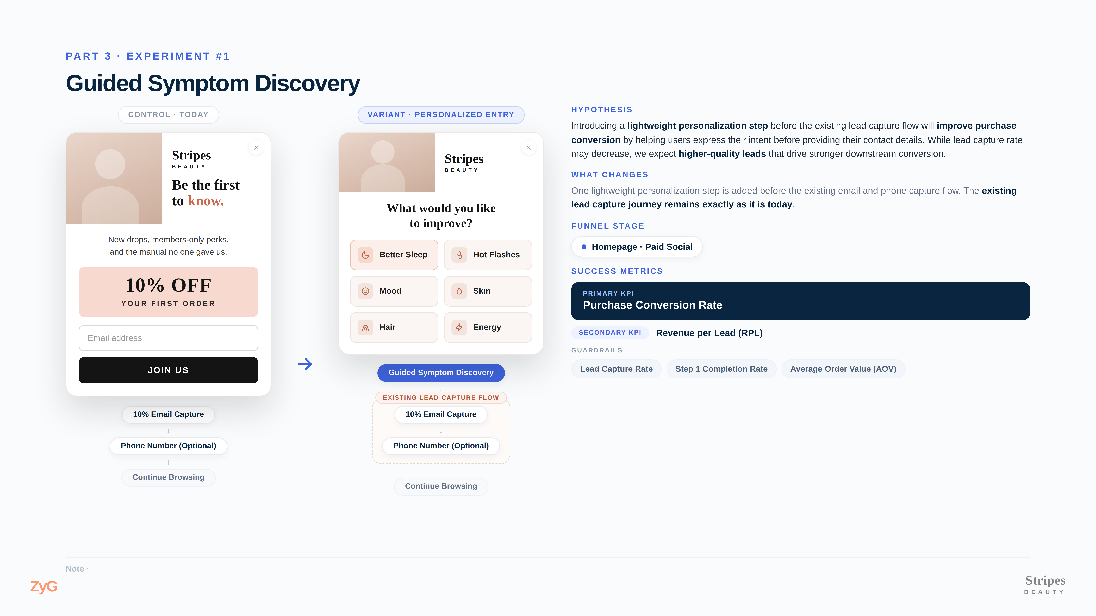

Slide 15
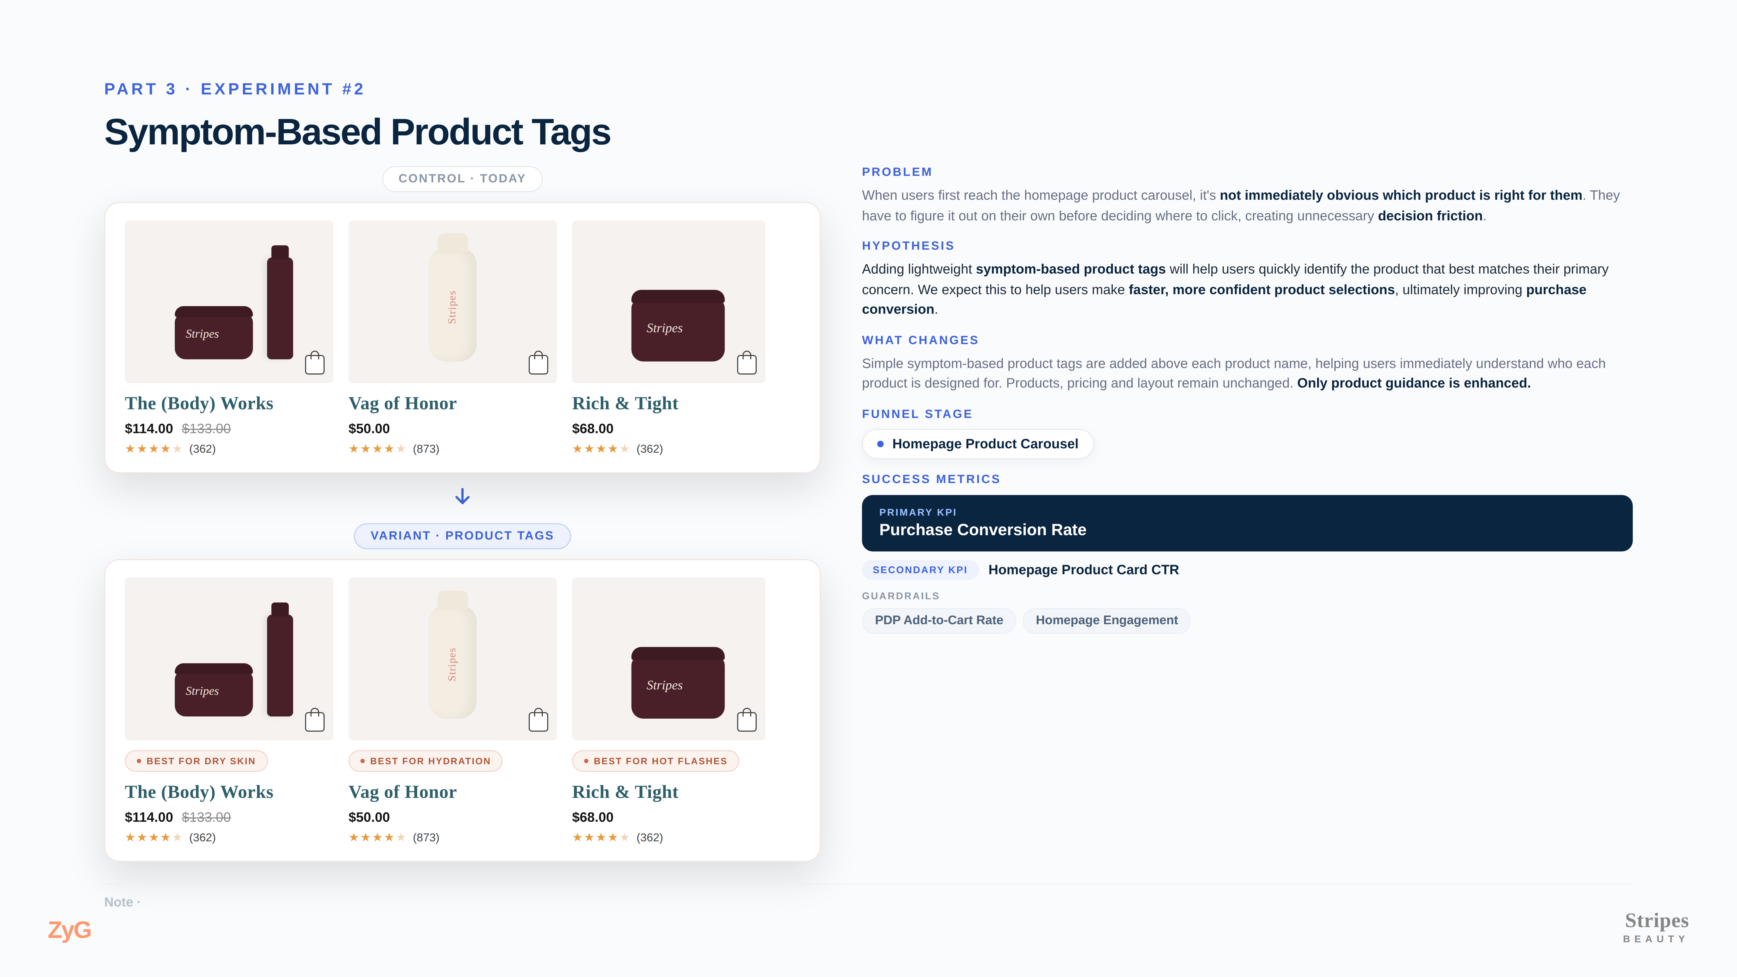

Slide 16
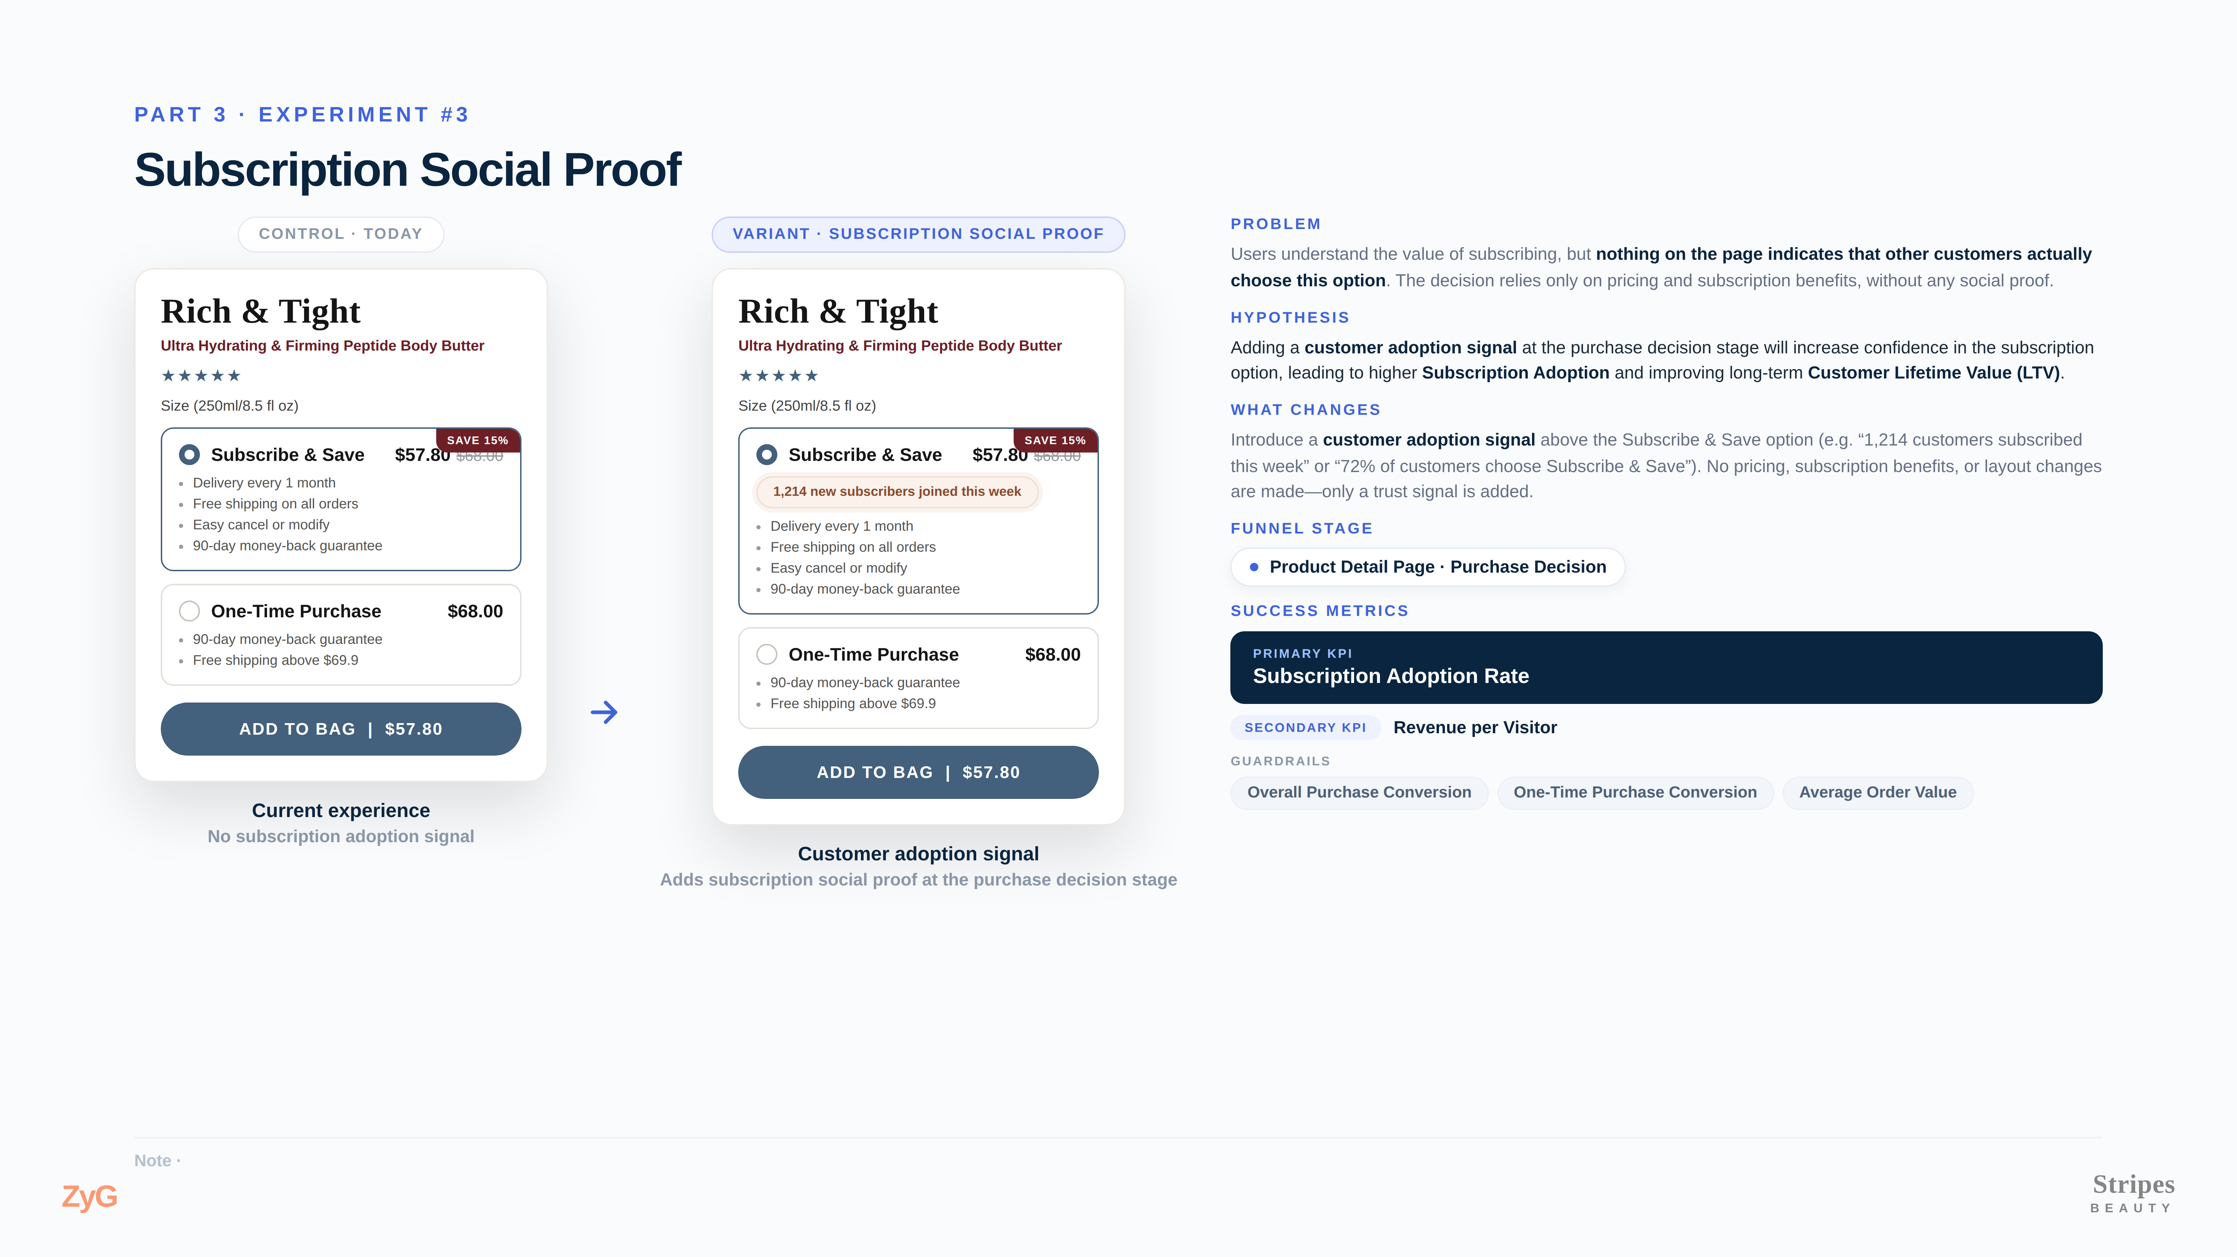

Slide 17
04
Part 4
AI for Growth Teams
If I could build one AI capability for ZyG's growth team, this is where I'd start.
ZyG
Stripes BEAUTY

Slide 18
THE OPPORTUNITY
AI changed the bottleneck
AI ALREADY HELPS TEAMS CREATE
"How do we build this?"
Landing pages
Ad creatives
Copy variations
↓
A/B test variants
"What should we build next?"
Creating assets is becoming easier than ever. The harder question is deciding what to build.
That's where product teams still spend most of their time.
MY FOCUS
My focus isn't making creation faster. It's making product decisions smarter.
ZyG
Stripes BEAUTY

Slide 19
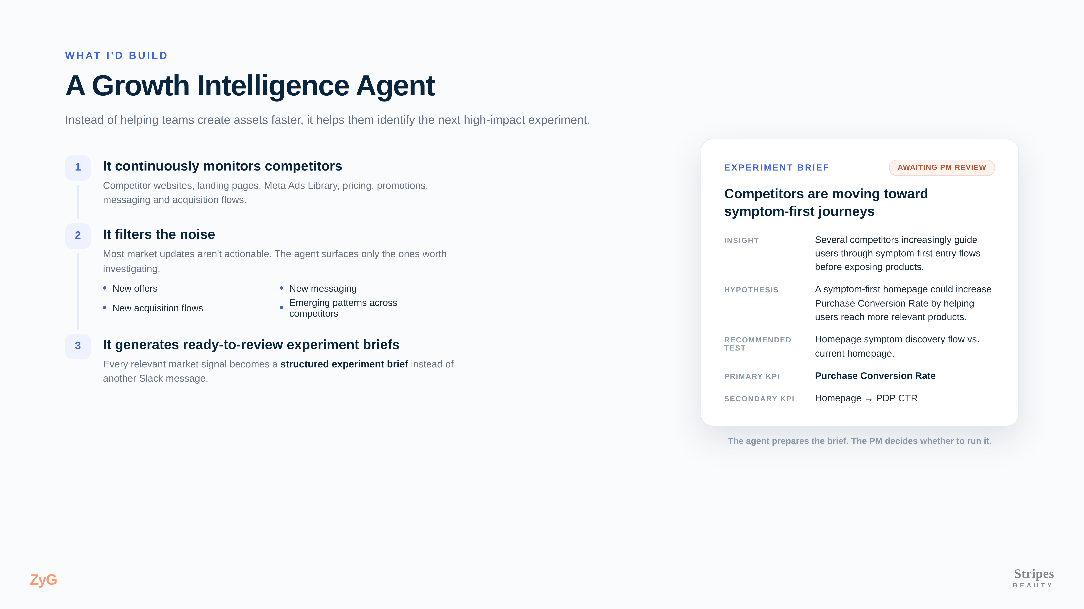

Slide 20
HUMAN IN THE LOOP
Keep humans in the decision loop
AI IS GOOD AT
PRODUCT TEAMS STILL DECIDE
Finding market changes
Does this fit our strategy?
Detecting patterns
Does this fit our brand?
Drafting experiment ideas
Is this worth building?
Preparing experiment briefs
Should this be our next priority?
The agent makes sure the team never misses an opportunity. The product team decides which opportunities are worth pursuing.
ZyG
Stripes BEAUTY

