Slide 1
Transport Layer Security(TLS)
By Levi Dworkin

Slide 2
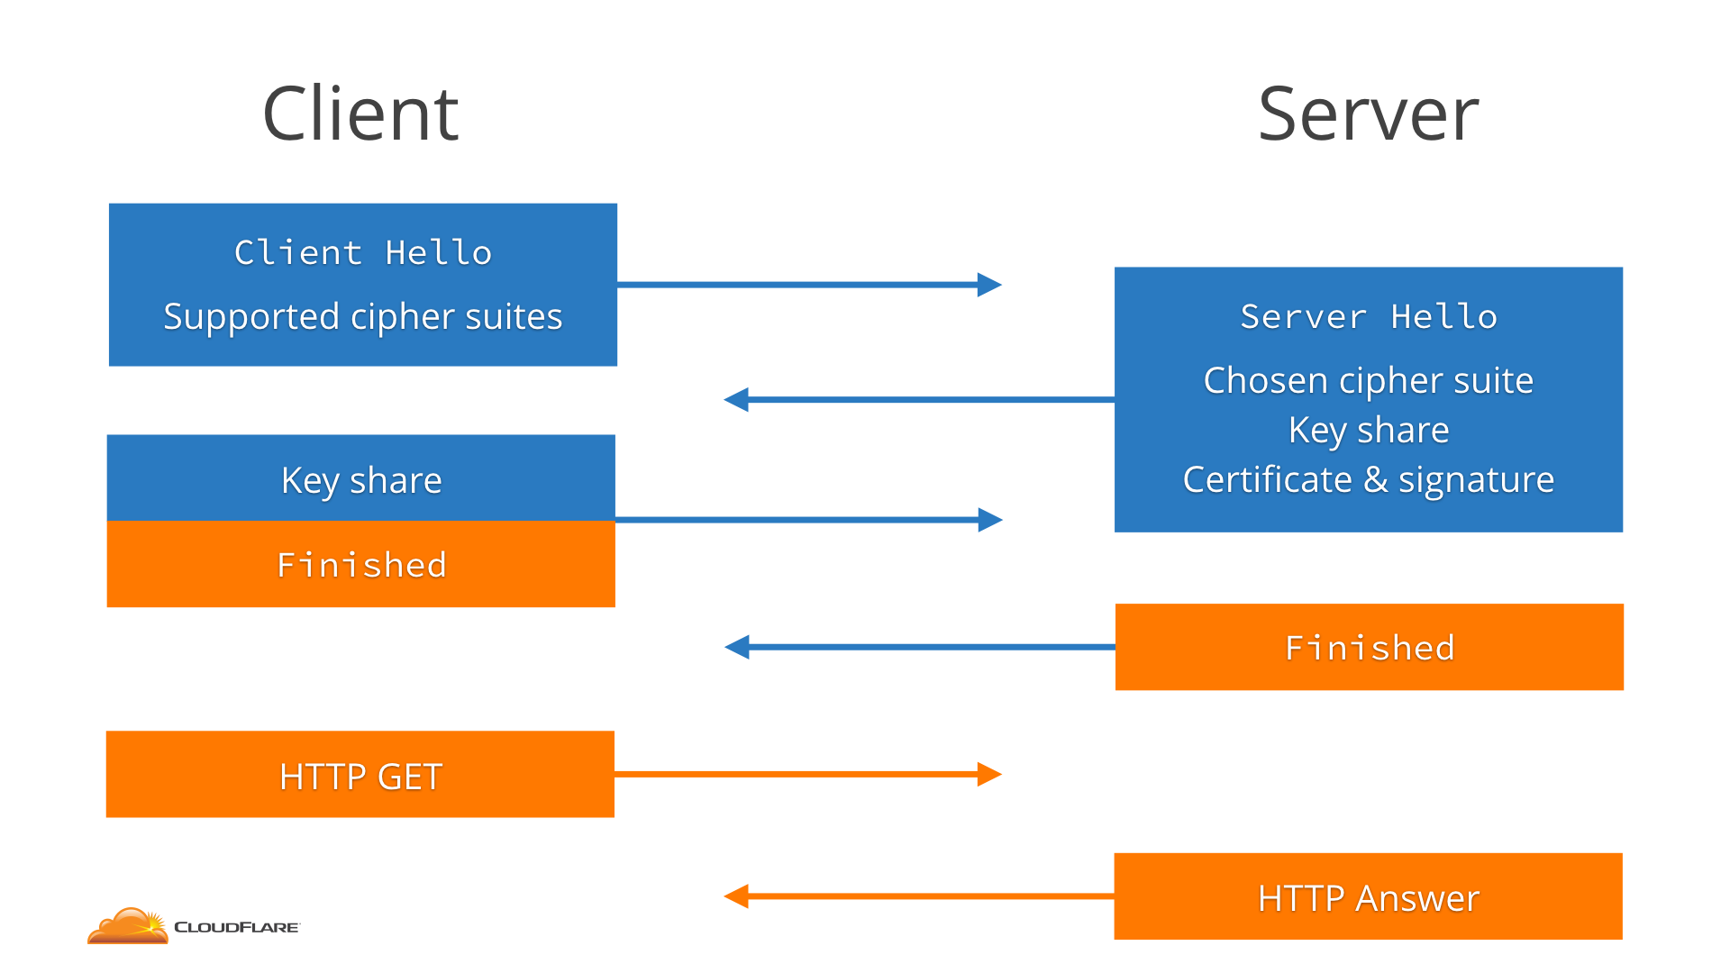
TLS 1.2: 2-RTT
Notes:
The client starts with a ClientHello that says "hey, I want to speak TLS 1.2, with one of these cipher suites".
The server answers with a ServerHello that says "sure, let's speak TLS 1.2, and I pick this cipher suite".
Along with that the server sends its key share based on what cipher suite was selected.
Finally, the server sends the website certificate (signed by the CA) and a signature on portions of ClientHello and ServerHello, including the key share, so that the client knows that those are authentic.
The client then generates its own key share mixed with the server key share, and thus generates the encryption keys for the session.
Finally, the client sends the server its key share, enables encryption and sends a Finished message (which is a hash of a transcript of what happened so far). The server does the same: it mixes the key shares to get the key and sends its own Finished message.

Slide 3
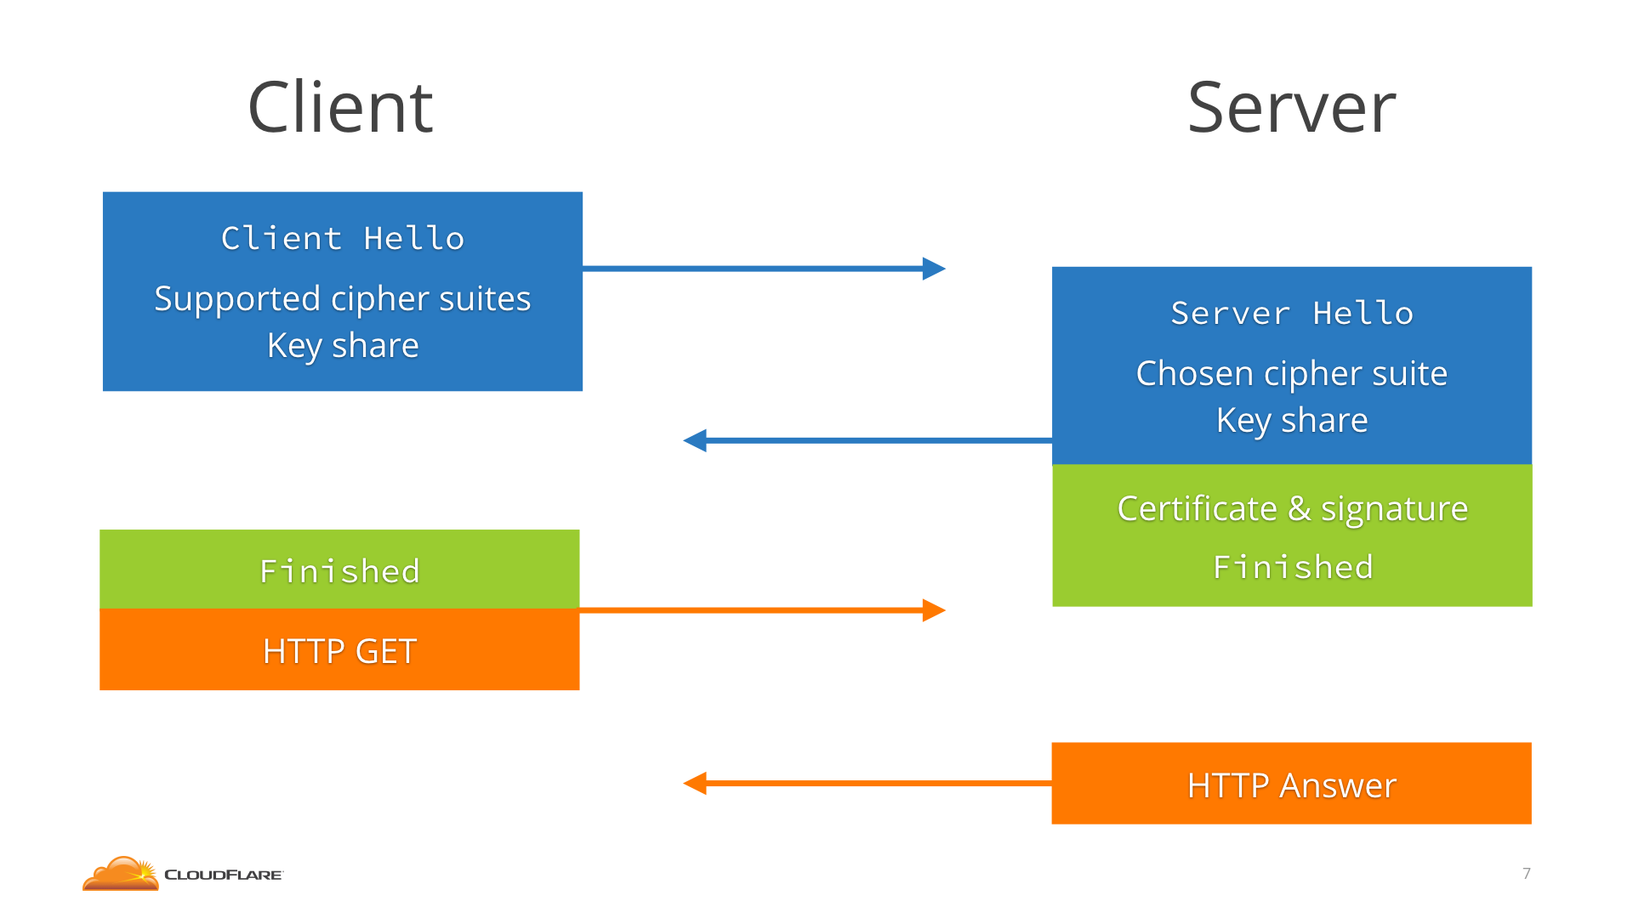
TLS 1.3: 1-RTT
Notes:
Aside the Client Hello it also makes a guess as to which key agreement algorithm the server will choose, and sends a key share for that.
So the server sends the ServerHello, its key share, the certificate (now encrypted, since it has a key!), and already the Finished message.
The client receives all that, generates the keys using the key share, checks the certificate and Finished, and it's immediately ready to send the HTTP request, after only one round-trip.

Slide 4
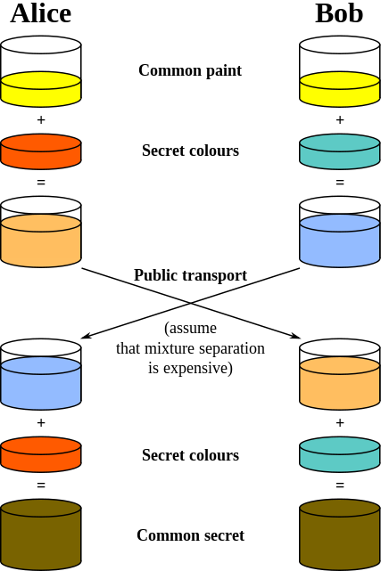
Diffie-Hellman key exchange algorithm

Slide 5


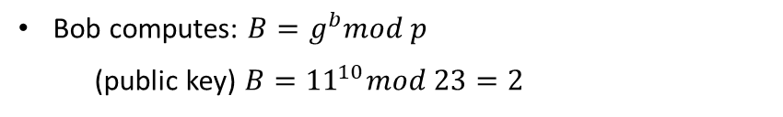


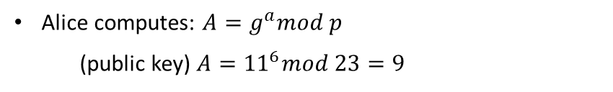


Diffie-Hellman Key Exchange
Bob and Alice know and have the same:
P=23 (a prime number) g=11 (a generator)
Alice chooses a secret random number a = 6 (private key)
Bob chooses a secret random number b = 10 (private key)
Alice computes: $A=g^{a}mod p$
(public key) $A={11}^{6}mod 23=9$
Bob computes: $B=g^{b}mod p$
(public key) $B={11}^{10}mod 23=2$
Alice receives B = 2 from Bob
Bob receives A = 9 from Alice
Secret Key: $k=B^{a}mod p$
Secret Key: $k=A^{b}mod p$
Alice computes: $k=2^{6}mod 23=18$
Bob computes: $k=9^{10}mod 23=18$
The common secret key is: 18 (session key)
N.B. We could also have written: $k=g^{ab}mod p$
Notes:
Diffie Hellman: An algorithm used to establish a shared secret between two parties (exchanging cryptography keys).
Ephemeral keys = short lived keys
Ephemeral Diffie-Hellman (DHE in the context of TLS) differs from the static Diffie-Hellman (DH) in the way that static Diffie-Hellman key exchanges always use the same Diffie-Hellman private keys. So, each time the same parties do a DH key exchange, they end up with the same shared secret.
When a key exchange uses Ephemeral Diffie-Hellman a temporary DH key is generated for every connection and thus the same key is never used twice. This enables Forward Secrecy (FS), which means that if the long-term private key of the server gets leaked, past communication is still secure.
This distinction also holds for the Elliptic Curve variants ECDHE (ephemeral, provides Forward Secrecy) and ECDH (static).

Slide 6

Correctness
Is it possible to “hack” Diffie-Hellman by knowing the prime number and the generator parameters?
to compute the secret key you must first be able to compute a (Alice's secret key) or b ( Bob's secret key) this will require the eavesdropper to compute the discrete logarithm and since there isn't any known efficient algorithm that can compute that than Diffie-Hellmen is pretty secure, and the third party (the eavesdropper) will never know the secret key. (Note that the right selection of p and g is critical for making a secure key exchange).
Notes:
בעיית הלוגריתם הבָּדִיד
Discrete Logarithm problem - the discrete logarithm problem over carefully chosen groups has no efficient solution.

Slide 7
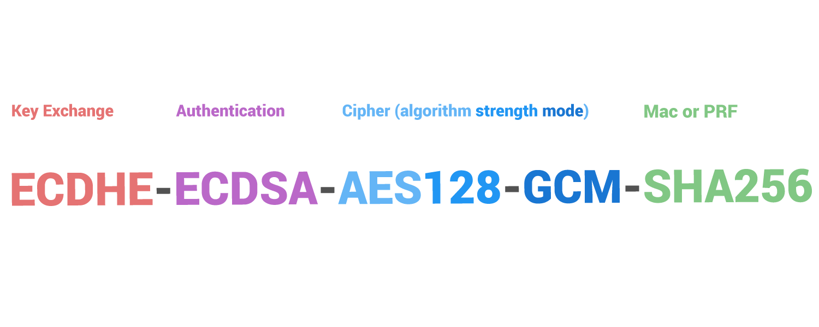
Cipher Suite

Slide 8
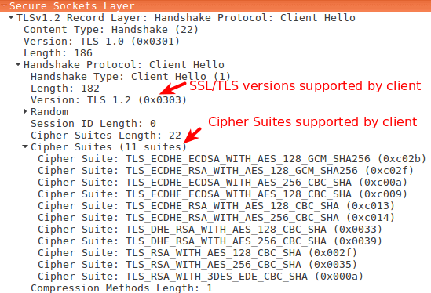
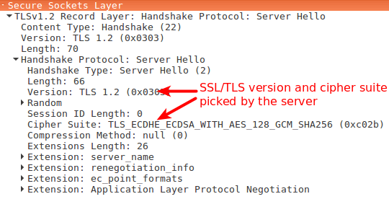
Client Hello / Server Hello

Slide 9
Resumption
One existing way to speed up TLS connections is called resumption. It's what happens when the client has connected to that server before, and uses what they remember from the last time to cut short the handshake.
How is it done?

Slide 10
Session, Session ID, Session Ticket
A session is a temporary and interactive information interchange between two or more communicating devices
Session ID (stateful server) – The server gives the client a session id in first session. The next time the client wants to connect it will show it’s session id and the server will then fetch the previous session which it had stored.
Session Ticket (stateless server) – The server gives the client a session ticket, which is encrypted with the whole session and only the server can decrypt, in first session. The next time the client wants to connect it’ll provide the session ticket and the server will decrypt the previous session.

Slide 11
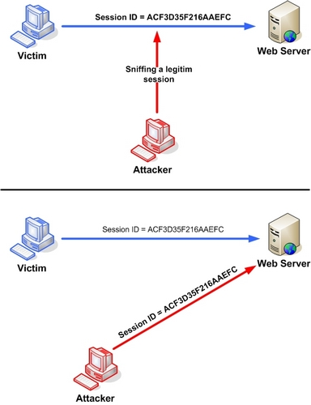
Session ID

Slide 12
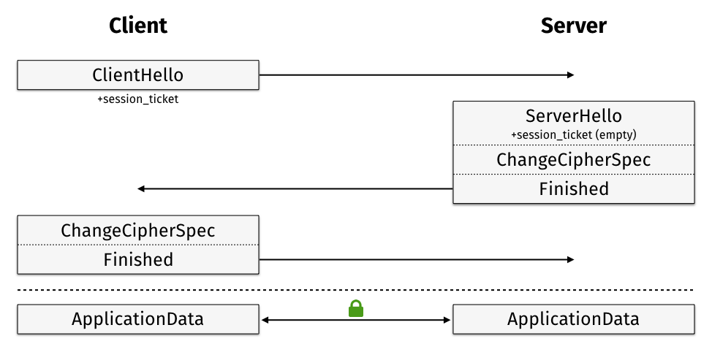
Session Ticket

Slide 13
DHE vs DH
Ephemeral Diffie-Hellman (DHE in the context of TLS) differs from the static Diffie-Hellman (DH) in the way that static Diffie-Hellman key exchanges always use the same Diffie-Hellman private keys. So, each time the same parties do a DH key exchange, they end up with the same shared secret.
When a key exchange uses Ephemeral Diffie-Hellman a temporary DH key is generated for every connection and thus the same key is never used twice. This enables Forward Secrecy (FS), which means that if the long-term private key of the server gets leaked, past communication is still secure.
This distinction also holds for the Elliptic Curve variants ECDHE (ephemeral, provides Forward Secrecy) and ECDH (static).

Slide 14
Forward Secrecy
Forward Secrecy gives assurance that your session keys will not be compromised even if the private key of the server is compromised.
By generating a unique session key for every session a user initiates, even the compromise of a single session key will not affect any data other than that exchanged in the specific session protected by that particular key.
The key exchange has to be ephemeral (e.g. Ephemeral Diffie-Hellman). This means that the client and the server will generate a new set of Diffie-Hellman parameters for each session.

Slide 15
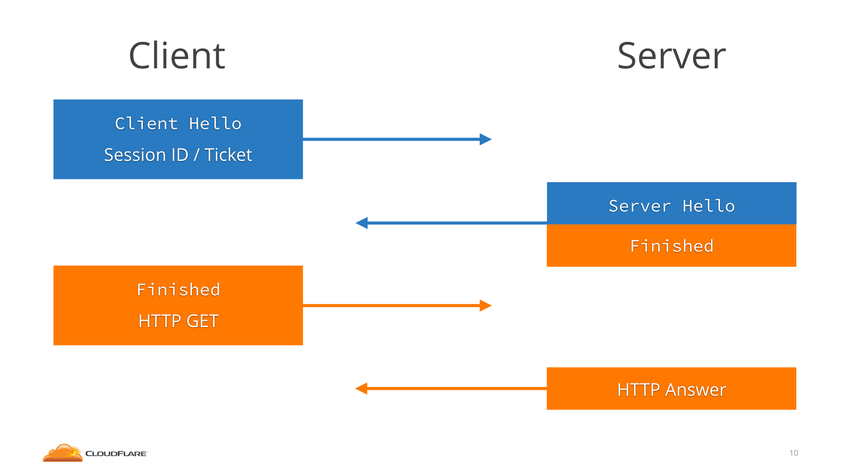
TLS 1.2: 1-RTT Resumption
Notes:
The server would send the client a Session ID/Ticket. Then the next time the client would connect, it would send the Session ID/Ticket and the server would go like "hey, I know you, we have agreed on a key already", skip the whole key shares dance, and jump straight to Finished, saving a round-trip.

Slide 16
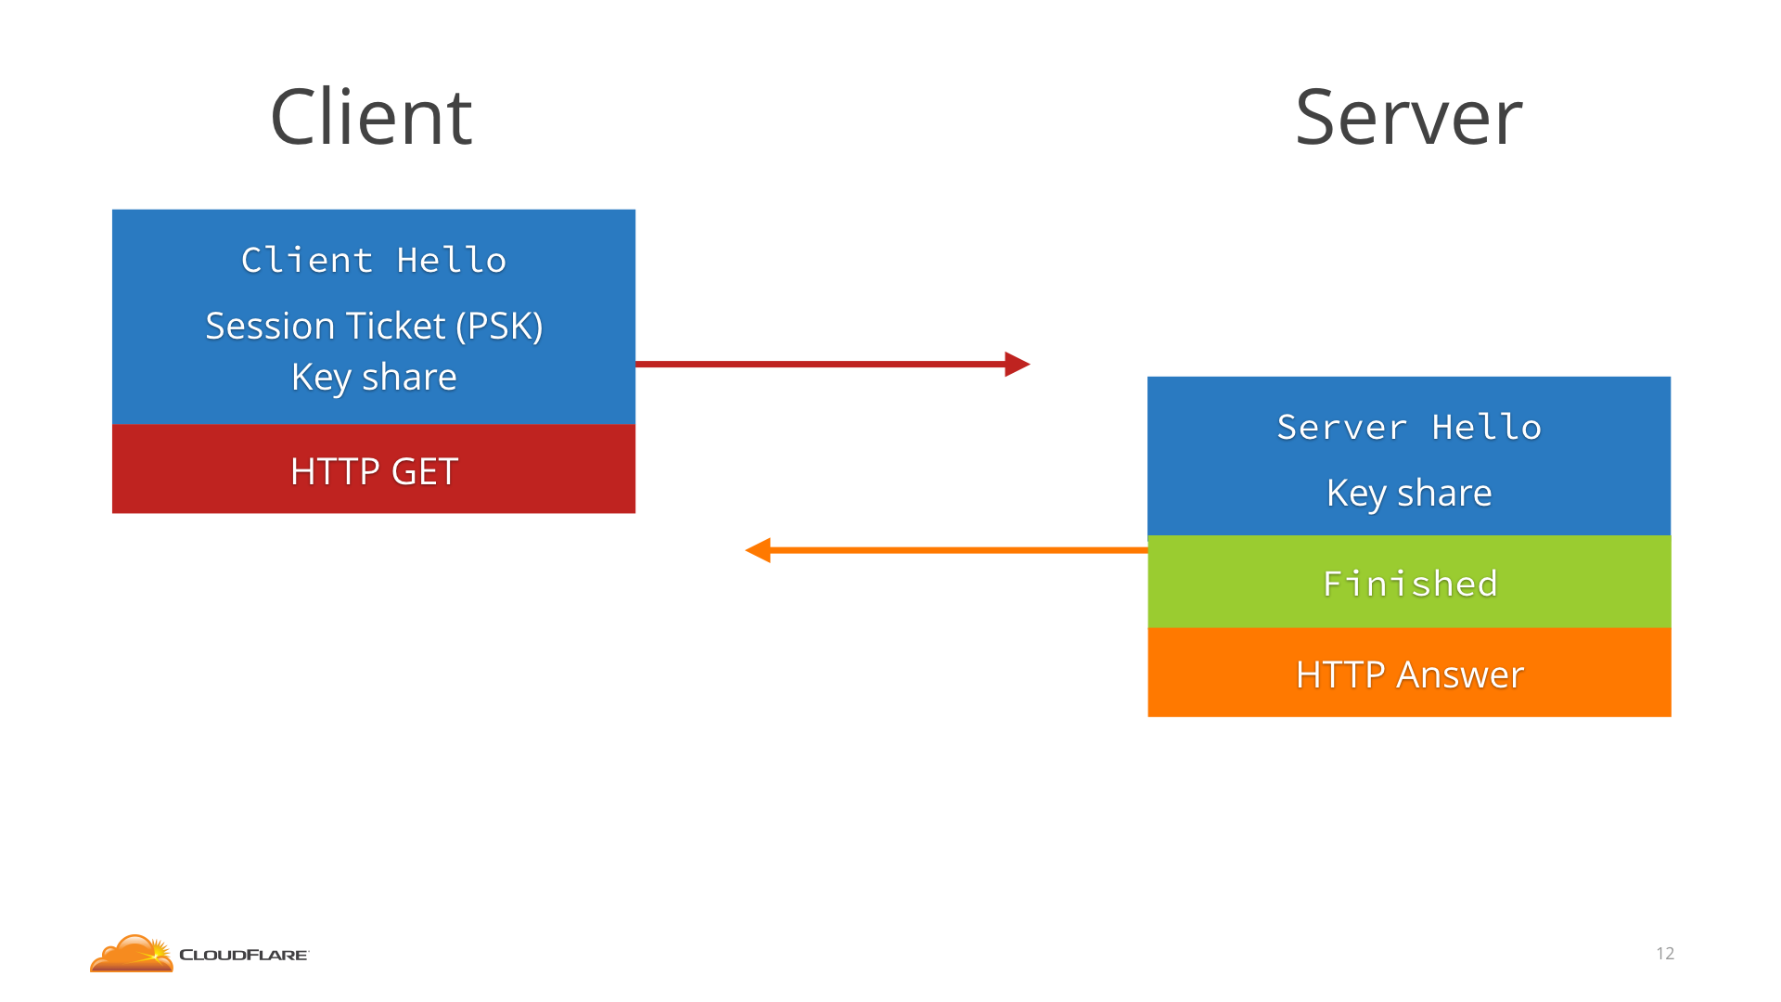
TLS 1.3: 0-RTT Resumption!
Notes:
The client and server agree on a PSK (pre-shared key, or Resumption key), and the server would send the client a Session Ticket (which could be encrypted copy of the PSK, to avoid reference number). Then the next time the client connects, it sends the Session Ticket in the ClientHello and then immediately, without waiting for any round trip, sends the HTTP request encrypted with the PSK. The server figures out the PSK from the Session Ticket and uses that to decrypt the 0-RTT data.

Slide 17
Caveats of 0-RTT
Since the PSK is not agreed upon with a fresh round of Diffie Hellman, it does not provide Forward Secrecy against a compromise of the Session Ticket key. That is, if after a year an attacker somehow obtains the Session Ticket key, it can decrypt the Session Ticket, obtain the PSK and decrypt the 0-RTT data the client sent (but not the rest of the connection).
This is why it's important to rotate often and not persist Session Ticket keys. TLS 1.2 has never provided any Forward Secrecy against a compromise of the Session Ticket key at all, so even with 0-RTT 1.3 is an improvement upon 1.2.

Slide 18
Caveats of 0-RTT
Replay attacks: If an attacker intercepted a 0-RTT packet with a HTTP POST of transferring money, he could resend it a bunch of times without the server being any the wiser.
The solution would be for the server to demand a full 1-RTT handshake on operations that are not idempotent (like a transaction), received in 0-RTT data.
Notes:
An idempotent HTTP method is a HTTP method that can be called many times without different outcomes. It would not matter if the method is called only once, or ten times over. The result should be the same.

Slide 19
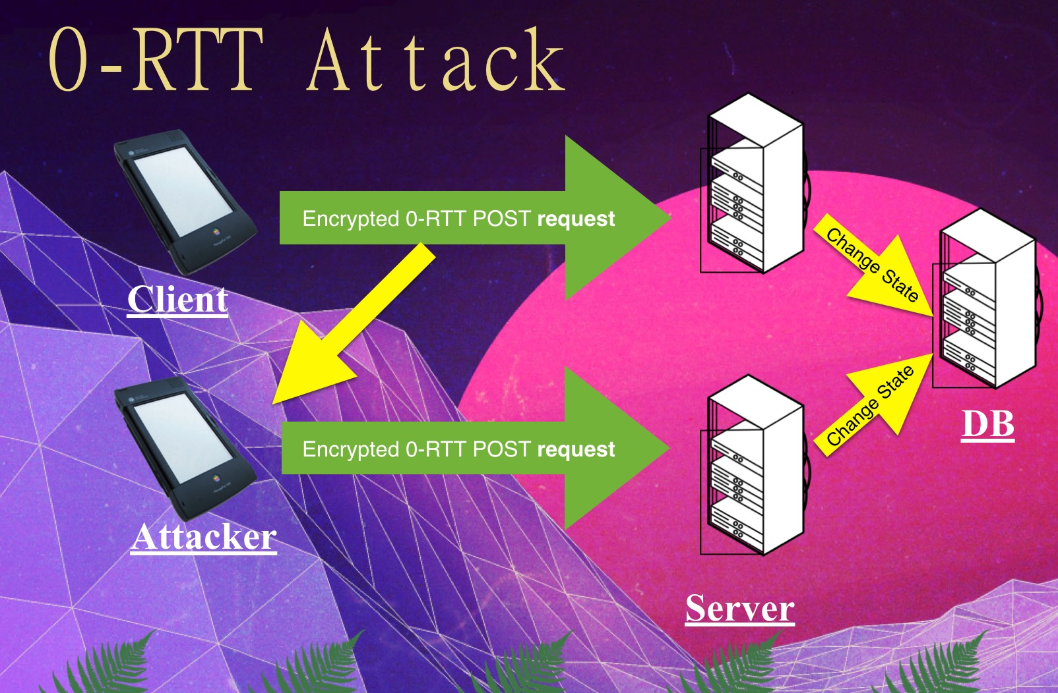

Slide 20
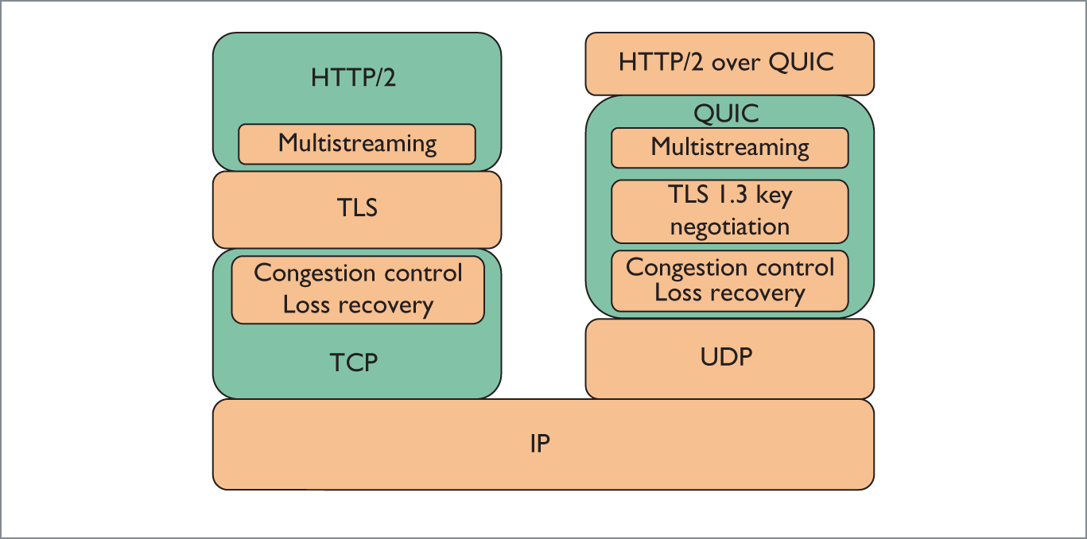
QUIC vs TCP

Slide 21
Server Name Indication(SNI)
SNI is an extension to the TLS computer networking protocol by which a client indicates which hostname it is attempting to connect to at the start of the handshaking process. This allows a server to present multiple certificates on the same IP Address and hence allows multiple secure (HTTPS) websites to be served by the same IP address without requiring all those sites to use the same certificate.
The desired hostname is not encrypted, so an eavesdropper can see which site is being requested!
Notes:
(It is the conceptual equivalent to HTTP/1.1 name-based virtual hosting).

Slide 22
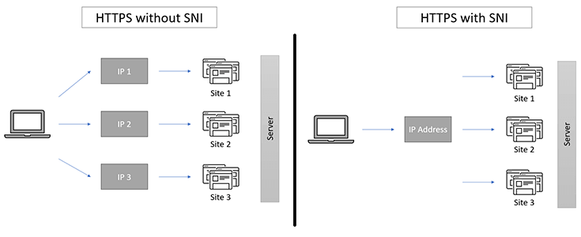

Slide 23
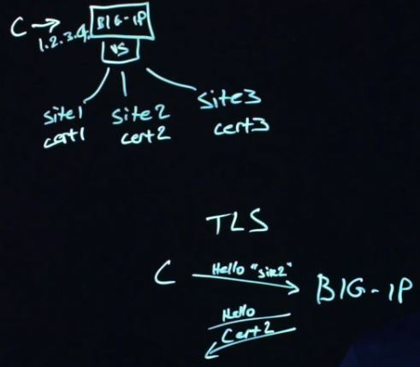

Slide 24
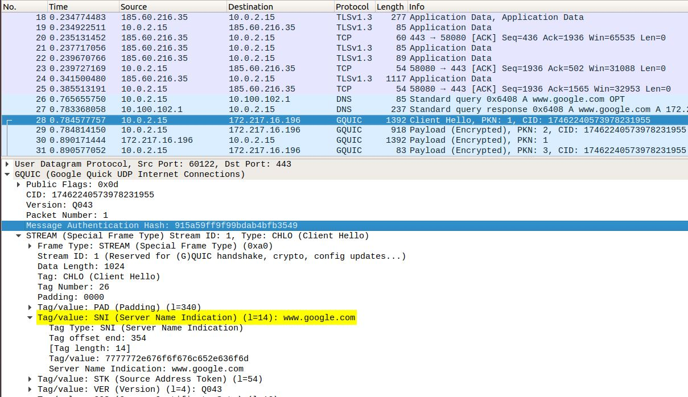
Notes:
gQUIC uses TLS 1.3 and TLS 1.3 has an SNI.

Slide 25
How TLS secures TCP

Slide 26
So how does TLS actually secure QUIC?
Notes:
Difference between tls with tcp and with quic?

