Slide 1
Web Application Framework
Sadna - version1

Slide 2
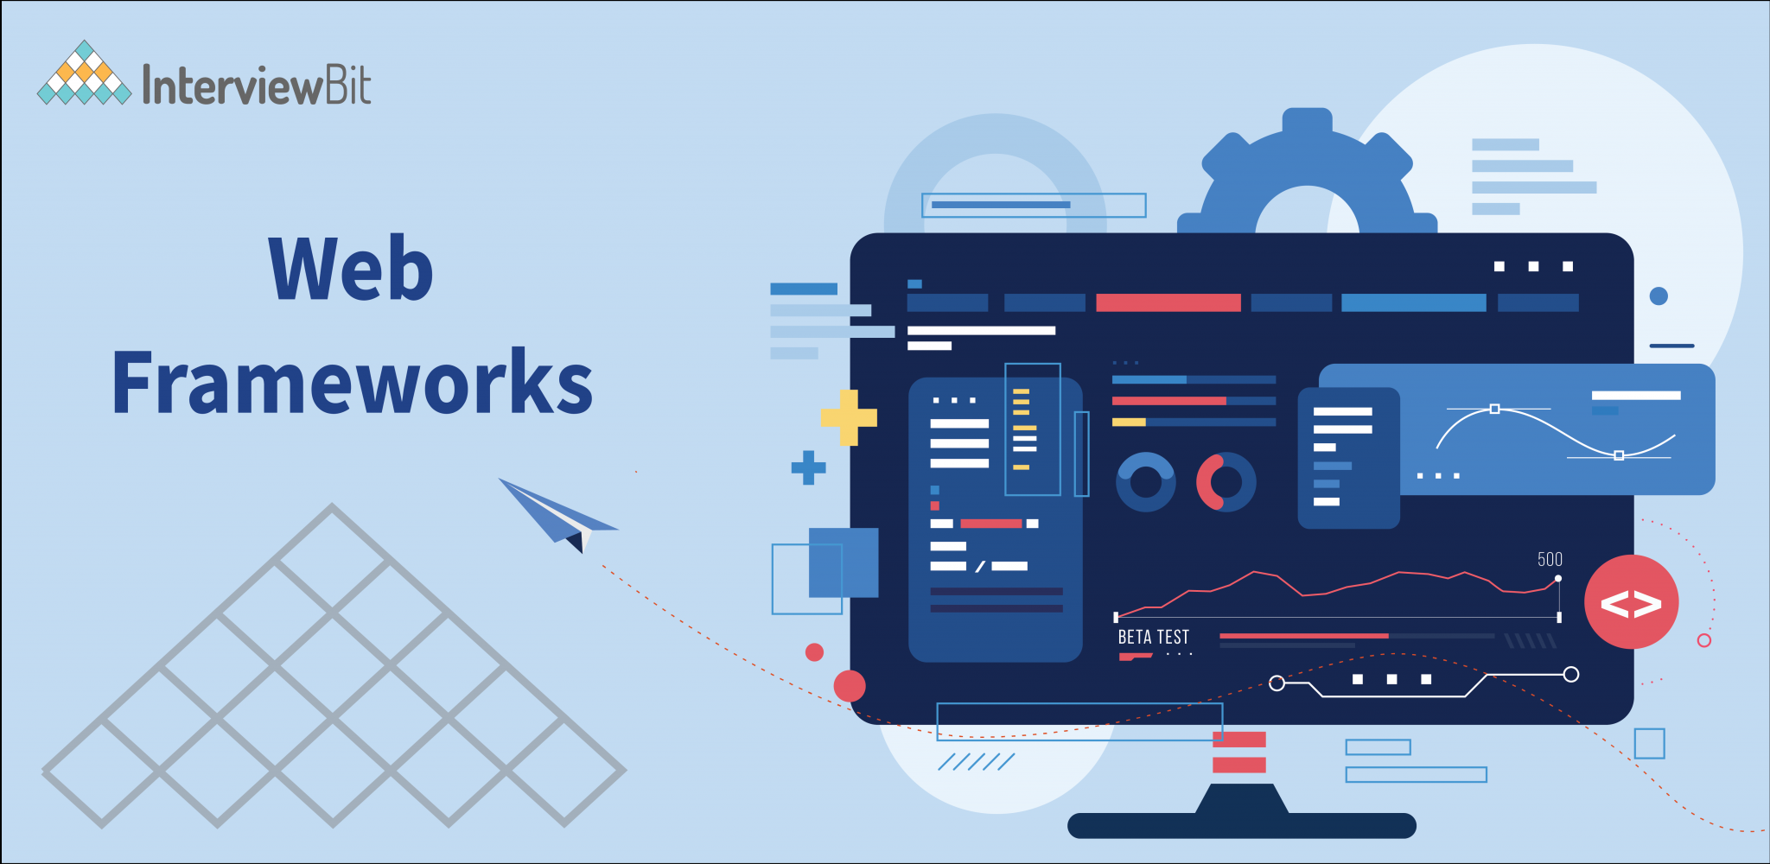
What is WAF?
A web application framework is a software framework that is designed to support the development of web applications, such as: websites, web services, and web APIs.
A web application framework typically provides a set of tools and libraries that help developers create web applications quickly and efficiently, without having to write all of the code from scratch.

Slide 3
Why Should We Use It?
The primary use of a web application framework is to make it easier and faster to develop web applications.
By providing a set of pre-built tools and libraries, a WAF can help developers avoid common pitfalls and focus on building the unique features of their application.
WAFs can also help ensure that the resulting application is secure, reliable, and scalable.

Slide 4
What is Web Service?
A web service is a type of software system that provides a standardized way for different applications to communicate with each other over the internet.
The web service exposes a set of APIs that allow other applications to send requests and receive responses in a standardized format. This allows different applications to communicate with each other regardless of the programming languages or platforms they are written in, as long as they can send and receive HTTP requests and responses.
Web services typically use the HTTP protocol to transmit data, and they often rely on XML or JSON for data formatting.

Slide 5
Common Web-Services of WAF
Templating
most WAFs include tools for generating dynamic HTML content based on data retrieved from a database.
Routing
the process of mapping incoming requests to the appropriate handler function or controller method. When a user makes a request to a web application, the web application needs to figure out what code should handle that request and generate the appropriate response.

Slide 6
Common Web-Services of WAF
Database integration
Many WAFs provide tools for connecting to and interacting with databases, which are often used to store and retrieve data for the web application.
Security
WAF may include tools for handling user such as user authentication, authorization, input validation and cross-site attacks prevention.

Slide 7






Popular Types of WAF:
Spring framework
(java)
Masonite (python)
ASP.NET (c#)
Flask (python)
Ruby on Rails (ruby)
Django (python)

Slide 8
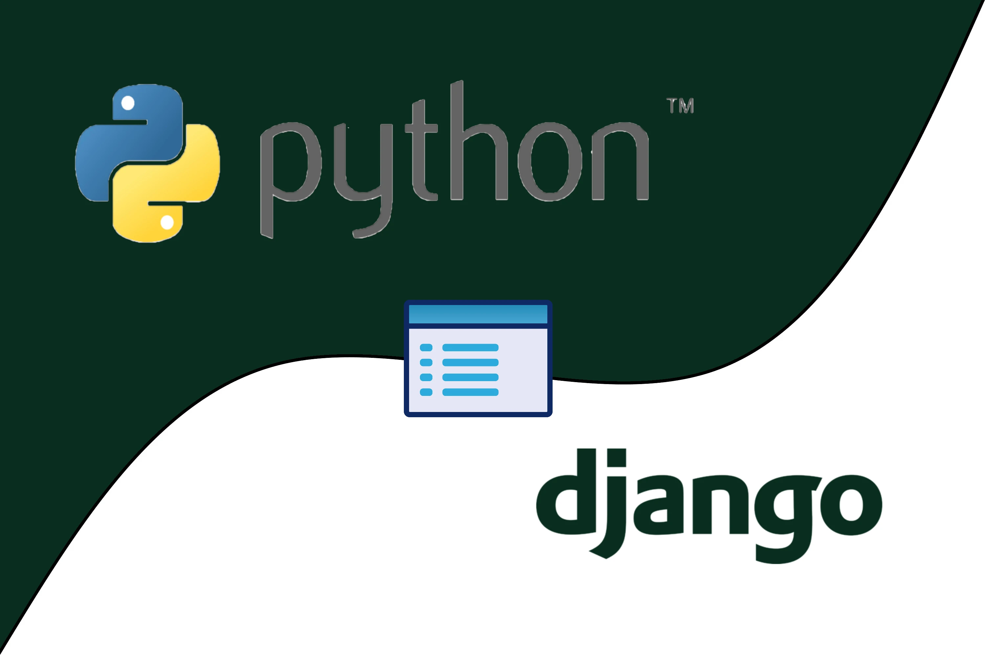
Django
Django is a high-level Python web framework that encourages rapid development and clean, pragmatic design for building web applications in Python
It provides a set of tools and features that allow developers to create complex, database-driven web applications quickly and efficiently.
It’s free and an open source framework.

Slide 9

What Web-Services Django Provide?
Security features
Forms and validation
Admin interface
Object-relational mapping (ORM)
Caching
Routing and URL handling
Internationa-lzation and localization

Slide 10
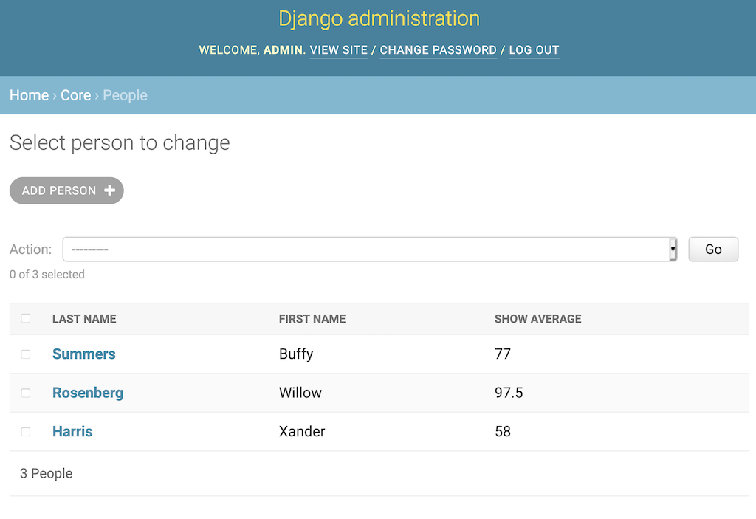
How Will We Use it In Our Project?
Authentication system
Django handles user accounts, groups, permissions and cookie-based user sessions. allow users to create accounts and safely log in/out. We will use it to ensure the user logging will be secured without using any security logging system or regex to check passwords.
Admin interface
Django reads metadata in our models to provide a powerful and production-ready interface that will allow us to manage user accounts, content and data more easi

Slide 11
How Will We Use it In Our Project?
Forms
where numerous items of data of several different types may need to be prepared for display in a form, Django can prepare and restructure data to make it ready for rendering , create HTML forms for the data, and receive and process submitted forms and data from the client.
Security
Django provides multiple protections against Clickjacking, Cross-site scripting, Cross-site request forgery, SQL injection and remote code execution. Therefore, in such a large scale project it will be easier for us to leave the security control to Django so we’ll be able to improve other parts of the system.

Slide 12
What Adjustments Should We Do To Use It?
Rearrange the project structure
Refactor the code to use Django conventions
Configure database connection and other external systems
Create integration tests

Slide 13
Real-time Notifications in Django:
Set up Asynchronous Server Gateway Interface in our app
updating our project's settings file to include the channels and routing configuration
(The ASGI file comes by default in newer versions of Django (3.2 or greater) )
Connect is used to establish connections between the front end and the backend.
Receive is used to handle requests sent from the front end and deal with them accordingly.
Disconnect is used to deal with what should happen if the WebSocket were to close or shut down.
Create WebSocket consumers
Connect is used to establish connections between the front end and the backend.
Receive is used to handle requests sent from the front end and deal with them accordingly.
Disconnect is used to deal with what should happen if the WebSocket were to close or shut down.
Every “consumer” in Django channels needs to have three defined methods: connect, receive and disconnect.
Our WebSocket will first “establish” a connection. Once the connection has been established, The backend will “listen” for any event that the front end might send to it and handle that in the “Receive” method.

Slide 14
Real-time Notifications in Django:
Enter Redis
Redis is an open-source (BSD licensed), in-memory data structure store, used as a database, cache, and message broker. It is integral to getting our WebSockets running.
Set up a route for your consumer
set up a route that maps incoming WebSocket connections to our consumer.
Note:
We can use Django’s built-in session framework instead of Redis. This framework allows you to store and retrieve data on a per-session basis.
Session - a mechanism for storing user-specific data on the server side, which can be accessed and modified throughout the user's browsing session.
Send notifications from our views
Now can use your Django views to send notifications to the client by sending messages to the WebSocket connection associated with the user's session

