Slide 1
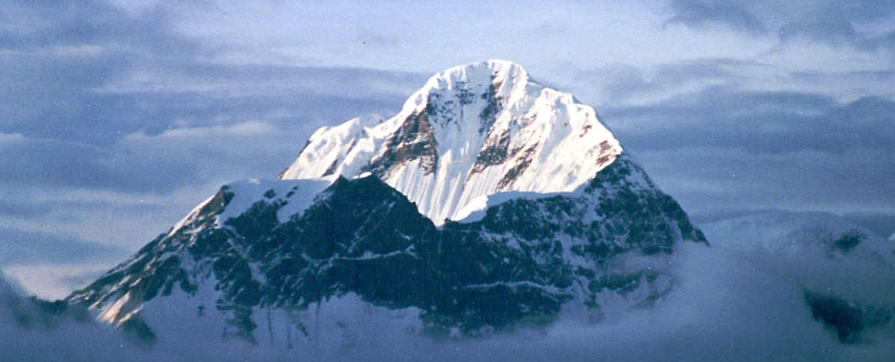
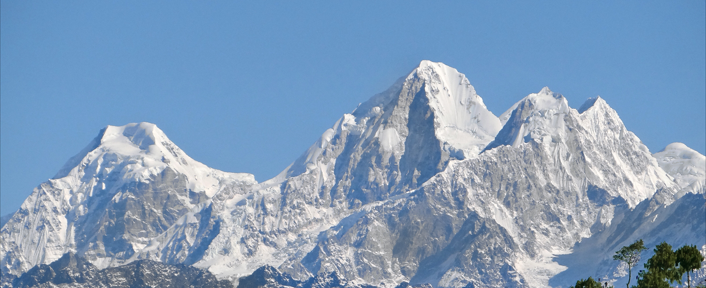
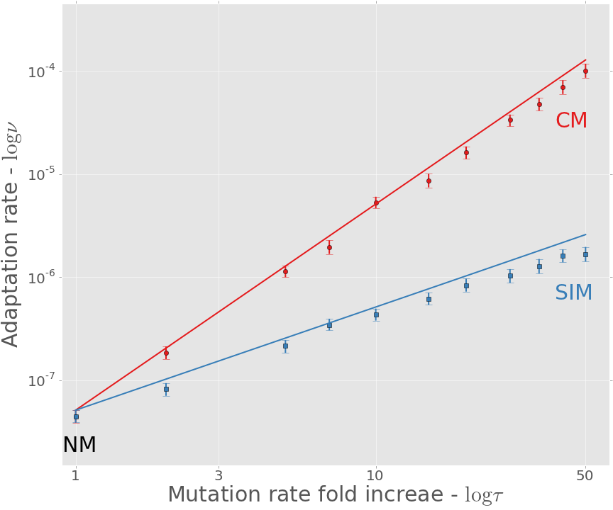
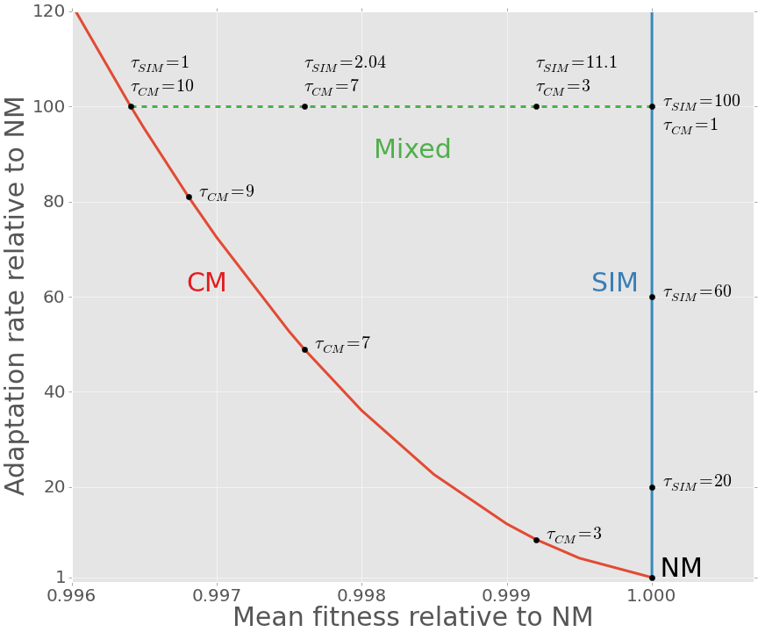
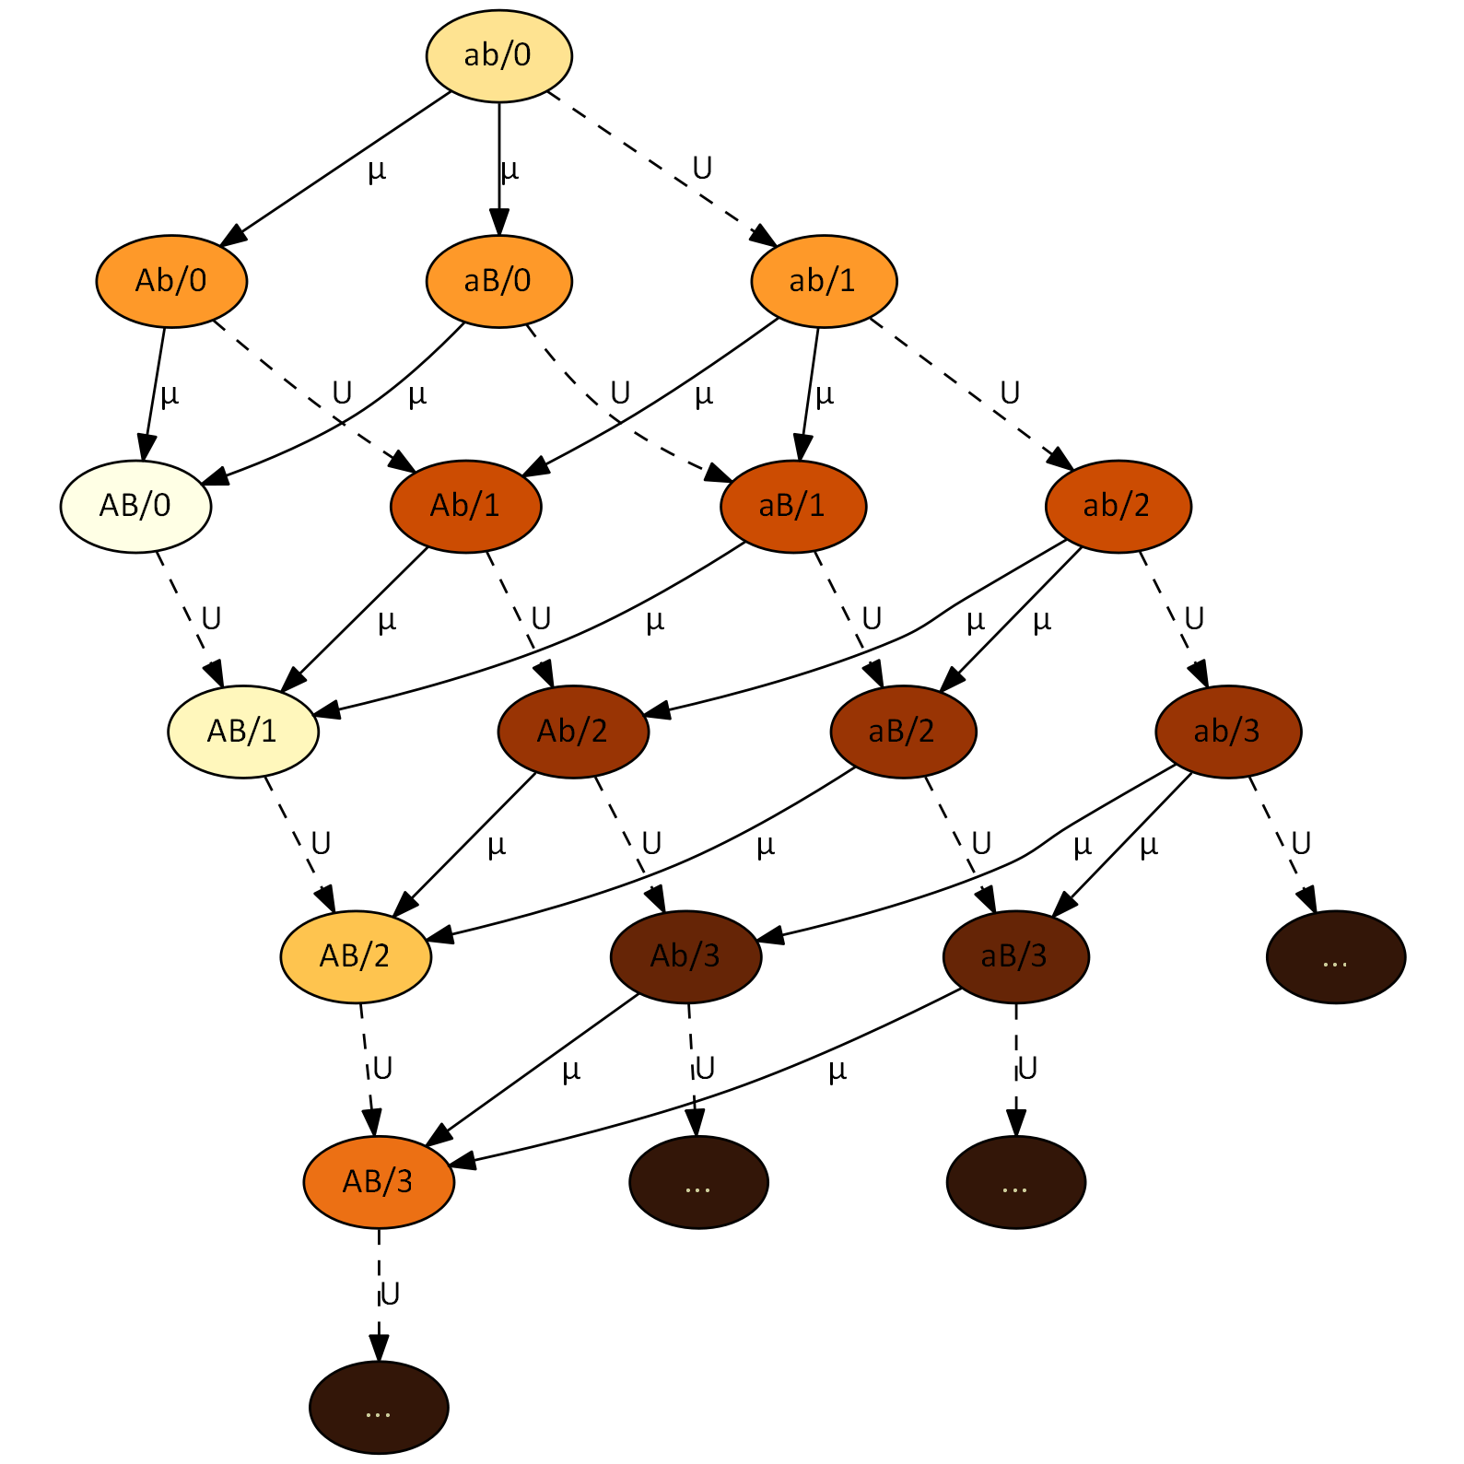
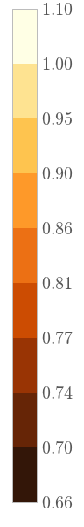
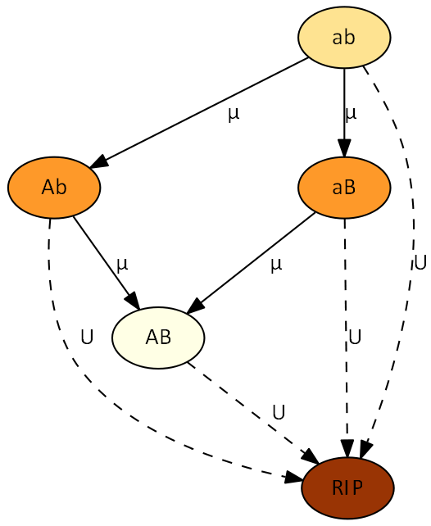
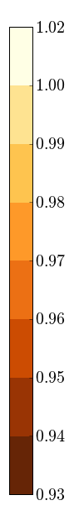







Adaptability, Adaptedness and Stress-Induced Mutagenesis
Yoav Ram & Lilach Hadany Department of Molecular Biology and Ecology of Plants, Life Science Faculty, Tel-Aviv University, Israel
Background
Mutagenesis is induced by stress responses in various species of bacteria (1-3).
In a previous work (4) we studied the evolution of stress-induced mutagenesis in constant and changing environments. We showed that stress-induced mutagenesis (SIM) is favored by selection over constant rate mutagenesis because it generates beneficial mutations when they are most needed.
Complex adaptations require two or more mutations that are jointly advantageous but separately deleterious, and therefore presents an open evolutionary question, first described by Sewall Wright in 1931 (5) and popularized using the fitness landscape metaphor:
Adaptation rate results
The adaptation rate ν is approximated with normal mutagenesis (NM), constitutive mutagenesis (CM) and stress-induced mutagenesis (SIM):
$$ν_{NM}≈2NHμ^{2}\left(1−U\right)\left(2−U\right)≈4NHμ^{2}$$
$$ν_{CM}≈τ^{2}∙ν_{NM}$$
$$ν_{SIM}≈ν_{NM}∙\frac{2τ}{\left(2−τU\right)}≈τ∙ν_{NM}$$
SIM increases the adaptation rate of complex traits: solid lines are analytic approximations, markers are results of simulations (see below), error bars are 95% CI:
SIM is more efficient than CM
Adaptability
Constitutive mutagenesis (CM) increases the rate of complex adaptation τ²-fold.
Stress-induced mutagenesis (SIM) increases the rate of complex adaptation τ-fold.
Adaptedness
CM decreases the population mean fitness e^{-U(τ-1)}-fold due to due to accumulation of deleterious mutations [REF].
SIM slightly increases the population mean fitness (4).
SIM breaks the adaptability-adaptedness trade-off
SIM is a Pareto improvement over CM – it can achieve the same adaptation rate (by increasing τ), without reducing the fitness of the population.
If τ² is to high, a mixed strategy, in which all individuals increase their mutation rate τ_{CM}-fold and stressed individuals increase their mutation rate τ_{SIM}-fold, is still more efficient than CM.
[1]
fitness
[3]
[5]
genotype
Citation | Estimate | Name | Sign
6,7 | 0.001-0.01 | Selection coefficient | s
8 | 1-10 | Double mutant advantage | H
8,9 | 0.003-0.0004 | Genomic mutation rate | U
7 | U/5000 | Beneficial site mutation rate | µ
10 | 1-100 | Mutation rate increase | τ
11 | 10⁵-10¹⁰ | Population size | N
Table 1. Model parameters and estimated values for bacteria.
Model
Figure 2 describes are two-locus (A/a and B/b) analytic model of adaptation in a rugged fitness landscape.
Each node represents a genotype. Genotype ab is the wildtype, AB is the adaptive peak with the highest fitness, and the single mutants Ab and aB are adaptive valleys with fitness lower than the wildtype - the darker the color the lower the fitness. “RIP” represents genotypes with deleterious mutations that will not contribute to adaptation (“the living dead”).
Arrows define the direction of mutation and denote the relevant mutation rate: U for background deleterious mutation (dashed lines) and µ for mutations in the A/a and B/b loci (solid lines).
Simulations
Figure 4 describes our multi-locus Wright-Fisher simulations. The major difference from Figure 3 is that nodes also specify the number of deleterious mutations after the forward slash. The figure shows as much as three mutations for simplicity; the simulations had as much as 25.
Summary
We analyzed the mean fitness at a mutation-selection balance and the adaption rate on a rugged fitness landscape with and without stress-induced mutagenesis.
We showed that stress-induced mutagenesis increases the rate of complex adaptation, and that in contrast to constitutive mutagenesis, it does not jeopardize the fitness of populations under stable conditions.
[4]
fitness
fitness
Literature cited
Rosenberg SM, et al. Genetics 1998, 148:1559–66
Galhardo RS, et al. Crit Rev Biochem Mol Biol 2007, 42:399–435
Bjedov I, et al. Science 2003, 300:1404–9
Ram Y, Hadany L. Evolution 2012, 66:2315–28
Wright S. Am Nat 1988, 131:115–123
Kibota TT, Lynch M. Nature 1996, 381:694–6
Gordo I, et al. J Mol Microbiol Biotech 2011, 21:20–35
Drake JW, et al. Genetics 1998, 148:1667–86
Wielgoss S, et al. G3 2011, 1:183
Hall LMC, Henderson-Begg SK. Microbiology (UK) 2006, 152(Pt 9):2505–14
Berg OG. Genetics 1996, 142:1379–82.
Kimura M, Maruyama T. Genetics 1966, 54:1337–51.
[2]
Contact information
yoavram@post.tau.ac.il
@yoavram
http://www.yoavram.com

