Slide 1
Probabilistic approach to the probability of improvement in Fisher's geometric model
Yoav Ram
Hadany Lab
December 2013

Slide 2
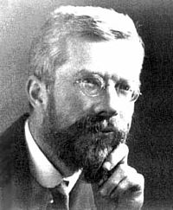
Introduction
Fisher introduced his “geometric model” in page 32 of the book The Genetical Theory of Natural Selection
Download pdf from http://archive.org/details/geneticaltheoryo031631mbp
Mutation pleiotropy
Support for adaptation by small mutations
Criticisms:
Wright: adaptive peak shifts
Kimura: fixation probability
Sir Ronald A. Fisher
1890-1962
England & Australia

Slide 3
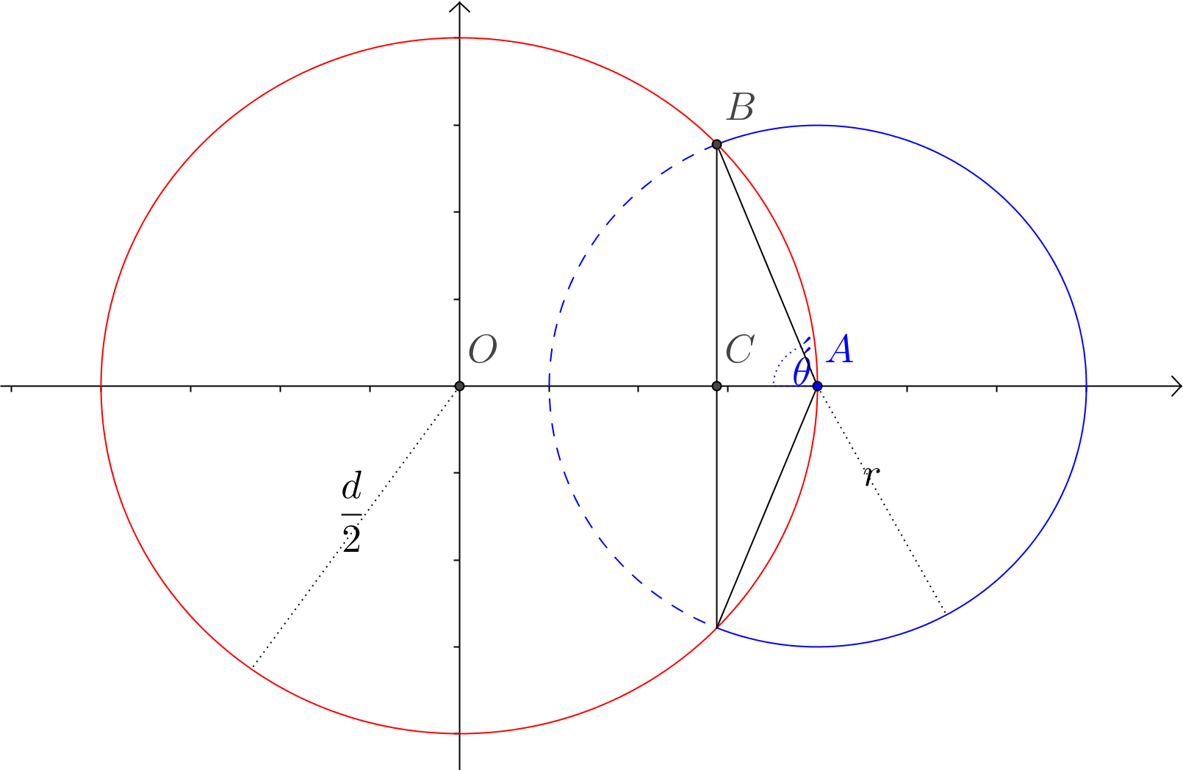
Fisher’s geometric model in 2D
2 trait phenotype space
O: optimal phenotype
A: current phenotype
Blue circle: all possible mutants
Red circle: all phenotypes with fitness = A
Dashed arc: mutants with fitness > A

Slide 4

Probability of improvement, p_{2D}
$p_{2D}$ is the part of the blue circle that is dashed
B: intersection of the circles
$C=\left(x,0\right)$
$θ$ is the angle between AB and AC
$p_{2D}=\frac{2θ}{2π}$
x

Slide 5

Probability of improvement, p_{2D}
We need to find x:
$$\left\{\begin{aligned}{\left(x−\frac{d}{2}\right)}^{2}+y^{2}=r^{2} \\ x^{2}+y^{2}={\left(\frac{d}{2}\right)}^{2}\end{aligned}\right.$$
$$x=\frac{d}{2}−\frac{r^{2}}{d}$$
$$AB = r$$
$$AC = d/2−x$$
$$\cos{θ}=\frac{AC}{AB}=\frac{r}{d}$$
x

Slide 6

Probability of improvement, p_{2D}
$$p_{2D}=\frac{\cos^{−1}\left(\frac{r}{d}\right)}{π}$$

Slide 7
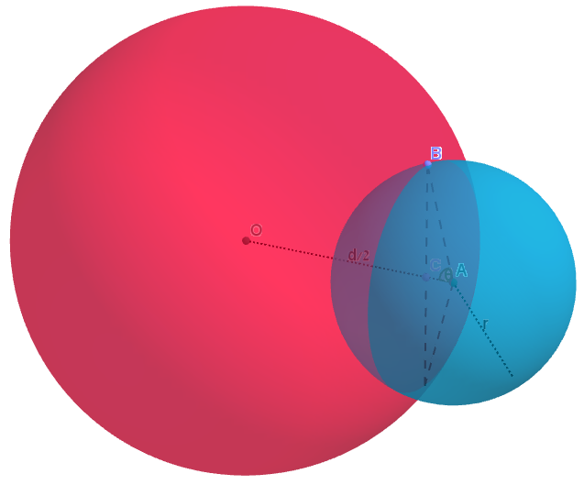

Fisher’s geometric model in 3D
3 trait phenotype space
Find AC like in 2D
The area of a spherical cap – the shaded part of the blue sphere – is $2πrh$ - where h is r-AC
The area of the whole sphere is $4πr^{2}$
$p_{3D}=\frac{2πr\left(r−\frac{r^{2}}{d}\right)}{4πr^{2}}$
B
O
d/2
C
A
θ
r

Slide 8

Fisher’s geometric model in 3D
$$p_{3D}=\frac{1}{2}\left(1−\frac{r^{2}}{d}\right)$$
B
O
d/2
C
A
θ
r

Slide 9
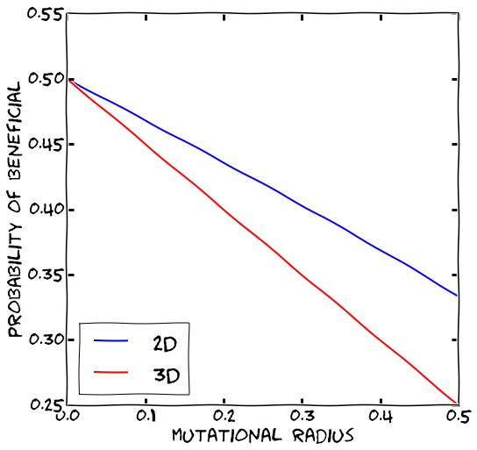


Comparison: 2D vs. 3D
$$p_{2D}=\frac{\cos^{−1}\left(\frac{r}{d}\right)}{π}$$
$$p_{3D}=\frac{1}{2}\left(1−\frac{r^{2}}{d}\right)$$

Slide 10

General result
For an arbitrary number of traits n
$p_{n}=\frac{\int_{0}^{\cos^{−1}\left(\frac{r}{d}\right)}{\sin^{n−2}{(θ)}dθ}}{\int_{0}^{π}{\sin^{n−2}{(θ)}dθ}}$.
Rice 1990, Hartl & Taubes 1996, Waxman & Welch 2005

Slide 11
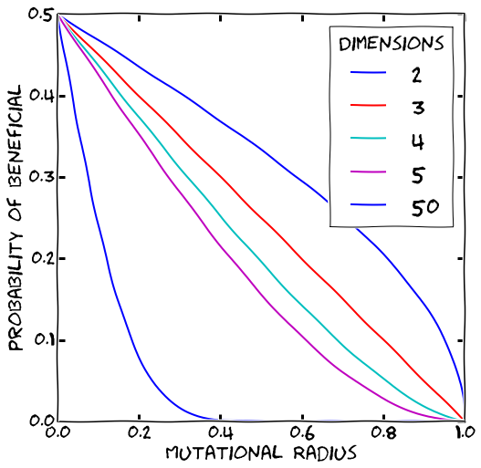
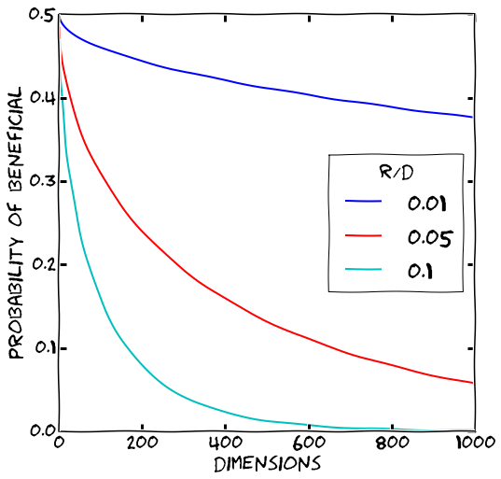

Multiple traits

Slide 12

Asymptotic result for many traits
This is the result given by Fisher (1930, pg. 40)
Can be found as an approximation of $p_{n}$
$$p_{F}=1−φ\left(\sqrt{n}\frac{r}{d}\right)=$$
$$\frac{1}{\sqrt{2π}}\int_{\sqrt{n}\frac{r}{d}}^{∞}{e^{−\frac{t^{2}}{2}}dt}$$
$φ$ is the cumulative probability function of the standard normal distribution

Slide 13
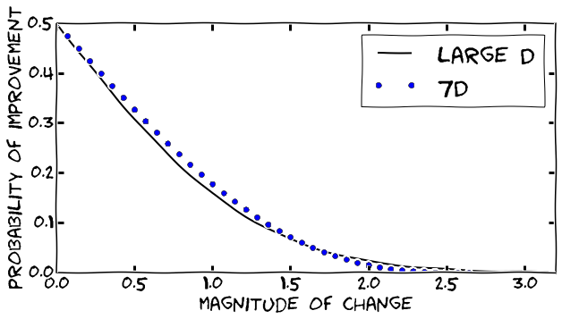
Comparison of asymptotic result

Slide 14
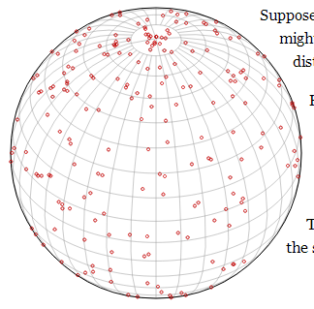

Random points on a sphere
Generate uniformly distributed points on a sphere.
Picking spherical coordinates:
$λ \sim Uniform [−180°, 180°)$
$φ\sim Uniform [−90°, 90°)$
Uneven distribution: density increasing around the poles
The area of a given “square” of width $Δλ$ and height $Δφ$ varies with $φ$
See how the squares get smaller towards the poles?
http://www.jasondavies.com/maps/random-points/

Slide 15
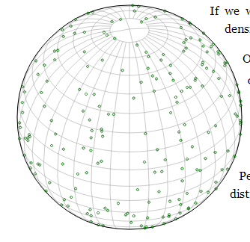

Random points on a sphere
Any area on the sphere should contain approximately the same density of points
$λ \sim Uniform [−180°, 180°)$
$x \sim Uniform [0, 1)$
$φ =\cos^{−1}\left(2x − 1\right)$
Some points seem too close together, and some seem too far apart. This is OK!

Slide 16
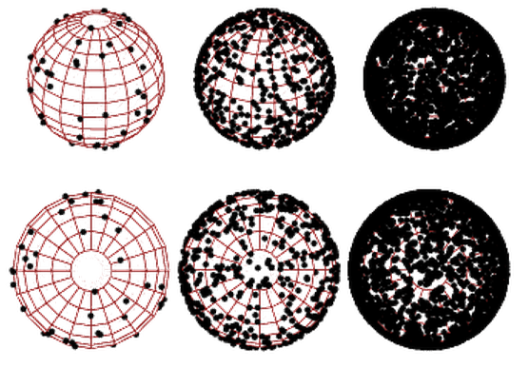

Random points on a hypersphere
For a hypersphere in n dimensional space and radius r:
Pick $Z_{i}∼Normal\left(0,1\right), 1≤i≤n$
Normalize and stretch:
$X_{i}=r⋅\frac{Z_{i}}{\left\|Z\right\|}=r⋅\frac{Z_{i}}{\sum_{i=1}^{n}{Z_{i}^{2}}}$
$X$ is a random point on the hypersphere with radius 1
http://mathworld.wolfram.com/SpherePointPicking.html
Muller, 1959

Slide 17

Our probabilistic approach
$A=\left(\frac{d}{2},0,…,0\right)$ – current phenotype
$X=r⋅\frac{Z}{\left\|Z\right\|}$ - mutation
Probability of improvement:
$$p=\operatorname{Pr}\left(\left\|A+X\right\|<\frac{d}{2}\right)=Pr\left(\frac{X_{1}}{r}>\frac{r}{d}\right)$$

Slide 18

Relation to previous results
$$Pr\left(\frac{X_{1}}{r}>\frac{r}{d}\right)=\frac{1}{2}Pr\left(\frac{X_{1}^{2}}{r^{2}}>{\left(\frac{r}{d}\right)}^{2}\right)=\frac{1}{2}Pr\left(\frac{Z_{1}^{2}}{Z_{1}^{2}+\sum_{i=2}^{n}{Z_{i}^{2}}}>\frac{r^{2}}{d^{2}}\right)$$
The sum of squares of normals is chi-squared:
$\sum_{i=1}^{k}{Z_{i}^{2}}∼χ^{2}\left(k\right)$
The ratio of chi-squared and its sum with another chi-squared is beta:
$$\frac{Z_{1}^{2}}{Z_{1}^{2}+\sum_{i=2}^{n}{Z_{i}^{2}}}∼Beta\left(\frac{1}{2}, \frac{n−1}{2}\right)$$
The probability of improvement is:
$$Pr\left(\frac{X_{1}}{r}>\frac{r}{d}\right)=\frac{1}{2}\left(1−I_{\frac{r^{2}}{d^{2}}}\left(\frac{1}{2}, \frac{n−1}{2}\right)\right)$$

Slide 19

Relation to previous results
Using the hypergeometric function ₂F₁:
$$\int_{0}^{φ}{\sin^{n}\left(θ\right)dθ}=\frac{1}{2}B_{\sin^{2}\left(φ\right)}\left(\frac{n+1}{2},\frac{1}{2}\right)=\frac{1}{2}I_{\sin^{2}\left(φ\right)}\left(\frac{n+1}{2},\frac{1}{2}\right)B\left(\frac{n+1}{2},\frac{1}{2}\right)$$
Therefore we can substitute to get:
$$p_{n}=\frac{1}{2}\left(1−I_{\frac{r^{2}}{d^{2}}}\left(\frac{1}{2},\frac{n−1}{2}\right)\right)=Pr\left(\frac{X_{1}}{r}>\frac{r}{d}\right)$$

Slide 20

Relation to previous results
We use the identity $I_{x}\left(a,a\right)=\frac{1}{2}I_{4x\left(1−x\right)}\left(a,\frac{1}{2}\right), 0≤x≤\frac{1}{2}$:
$$p_{n}=\frac{1}{2}\left(1−I_{\frac{r^{2}}{d^{2}}}\left(\frac{1}{2},\frac{n−1}{2}\right)\right)=I_{\frac{1}{2}\left(1−\frac{r}{d}\right)}\left(\frac{n−1}{2},\frac{n−1}{2}\right)=P\left(D<\frac{1}{2}\left(1−\frac{r}{d}\right)\right), D∼Beta \left(\frac{n−1}{2},\frac{n−1}{2}\right)$$
Generally, $Beta(a,a)$ is well approximated by $Normal\left(\frac{1}{2},\frac{1}{8a+4}\right)$ when $a$ is large

Slide 21
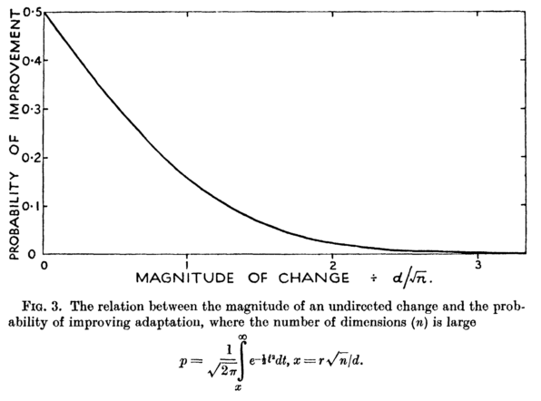

Relation to previous results
$D$ is approximated by $Normal\left(\frac{1}{2},\frac{1}{4n}\right)$ and
$$p_{n}≈φ\left(\frac{\frac{1}{2}\left(1−\frac{r}{d}\right)−\frac{1}{2}}{\sqrt{\frac{1}{4n}}}\right)=φ\left(−\sqrt{n}\frac{r}{d}\right)$$
$$=1−φ\left(\sqrt{n}\frac{r}{d}\right)$$
This is the result presented by Fisher

Slide 22
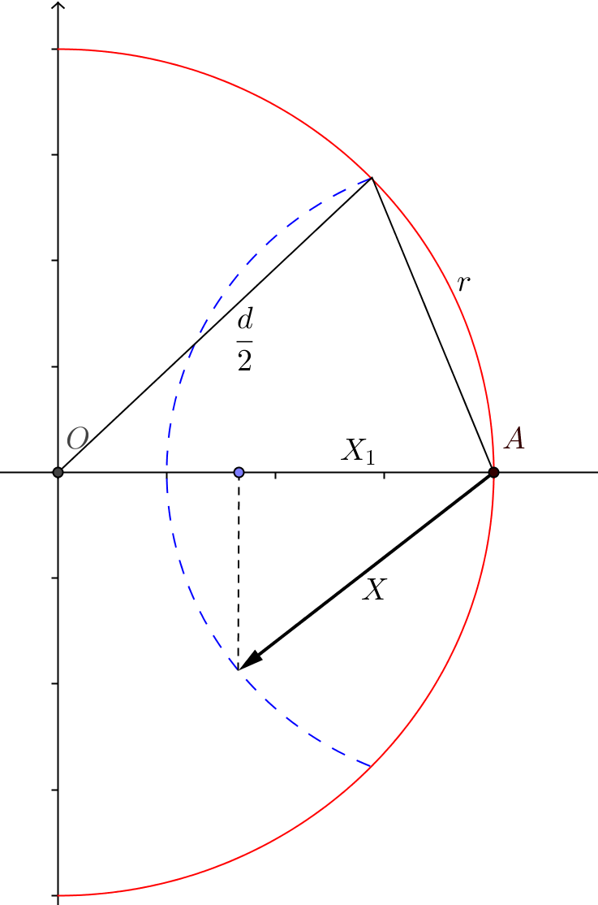

New intuition
$$P_{n}=Pr\left(\frac{X_{1}}{r}>\frac{r}{d}\right)$$
For a mutation to improve fitness, the relative size of the effect of the mutation in the direction towards the optimum must be larger than half the ratio between the total mutation size and the distance to the optimum

