Slide 1
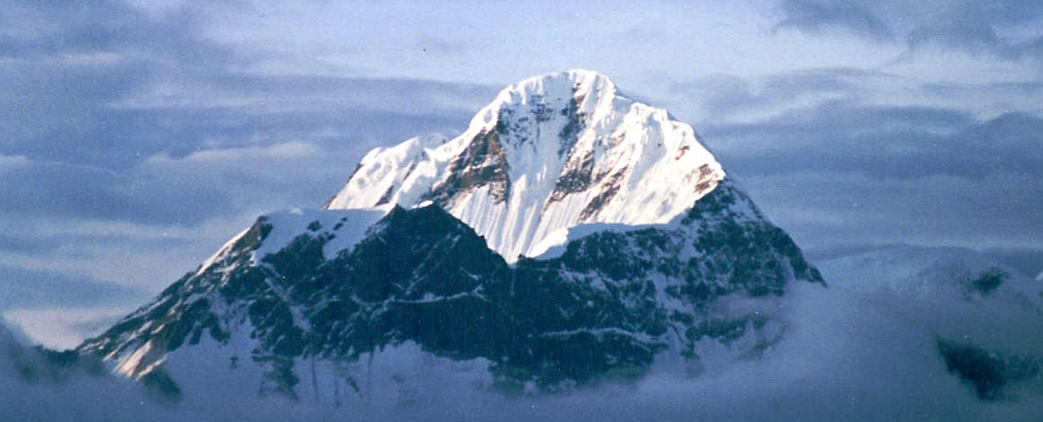
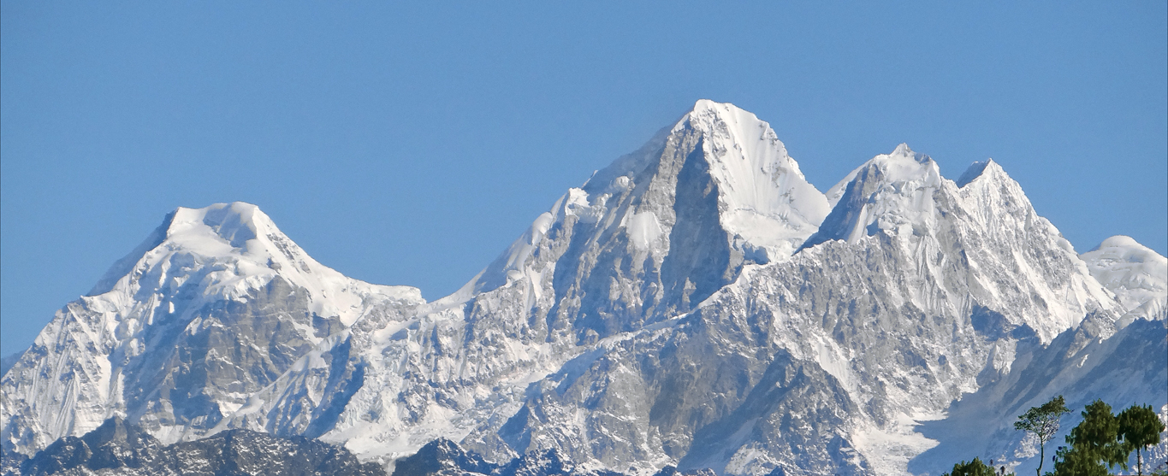
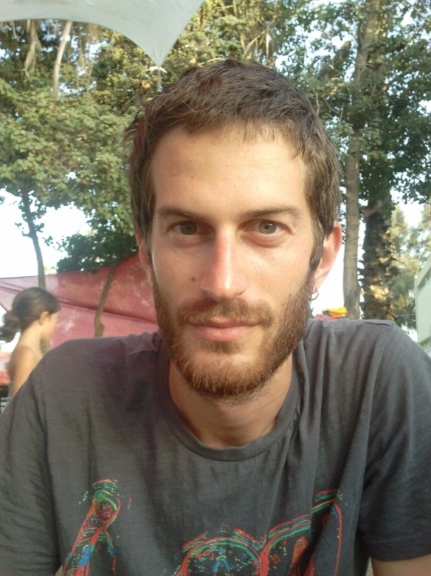

Stress-Induced Mutagenesis & Evolution of Complex Traits
Yoav Ram, Lilach Hadany Department of Molecular Biology and Ecology of Plants, Life Science Faculty, Tel-Aviv University, Israel
Introduction
The evolution of complex traits, coded by multiple genes, presents an open evolutionary question, first described by Sewall Wright in 1931 (1): if different alleles are separately deleterious but jointly advantageous, how can a population evolve from one co-adapted gene complex to a better one?
Fig. 1 below illustrate s this problem using the fitness landscape metaphor: consider a single -peak (top panel) and a multi-peak (bottom panel) landscape. Height represents fitness and different geographic coordinates represent different genotypes. Mutation moves the population in all directions whereas selection drives the population uphill.
In the single-peak landscape a population of bacteria evolves, for example, antibiotic resistance in a stepwise manner. In the multi-peak landscape, however, the population can get stuck on the lower peak because selection will prevent it from descending to the valley between the peaks.
Bla bla bla
Bla bla bla
Stochastic model
We modeled a population
fitness
genotype
Figure 1. Fitness landscape metaphor. (A) A single-peak fitness landscape. Selection drives the population uphill towards the global maximum. (B) A multi-peak fitness landscape. Selection drives the population uphill towards the closest peak – the global or local maximum.
Deterministic results
Stochastic results
Summary
Literature cited
For more information
Please contact Yoav Ram at yoavram@post.tau.ac.il
or +972-545-383136 or visit www.yoavram.com

