Slide 1
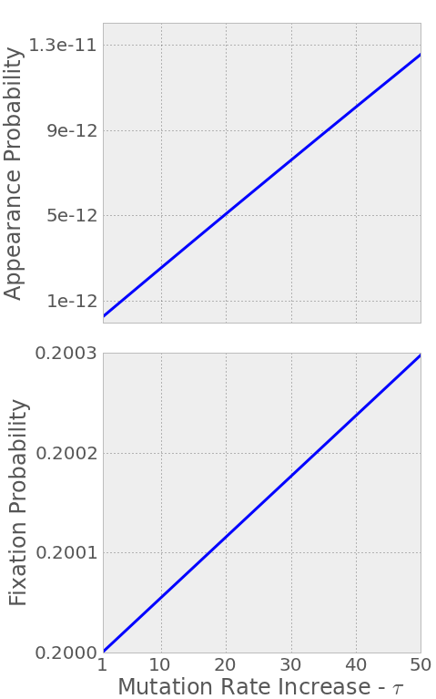
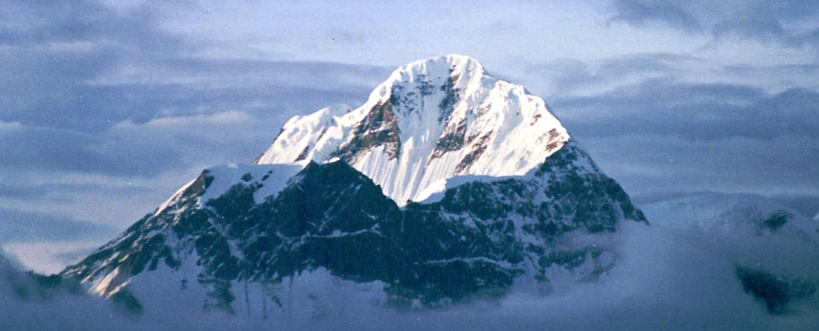
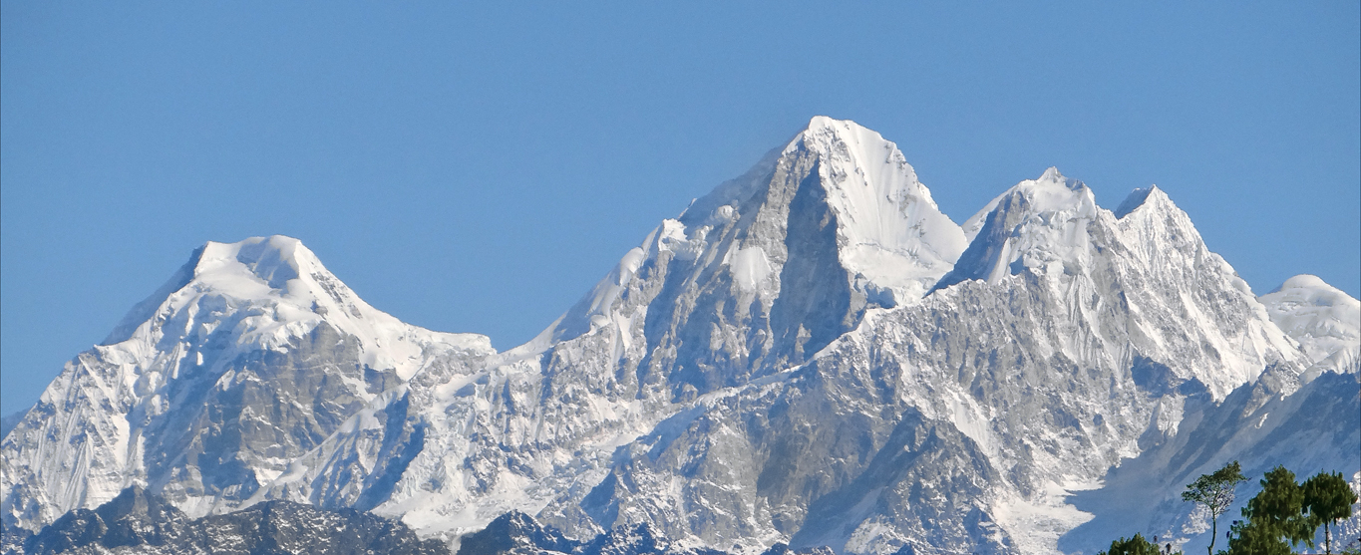
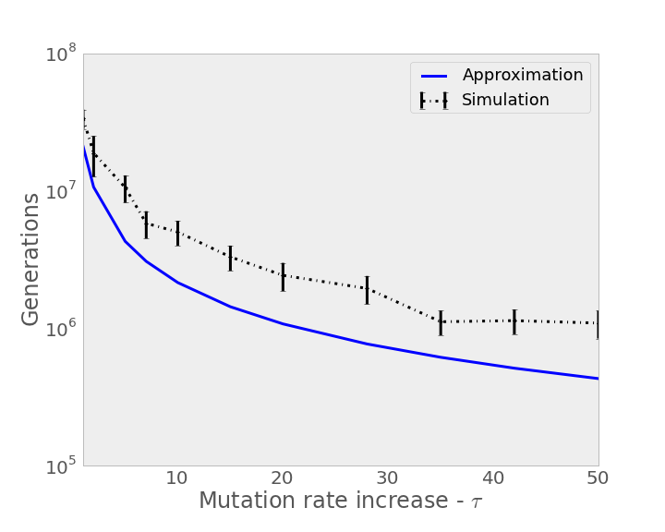
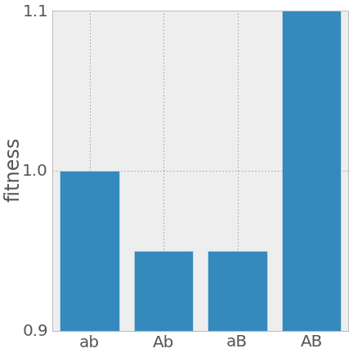
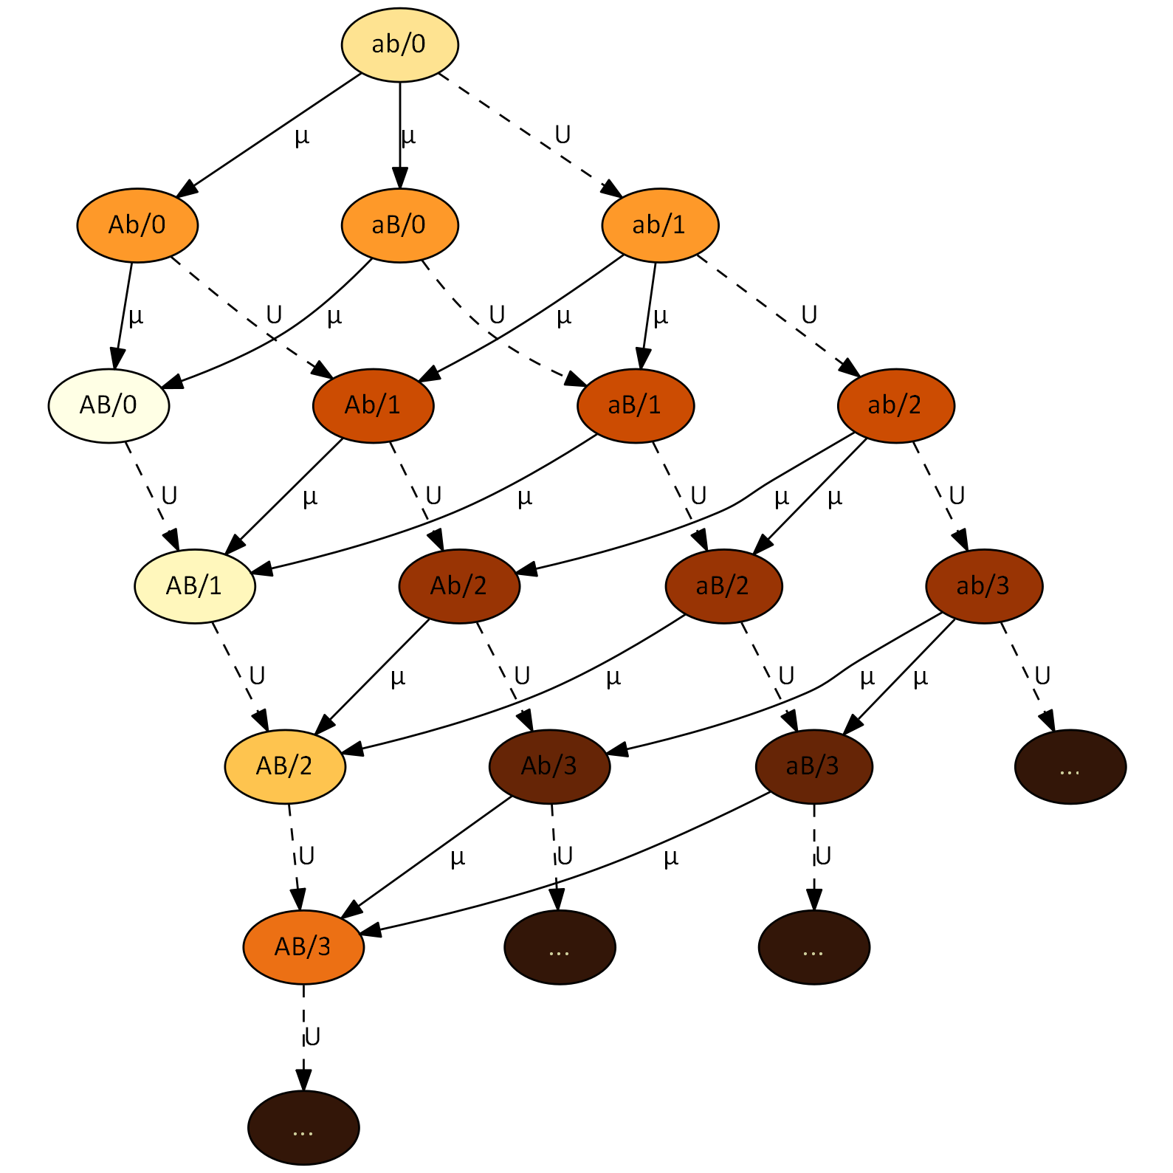
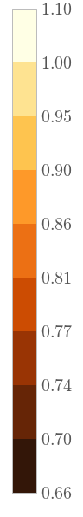
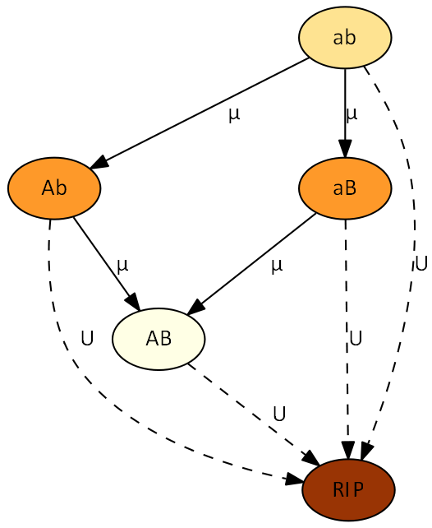
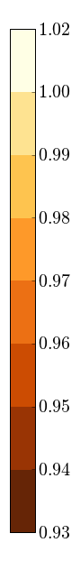







Stress-Induced Mutagenesis and the Evolution of Complex Traits
Yoav Ram & Lilach Hadany Department of Molecular Biology and Ecology of Plants, Life Science Faculty, Tel-Aviv University, Israel
Background
Adaptive peak shifts
The evolution of complex traits coded by multiple genes presents an open evolutionary question, first described by Sewall Wright in 1931 (1): if different alleles are separately deleterious but jointly advantageous, how can a population evolve from one co-adapted gene complex to a better one?
The problem is illustrated using the fitness landscape metaphor:
In a single-peak fitness landscape selection drives the population uphill towards the global maximum (Fig. 1). In a multi-peak rugged fitness landscape selection drives the population uphill towards the closest peak, preventing it from shifting to the higher peak (Fig. 2).
Stress-Induced Mutagenesis
The mutation rate is induced by stress responses in various species of bacteria (2-4).
In a previous work (5) we studied the evolution of stress-induced mutagenesis in constant and changing environments. We showed that stress-induced mutagenesis is favored by selection over constant rate mutagenesis because of the beneficial mutations it generates when they are most needed.
Analytic Approximations
The appearance probability q of the double mutant AB can be approximated with or without stress-induced mutagenesis (SIM):
$$q≈\left(1−U\right)\left(2−U\right)\frac{μ^{2}}{s}$$
$$q_{sim}≈\left(1−τU\right)2τ\frac{μ^{2}}{s}$$
where U is the genomic deleterious mutation rate, µ is the beneficial mutation rate in the a/A and b/B loci, τ is the mutation rate fold increase and s is the selection.
It can be shown that $q_{sim}>q$ if $0.5>τU>U$ – SIM increases the appearance probability q if the increased mutation rate is below 0.5.
The fixation probability ρ of the double mutant AB can be approximated as well:
$$ρ≈2sH$$
$$ρ_{sim}≈2sH+2\frac{U^{2}}{s}\left(1−s\right)\left(τ−1\right)$$
where H is the relative selective advantage of the double mutant.
This means that $ρ_{sim}>ρ$ if $τ>1$ – SIM increases the fixation probability.
The population adaptation rate ν can be approximated by a geometric distribution with 1/Nqρ as the probability and N as the population size:
$$ν≈2NHμ^{2}\left(1−U\right)\left(2−U\right)$$
$$ν_{sim}≈4Nτμ^{2}\left(1−τU\right)\left(H+\frac{U^{2}}{s^{2}}\left(1−s\right)\left(τ−1\right)\right)$$
Now $ν_{sim}>ν$ if $1>τU>U$ – SIM increases the adaption rate if the increased mutation rate is below 1.
Results
Figs. 6 and 7 show that as the mutation rate of stressed individuals increases, the appearance probability (Fig. 6) and fixation probability (Fig .7) of the double mutant AB increase. Note that the lines begin at X1 increase – equivalent to constant low mutation rate.
Fig. 8 shows that the expected adaptation time decreases with the increase in the mutation rate of stressed individuals, both in the approximation (blue) and the simulation (black).
The difference between the approximation and the simulation estimation can be accounted to co-occurring double mutants.
[6]
[1]
[7]
fitness
[2]
genotype
[8]
Citation | Estimate | Name | Sign
6,7 | 0.001-0.01 | Selection coefficient | s
8 | 1-10 | Double mutant advantage | H
8,9 | 0.003-0.0004 | Genomic mutation rate | U
7 | U/5000 | Beneficial site mutation rate | µ
10 | 1-100 | Mutation rate increase | τ
- | 10⁴-10¹⁰ | Population size | N
Table 1. Model parameters and estimated values for bacteria.
Analytic Model
We model two loci, A/a and B/b. The genotype ab is the low peak and AB is the higher peak (see Fig. 3).
Fig. 4 shows described the model. Each node represent a specific genotype. Node labels specify the alleles at the A/a and B/b loci. The “RIP” node represents genotypes with deleterious mutations that will not contribute to adaptation. Arrows define the direction of mutation and their labels denote the relevant mutation rate: U for deleterious mutation and µ for beneficial mutation. Node colour indicates the fitness of a genotype, from pale brown for optimal fitness to dark brown for lower fitness.
Simulations
We used multi-locus Wright-Fisher simulations. Fig. 5 describes the model in a similar way to Fig. 4, only node labels specify both the alleles at the A/a and B/b loci and the number of deleterious mutations, but only as much as 3 deleterious mutations are shown to keep the figure simple.
Summary
We analyzed the adaption time on a rugged fitness landscape with and without stress-induced mutagenesis.
Our results suggest that stress-induced mutagenesis can resolve the problem of adaptive peak shifts by increasing the capacity of populations to adapt, in particular in the case of complex adaptation, without the burden of deleterious mutations that is created by constitutive mutagenesis in asexual populations.
[3]
[5]
fitness
fitness
Literature cited
Wright S. Am Nat 1988, 131:115–123
Rosenberg SM, et al. Genetics 1998, 148:1559–66
Galhardo RS, et al. Crit Rev Biochem Mol Biol 2007, 42:399–435
Bjedov I, et al. Science 2003, 300:1404–9
Ram Y, Hadany L. Evolution 2012, 66:2315–28
Kibota TT, Lynch M. Nature 1996, 381:694–6
Gordo I, et al. J Mol Microbiol Biotech 2011, 21:20–35
Drake JW, et al. Genetics 1998, 148:1667–86
Wielgoss S, et al. G3 2011, 1:183
Hall LMC, Henderson-Begg SK. Microbiology (UK) 2006, 152(Pt 9):2505–14
[4]
Contact information
yoavram@post.tau.ac.il
@yoavram
http://www.yoavram.com

