Slide 1
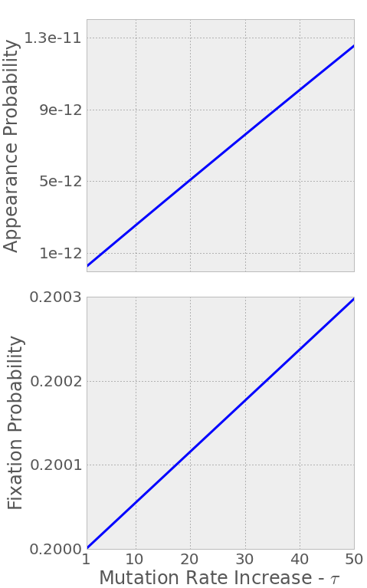
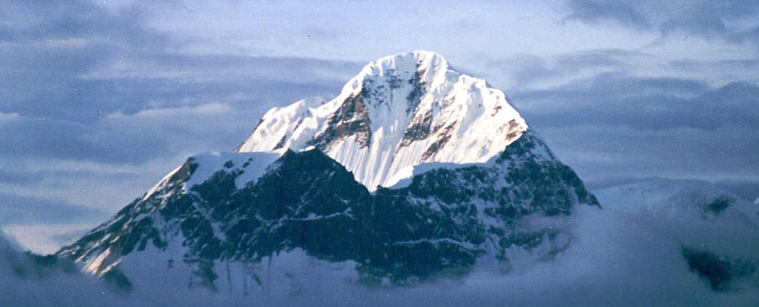
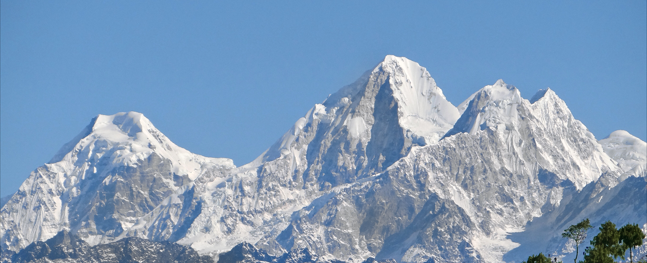
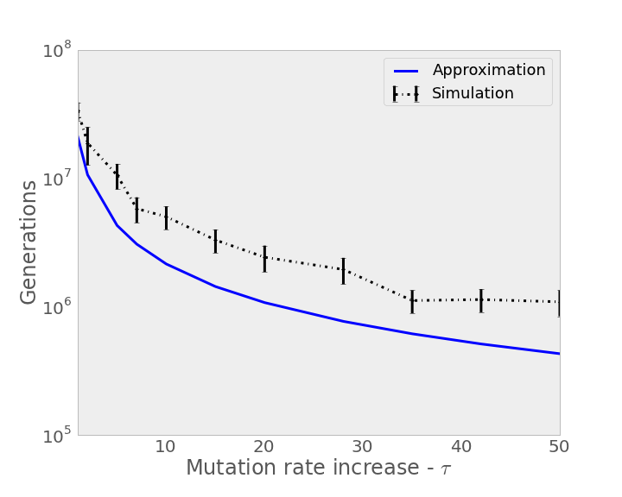
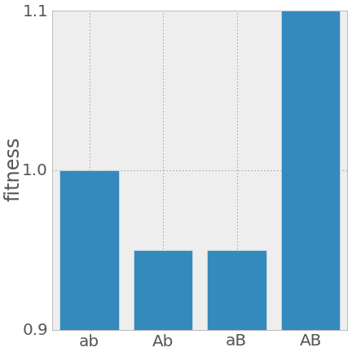
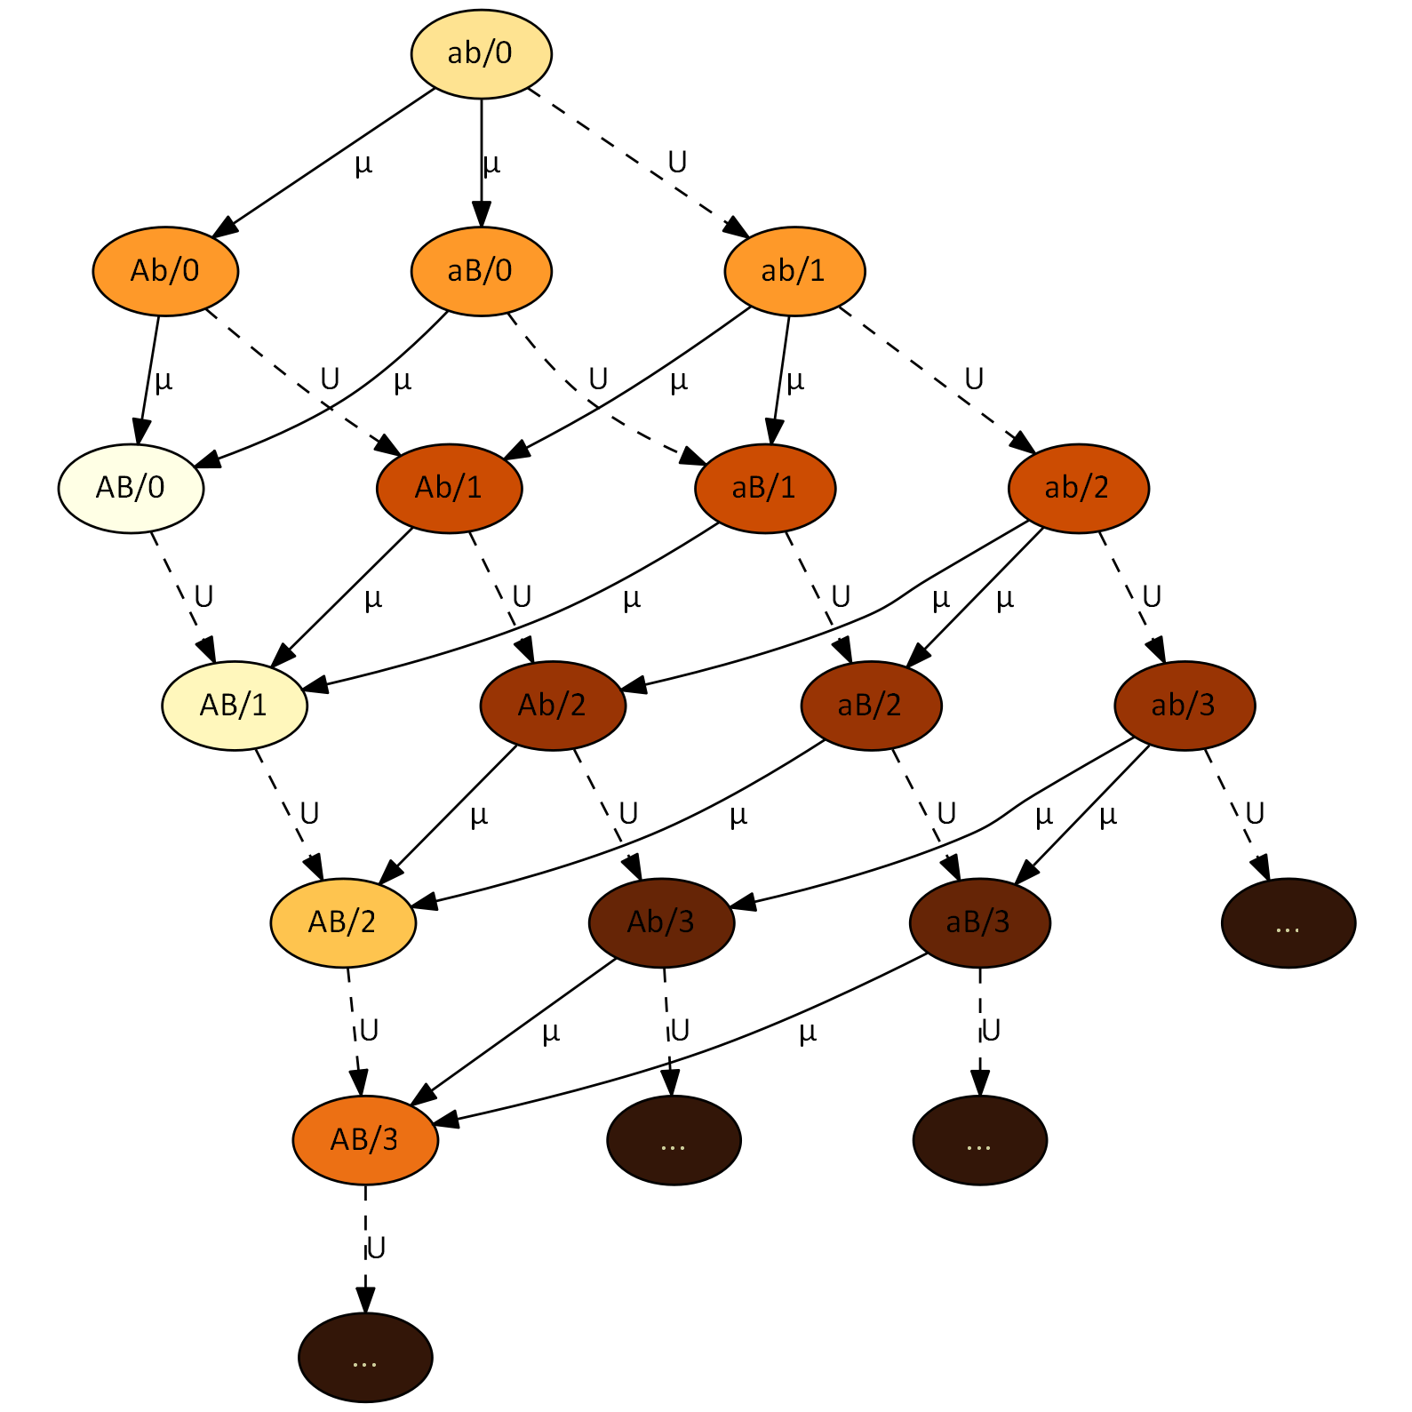
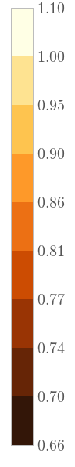
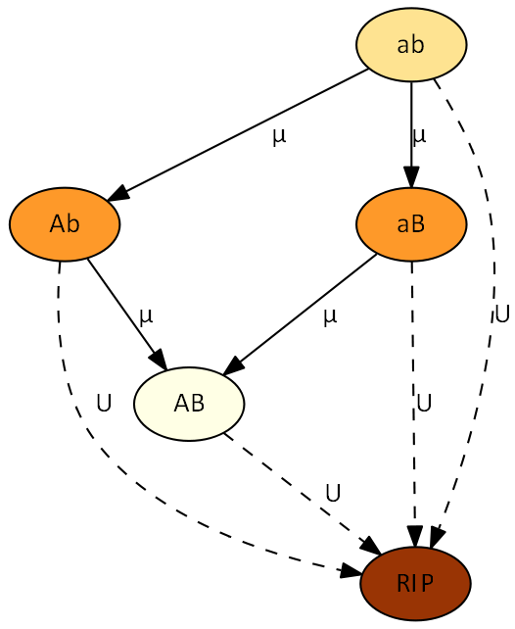
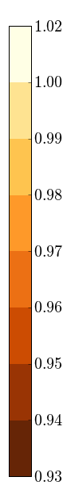







Stress-Induced Mutagenesis and the Evolution of Complex Traits
Yoav Ram & Lilach Hadany Department of Molecular Biology and Ecology of Plants, Life Science Faculty, Tel-Aviv University, Israel
Background
Adaptive peak shifts
The evolution of complex traits coded by multiple genes presents an open evolutionary question, first described by Sewall Wright in 1931 (1): if different alleles are separately deleterious but jointly advantageous, how can a population evolve from one co-adapted gene complex to a better one?
The problem is illustrated using the fitness landscape metaphor:
In a single-peak fitness landscape selection drives the population uphill towards the global maximum (Figure 1). In a multi-peak rugged fitness landscape selection drives the population uphill towards the closest peak, preventing it from shifting to the higher peak (Figure 2).
Stress-Induced Mutagenesis
Mutagenesis is induced by stress responses in various species of bacteria (2-4).
In a previous work (5) we studied the evolution of stress-induced mutagenesis in constant and changing environments. We showed that stress-induced mutagenesis is favored by selection over constant rate mutagenesis because it generates beneficial mutations when they are most needed.
Analytic Approximations
The appearance probability q of the double mutant AB is approximated with or without stress-induced mutagenesis (SIM):
$$q≈\left(1−U\right)\left(2−U\right)\frac{μ^{2}}{s}$$
$$q_{sim}≈\left(1−τU\right)2τ\frac{μ^{2}}{s}$$
where U is the genomic deleterious mutation rate, µ is the beneficial mutation rate in the a/A and b/B loci, τ is the mutation rate fold increase and s is the selection coefficient.
It can be shown that $q_{sim}>q$ if $0.5>τU>U$ – SIM increases the appearance probability q if the increased mutation rate is below 0.5.
The fixation probability ρ of the double mutant AB is approximated by:
$$ρ≈2sH$$
$$ρ_{sim}≈2sH+2\frac{U^{2}}{s}\left(1−s\right)\left(τ−1\right)$$
where H is the relative selective advantage of the double mutant.
This means that $ρ_{sim}>ρ$ if $τ>1$ – SIM always increases the fixation probability ρ.
The population adaptation rate ν is approximated by a geometric distribution with 1/Nqρ as the probability and N as the population size:
$$ν≈2NHμ^{2}\left(1−U\right)\left(2−U\right)$$
$$ν_{sim}≈4Nτμ^{2}\left(1−τU\right)\left(H+\frac{U^{2}}{s^{2}}\left(1−s\right)\left(τ−1\right)\right)$$
Here $ν_{sim}>ν$ if $1>τU>U$ – SIM increases the adaption rate ν if the increased mutation rate is below 1.
Results
Figs. 6 and 7 show that as the mutation rate of stressed individuals increases, the appearance probability (Fig. 6) and fixation probability (Fig .7) of the double mutant AB increase. Note that the lines begin at X1 increase – equivalent to constant low mutation rate.
Fig. 8 shows that the expected adaptation time decreases with the increase in the mutation rate of stressed individuals, both in the approximation (blue) and the simulation (black).
The difference between the approximation and the simulation estimation can be accounted to co-occurring double mutants.
[6]
[1]
[7]
fitness
[2]
genotype
[8]
Citation | Estimate | Name | Sign
6,7 | 0.001-0.01 | Selection coefficient | s
8 | 1-10 | Double mutant advantage | H
8,9 | 0.003-0.0004 | Genomic mutation rate | U
7 | U/5000 | Beneficial site mutation rate | µ
10 | 1-100 | Mutation rate increase | τ
- | 10⁴-10¹⁰ | Population size | N
Table 1. Model parameters and estimated values for bacteria.
Analytic Model
We model two loci, A/a and B/b. Genotype ab is the low peak and AB is the higher peak.
Figure 4 described the model.
Each node represents a genotype. The “RIP” node represents genotypes with deleterious mutations that will not contribute to adaptation.
Arrows define the direction of mutation and denote the relevant mutation rate: U (dashed lines) for deleterious mutation and µ (solid lines) for beneficial mutations.
Node color indicates the fitness of a genotype, from pale brown for high fitness to dark brown for low fitness.
Simulations
Figure 5 describes our multi-locus Wright-Fisher simulations. The major difference from Figure 4 is that nodes also specify the number of deleterious mutations after the forward slash. The figure shows as much as three mutations for simplicity; the simulations had as much as 25.
Summary
We analyzed the adaption time on a rugged fitness landscape with and without stress-induced mutagenesis.
Our results suggest that stress-induced mutagenesis can resolve the problem of adaptive peak shifts by increasing the capacity of populations to adapt, in particular in the case of complex adaptation, without the burden of deleterious mutations that is created by constitutive mutagenesis in asexual populations.
[3]
[5]
fitness
fitness
Literature cited
Wright S. Am Nat 1988, 131:115–123
Rosenberg SM, et al. Genetics 1998, 148:1559–66
Galhardo RS, et al. Crit Rev Biochem Mol Biol 2007, 42:399–435
Bjedov I, et al. Science 2003, 300:1404–9
Ram Y, Hadany L. Evolution 2012, 66:2315–28
Kibota TT, Lynch M. Nature 1996, 381:694–6
Gordo I, et al. J Mol Microbiol Biotech 2011, 21:20–35
Drake JW, et al. Genetics 1998, 148:1667–86
Wielgoss S, et al. G3 2011, 1:183
Hall LMC, Henderson-Begg SK. Microbiology (UK) 2006, 152(Pt 9):2505–14
[4]
Contact information
yoavram@post.tau.ac.il
@yoavram
http://www.yoavram.com

