Slide 1
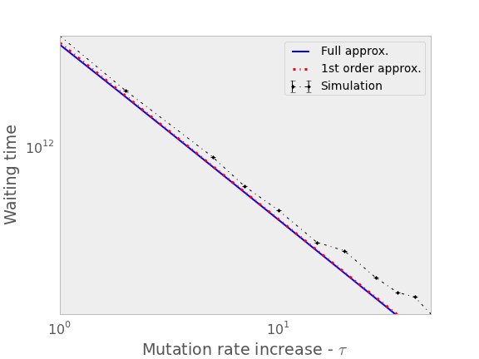
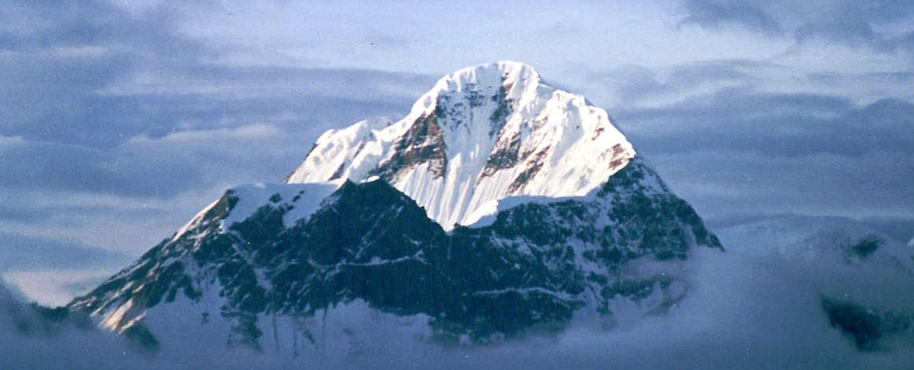
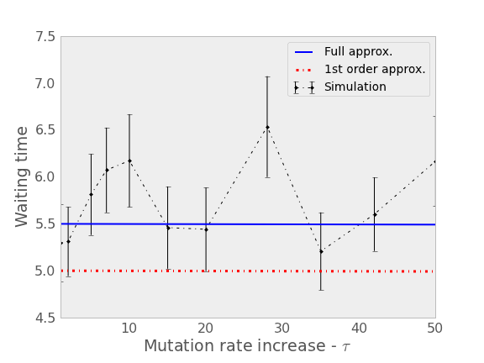
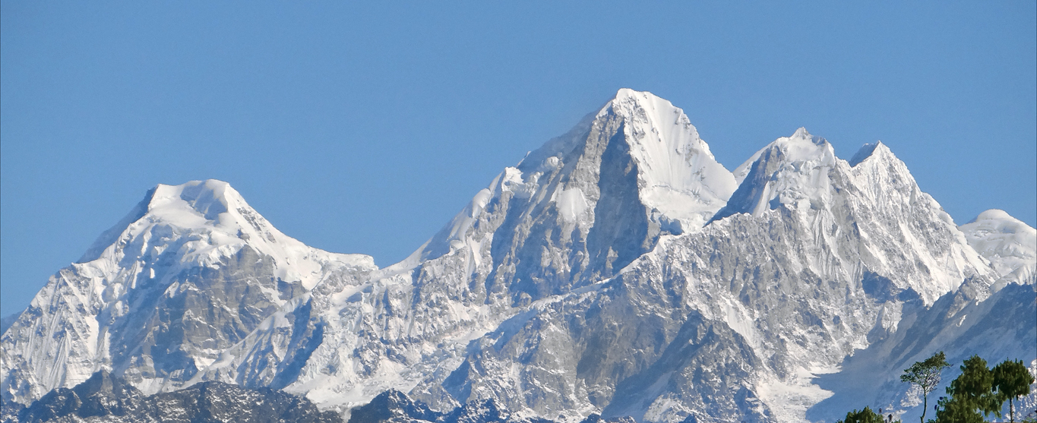
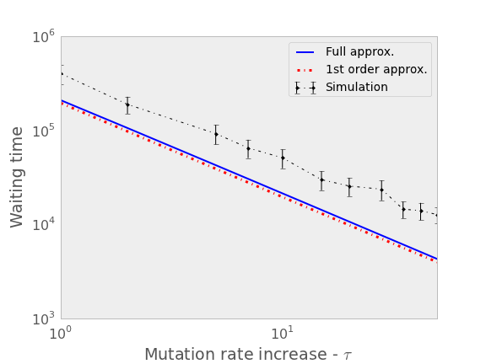
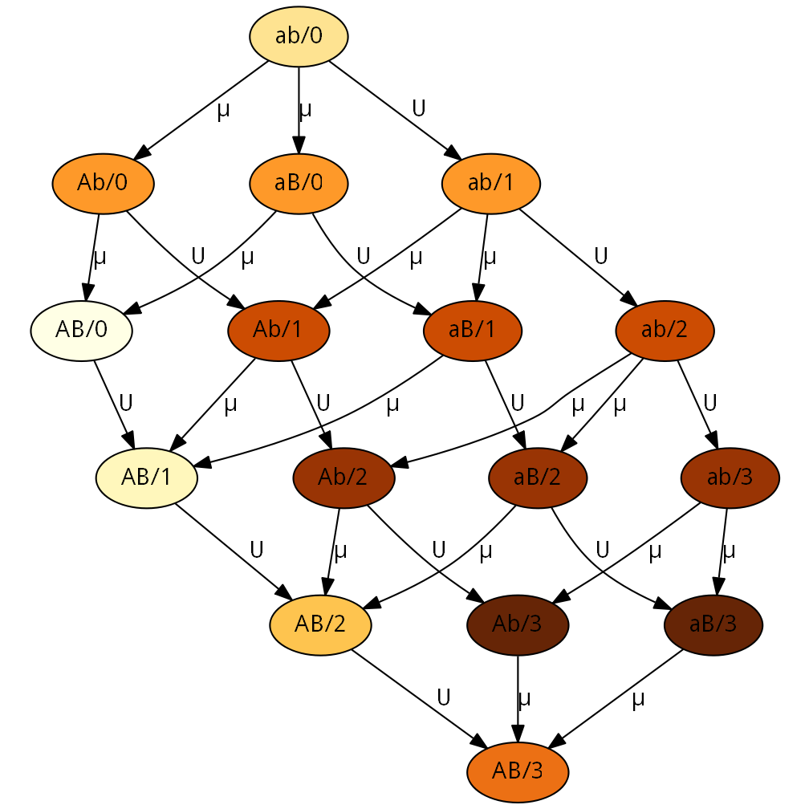
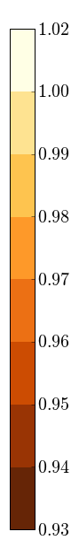
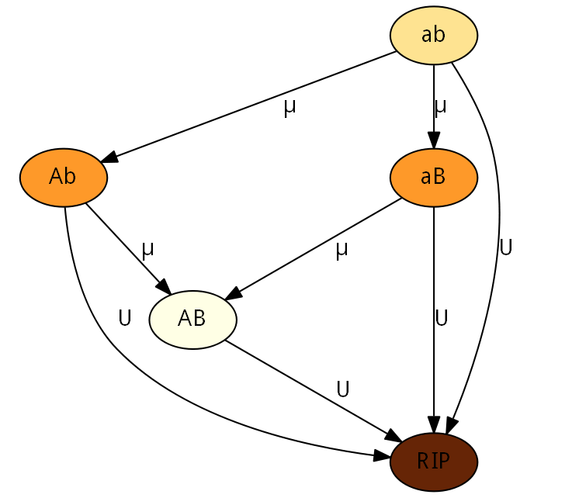



Stress-Induced Mutagenesis & Evolution of Complex Traits
Yoav Ram, Lilach Hadany Department of Molecular Biology and Ecology of Plants, Life Science Faculty, Tel-Aviv University, Israel
Background
The evolution of complex traits, coded by multiple genes, presents an open evolutionary question, first described by Sewall Wright in 1931 (1): if different alleles are separately deleterious but jointly advantageous, how can a population evolve from one co-adapted gene complex to a better one?
Figure 1 below illustrates this problem using the fitness landscape metaphor.
Stress-Induced Mutagenesis
In various species of bacteria as well as yeast, algae, flies and human cancer cells (2-3), the mutation rate is induced by stress responses.
In a previous work (4) we modeled the evolution of stress-induced mutagenesis in asexual population in constant and changing environments. Our results showed that stress-induced mutagenesis is favored by selection over constant rate mutagenesis because of the beneficial mutations it generates when they are most needed.
Analytic approximations
The appearance probability q of the double mutant AB can be approximated with or without stress-induced mutagenesis (SIM):
$$q≈\left(1−U\right)\left(2−U\right)\frac{μ^{2}}{s}$$
$$q_{sim}≈\left(1−τU\right)2τ\frac{μ^{2}}{s}$$
where U is the genomic deleterious mutation rate, µ is the beneficial mutation rate in the a/A and b/B loci, τ is the mutation rate fold increase and s is the selection.
It can be shown that $q_{sim}>q$ if $U^{−1}/2>τ>1.$
The fixation probability ρ of the double mutant AB can be approximated as well:
$$ρ≈2sH$$
$$ρ_{sim}≈2sH+2\frac{U^{2}}{s}\left(1−s\right)\left(τ−1\right)$$
where H is the relative selective advantage of the double mutant.
It is easy to see that $ρ_{sim}>ρ$ if $τ>1$.
The population adaptation rate ν can be approximated by a geometric distribution with 1/Nqρ as the probability, with N as the population size:
$$ν≈2NHμ^{2}\left(1−U\right)\left(2−U\right)$$
$$ν_{sim}≈4Nτμ^{2}\left(1−τU\right)\left(H+\frac{U^{2}}{s^{2}}\left(1−s\right)\left(τ−1\right)\right)$$
Now $ν_{sim}>ν$ if $U^{−1}>τ>1$.
Results
Figure 5. Waiting time for appearance of double mutant. The number of generations before the appearance of a double mutant. Approximated by 1/Nq. Parameters used: U=0.0004, µ=U/5000, s=0.05, N=10⁸, see Table 1 for refs.
Figure 5. Fixation attempts. The number of double mutants extinctions before fixation. Approximated by 1/ρ. Parameters used: U=0.0004, µ=U/5000, s=0.05, H=2, N=10⁸, see Table 1 for refs.
fitness
genotype
Figure 1. Fitness landscape metaphor. Height represents fitness and different geographic coordinates represent different genotypes. Mutation and drift move the population in all directions whereas selection drives the population uphill. (A) A single-peak fitness landscape. Selection drives the population uphill towards the global maximum. (B) A multi-peak rugged fitness landscape. Selection drives the population uphill towards the closest peak – the global or local maximum.
Citation | Estimate | Name | Symbol
5, 6 | 0.001-0.01 | Selection coefficient | s
6 | 1-10 | Double mutant advantage | H
7, 8 | 0.003-0.0004 | Genomic mutation rate | U
6 | U/5000 | Beneficial site mutation rate | µ
9 | 1-100 | Mutation rate increase | τ
- | 10⁴-10¹⁰ | Population size | N
Figure 6. Adaptation time. The number of generations before fixation of a double mutant. The simulation results verify the analytical results: stress-induced mutagenesis increases the adaptation rate. Parameters used: U=0.0004, µ=U/5000, s=0.05, H=2, N=10⁸, see Table 1 for refs.
Table 1. Model parameters and estimated values for bacteria.
Analytic Model
Consider an asexual population with two bi-allelic loci, a/A and b/B at a mutation-selection balance. An environmental change causes the previously deleterious combination AB to be favorable, but the intermediate types Ab and aB are still deleterious.
In addition to adaptation, the population must also cope with deleterious mutations, so we assumed that individuals with deleterious mutations will not contribute to the adaptation process.
Simulations
We performed Wright-Fisher simulations without recombination. We tracked the frequency of ab, Ab, aB and AB and the number of deleterious mutations in each type – see Figure 2.
Summary
We analyzed the adaption time on a rugged fitness landscape with and without stress-induced mutagenesis.
Our results suggest that stress-induced mutagenesis can resolve the problem of adaptive peak shifts by increasing the capacity of populations to adapt, in particular in the case of complex adaptation, without the burden of deleterious mutations that is created by constitutive mutagenesis in asexual populations.
fitness
Literature cited
Wright S. Am Nat 1988, 131:115–123.
Galhardo RS, et al. Crit Rev Biochem Mol Biol 2007, 42:399–435.
Bjedov I, et al.. Science 2003, 300:1404–9.
Ram Y, Hadany L. Evolution 2012, 66:2315–28.
Kibota TT, Lynch M. Nature 1996, 381:694–6.
Gordo I, et al. J Mol Microbiol Biotech 2011, 21:20–35.
Drake JW, et al. Genetics 1998, 148:1667–86.
Wielgoss S, et al. G3 2011, 1:183.
Hall LMC, Henderson-Begg SK. Microbiology (UK) 2006, 152(Pt 9):2505–14.
Figure 2 – Fitness landscape illustration for analytical model. Each node represent a specific genotype. Node labels specify the alleles at the A/a and B/b loci. The “RIP” node represents genotypes with deleterious mutations that will not contribute to adaptation. Arrows define the direction of mutation and their labels denote the relevant mutation rate. Node colour indicates the fitness of a genotype, from pale brown for optimal fitness (1+sH) to dark brown for lower fitness (1-s). Parameters: s=0.01, H=2.
Figure 3 – Fitness landscape illustration for simulations. Each node represent a specific genotype. Node labels specify the alleles at the A/a and B/b loci and the number of additional deleterious alleles after the forward slash, but only as much as 3 deleterious mutations are shown to keep the figure simple. Arrows define the direction of mutation and their labels denote the relevant mutation rate. Node colour indicates the fitness of a genotype, from pale brown for optimal fitness (1+sH) to dark brown for lower fitness ((1-s)³) – see the colourbar. Parameters: s=0.01, H=2.
For more information
Please contact Yoav Ram at yoavram@post.tau.ac.il
or +972-545-383136 or visit www.yoavram.com

