Slide 1
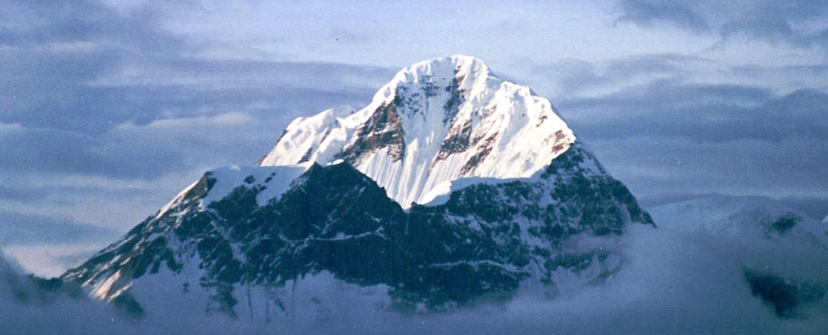
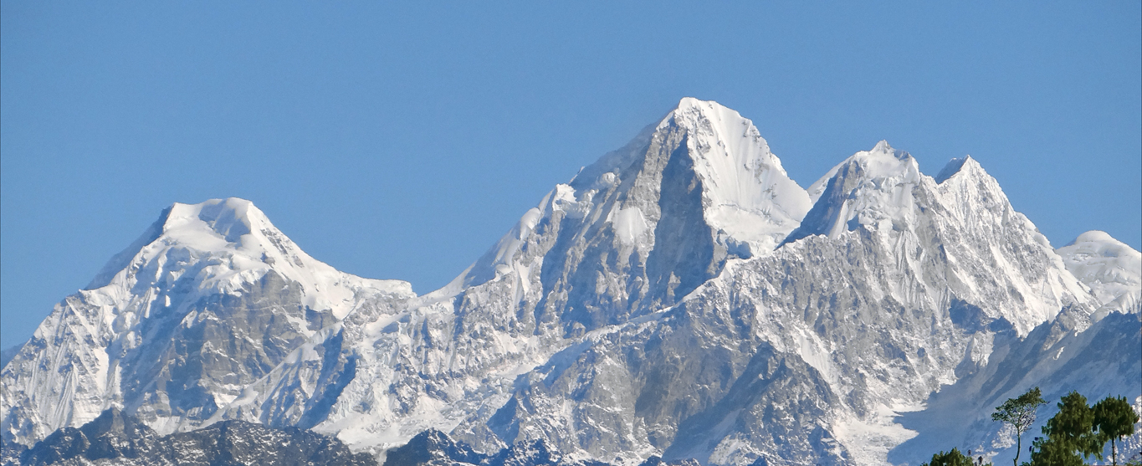
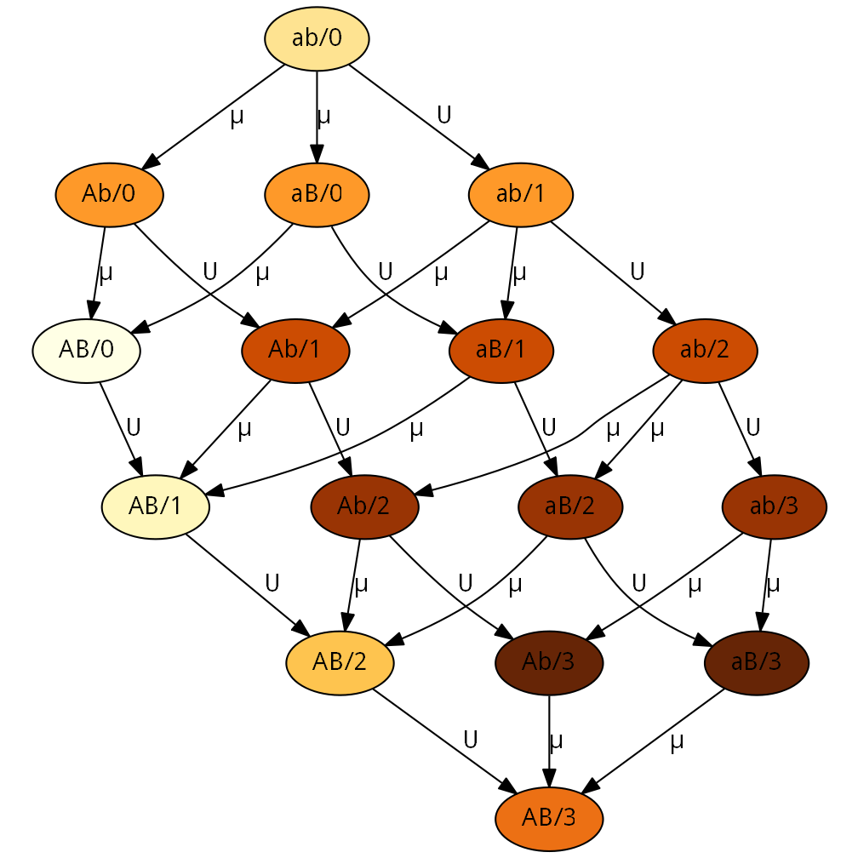
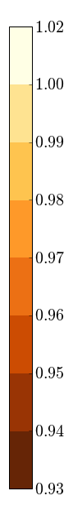
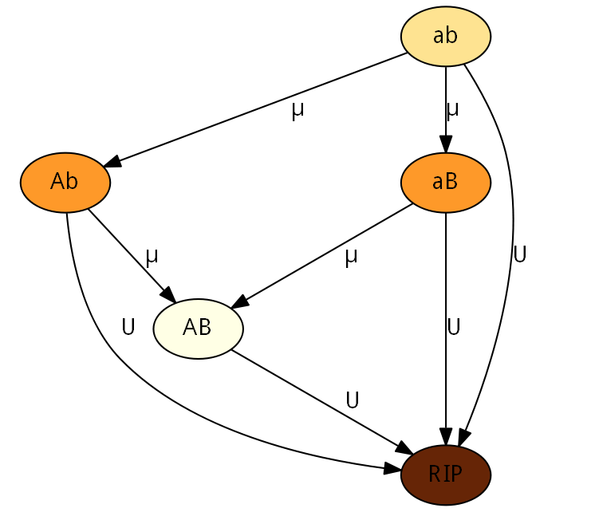



Stress-Induced Mutagenesis & Evolution of Complex Traits
Yoav Ram, Lilach Hadany Department of Molecular Biology and Ecology of Plants, Life Science Faculty, Tel-Aviv University, Israel
Background
The evolution of complex traits, coded by multiple genes, presents an open evolutionary question, first described by Sewall Wright in 1931 (1): if different alleles are separately deleterious but jointly advantageous, how can a population evolve from one co-adapted gene complex to a better one?
Figure 1 below illustrate s this problem using the fitness landscape metaphor.
Stress-Induced Mutagenesis
In various species of bacteria (2) as well as yeast, algae, flies and human cancer cells (3), the mutation rate is induced by stress responses.
In a previous work (4) we modeled the evolution of stress-induced mutagenesis in asexual population in constant and changing environments. Our results showed that stress-induced mutagenesis is favored by selection over constant rate mutagenesis because of the beneficial mutations it generates when they are most needed.
Analytic Results
The appearance probability q of the double mutant AB can be approximated with or without stress-induced mutagenesis (SIM):
$$q≈\left(1−U\right)\left(2−U\right)\frac{μ^{2}}{s}$$
$$q_{sim}≈\left(1−τU\right)2τ\frac{μ^{2}}{s}$$
where U is the genomic deleterious mutation rate, µ is the beneficial mutation rate in the a/A and b/B loci, τ is the mutation rate fold increase and s is the selection.
It can be shown that $q_{sim}>q$ if $U^{−1}/2>τ>1.$
The fixation probability ρ of the double mutant AB can be approximated as well:
$$ρ≈2sH$$
$$ρ_{sim}≈2sH+2\frac{U^{2}}{s}\left(1−s\right)\left(τ−1\right)$$
where H is the relative selective advantage of the double mutant.
It is easy to see that $ρ_{sim}>ρ$ if $τ>1$.
The population adaptation rate ν can be approximated by a geometric distribution with 1/Nqρ as the probability, with N as the population size:
$$ν≈2NHμ^{2}\left(1−U\right)\left(2−U\right)$$
$$ν_{sim}≈4Nτμ^{2}\left(1−τU\right)\left(H+\frac{U^{2}}{s^{2}}\left(1−s\right)\left(τ−1\right)\right)$$
Now $ν_{sim}>ν$ if $U^{−1}>τ>1$.
Bla bla bla
fitness
genotype
Figure 1. Fitness landscape metaphor. Height represents fitness and different geographic coordinates represent different genotypes. Mutation and drift move the population in all directions whereas selection drives the population uphill. (A) A single-peak fitness landscape. Selection drives the population uphill towards the global maximum. (B) A multi-peak fitness landscape. Selection drives the population uphill towards the closest peak – the global or local maximum.
Reference | Estimate | Name | Symbol
Kibota & Lynch 1996 Gordo et al. 2011 | 0.001-0.01 | Selection coefficient | s
Gordo et al. 2011 | 1-10 | Double mutant advantage | H
Drake et al. 1998 Wielgoss et al. 2011 | 0.003-0.0004 | Genomic mutation rate | U
Gordo et al. 2011 | U/5000 | Beneficial site mutation rate | µ
Hall & Henderson-Begg 2006 | 1-1,000 | Mutation rate increase | τ
- | 10⁴-10¹⁰ | Population size | N
Table 1. Model parameters and estimated values for bacteria.
Model
Consider an asexual population with two bi-allelic loci, a/A and b/B at a mutation-selection balance. An environmental change causes the previously deleterious combination AB to be favorable, but the intermediate types Ab and aB are still deleterious.
In addition to adaptation, the population must also cope with deleterious mutations, so we assumed that individuals with deleterious mutations will not contribute to the adaptation process.
Simulations
We performed Wright-Fisher simulations without recombination. We tracked the frequency of ab, Ab, aB and AB and the number of deleterious mutations in each type – see Figure 2.
Summary
fitness
Literature cited
Figure 2 – Fitness landscape illustration for analytical model. Each node represent a specific genotype. Node labels specify the alleles at the A/a and B/b loci. The “RIP” node represents genotypes with deleterious mutations that will not contribute to adaptation. Arrows define the direction of mutation and their labels denote the relevant mutation rate. Node colour indicates the fitness of a genotype, from pale brown for optimal fitness (1+sH) to dark brown for lower fitness (1-s). Parameters: s=0.01, H=2.
Figure 3 – Fitness landscape illustration for simulations. Each node represent a specific genotype. Node labels specify the alleles at the A/a and B/b loci and the number of additional deleterious alleles after the forward slash, but only as much as 3 deleterious mutations are shown to keep the figure simple. Arrows define the direction of mutation and their labels denote the relevant mutation rate. Node colour indicates the fitness of a genotype, from pale brown for optimal fitness (1+sH) to dark brown for lower fitness ((1-s)³) – see the colourbar. Parameters: s=0.01, H=2.
For more information
Please contact Yoav Ram at yoavram@post.tau.ac.il
or +972-545-383136 or visit www.yoavram.com

