Slide 1
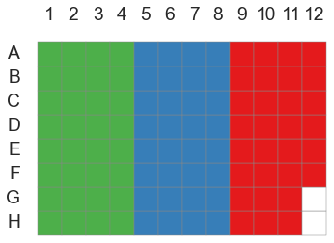
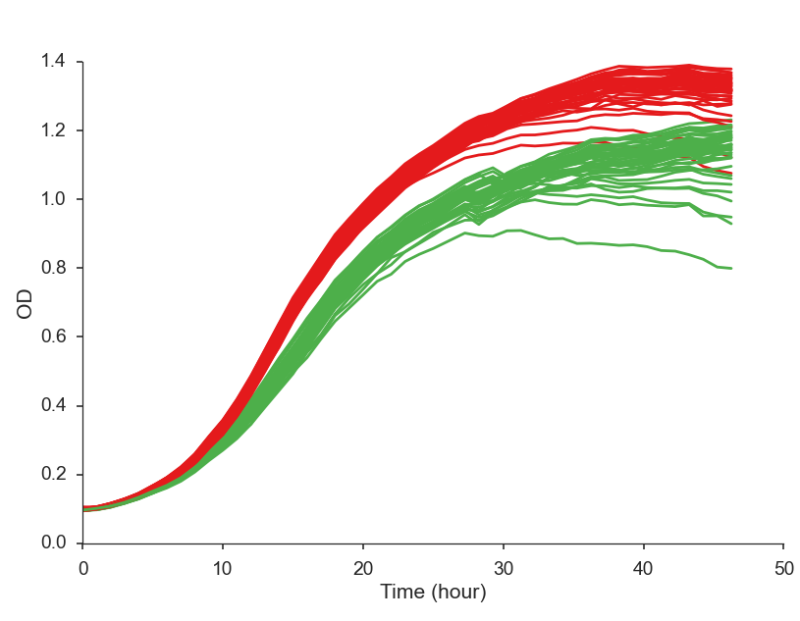
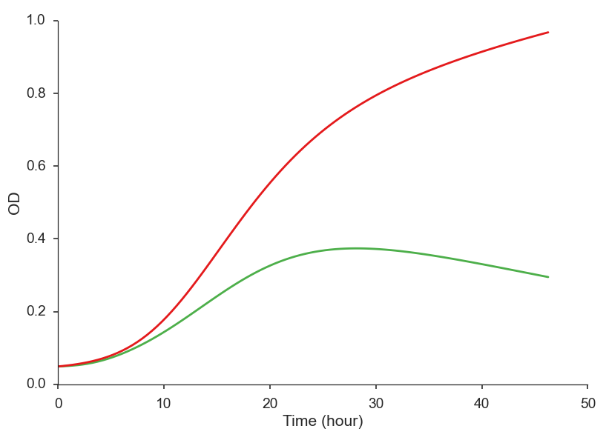
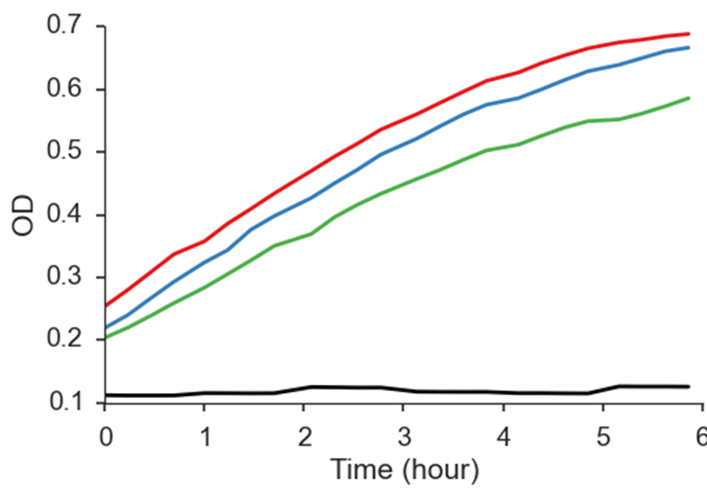
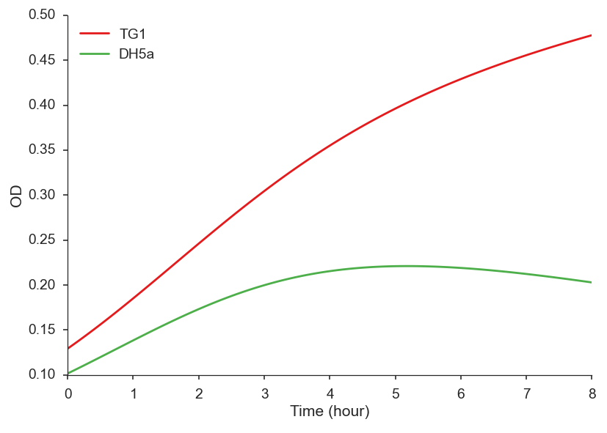
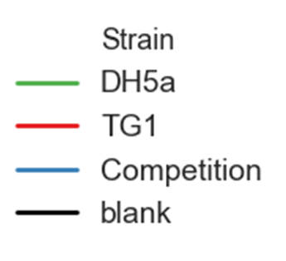
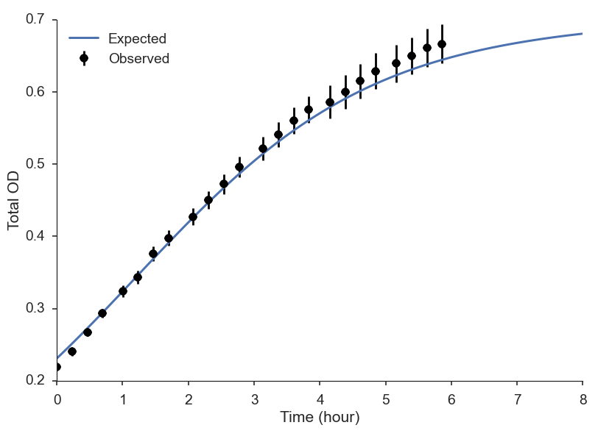
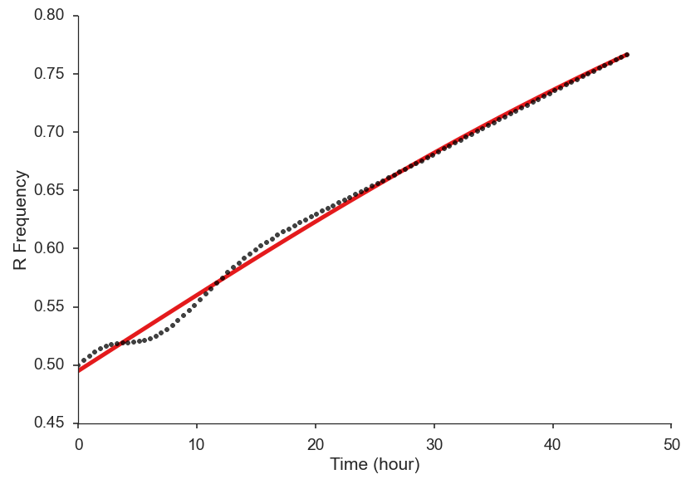
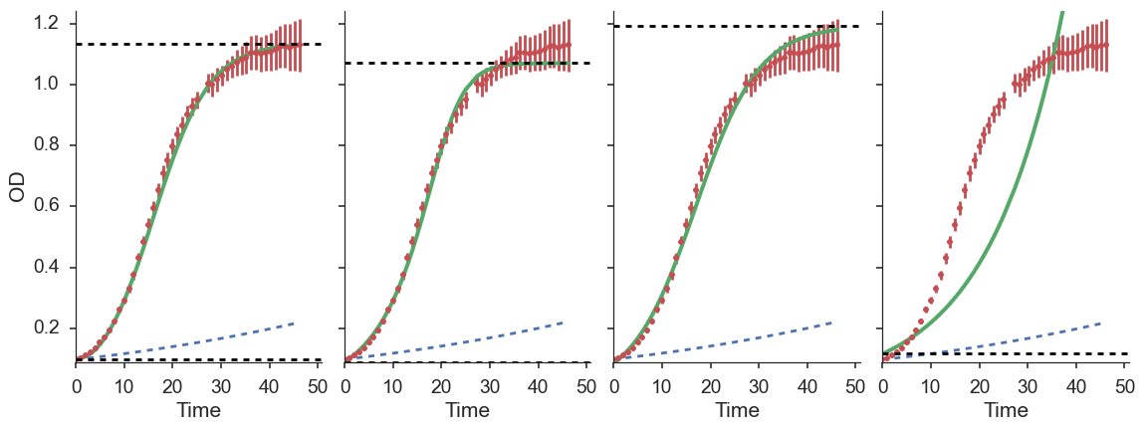
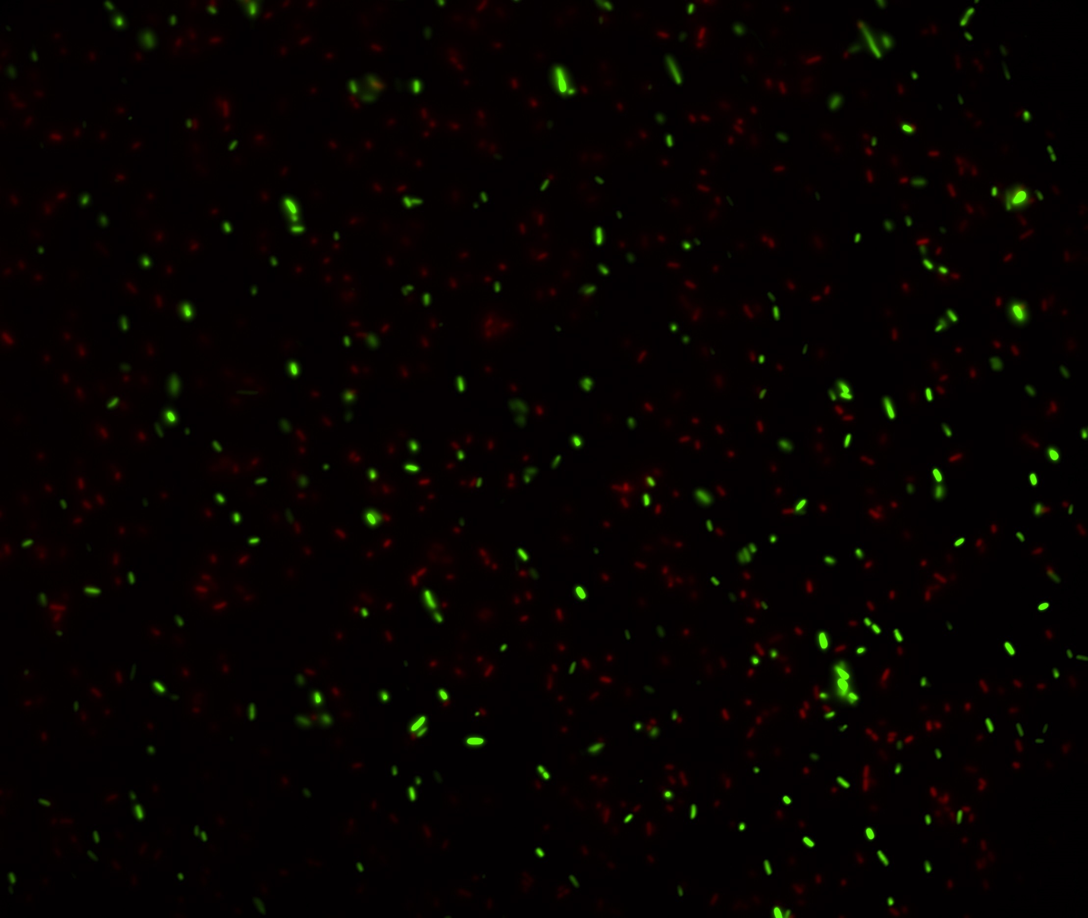
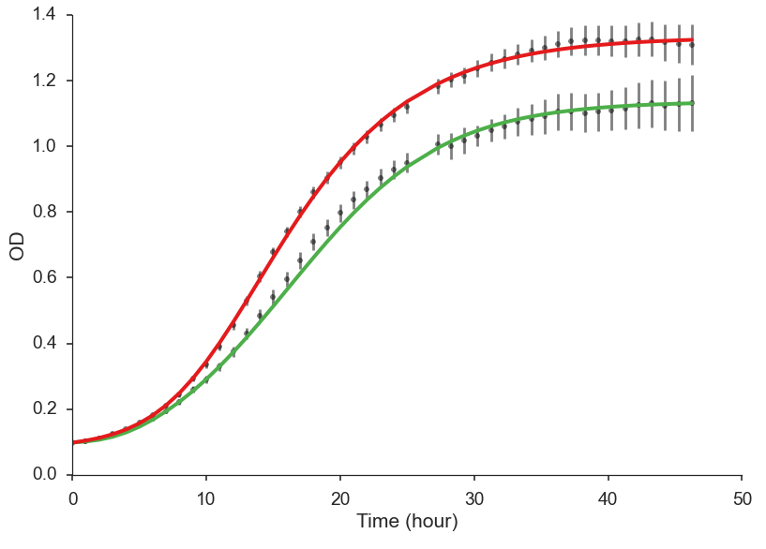

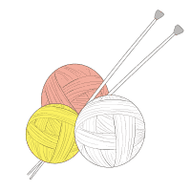














Predicting competition dynamics and estimating selection coefficients using eco-evolutionary models
Yoav Ram¹, Eynat Dellus-Gur¹, Uri Obolski¹, Maayan Bibi², Judith Berman², Lilach Hadany¹ Dept. of Molecular Biology & Ecology of Plants¹ and Dept. of Molecular Microbiology & Biotechnology², Tel-Aviv University, Tel-Aviv, Israel
Growth curves
Replace the “blah, blah, blah” with your own “blah, blah, blah.”
Competition simulation
Two-strain ordinary differential equation:
$$\frac{dN_{i}}{dt}=r_{i}α_{i}\left(t\right)N_{i}\left(1−{\left(\frac{N_{G}+N_{R}}{K_{i}}\right)}^{ν_{i}}\right)$$
Testing the model
Blah, blah, blah
Model selection
Baranyi-Roberts model:
$$\frac{dN}{dt}=rα\left(t\right)N\left(1−{\left(\frac{N}{K}\right)}^{ν}\right), α\left(t\right)=\frac{q_{0}}{q_{0}+e^{−mt}}$$
$N$ – population density $K$ – maximum density
$r$ – growth rate (low density) $ν$ – growth deceleration
$α\left(t\right)$ - physiological adjustment function
$q_{0}$ - initial physiological state $m$ – physio. adjustment rate
Selection estimation
Kimura and Crow 1970:
$$p\left(t\right)=\frac{p_{0}}{p_{0}+\left(1−p_{0}\right)e^{−st}}$$
$p_{0}$ - initial frequency $s$ – selection coefficient
$$p_{0}=0.495±0.001, s=0.0261±0.00018$$
References
Blah, blah, and blah. 2012. Blahing, blahing, and more blahing. Journal of Blahology 1:1-2.
Blah, blah, and blah. 2012. Blahing, blahing, and more blahing. Journal of Blahology 1:1-2.
Blah, blah, and blah. 2012. Blahing, blahing, and more blahing. Journal of Blahology 1:1-2.
Blah, blah, and blah. 2012. Blahing, blahing, and more blahing. Journal of Blahology 1:1-2.
Blah, blah, and blah. 2012. Blahing, blahing, and more blahing. Journal of Blahology 1:1-2.
Acknowledgments
←plato.yoavram.com
curveball.yoavram.com→
yoav@yoavram.com
@yoavram
@yoavram
www.yoavram.com
a
Israeli
Ministry
of Science
and
Technology
Notes:
Copyright Colin Purrington (http://colinpurrington.com/tips/academic/posterdesign).

