Slide 1

Predicting Competitions & Estimating Selection in Microorganisms
Yoav Ram
Hadany Lab
Molecular Mechanisms in Evolution
Gordon Research Conference2015

Slide 2
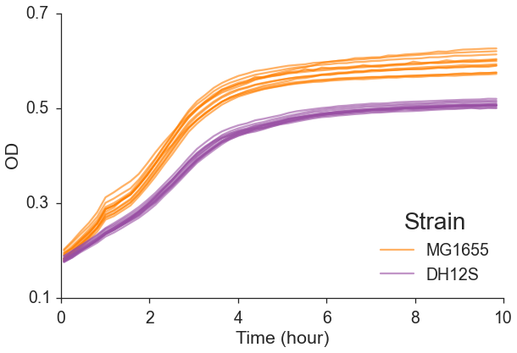
Which is fitter?

Slide 3
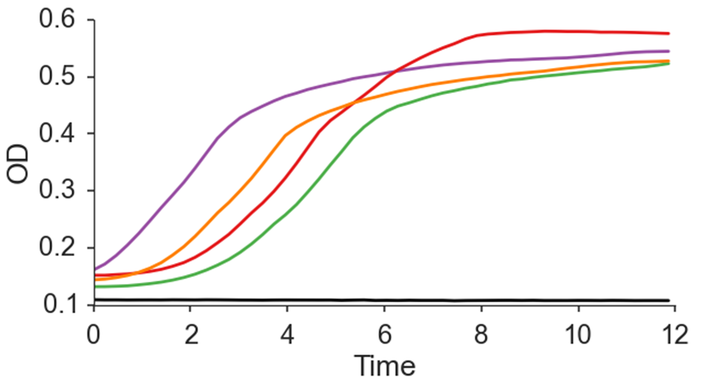
Which is fitter?

Slide 4
How much fitter???

Slide 5
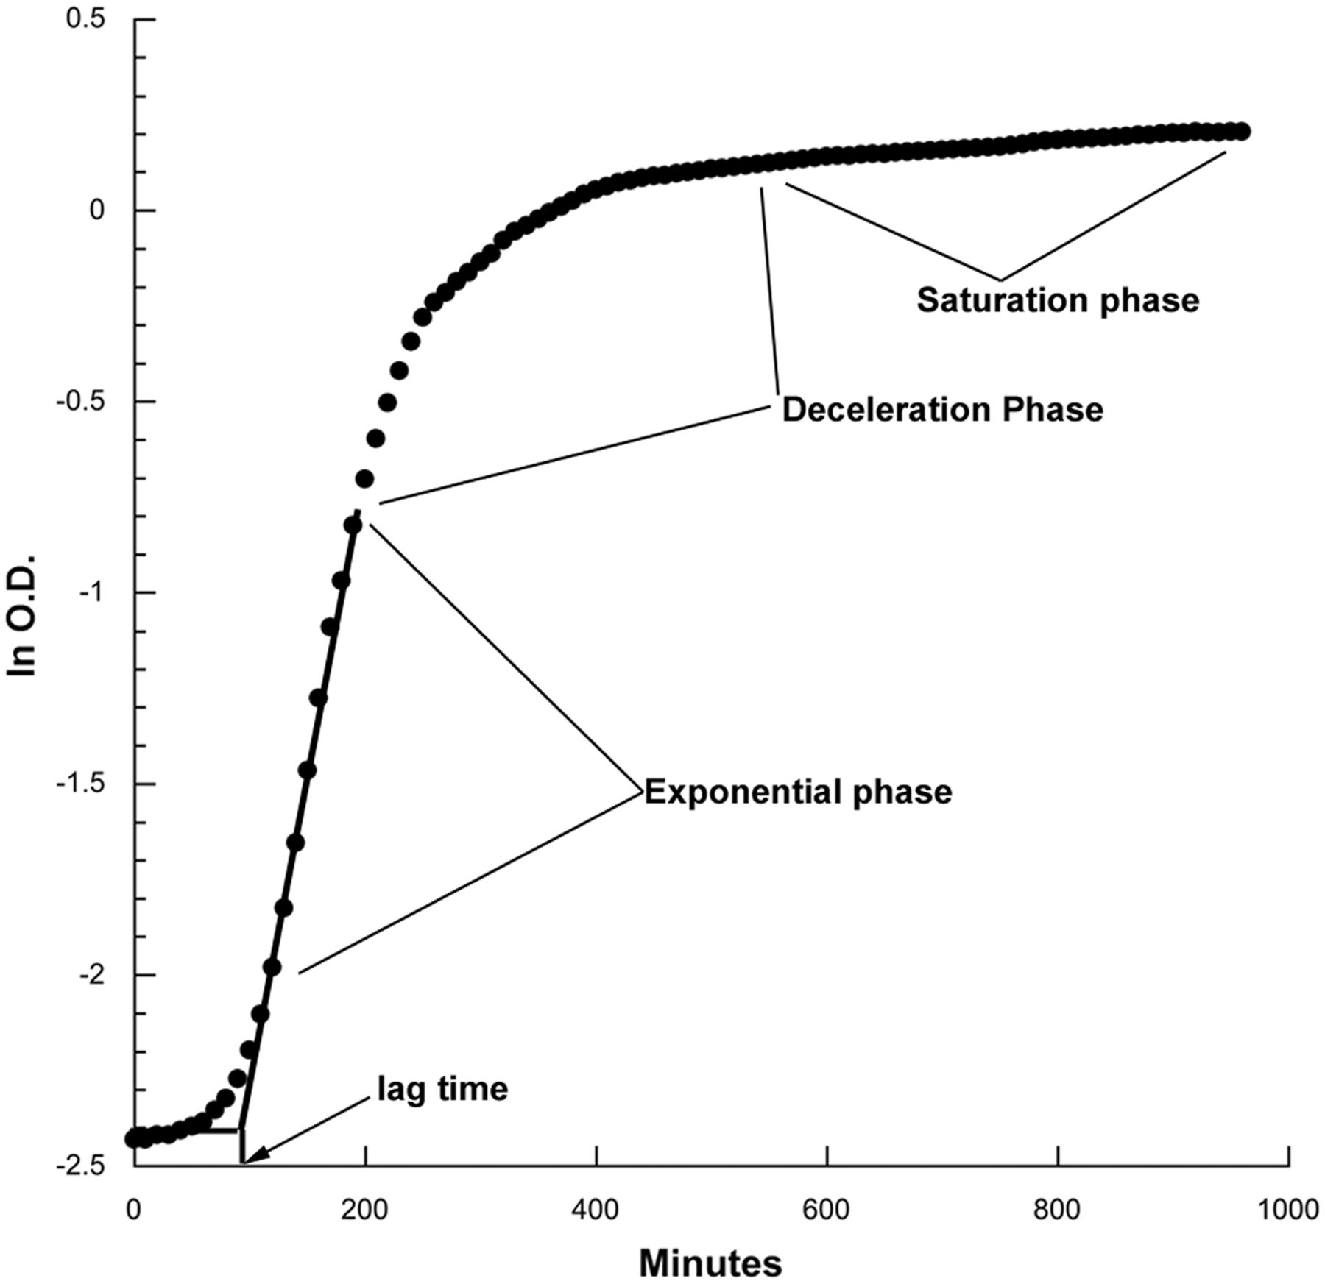
Growth phases
Lag time
Exponential phase
Deceleration phase
Saturation phase
Death phase?
Diauxic shift?
Hall et al., Mol. Biol. Evol. 2014

Slide 6

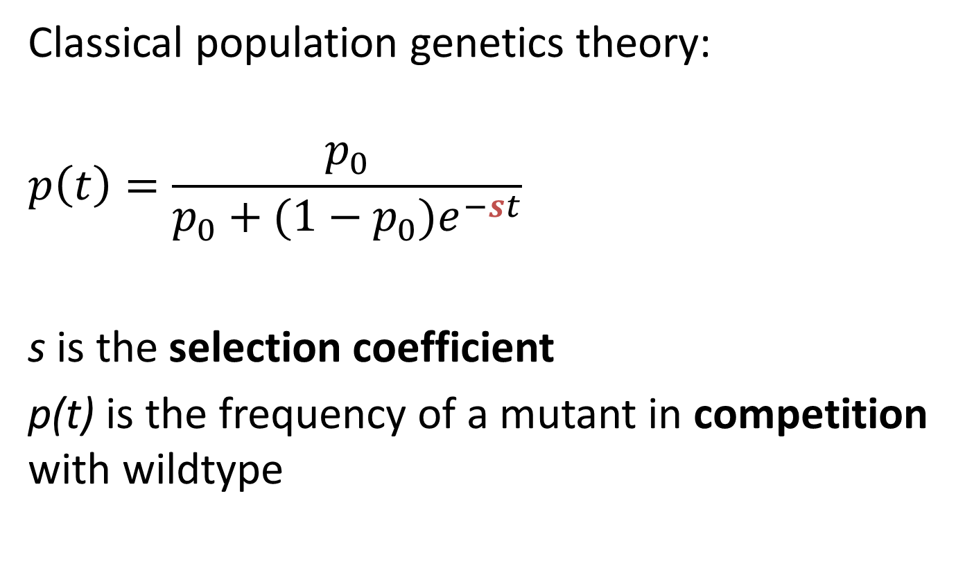
One parameter to rule them all
Classical population genetics theory:
$$p\left(t\right)=\frac{p_{0}}{p_{0}+(1−p_{0})e^{−st}}$$
s is the selection coefficient
p(t) is the frequency of a mutant in competition with wildtype
Kimura & Crow 1970

Slide 7
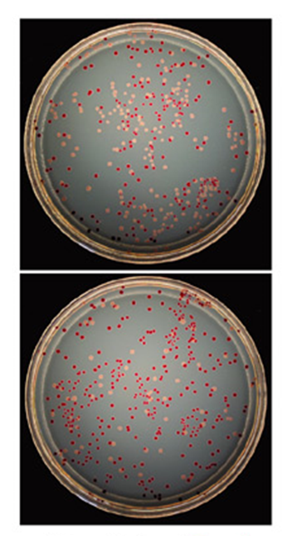
Competition assays
Strains must have a genotypic or phenotypic marker
Problem: Laborious and Costly
Our Solution: Theoretical framework that predicts competitions
Fit growth models to growth curves
Predict competitions
Infer selection coefficients
Ara⁻
Ara⁺
Wiser & Lenski 2015
Elena & Lenski 2003

Slide 8
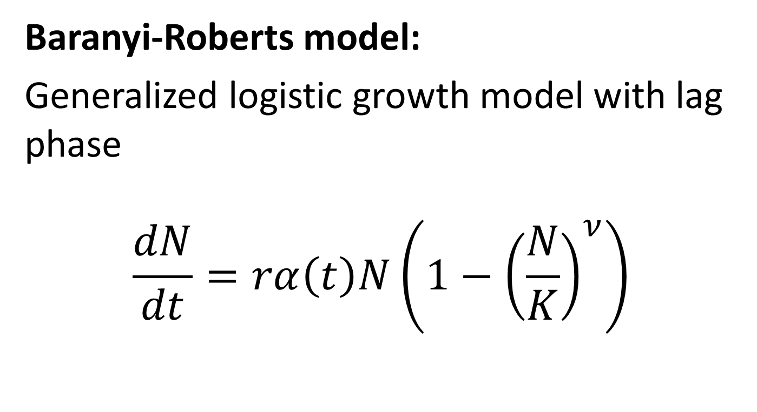
Growth model
Baranyi-Roberts model:
Generalized logistic growth model with lag phase
$$\frac{dN}{dt}=rα\left(t\right)N\left(1−{\left(\frac{N}{K}\right)}^{ν}\right)$$
Baranyi & Roberts, Int. J. Food Microbiol. 1994

Slide 9
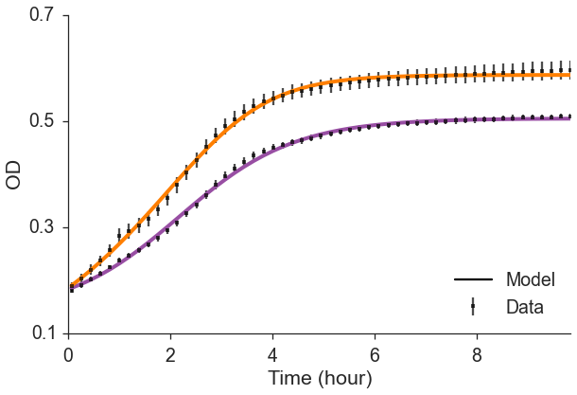
Growth model
N₀: 0.185
r: 0.39
K: 0.59
nu: 2.97
Lag: 0.18 hours
Max growth: 0.38
N₀: 0.09
r: 0.86
K: 0.5
nu: 1
Lag: 0.4 hours
Max growth: 0.27

Slide 10
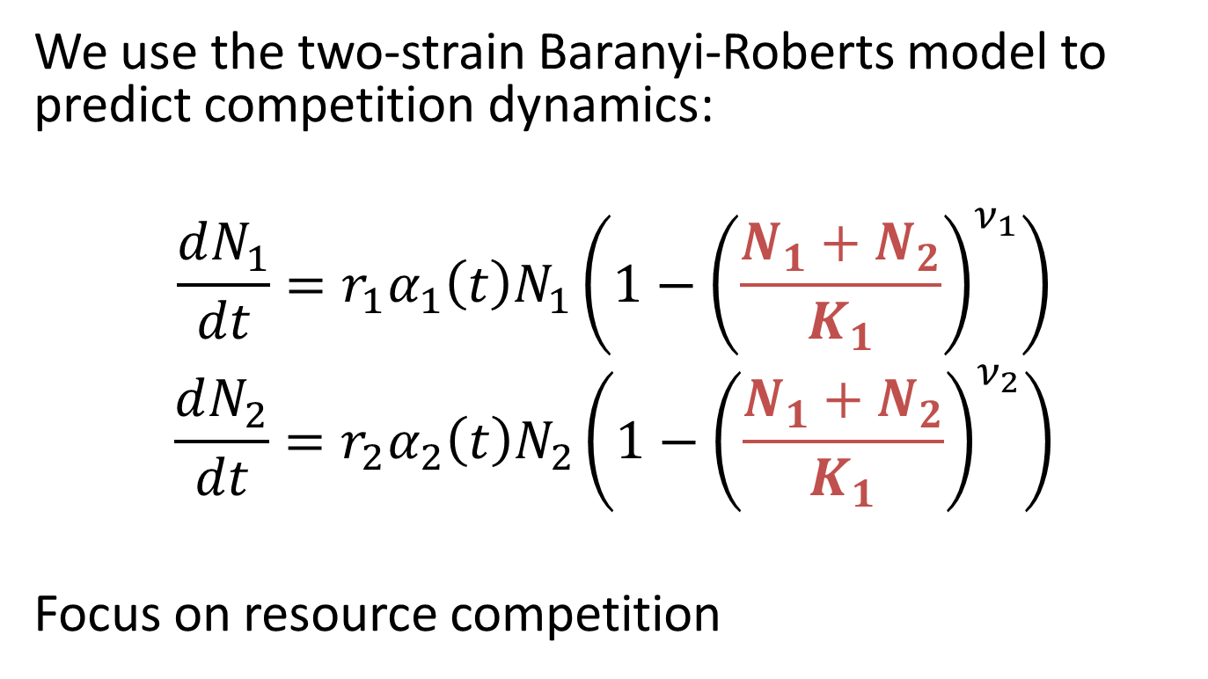
Competitions prediction
We use the two-strain Baranyi-Roberts model to predict competition dynamics:
$$\frac{dN_{1}}{dt}=r_{1}α_{1}\left(t\right)N_{1}\left(1−{\left(\frac{N_{1}+N_{2}}{K_{1}}\right)}^{ν_{1}}\right)$$
$$\frac{dN_{2}}{dt}=r_{2}α_{2}\left(t\right)N_{2}\left(1−{\left(\frac{N_{1}+N_{2}}{K_{1}}\right)}^{ν_{2}}\right)$$
Focus on resource competition

Slide 11
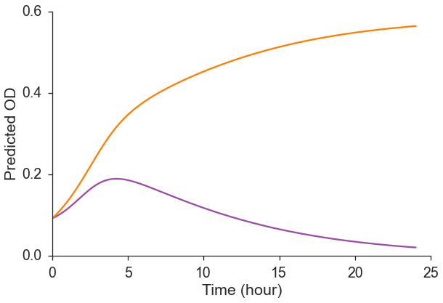
Competitions prediction

Slide 12
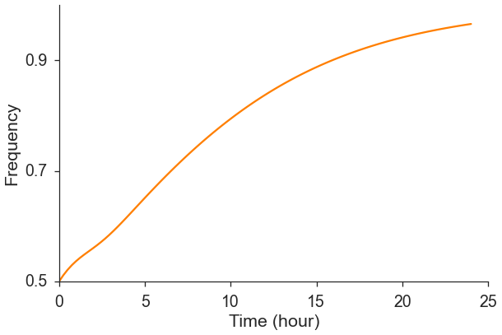
Predicted frequency over time

Slide 13
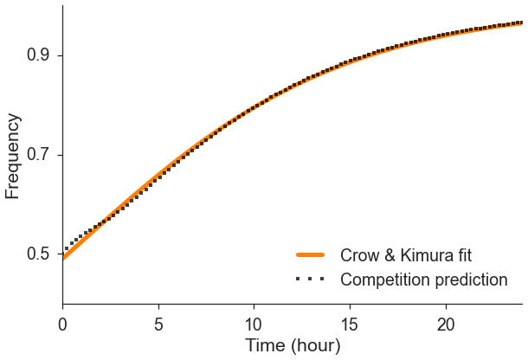

Estimating election coefficient
$$p\left(t\right)=\frac{p_{0}}{p_{0}+(1−p_{0})e^{−st}}→$$
$$p_{0}=0.489$$
$$s=0.134 hr^{−1}$$

Slide 14

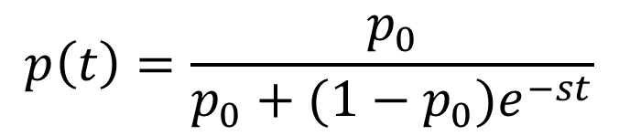
s_{e} - effective selection coefficient
Our suggestion for selection measure
The selection coefficient required to reproduce the frequency dynamics in an idealized population
Similar to N_{e} – effective population size
$$p\left(t\right)=\frac{p_{0}}{p_{0}+(1−p_{0})e^{−st}}$$
$$s_{e}=0.134 hr^{−1}$$

Slide 15
Experimental test of model predictions

Slide 16
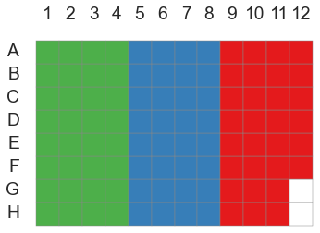
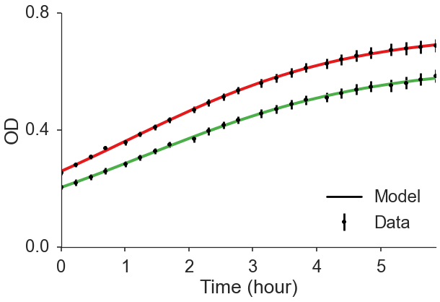
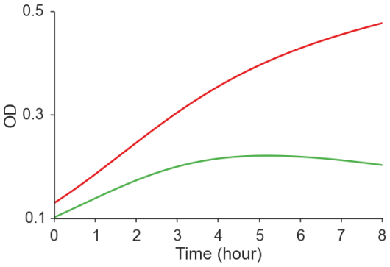
Testing the model prediction
Two E. coli strains
Separately & in competition
Measure OD over time
Fit growth model
Predict competitions from fitted growth models
Validate predictions using experimental competition assays

Slide 17
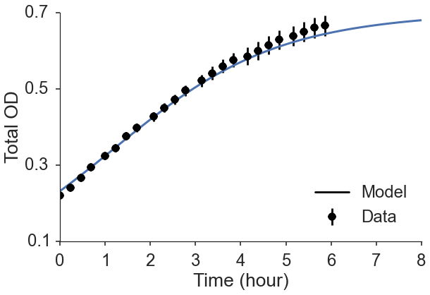
Model – Experiment comparison

Slide 18
Testing the model prediction
Two E. coli strains: TG1, DH5α
Measure OD over time
Fit growth model
Predict competitions from fitted growth models
Validate predictions using competition assays
Label strains with fluorescent proteins
Use fluorescence to measure frequencies over time
Work in progress

Slide 19
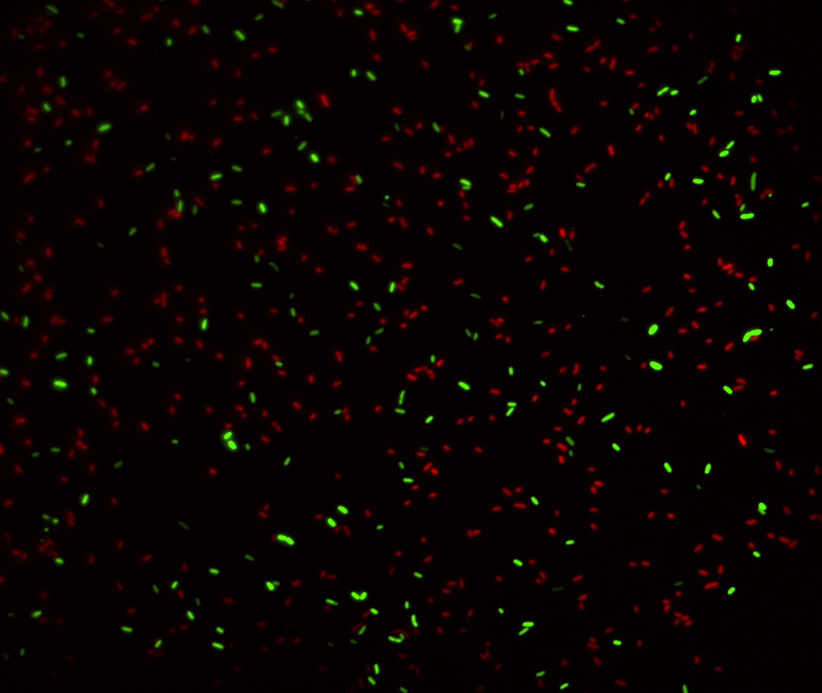
Microscopy: Maayan Bibi

Slide 20
Summary
Fit growth models to single strain growth
Use growth models to predict competitions
Use predicted competitions to infer s_{e} - an effective selection coefficient, à la N_{e}
Focus on resource competition
If other interactions exist: s=s_{res}+s_{inter}
Stationary phase? Death? Diauxic shift?

Slide 21
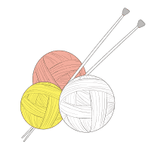
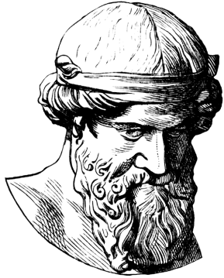
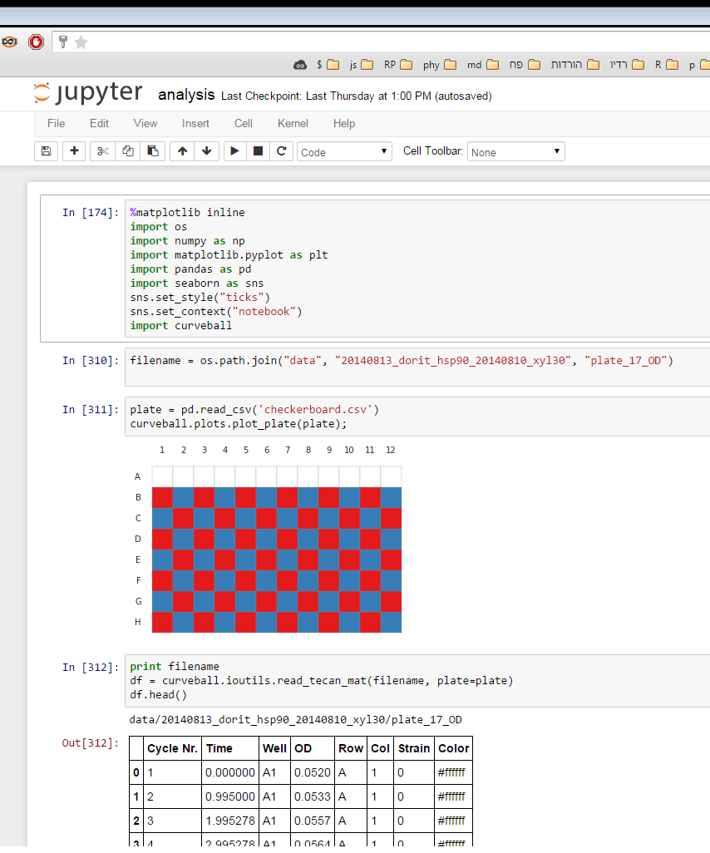
We open source our tools! G github.com/yoavram

Slide 22

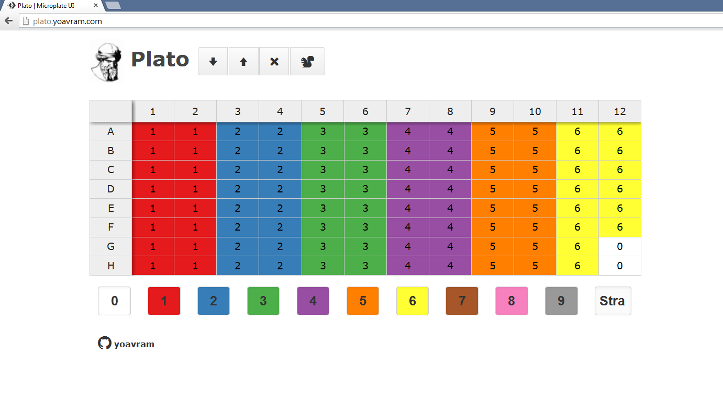
Plato
Plato: design microplates and download them as a CSV file
http://plato.yoavram.com/

Slide 23
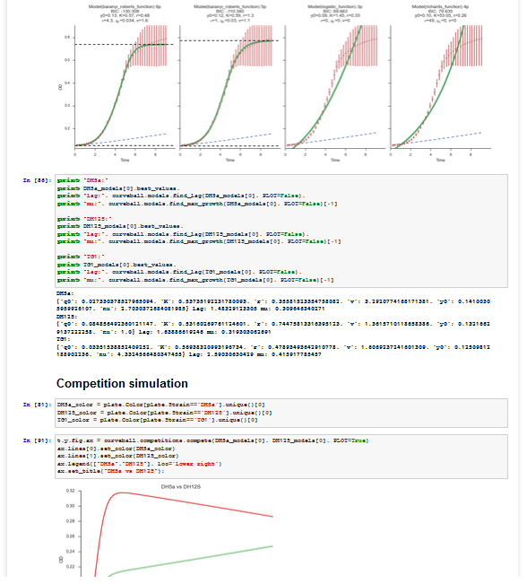
Curveball
Curveball analyzes microbial growth curves using ecological and evolutionary models
Do everything in this presentation & more
Written in Python
http://curveball.yoavram.com

Slide 24








Acknowledgments
TAU
Lilach Hadany*
Uri Obolski*
Eynat Dellus-Gur*
Ariel Guiejman
Eyal Zinger
Marine Veits
Itzhak Khait
Ohad Lewin-Epstein
Ilia Raysin
* Collaborators on this project
TAU
Judith Berman*
Maayan Bibi*
Noa Wertheimer
Alex Rosenberg
Adi Zisman
Feng Yang
Ella Shtifman Segal
UMT
Eugene Kroll
WIS
Tzachi Pilpel
Dorit Hizi
Idan Frumkin
Orna Dahan
Avihu Yona
Lior Zelcbuch
Israeli Ministry
of Science & Technology
Contact
The Anat Karuskopf Fund
yoav@yoavram.com
@yoavram
github.com/yoavram
www.yoavram.com
a

