Slide 1
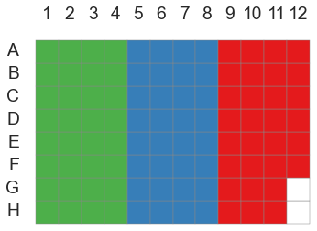
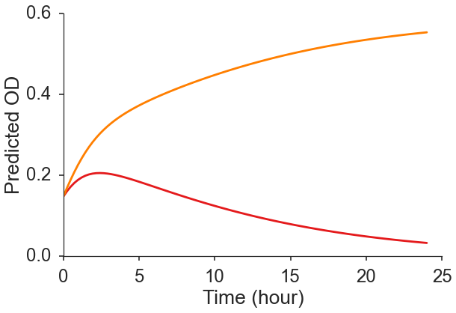
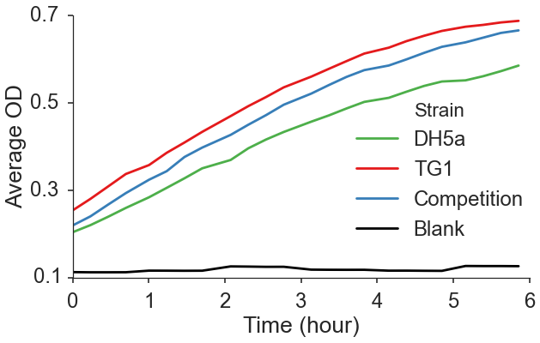
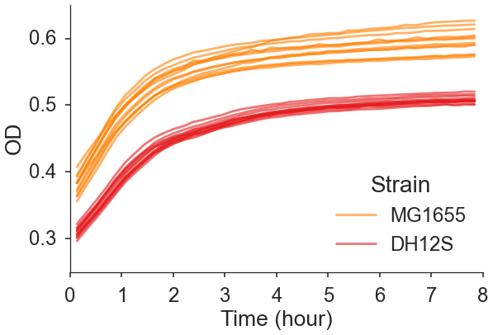
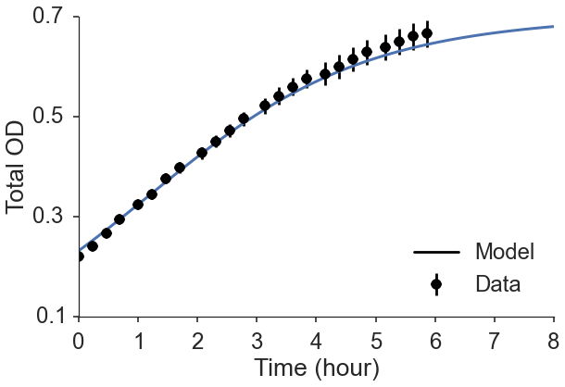
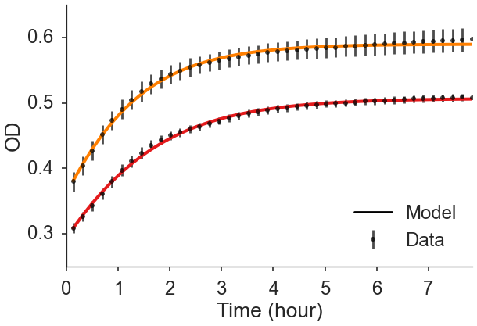
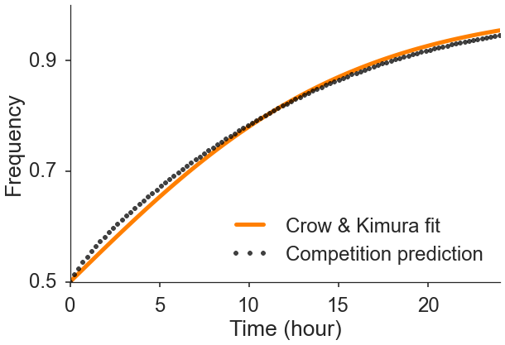








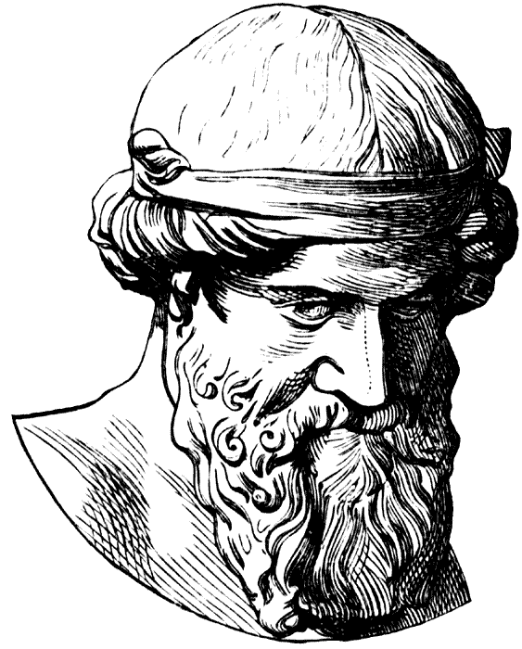
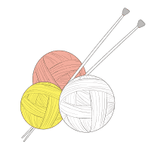




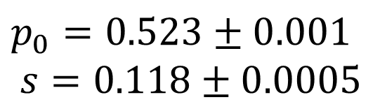
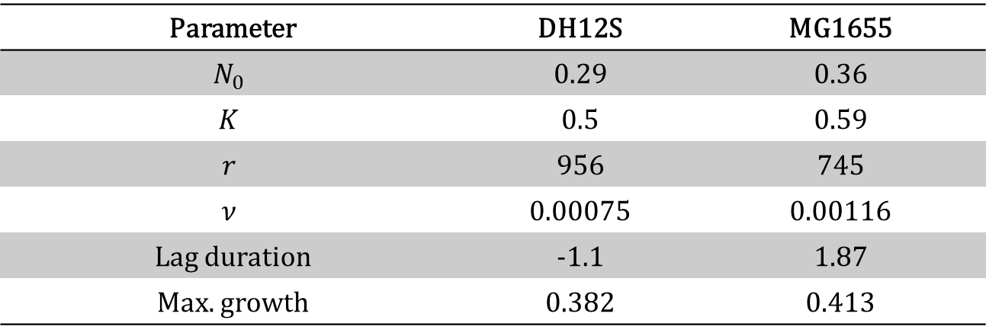


Predicting competition dynamics & estimating selection
Yoav Ramª, Eynat Dellus-Gurª, Uri Obolskiª, Maayan Bibi^{b}, Judith Berman^{b}, Lilach Hadanyª
(a) Dept. of Molecular Biology & Ecology of Plants, (b) Dept. of Molecular Microbiology & Biotechnology,
Tel-Aviv University, Tel-Aviv, Israel
Introduction
Experiments often use growth curves to estimate the growth rate as a proxy of fitness
Models use selection coefficients for the relative fitness of genotypes
The only bridge between experiments and theory, competition assays, are expensive and laborious.
We suggest an alternative method that can predict competitions from growth curves and estimate selection coefficients.
Competition prediction
Competitions are simulated by integrating a two-species ordinary differential equation (ODE). We assume that the only interaction between strains is resource competition^{2,4}.
The two-species ordinary differential equation for the Baranyi-Roberts model is^{1,4}:
$$\frac{dN_{i}}{dt}=r_{i}α_{i}\left(t\right)N_{i}\left(1−{\left(\frac{N_{1}+N_{2}}{K_{i}}\right)}^{ν_{i}}\right)$$
Experimental test
Experimental Design. We grow two E. coli strains separately and in competition in a 96-well plate and measure their OD over time.
Results. The total OD predicted by the model (solid blue line) is in good agreement with the total OD in the competition experiments (black markers).
DH5α
DH5α
+
TG1
TG1
Growth models
Data. Growth curves of two E. coli strains:
Model fitting. We fit the Baranyi-Roberts growth model¹, an extension of the logistic growth model that includes lag and deceleration phases:
$$\frac{dN}{dt}=rα\left(t\right)N\left(1−{\left(\frac{N}{K}\right)}^{ν}\right), α\left(t\right)=\frac{q_{0}}{q_{0}+e^{−mt}}$$
$N$ – population density $K$ – maximum density
$r$ – growth rate (low density) $ν$ – growth deceleration
$α\left(t\right)$ - physiological adjustment function
$q_{0}$ - initial physiological state $m$ – physio. adjustment rate
Fitness inference
Classical population genetics. According to Crow & Kimura³ the frequency of the advantageous strain $p$ changes according to:
$$p\left(t\right)=\frac{p_{0}}{p_{0}+\left(1−p_{0}\right)e^{−st}}$$
where $p_{0}$ is the initial frequency and $s$ is the selection coefficient of the advantageous strain.
Effective selection coefficient. We fit the above equation to the frequency of the advantageous strain in the competition simulation.
The inferred $s$ is the effective selection coefficient of the advantageous strain: the selection coefficient that would cause similar change in frequency in an idealized population.
Model Selection
Competition Prediction
$$p_{0}=0.523±0.001$$
$$s=0.118±0.0005$$
MG1655 | DH12S | Parameter
0.36 | 0.29 | $$N_{0}$$
0.59 | 0.5 | $$K$$
745 | 956 | $$r$$
0.00116 | 0.00075 | $$ν$$
1.87 | -1.1 | Lag duration
0.413 | 0.382 | Max. growth
Summary
We developed a theoretical framework that uses single strain growth curves to predict competitions and infer selection coefficients. This framework will help bridge the gap between experiments and models in evolutionary biology.
References
Baranyi, J., Roberts, T. A., 1994. A dynamic approach to predicting bacterial growth in food. Int. J. Food Microbiol. 23, 277–294.
Chevin, L.-M., 2011. On measuring selection in experimental evolution. Biol. Lett. 7, 210–3.
Crow, J.F., Kimura, M., 1970. An introduction to population genetics theory. Burgess Pub. Co., Minneapolis.
Masel, J., 2014. Eco-evolutionary “fitness” in 3 dimensions: absolute growth, absolute efficiency, and relative competitiveness. ArXiv:1407.1024
Acknowledgments
We thank I. Ben-Zion, L. Zelcbuch, E. Kroll, Y. Pilpel, D. Hizi, I. Frumkin, O. Dahan, and A. Yona for sharing materials, data, impressions, and ideas; N. Wertheimer, A. Rosenberg, A. Zisman, F. Yang, and E. Shtifman Segal for generous help with experiments.
yoav@yoavram.com
@yoavram
github.com/yoavram
www.yoavram.com
Israeli Ministry
of Science & Technology
a
The Anat Karuskopf Fund
Plato
Curveball
plato.yoavram.com
curveball.yoavram.com
Notes:
Copyright Colin Purrington (http://colinpurrington.com/tips/academic/posterdesign).

