Slide 1
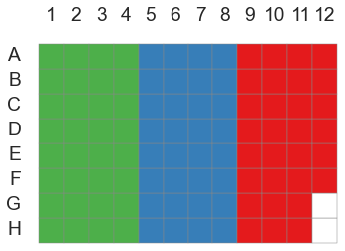
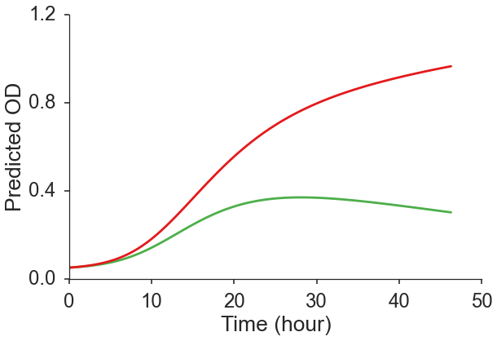
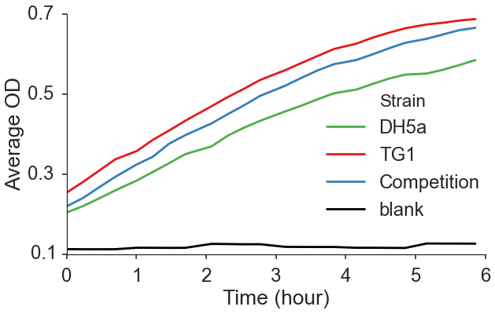
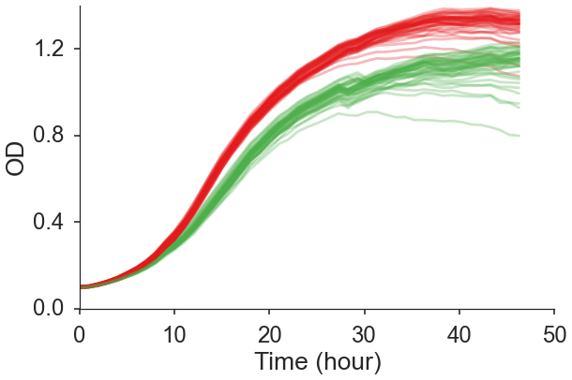
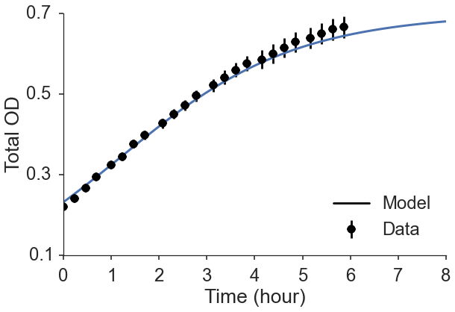
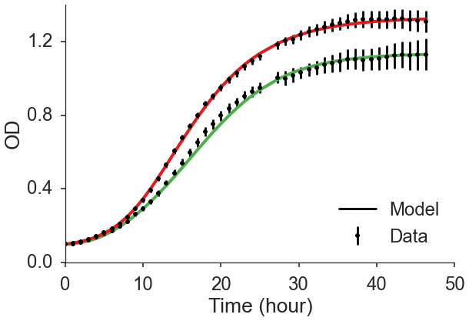
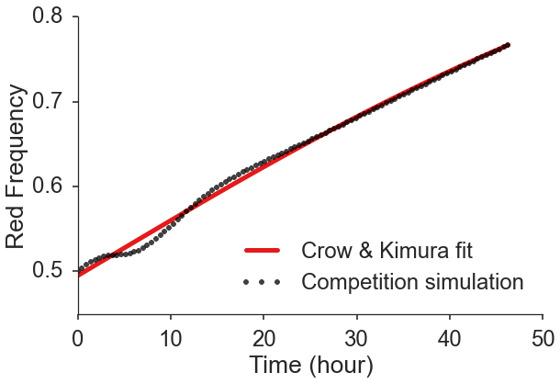

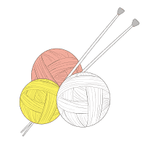
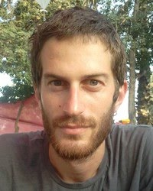












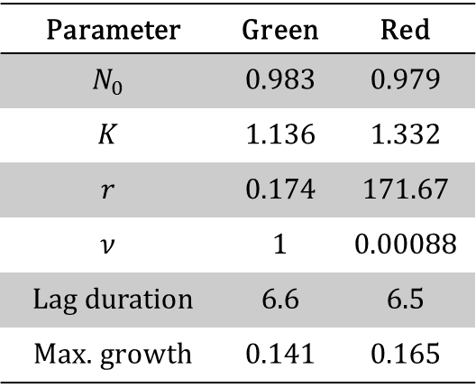
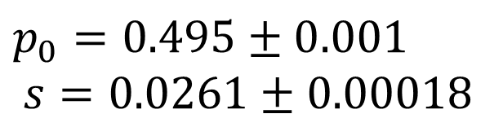

Predicting competition dynamics & estimating selection
Yoav Ram¹, Eynat Dellus-Gur¹, Uri Obolski¹, Maayan Bibi², Judith Berman², Lilach Hadany¹ Dept. of Molecular Biology & Ecology of Plants¹ and Dept. of Molecular Microbiology & Biotechnology², Tel-Aviv University, Tel-Aviv, Israel
Introduction
Experiments often use growth curves to estimate the growth rate as a proxy of fitness; however, evolutionary models use selection coefficients to model the relative fitness of genotypes.
The only existing “bridge” between experiments and theory are competitions assays. But these assays are expensive and laborious. Therefore, many investigators do without competition assays entirely. An alternative method is required, one that can be used to estimate fitness from growth curves.
Competition prediction
Competitions will be simulated by integrating a two-species ordinary differential equation (ODE). We assume that the only interaction between strains in resource competition^{2,4}.
For example, the two-strain ordinary differential equation for the Baranyi-Roberts model is^{1,4}:
$$\frac{dN_{i}}{dt}=r_{i}α_{i}\left(t\right)N_{i}\left(1−{\left(\frac{N_{G}+N_{R}}{K_{i}}\right)}^{ν_{i}}\right)$$
Experimental test
To test the model prediction we grow two strains of E. coli separately and in competitions in a 96-well plate and measure their OD over time.
The total OD predicted by the model (solid blue line) has a good fit with the total OD in the competition experiments (black markers).
Growth models
These are 84 growth curves of two different yeast species (red and green):
We use an extension of the logistic model – the Baranyi-Roberts model¹:
$$\frac{dN}{dt}=rα\left(t\right)N\left(1−{\left(\frac{N}{K}\right)}^{ν}\right), α\left(t\right)=\frac{q_{0}}{q_{0}+e^{−mt}}$$
$N$ – population density $K$ – maximum density
$r$ – growth rate (low density) $ν$ – growth deceleration
$α\left(t\right)$ - physiological adjustment function
$q_{0}$ - initial physiological state $m$ – physio. adjustment rate
Fitness inference
Fitness can be inferred from competitions in several ways^{2,3,5}.
For example, according to Crow & Kimura³ the frequency of the red strain $p$ changes according to:
$$p\left(t\right)=\frac{p_{0}}{p_{0}+\left(1−p_{0}\right)e^{−st}}$$
where $p_{0}$ is the initial frequency and $s$ is the selection coefficient of the red strain.
We fit this equation to the frequency of the strain under question in the competition simulation.
The inferred $s$ is the effective selection coefficient: the selection coefficient in an idealized population that would cause similar change in frequency as the population under consideration.
Model Selection
Competition Prediction
We fit four versions of the model to the data (using least squares) and choose the best model with a model selection procedure.
Red | Green | Parameter
0.979 | 0.983 | $$N_{0}$$
1.332 | 1.136 | $$K$$
171.67 | 0.174 | $$r$$
0.00088 | 1 | $$ν$$
6.5 | 6.6 | Lag duration
0.165 | 0.141 | Max. growth
$$p_{0}=0.495±0.001$$
$$s=0.0261±0.00018$$
Summary
Our framework predicts competition assay results and infers selection coefficients, thus improving communication between microbial and theoretical evolutionary biologists and helping to standardize the way fitness is measured and reported in the literature.
References
Baranyi, J., Roberts, T. A., 1994. A dynamic approach to predicting bacterial growth in food. Int. J. Food Microbiol. 23, 277–294.
Chevin, L.-M., 2011. On measuring selection in experimental evolution. Biol. Lett. 7, 210–3.
Crow, J.F., Kimura, M., 1970. An introduction to population genetics theory. Burgess Pub. Co., Minneapolis.
Masel, J., 2014. Eco-evolutionary “fitness” in 3 dimensions: absolute growth, absolute efficiency, and relative competitiveness. ArXiv:1407.1024
Wiser, M.J., Lenski, R.E., 2015. A Comparison of Methods to Measure Fitness in Escherichia coli. PLoS One 10, e0126210.
Acknowledgments
We thank I. Ben-Zion, L. Zelcbuch, Y. Pilpel, D. Hizi, I. Frumkin, O. Dahan, and A. Yona for sharing materials, data, impressions, and ideas; N. Wertheimer, A. Rosenberg, A. Zisman, F. Yang, and E. Shtifman Segal for generous help in the wet lab.
←plato.yoavram.com
curveball.yoavram.com→
yoav@yoavram.com
@yoavram
@yoavram
www.yoavram.com
a
Israeli
Ministry
of Science
and
Technology
Notes:
Copyright Colin Purrington (http://colinpurrington.com/tips/academic/posterdesign).

