Slide 1
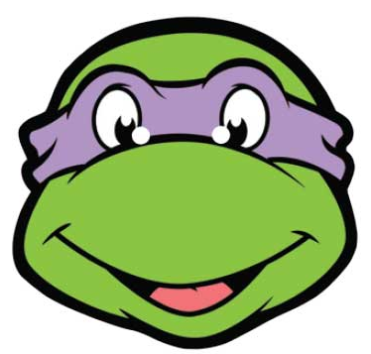


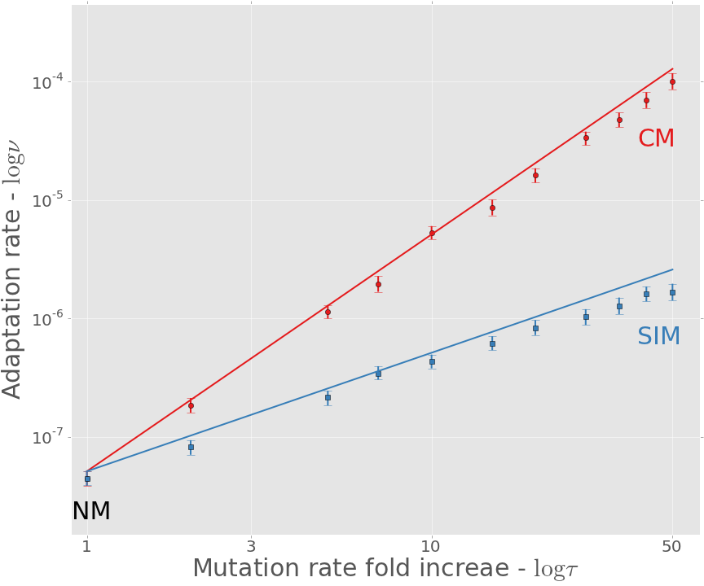
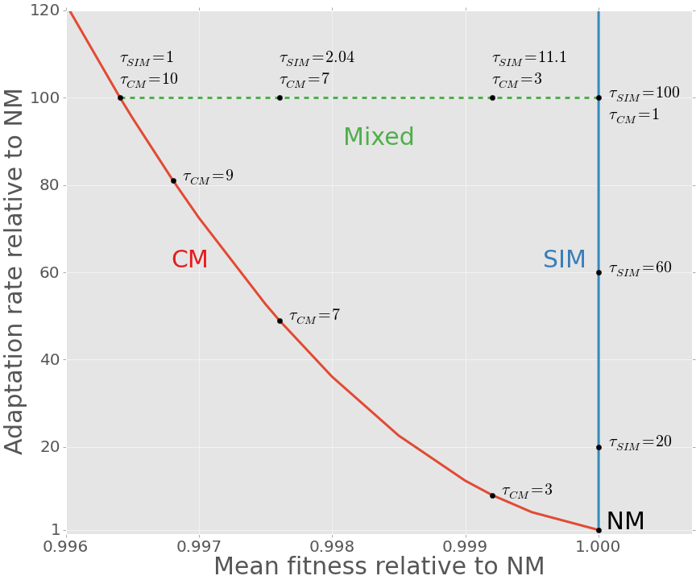
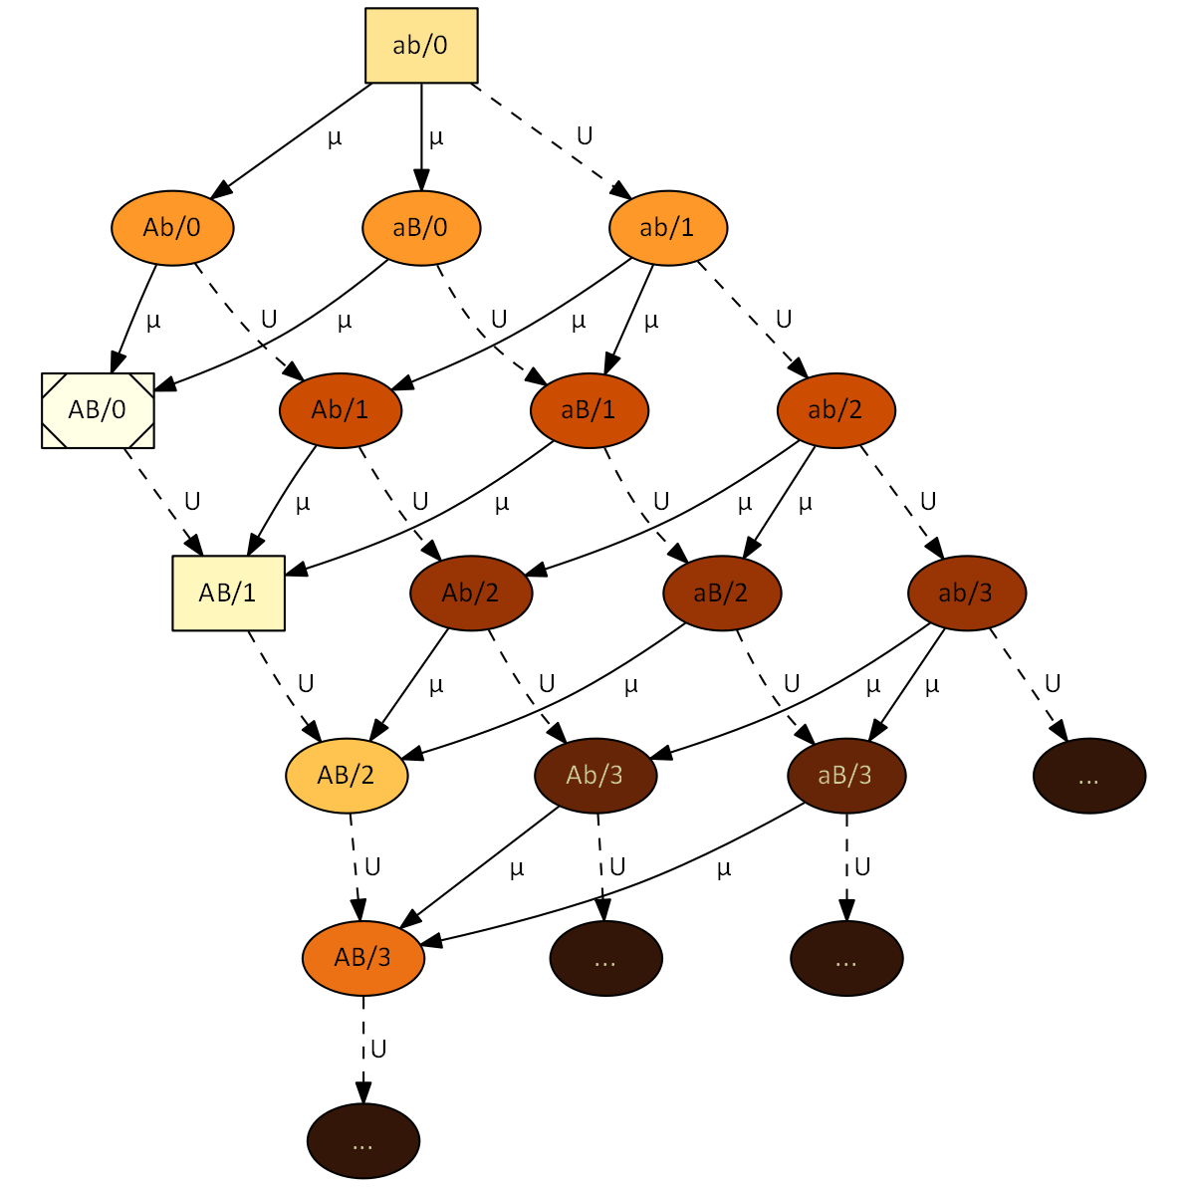
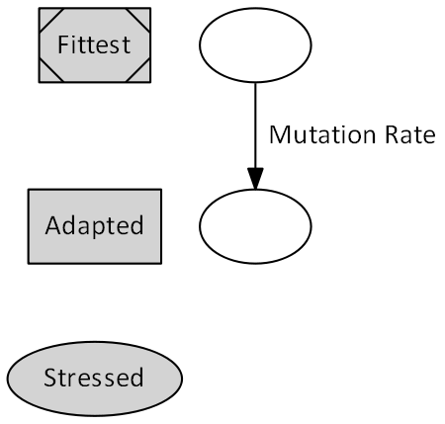
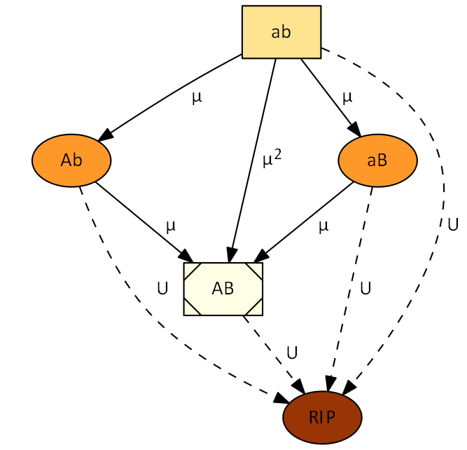





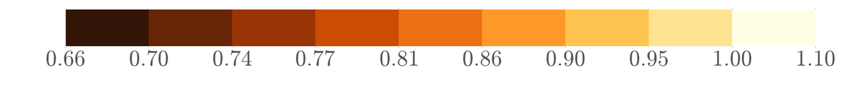






D21SY13PS0001 | Poster #1 | Wed. 21 | SY13: Rapid evolution and population genetics
Adaptability, Adaptedness and
Stress-Induced Mutagenesis
Yoav Ram & Lilach Hadany Department of Molecular Biology and Ecology of Plants, Life Science Faculty, Tel-Aviv University, Israel
Background
Mutagenesis is induced by stress responses in various species of bacteria and even in eukaryotes (Galhardo et al. 2007, Bjedov et al. 2003).
In a previous work (Ram & Hadany 2012) we studied the evolution of stress-induced mutagenesis in constant and changing environments. We showed that stress-induced mutagenesis (SIM) is favored by selection over constant rate mutagenesis because it generates beneficial mutations when they are most needed.
Complex adaptations require two or more mutations that are jointly advantageous but separately deleterious, and therefore presents an open evolutionary question, first described by Sewall Wright (1931) and popularized using the fitness landscape metaphor:
Adaptation rate results
The adaptation rate ν as a function of the mutation rate fold-increase τ is approximated with normal mutagenesis (NM), constitutive mutagenesis (CM) and stress-induced mutagenesis (SIM) by:
$$ν_{NM}≈2NHμ^{2}\left(1−U\right)\left(2−U\right)≈4NHμ^{2}$$
$$ν_{CM}≈τ^{2}∙ν_{NM}$$
$$ν_{SIM}≈ν_{NM}∙\frac{2τ}{\left(2−τU\right)}≈τ∙ν_{NM}$$
SIM increases the adaptation rate of complex traits: solid lines are analytic approximations, markers are results of simulations (see below), error bars are 95% CI. Both axes are in log scale – the slope of the CM line is twice as steep as the slope of the SIM line.
The difference between the approximations and the simulations is explained by appearances of AB on deleterious backgrounds in the simulations (“rise of the living dead”).
SIM is more efficient than CM
Adaptability: adapting to new conditions
Constitutive mutagenesis (CM) increases the rate of complex adaptation τ²-fold (τ: mutation rate fold-increase).
Stress-induced mutagenesis (SIM) increases the rate of complex adaptation τ-fold.
Adaptedness: staying adapted to existing conditions
CM decreases the population mean fitness in stable environments ≈(1-Uτ)-fold due to the accumulation of deleterious mutations (Kimura & Maruyama 1966).
SIM slightly increases the population mean fitness (Ram & Hadany 2012).
Breaking the adaptability-adaptedness trade-off
Both CM and SIM increase the adaptability of populations, represented by their adaptation rate. SIM, in contrast to CM, doesn’t reduce the adaptedness of populations, represented by the mean fitness in stable environments.
In mixed strategies all individuals increase their mutation rate τ_{CM}-fold and stressed individuals increase their mutation rate τ_{SIM}-fold. These strategies represent the space between the CM and SIM lines.
[1]
fitness
Approximation
[3]
[5]
Simulation
genotype
Adaptability - Adaptation rate relative to NM
Citation | Estimate | Name | Sign
5,6 | 0.001-0.01 | Selection coefficient | s
7 | 1-10 | Double mutant advantage | H
7,8 | 0.003-0.0004 | Genomic mutation rate | U
6 | U/5000 | Beneficial site mutation rate | µ
9 | 1-100 | Mutation rate increase | τ
10 | 10⁵-10¹⁰ | Population size | N
Table 1. Model parameters and estimated values for bacteria.
Adaptedness - Mean fitness relative to NM
(NM: normal mutagenesis)
Model
Figure 2 describes are two-locus (A/a and B/b) model of complex adaptation.
Each node represents a genotype. Genotype ab is the wildtype local adaptive peak, AB is the global adaptive peak with the highest fitness, and the single mutants Ab and aB are adaptive valleys with fitness lower than the wildtype - the darker the color the lower the fitness. “RIP” represents genotypes with deleterious mutations that will not contribute to adaptation (“the living dead”).
Arrows define the direction of mutation and denote the relevant mutation rate: U for background deleterious mutations (dashed lines) and µ for mutations in the A/a and B/b loci (solid lines).
Simulations
Figure 4 describes our multi-locus Wright-Fisher simulations, which also account for genotypes with deleterious mutations – denoted by the number after the slash (ab/2 is ab with two deleterious mutations) – so there are no “living dead”.
The figure shows up to three mutations for simplicity, the simulations has up to 25.
Summary
We compared the adaptability (ability to adapt) and adaptedness (ability to stay adapted) of populations with and without stress-induced mutagenesis.
We showed that stress-induced mutagenesis increases the adaptability of a population and that in contrast to constitutive mutagenesis, it does not jeopardize its adaptedness.
[4]
Literature cited
Galhardo RS, et al. Crit Rev Biochem Mol Biol 2007, 42:399–435
Bjedov I, et al. Science 2003, 300:1404–9
Ram Y, Hadany L. Evolution 2012, 66:2315–28
Wright S. Am Nat 1988, 131:115–123
Kibota TT, Lynch M. Nature 1996, 381:694–6
Gordo I, et al. J Mol Microbiol Biotech 2011, 21:20–35
Drake JW, et al. Genetics 1998, 148:1667–86
Wielgoss S, et al. G3 2011, 1:183
Hall LMC, Henderson-Begg SK. Microbiology 2006, 152, 9:2505–14
Berg OG. Genetics 1996, 142:1379–82
Kimura M, Maruyama T. Genetics 1966, 54:1337–51
[2]
Contact information
yoavram@post.tau.ac.il
www.yoavram.com
+972.545.383136
@yoavram
fitness
fitness
Manna Center for Plant Biosciences

