Slide 1

The role of stress-induced mutation in the emergence of complex adaptations
Yoav Ram & Lilach Hadany
SIDEER Symposium 2013
Sede Boqer, Israel

Slide 2

Mutation
“Mutations … supply the raw materials for evolution”
Dobzhansky T, Genetics and Origin of Species 1937
“Mutation is the ultimate source of variation on which natural selection acts”
Lynch M, PNAS 2007

Slide 3
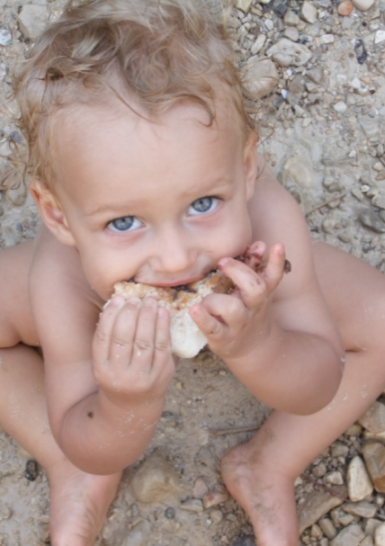
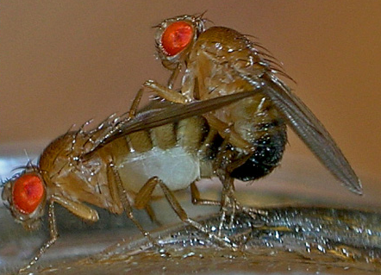
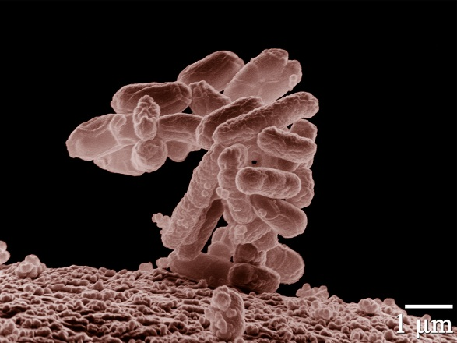
Variation in mutation rates
Between species
“Noticeable” mutations per genome per generation
Mammals (H. sapiens): XXX (XXX)
Flies (D. melanogaster): XXX (XXX)
Bacteria (E. coli): 0.003 (Drake 1991)

Slide 4
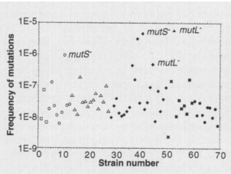
Variation in mutation rates
Between populations
Mutation rate of 69 natural isolates of E. coli - Matic et al. 1997

Slide 5
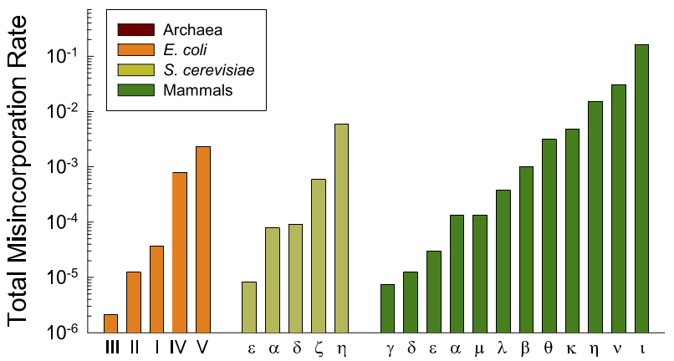
Variation in mutation rates
Within individuals
Error rates DNA polymerases – Lynch 2011

