Slide 1

The role of stress-induced mutation in the emergence of complex adaptations
Yoav Ram & Lilach Hadany
SIDEER Symposium 2013
Sede Boqer, Israel

Slide 2

Mutation
“Mutations … supply the raw materials for evolution”
Dobzhansky T, Genetics and Origin of Species 1937
“Mutation is the ultimate source of variation on which natural selection acts”
Lynch M, PNAS 2007

Slide 3
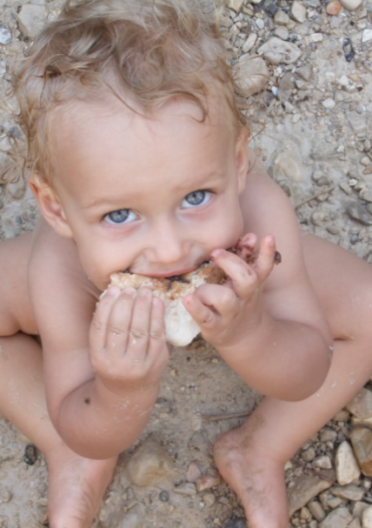
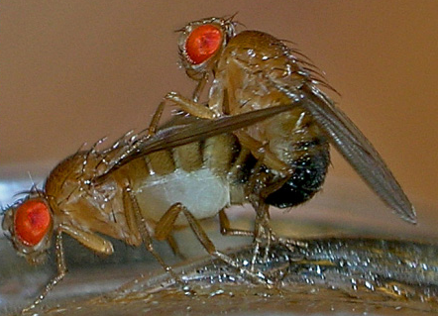
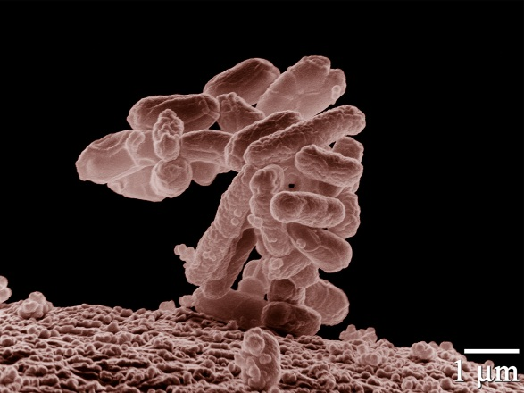
Variation in mutation rates
Between species
“Noticeable” mutations per genome per generation
Mammals (H. sapiens): XXX (XXX)
Flies (D. melanogaster): XXX (XXX)
Bacteria (E. coli): 0.003 (Drake 1991)

Slide 4
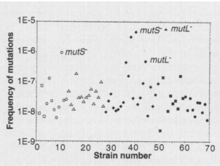
Variation in mutation rates
Between populations
Mutation rate of 69 natural isolates of E. coli - Matic et al. 1997

Slide 5
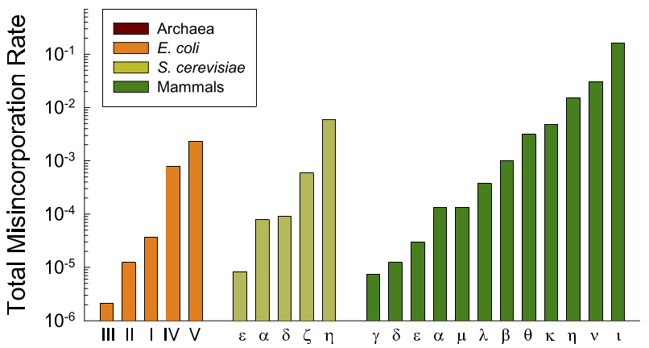
Variation in mutation rates
Within individuals
Error rates DNA polymerases – Lynch 2011

Slide 6
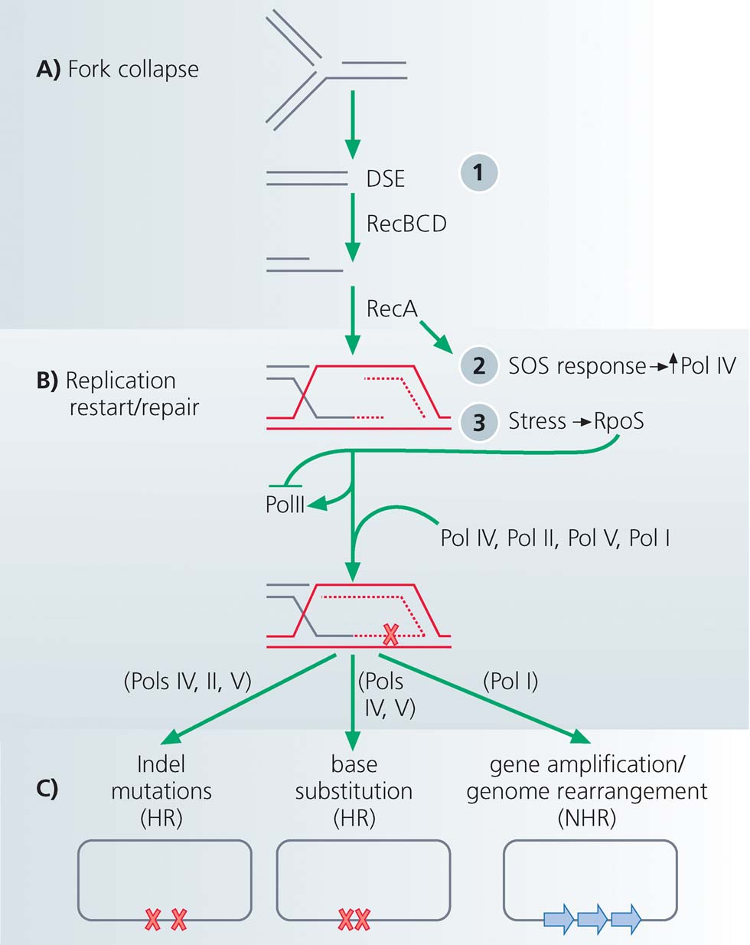
Stress-induced mutation
Rosenberg et al. 2012
Error prone DNA polymerases are induced by stress responses:
SOS response
Carbon starvation
DNA damage
In E. coli

Slide 7
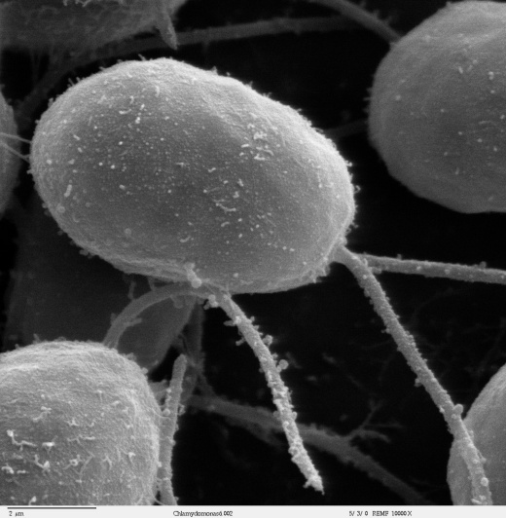
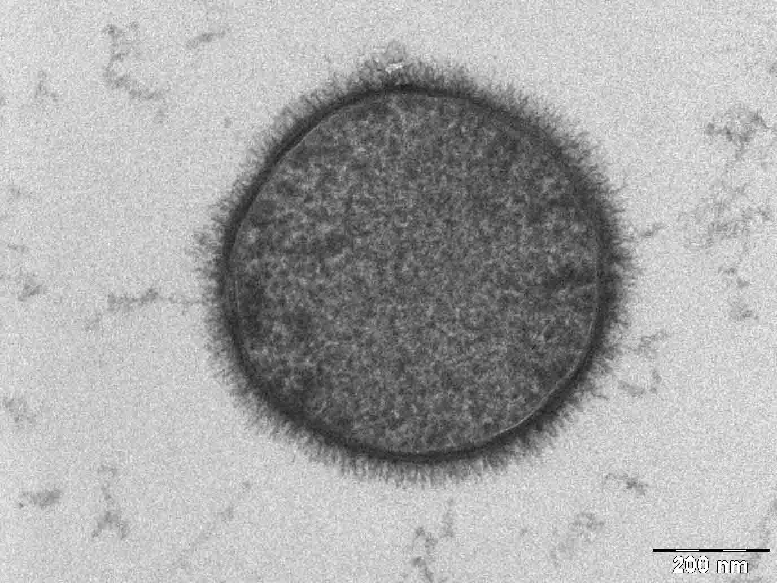
C. reinhardtii
Evidence
Bacteria
Escherichia coli Bjedov et al. 2003
Bacillus subtilis Sung and Yasbin 2002
Pseudomonas putida Kivisaar 2010
Pseudomonas aeruginosa Weigand & Sundin 2012
Listeria monocytogenes van der Veen et al. 2010
Staphylococcus aureus Cirz et al. 2007
Mycobacterium tuberculosis Boshoff et al. 2003
Eukaryote
Chlamydomonas reinhardtii Goho & Bell 2000
Saccharomyces cerevisiae Hall 1992; Heidenreich 2007
Caenorhabditis elegans & briggsae Matsuba et al. 2012
Drosophila melanogaster Sharp & Agrawal 2012
Human cancer cells Hara et al. 2005; Bristow & Hill 2008
Reviewed by Foster 2007; Galhardo et al. 2007; Rosenberg et al. 2012; Poole 2012
B. subtilis

Slide 8
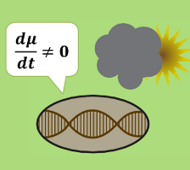
Evolution of Stress-Induced Mutation
Null Hypothesis: mutation is a by-product of stress
Alternative, non-adaptive hypotheses:
Cost of DNA replication fidelity (Dawson 1998)
Drift barrier hypothesis (Lynch 2010, 2011)
Adaptive hypothesis:
“…the evolutionary consequence of SIM is that bacteria are able to adapt rapidly to stressful environments…”
MacLean et al. 2013

Slide 9
Evolution of Stress-Induced Mutation
Deterministic model
Stochastic model
Constant environment
Infinite homogenous populations
Steady state analysis
General solution
Changing environment
Finite populations
Competitions between mutational strategies
Fixation and extinction
Simulations
Ram & Hadany, Evolution 2012

Slide 10
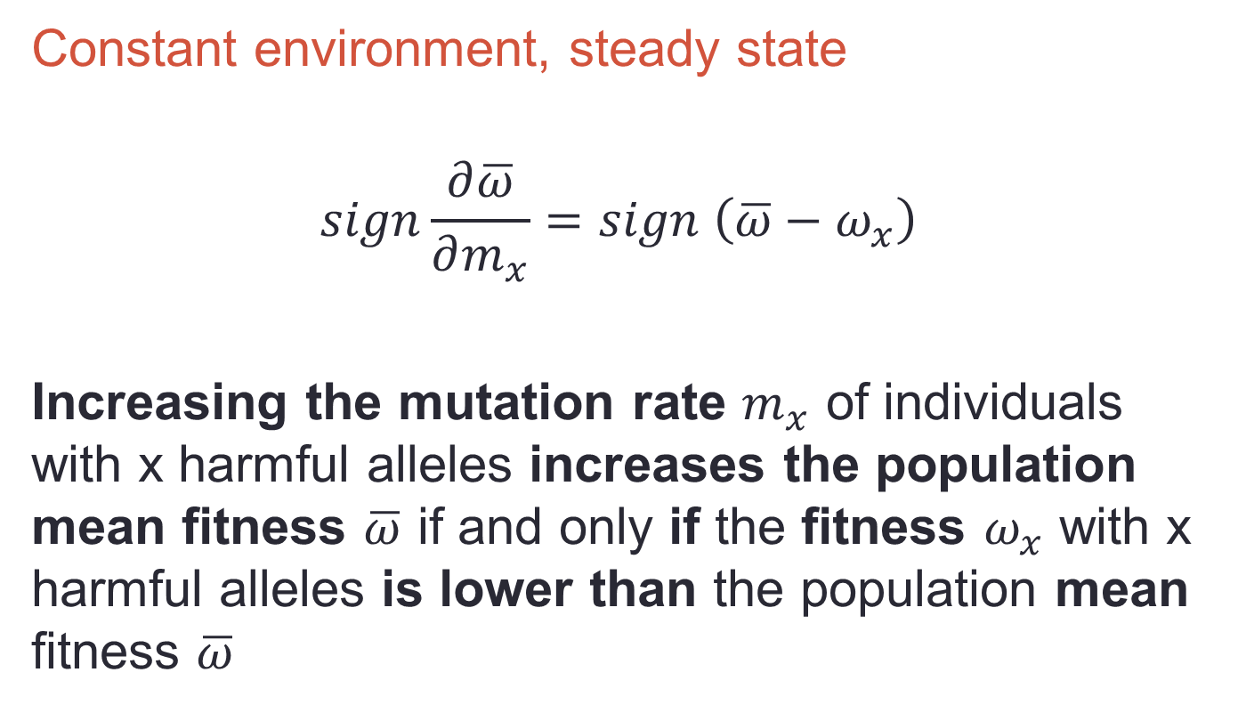
Deterministic model
Constant environment, steady state
$$sign\frac{∂\overline{ω}}{∂m_{x}}=sign \left(\overline{ω}−ω_{x}\right)$$
Increasing the mutation rate $m_{x}$ of individuals with x harmful alleles increases the population mean fitness $\overline{ω}$ if and only if the fitness $ω_{x}$ with x harmful alleles is lower than the population mean fitness $\overline{ω}$

Slide 11
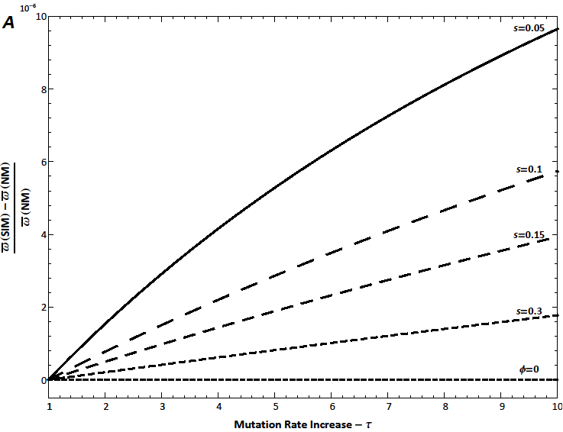
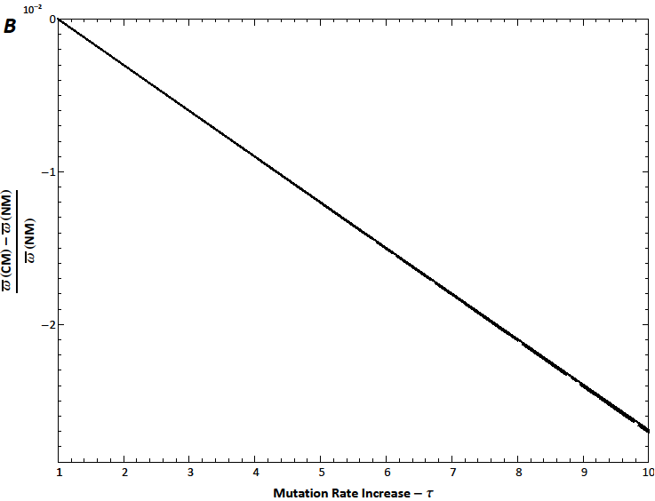
Results
SIM vs. NM
NM - Non-mutators
constant low rate of mutation
CM - Constitutive mutators
Constant high rate of mutation
SIM - Stress-induced mutators
Low mutation rate when well-adapted
High mutation rate when stressed
No Beneficial Mutations
Relative Fitness Advantage
CM vs. NM
Mutation Rate Increase

Slide 12
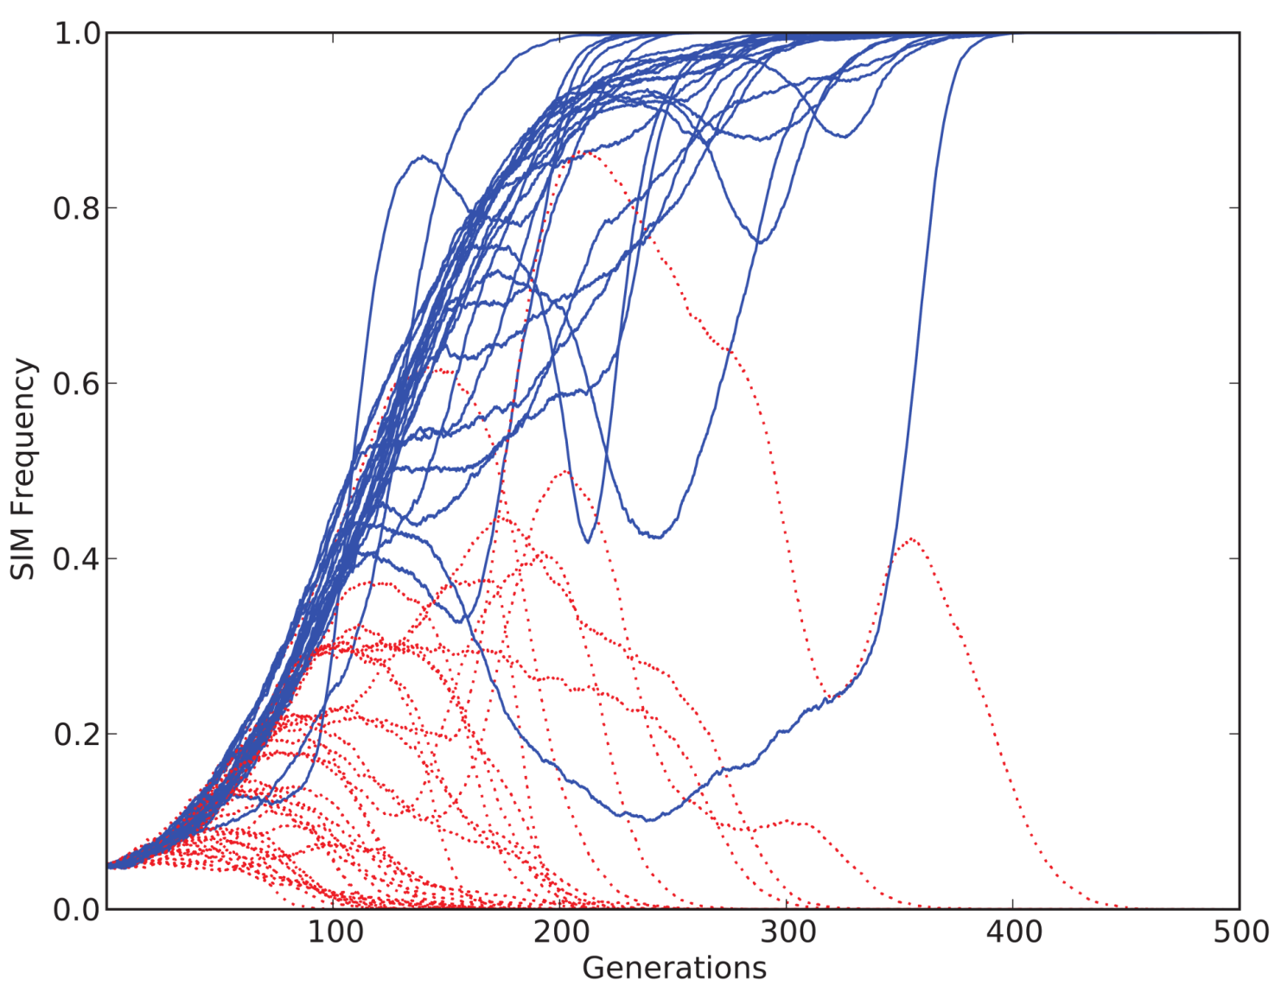
Stochastic model
Changing environment, competitions
Notes:
SIM π=1 τ=10 vs. CM τ=10; 60 replicates, SIM starts at 5% and wins in 40% (25/60, P<10⁻¹⁶)

Slide 13
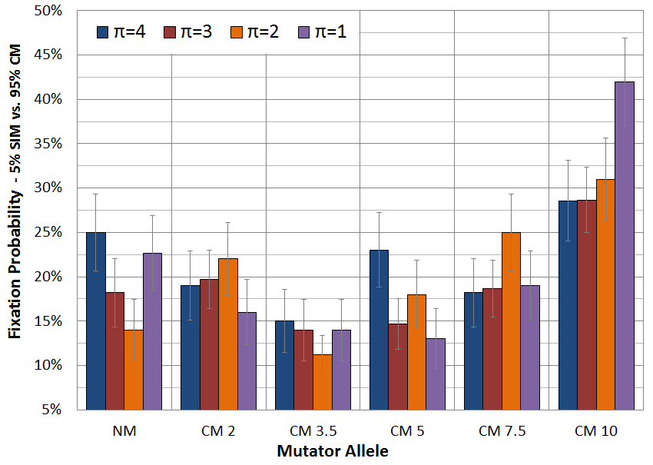
Competitions Summary
Notes:
SIM vs. CM, up to 500 generations, SIM starts at 5%, # replicates>100, µ=0.003, error bars: ±1 SE, P<0.001

Slide 14
Evolution of Stress-Induced Mutation
Ram & Hadany, Evolution 2012

