Slide 1

Stress-induced mutagenesis & complex adaptation
March 12 2015
Two2Many
Weizmann Inst.
Yoav Ram
Hadany Lab
Dept. of Molecular Biology and Ecology of Plants
Life Sciences Faculty
Notes:
Hello Im Yoav Ram from Hadany Lab at Tel-Aviv University.
I’d like to thank the organizers for giving me this opportunity.
I’ll talk today about stress-induced mutagenesis and complex adaptation.

Slide 2
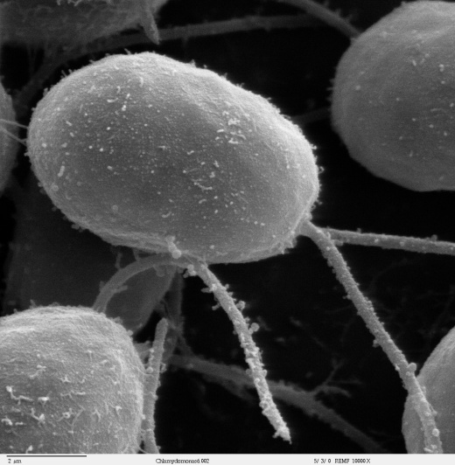
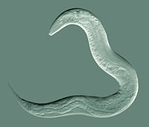
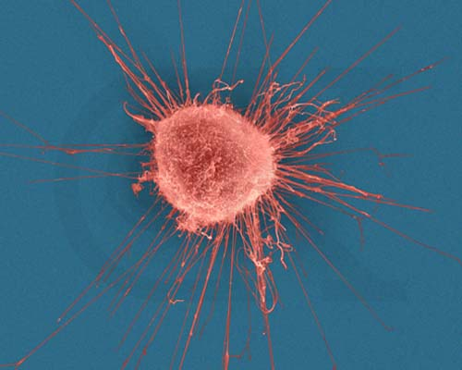
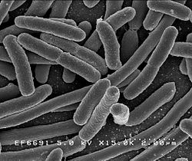
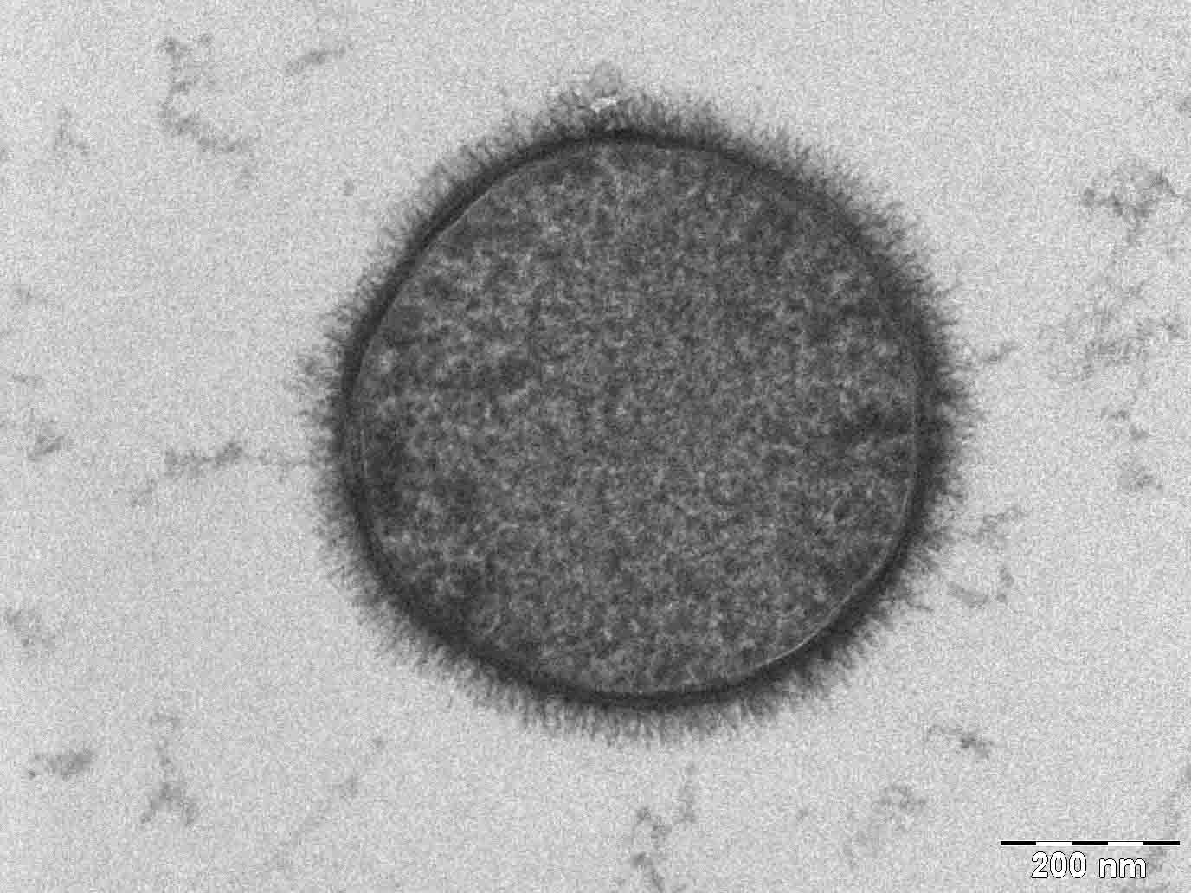
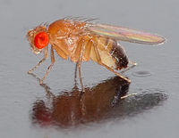
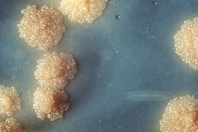
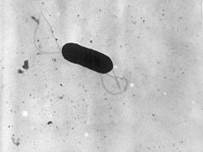
Stress-induced mutation
Green algea
Nematodes
E. coli
Bacillus subtilis
Breast cancer cell
D. Melanogaster
M. tuberculosis
L. monocytogenes
Notes:
Stress-induced mutation is the phenomenon in which stressed or maladapted individuals increase their mutation rate, sometime by several orders of magnitude.
Stress-induced mutation was studied in E coli and other species of bacteria, as well as yeast, algea and even flies and human cancer cells.

Slide 3
Causes and consequences of Stress-induced mutation
Evolution of stress-induced mutation:
SIM can evolve due to 2nd order selection
In constant and changing environments
Ram & Hadany, Evolution 2012
Consequences of stress-induced mutation:
Effect on complex adaptation
Ram & Hadany, Proceedings B 2014
Notes:
In my PhD I focused on the causes and consecuences of stress induced mutation.
In the first paper we showed that stress induced mutation can be selected due to the beneficial mutations it generates during both adaptation and in a constant environment.
In the second paper we studied the effect of stress induced mutation on the evolution of complex adaptations.

Slide 4
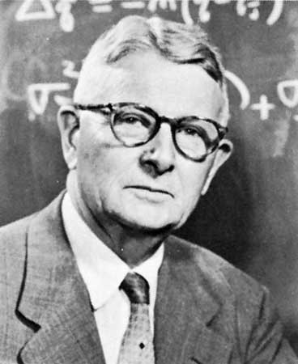

Adaptive peak shifts
←Fitness→
High peak
Sewall Wright
Low peak
Valley
←Genotype→
Notes:
A classical problem in evolutionary biology which was raised by Wright in the 1930’s is: if an adaptation requires two or more separately deleterious mutations, how can this adaptation evolve?
Consider this diagram of a complex fitness landscape.
Moving in the landscape (on the x-axis) means changing the genotype, which causes a change in the elevation which describes the fitness of the population.
In order for a population to successfully move from a low adaptive peak to a higher one, it must go through a fitness valley.
However, selection acts to push the population towards the nearest peak. So how can a population shift from one adaptive peak to a higher one?

Slide 5
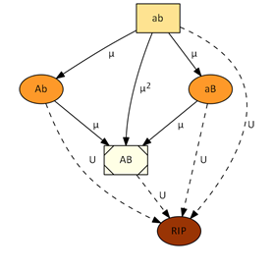
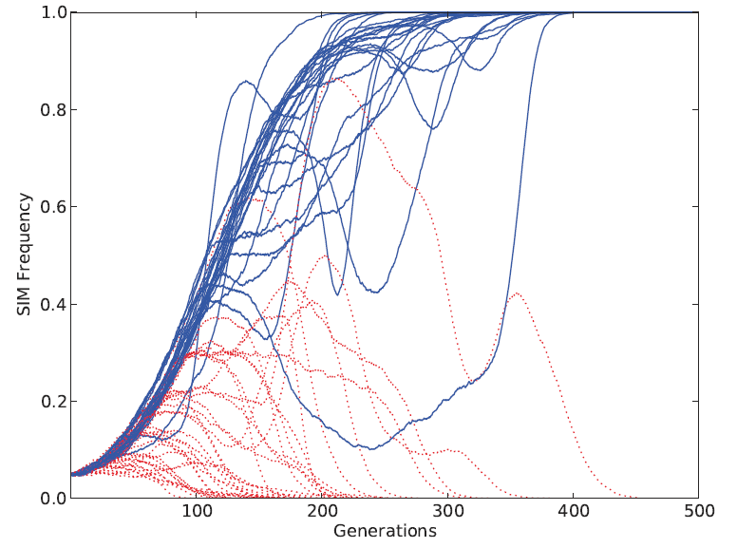
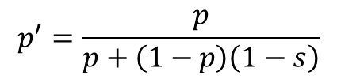
Methods
$$p^{′}=\frac{p}{p+\left(1−p\right)\left(1−s\right)}$$
Model
Follow allele frequencies over many generations
Probability of appearance of adapted mutant
Probability of fixation of adapted mutant
Simulations
Stochastic realizations of analytic model
Statistical analysis of many replicates
Notes:
To study this problem we used analytic models and simulations.
The model follows allele frequencies in the population over many generation and tries to estimate the probability that an adapted mutant appears and goes to fixation.
The simulations are more general and are used to check the model assumptions and results.

Slide 6
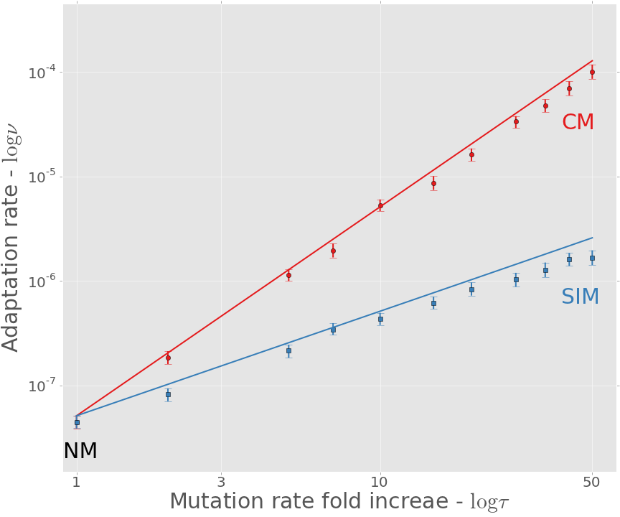
Adaptation rate
CM: constitutive mutation SIM: stress-induced mutation
Analytic model
Simulations
Notes:
This figure shows the adaptation rate on the y-axis and the mutation rate on the x-axis.
The figure shows that a stress-induced mutation increases the adaptation rate even when it only increases the mutation rate of stressed individuals.
This is a log scale so the increase in adaptation rate is significant.

Slide 7
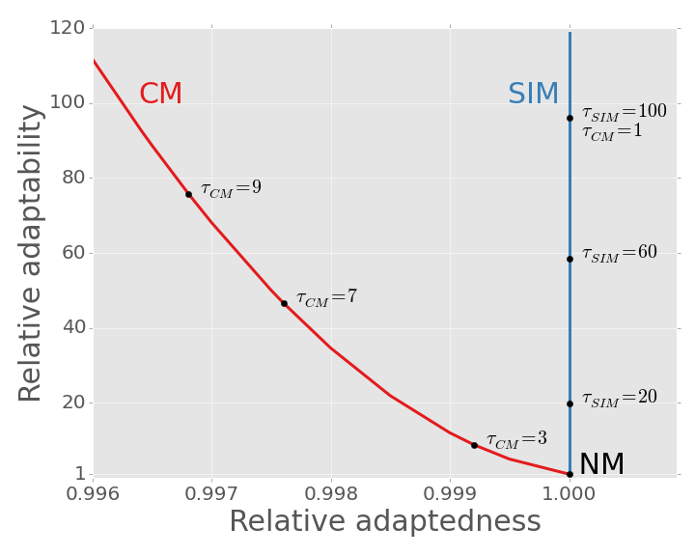
SIM breaks the trade-off between adaptability and adaptedness
Notes:
Zooming out, we can see here the adaptability – the ability to adapt – and the adaptedness – the ability to remain adapted.
We can see, in red, that constitutive mutation increases the mutation rate it increases the adaptability but decreseas the adaptedness.
Stress induced mutation on the other hand increases the adaptability without compromising the adaptedness.
Therefore stress-induced mutation can be considered a more efficient evolutionary strategy.

Slide 8





Acknowledgments
Lilach Hadany
Uri Obolski
Ariel Guiejman
Eyal Zinger
Manna Center for Plants Biosciences
Amalia Biron-Zigle Foundation
Contact
yoavram@gmail.com
@yoavram
www.yoavram.com
Notes:
I’d like to thank my advisor, Lilach Hadany, my lab members and funders.
If you have any questions I’ll be glad to answer them later on next to my poster or in email.

