Slide 1
The Cluster-Trisurf Program

Slide 2
Cluster-Trisurf version
Available at https://github.com/yoavrv/cluster-trisurf
More information:
README.md
--help
Repository of python help scripts trisurf-python has notebooks with example of uses.
Notes:
Names is due to working on the cluster the first time: maybe it should be changed to “trisurf” or “trisurf_ng”?

Slide 3
Cluster-Trisurf structure
+ globals
Vesicle
Tape
Global Vesicle Properties
Graph
Initialization
Center mass
Vertices
Program Controls
Volume
Connectivity
…
Notes:
Trisurf is structured around the Vesicle. The vesicle can be divided into three categories: the Tape, which controls how the program runs; vesicle properties, which hold global properties of the closed vesicle at runtime, and the Graph, the main structure representing the simulated surface.

Slide 4
Cluster-Trisurf structure
Vesicle
##################
## Trisurf Tape ##
##################
# a control file for the trisurf simulations
# $ are program control
# * are initialization only
####### Vesicle definitions ###########
# * nshell is a number of divisions of dipyramid
nshell=10
# $ dmax is the max. bond length (in units l_min)
dmax=1.7
# $ dmin_interspecies in the min. dist. between different vertex species (in units l_min)
dmin_interspecies=1.2
# $ max step size (in units l_min)
stepsize=0.15
Tape
Initialization
Program Controls
Notes:
Some options (like Nshell) are only relevant to the initialization of the mesh.
Other option (like stepsize) determine how Trisurf works at runtime.

Slide 5
Cluster-Trisurf structure
Vesicle
Tape
(base) ~yoav/Sim$ trisurf --force-from-tape --tape-options number_of_vertices_with_c0=50,allow_center_mass_motion=0
Initialization
50 CMCs
Vesicle fixed to 0,0,0
Program Controls
(base) ~yoav/Sim$ trisurf --tape-options number_of_vertices_with_c0=25,allow_center_mass_motion=1
Still 50 CMCs
Vesicle is free to move
Notes:
Changing the tape after initialization will only affect the program controls!

Slide 6
Cluster-Trisurf structure
Vesicle
globals
quiet: controls if trisurf (ts_fprintf) print to console
V0, A0: equilibrium volume, area for various constraints modes
epsvol, epsarea: allowed deviance from V0, A0 in some constraint modes
command_line_args: extra options from the command line
force_from_tape
reset_iteration_count
dump_from_vtk
Filenames
tape_opts
printing
Program control
Should shoved to vesicle or tape but complicated by initialization.
initialization mode
Host of paths where the trisurf files end up
overriding tape options from the command line
Notes:
There are also a bunch of globals: which are not particularly interesting

Slide 7
Cluster-Trisurf structure
Vesicle
Global Vesicle properties
Center mass
Pressure
Total Force
stepsize
Volume
Nucleus size
Spherical Harmonics
Confinement Plane
Area
Nucleus Position
dmax
Z_min, Z_max
Force_switch
Notes:
The vesicle has various fields relating to the properties of the vesicle itself, like center of mass position, volume, and area. These are mostly dynamical properties (orange) that are computed during the simulation.
There are also more program controls which are so far constants (dark orange:)m like pressure and stepsize. There are also some degrees of freedom (purple) (Nucleus position and confinement plane)

Slide 8
Cluster-Trisurf structure
Vesicle
Graph
Vertices
Connectivity
vlist
blist
Poly_list
Filament_list
tlist
clist
Notes:
The Graph represents the 2D surface. The nodes of the graph (Vertices) are the principal degree of freedom where most of the local properties of the membrane are determined, and the rest of the graph: bonds, triangles, and cell, are auxiliary, and primarily hold or cache information about the connectivity.

Slide 9

Cluster-Trisurf structure
Vesicle
Graph
struct ts_vertex {
ts_double x;
ts_double y;
ts_double z;
ts_double xk; //bending rigidity
ts_double xk2; //gaussian rigidity
ts_double w; // binding strength
ts_double c; // spon. curvature
ts_double f; // force magnitude
ts_double d; // spon. Deviator
ts_double ad_w; // adhesion strength
ts_flag type;
...
ts_double energy;
ts_double nx; //normal
ts_double ny;
ts_double nz;
...
Vertices
Connectivity
type, x, y, z, c0, d0, w, f…
vlist
blist
Poly_list
Filament_list
tlist
clist
Notes:
The vertices of the surface are held in vlist and represent the physical composition of the membrane. Their movement is the principal way the surface evolves. Each vertex has a long list of properties, including all the degrees of freedom of the graph: they determine the positions and the directors on anisotropic case.
Of secondary importance is the vertices in poly_list and filament_list, which represent 1d chains of polymers attached to the vesicle. These have been made to work but are not tested thoroughly.

Slide 10

Cluster-Trisurf structure
Vesicle
Graph
Vertices
Connectivity
vlist
blist
Poly_list
Filament_list
tlist
$$ℓ$$
clist
Notes:
The connectivity is a bunch of axillary structures: the bonds (blist) represent the connections between the vertices, and triangles (tlist) represent the surface, but they only really cache the property of the bonds and triangle, such as bond length, triangle normal, etc. The cells (clist) partition the space, to allow checks for collisions. Technically, all this information could be found from the vertices, which maintain their own independent lists of neighbors, but it makes bondflip, normal calculation, and collision detection easier.

Slide 11


Simulation lifecycle
-tape-options cmd line argument
For each vertex:
Try Vertexmove
Advance time by moves
For each bond: Try bondflip
New tape
Tape
$×$ mcsweeps
Force from tape
Initialization
Recalculate area, volume, center mass…
Monte carlo sweep
Save simulation into files
.bin file
Load binary
$×$ iterations
.bin file
Vesicle
.vtu file
Load vtu
New tape
.vtu file
<Tape>
<Tape>
Notes:
The simulation lifecycle is split into two stages: initialization and running loop. There are three ways to start the simulation: --force-from-tape, to create a new vesicle; (default) start from the state of a previous simulation; --restore-from-vtk, which starts from a geometry file.

Slide 12
--force-from-tape
Tape
Pentagonal bipyramid
Initial population
Initialization
--tape-options cmd line argument
Vesicle
New tape
New tape
(base) ~yoav/Sim$ ls
tape
(base) ~yoav/Sim$ trisurf --force-from-tape --tape-options opt1=val1,opt2=val2,opt3=#
Notes:
--force-from-tape creates a new simulation. A `tape` file in the same location is parsed, and using the options, trisurf creates a new vesicle.
--tape-option (-c) allows to specify replacement options from the command line.
In initialization, a vesicle is produced in the shape of pentagonal bipyramid, which is then populated with vertices (bare membrane and CMCs) according to the options.

Slide 13
Regular run
.bin file
Recreate vesicle from binary (restore_state)
Recalculate properties: energy, curvature, forces...
Tape
Vesicle
--tape-options
cmd line argument
New tape
New tape
(base) ~yoav/Sim$ ls
tape dump.bin
(base) ~yoav/Sim$ trisurf --tape-options iterations=200
Notes:
In the normal mode, the simulation continues from a binary file. The tape is created as previously. The vesicle is recreated directly from the saved binary data, and then its properties: energy, curvature, forces, etc. are recalculated, taking into account program controls in the tape.
A useful trick is to continue a simulation that got to its last time step by modifying the number of iterations.

Slide 14
--Restore-from-vtk
.vtu file
Recreate vesicle from vtk (parseDump)
Recalculate properties: energy, curvature, forces...
<Tape>
Tape
From <trisurf> and <UnstructuredGrid>
Vesicle
From <tape>
--tape-options
cmd line argument
New tape
New tape
(base) ~yoav/Sim$ ls
tape timestep_000199.vtu
(base) ~yoav/Sim$ trisurf --restore-from-vtk timestep_000199.vtu -c iterations=100
Notes:
In the restore mode, the simulation continues from the geometry file. The tape is created from the <tape> xml tag and updated with the --tape-options (alias –c). The simulations needs a tape file to exist, but it is not used.
The vesicle is recreated from the <trisurf> xml node and the VTK <UnstructuredGrid> xml node. Like previously, the properties: energy, curvature, forces, etc. are recalculated, taking into account program controls in the tape.

Slide 15

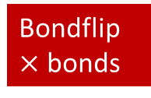
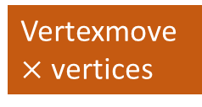

Monte Carlo iterations
Recalculate vesicle center mass, area, volume, force…
Vertexmove $×$ vertices
Monte carlo sweep
Advance time by moves
Vesicle
tape
$×$ iterations
$×$ mcsweeps
Bondflip
$×$ bonds
Save simulation into files
<version>
dump.bin
Timestep_{i:06}.vtu file
<tape>
<trisurf>
<UnstructuredGrid>
Notes:
The simulation is advanced by a main iterations loop. Each iteration, the main properties of the vesicle are recalculated: center of mass, area, volume, etc. Then, time is advance by s series of monte-carlo sweeps in a loop. After this, the current state of the simulation, the timestep, is saved into a binary dump (overriding the previous one), and to a new vtu file.

Slide 16
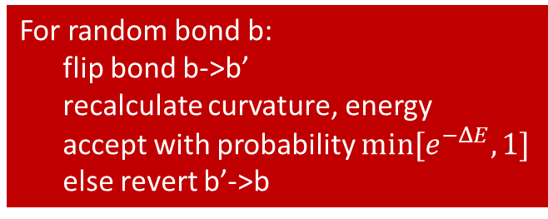
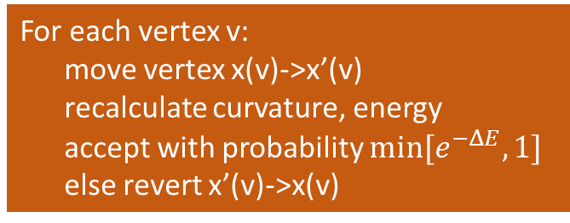
Monte Carlo iterations
For each vertex v:
move vertex x(v)->x’(v)
recalculate curvature, energy
accept with probability $min[e^{−ΔE},1]$
else revert x’(v)->x(v)
Advance time by moves
Vesicle
tape
$×$ mcsweeps
For random bond b:
flip bond b->b’
recalculate curvature, energy
accept with probability $min[e^{−ΔE},1]$
else revert b’->b
Notes:
The simulation is advanced by a main iterations loop. Each iteration, the main properties of the vesicle are recalculated: center of mass, area, volume, etc. Then, time is advance by s series of monte-carlo sweeps in a loop. After this, the current state of the simulation, the timestep, is saved into a binary dump (overriding the previous one), and to a new vtu file.

