Slide 1

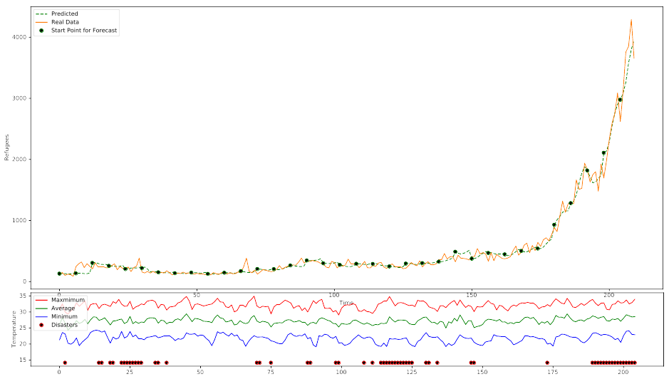
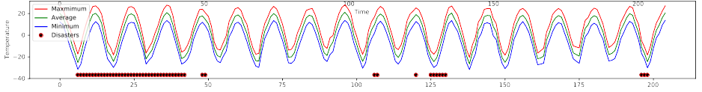
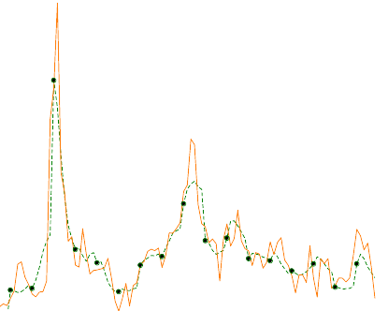
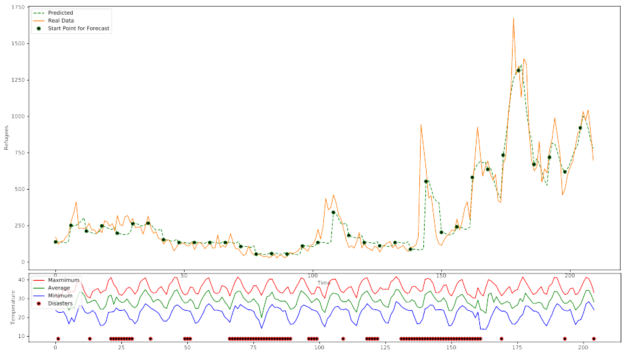
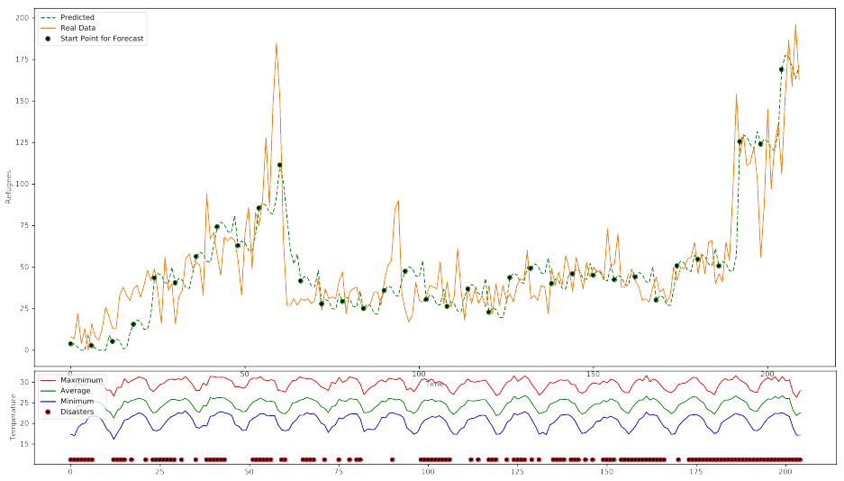
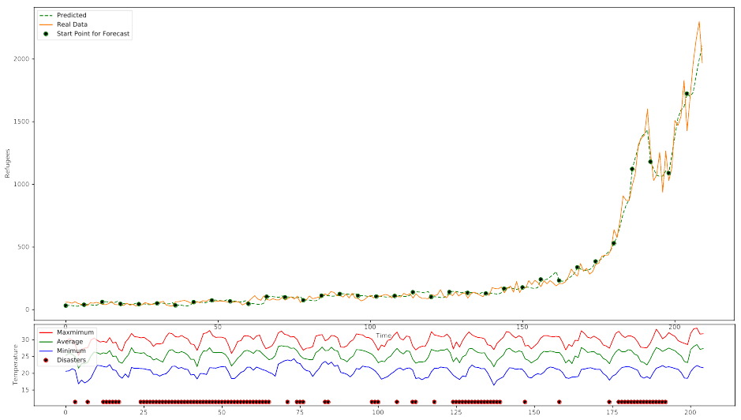
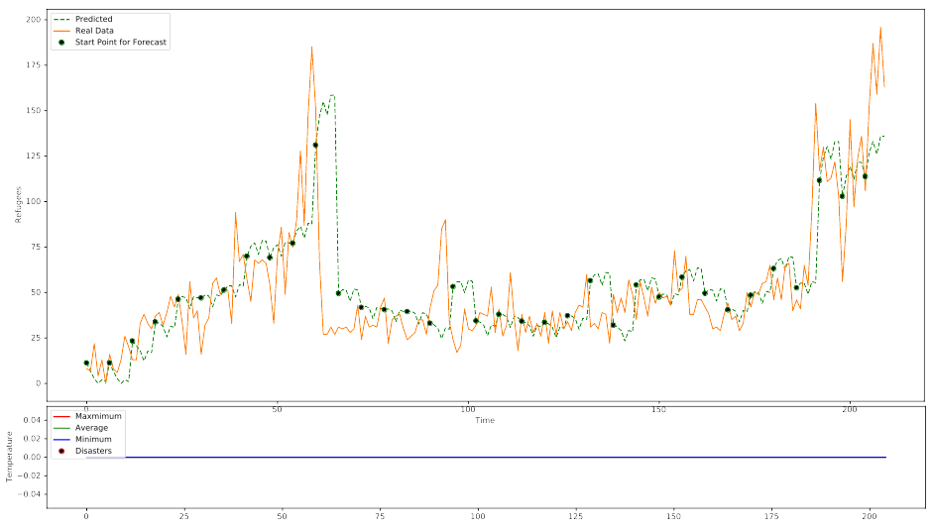
It’s Raining Men
Monika Srdic
Yoav Schneider
Computational Social Science 2017-2018
Can we predict migration waves using weather and natural distaster data?
Method:
Convolutional Neural network
Keras + Tensorflow
12 Hours of training
Input (Per Country):
Last 12 Months
Minimum, maximum and average temperatures
Natural disasters
Number of refugees
Method:
Convolutional Neural network
Keras + Tensorflow
12 Hours of training
Input (Per Country):
Last 12 Months
Minimum, maximum and average temperatures
Natural disasters
Number of refugees
El Salvador (1998 - 2016)
Output:
Predicted number of refugees for the next 6 Months
Mali (1998 - 2016)
Data Sources:
Global Weather:
  NOAA – National Oceanic and Atmospheric Administration (US)
Natural Disasters:
  EM-DAT – Emergency Event Database by the Centre for Research on the Epidemiology of Disasters (WHO, Belgium)
Refugees:
  UNHCR – The UN Refugee Agency
Brasil (1998 - 2016)
Is it really the weather data?
In order to make sure that the weather data do help in predicting the numbers of refugees, another model was trained with refugee numbers only, given the values for the last 12 months and predicting the number of refugees for the next 6 months
Results:
Mean Squared Error
with weather data: 2.0*10⁻⁴
without weather data: 2.8*10⁻⁴
Example, Brasil (1998 – 2016):
Honduras (1998 - 2016)
With Weather Data
Without Weather Data

