Slide 1


Hermes
Never miss a deal again
Notes:
Yoav Zimmerman
Second year CS
Hermes – the intelligent deal notification service

Slide 2









The Problem
Notes:
The problem – the web is full of expiring limited time deals and coupons
I want a new pair of headphones, and I want a good deal on them…
I could…
1) Check these sites every day until I find what I’m looking for
This is annoying… I’m not going through all these websites every day, I probably won’t even remember to do it!
2) Subscribe to each newsletter, switch slides

Slide 3
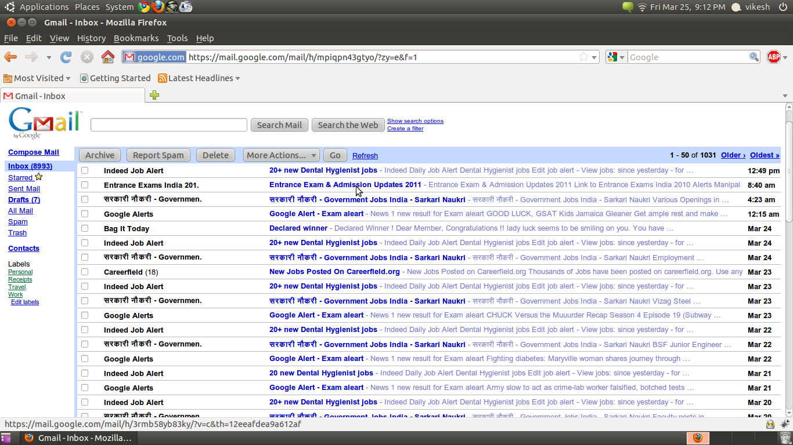
The Problem
Notes:
Before long, your inbox looks like this! We need a better solution, and I’ve come up with that: Hermes.

Slide 4


My Solution
Notes:
Hermes is a service that crawls all the deals on the web and indexes them intelligently by keywords. So what does that mean?

Slide 5


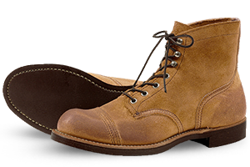
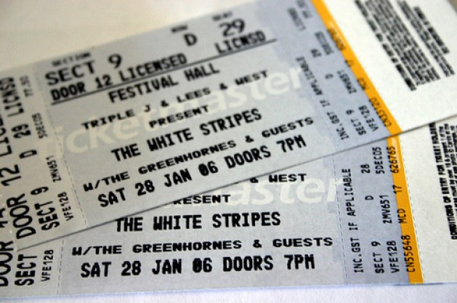
Simple
Hermes is…
Subscribe to any keyword or topic
Notes:
Simple web interface to subscribe to any keyword or topic
I type headphones in, will receive updates on Sennheiser, Audio-Technica, Dr Dre Beats
Fashion: “summer dresses”, “mens casual shoes”
Not limited by anything: “tropical house in los angeles”

Slide 6

Unobtrusive
Hermes is…
Pick time interval and length of time
Pick where to receive notifications
Notes:
My favorite part: unobtrusive!
Whenever you choose a keyword, pick the amount of time you will stay subscribed and how often you’d like to receive notifications
Hermes isn’t an annoying daily newsletter, it’s a friend forwarding you a deal that you’d legitimately be interested in
Choose where you’d like to receive notifications, email, SMS, facebook, twitter, or all integrated to all services

Slide 7
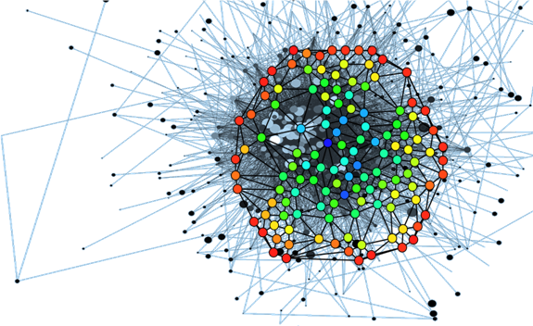
Intelligent
Hermes is…
Uses cutting edge technologies to bring users the best possible matches
Notes:
Uses cutting edge machine learning and web crawling techniques to bring users the best and most precise keyword matching possible

Slide 8
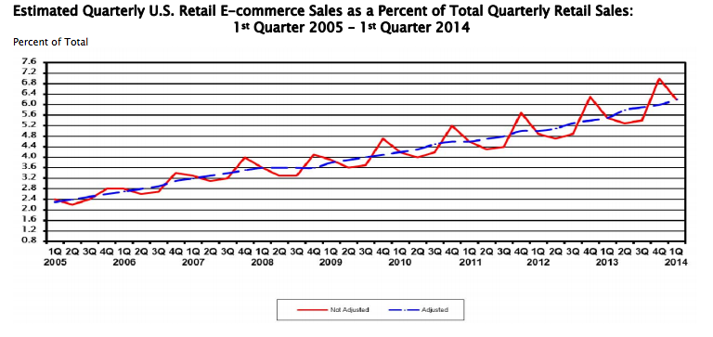
Source: US Census, Quarterly Retail E-Commerce Sales 1st Quarter 2014 Report
Notes:
It’s no secret that ecommerce has been increasing it’s stake in retail sales and will be for years to come

Slide 9

Partner with deal and ecommerce websites
Partner directly with retail brands and cut out the middleman
Build user base
$$
$$$$$
Notes:
Monetization! So many possibilities!

