Slide 1

Booking.com Review Ranking Challenge
Group Y&Y:
Yoav Zelinger
Yehonatan Kidushim

Slide 2

Introduction
We tested three approaches to predict connections between guests and reviews, experimenting with several models for each approach to optimize feature extraction and prediction accuracy.
Approach 1: Smart selection of negative samples for Contrastive Learning and use of cosine similarity.
Approach 2: Providing random negative samples, creating a custom loss function, and using the dot product for similarity.
Approaches 1 and 2 involved three weak-learners; Each weak learner was trained and predicted on different section (Title, Positive, Negative sections). The Learners were combined (using weights based on grid search on the validation), creating an ensemble model.
Approach 3: Used SentenceTransformer with Contrastive Learning
Approach 3 gave us the best results, which we will detail further in the upcoming slides.

Slide 3

Approach 3 Workflow
1. Feature Representation:
User Features:
Guest type & country
Accommodation type & country
month and number of nights for the stay.
Review Features: Title, positive and negative section.
These features were combined into structured descriptions for both the users and reviews, allowing the model to learn the relationships between them.
2. Model Training:
We used SentenceTransformer (all-MiniLM-L6-v2) and applied Contrastive Learning with the Multiple Negatives Ranking Loss function.

Slide 4

Approach 3 – Workflow cont.
3. Model Configuration:
We set the learning rate to 2e-5, the weight decay to 0.01, trained for 3 epochs with 5% warmup steps and used a batch size of 64.
4. Results:
The model achieved an MRR@10 of 0.13910, demonstrating the effectiveness of the approach in predicting relevant connections between guests and reviews.

Slide 5
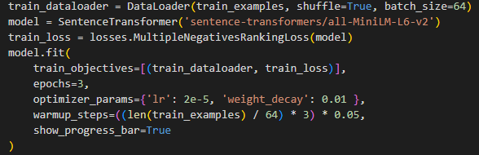
Our Model Implementation in Code (Link to the repository)

Slide 6
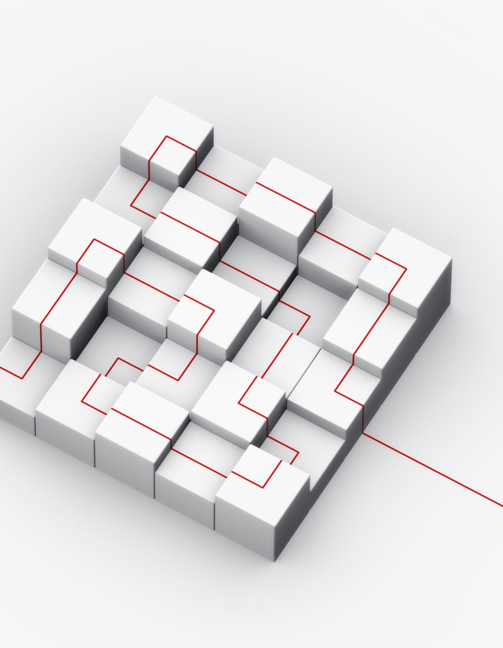
Improvements and Future Directions
Hyperparameter Tuning: Further optimization of learning rates, batch sizes, and other model parameters to improve performance.
Advanced Models: Exploring larger transformer-based architectures or other state-of-the-art models for improved prediction accuracy
Different Representations: Exploring various feature representations for users and reviews to improve model performance and prediction accuracy.

