Slide 1
NUMBER
PASSWORD
LOGIN

Slide 2
INSTALLATION
CONFIGURATION
CHECK

Slide 3
(I) FIND A PLACE
☐
Is it an open space with no shade?
Is the big solar panel getting direct sunlight?
Is the small solar panel on the weather station getting direct sunlight?
Is the wind speed sensor moving, when there’s wind?
Is it far from thieves?
Is the concrete solid?
✓
☐
✓
☐
✓
☐
✓
☐
☐
→
→

Slide 4

(C) REGISTER SENSOR
What’s the ID of the weather station?
→
→

Slide 5
(C) SET NAME / LOCATION
CLICK TO GET
NAME / LOCATION
→
→

Slide 6

(C) BEST CARRIER
What service provider is best?
→
→

Slide 7
(C) SET NUMBER
What’s the number of the SIM?
→
→

Slide 8
(C) CONFIRMATION
Name: | Mawryngkneng
Location: | 28.24598, 75.129082
SIM No: | "+919654317621"
Carrier: | Vodafone
→
→

Slide 9
(I) CHECK BLUETOOTH
Turn on your bluetooth.
/
Waiting…connecting.
→

Slide 10
9. CHECKING…
20
16
12
8
4
Uploading…
Running… / Hung. Reset
→

Slide 11
10. CHECKING…
Uploading…
Upload HTTP successful
Upload successful. / Upload failed.
→

Slide 12
11. CHECKING…
Air temp: 32C
Humidity: 50%
Air pressure: 1.05 atm
Wind Speed: 5 km/h
Rainfall: 0mm
Data within band. / Data outside band. Rechecking.
→

Slide 13
(I) SCREW STANDS
☐
Are all six screws on the base for the weather station stands?
Are all four screws on the solar panel?
✓
☐
✓
→
→

Slide 14
(I) FIND SOUTH
Find south.
→
→
Notes:
Compass

Slide 15
(I) CHECK VOLTAGE
What’s the current of the panel?
→
→

Slide 16
(I) MARK HOLES
Mark holes for weather station stands.
→
→

Slide 17
(I) DRILL HOLES
Drill holes for weather station stands.
→
→

Slide 18
17. CHECK BLUETOOTH
Turn on your bluetooth.
/
Waiting…connecting.
→

Slide 19
18. CHECKING…
20
16
12
8
4
Uploading…
Running… / Hung. Reset
→

Slide 20
19. CHECKING…
Uploading…
Upload HTTP successful
Upload successful. / Upload failed.
→

Slide 21
20. CHECKING…
Air temp: 32C
Humidity: 50%
Air pressure: 1.05 atm
Wind Speed: 5 km/h
Rainfall: 0mm
Data within band. / Data outside band. Rechecking.
→

Slide 22
(I) FASTEN STANDS
Fasten stands to roof.
→
→

Slide 23
22. CHECK BLUETOOTH
Turn on your bluetooth.
/
Waiting…connecting.
→

Slide 24
23. CHECKING…
20
16
12
8
4
Uploading…
Running… / Hung. Reset
→

Slide 25
24. CHECKING…
Uploading…
Upload HTTP successful
Upload successful. / Upload failed.
→

Slide 26
25. CHECKING…
Air temp: 32C
Humidity: 50%
Air pressure: 1.05 atm
Wind Speed: 5 km/h
Rainfall: 0mm
Data within band. / Data outside band. Rechecking.
→

Slide 27
26. CHECK BLUETOOTH
Turn off bluetooth.
/
Bluetooth off. Moving on.
→

Slide 28
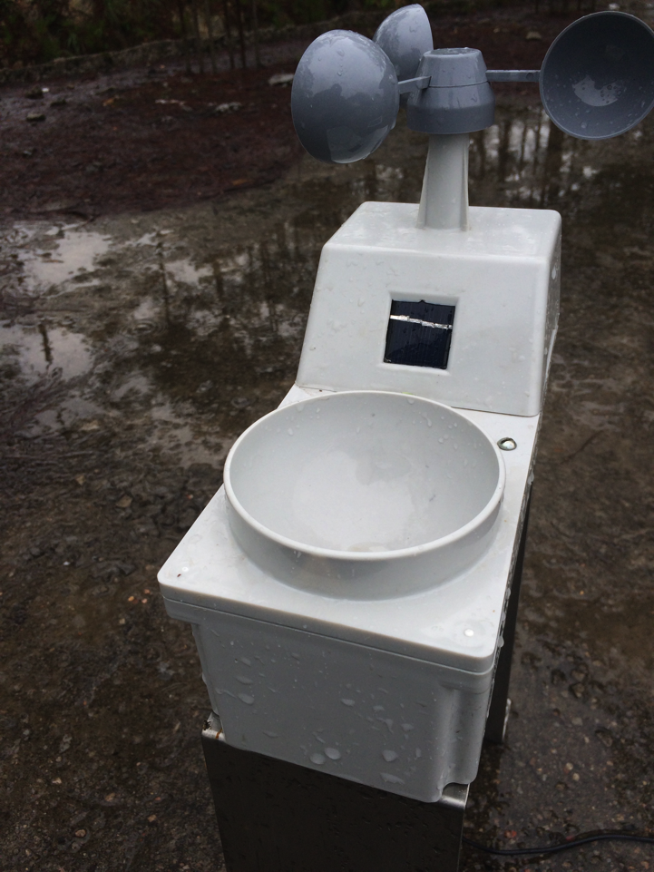
(I) Take a picture
→
→

