Slide 1
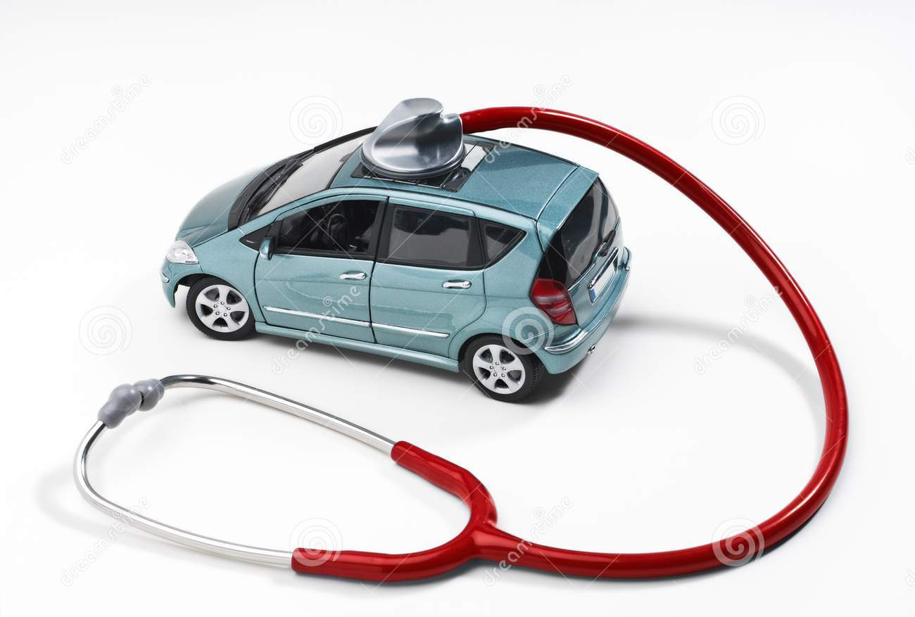
On-Board Diagnostics (OBD-II) Port Aug 26, 2014
Jasprit Singh Gill
PhD Student, Automotive Engg
CU-ICAR
jasprig@clemson.edu

Slide 2
Overview
OBD-II Port Overview
Regulations for OBD - SAE J1962 overview
Location
Connector types
Regulations
Connector contacts
OBD Protocols and Stack
Accessing OBD port
ELM327 Scanners
OBD Commands
SAE J1979 overview
ELM 327 scanner commands

Slide 3
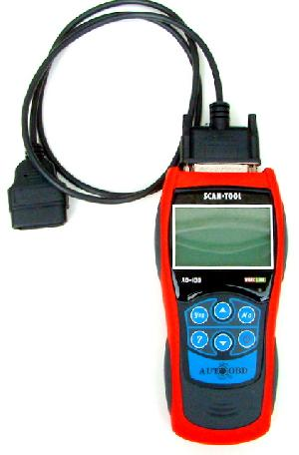
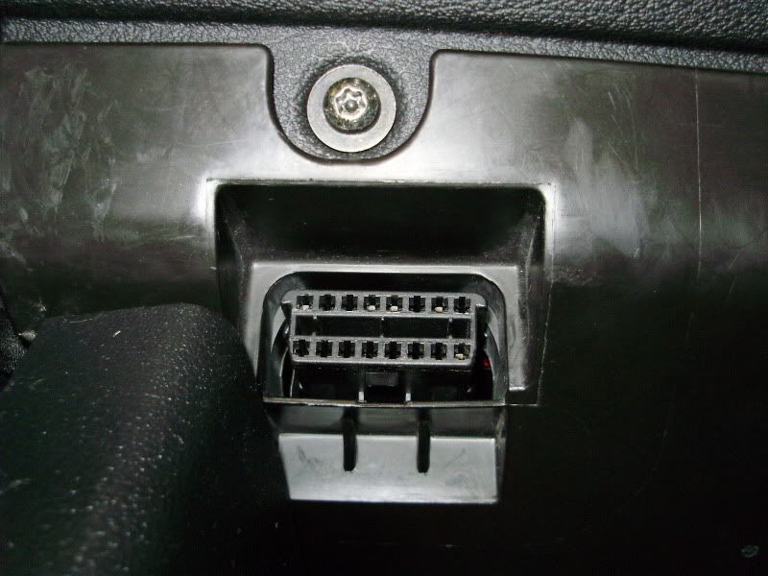
OBD-II port
On Board Diagnostic port
Mandatory in vehicles after 1996
Primary intention – emission checks

Slide 4
Audience for OBD port
For Repair Technicians:
pinpoint problems by retrieving vital automobile.
For State Agencies:
Where vehicle inspection and maintenance programs are required.
For Vehicle Owners:
Alerts about potential need for vehicle repair through the "Check Engine” light.
For Vehicle and Engine Manufacturers:
Required by EPA to be installed on light-duty vehicles and trucks, as well as heavy-duty engines.
Application developers
Source: http://www.epa.gov/obd/

Slide 5


Connector Types – A & B
Img source: https://www.scantool.net/support/index.php?_m=knowledgebase&_a=viewarticle&kbarticleid=3

Slide 6
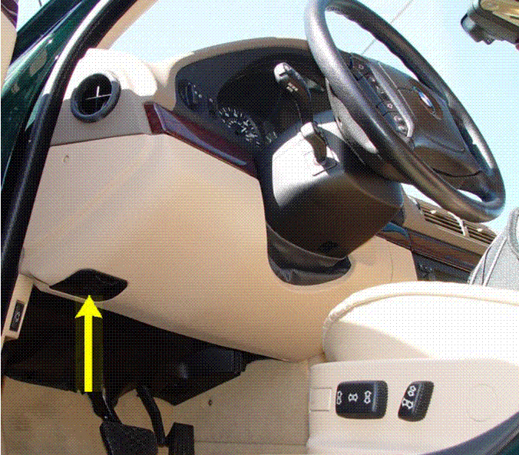
Location of Connector
Driver’s side foot-well
No higher than the bottom of the point where the steering column exits the instrument panel when at the lowest adjustable position.
Securely mounted to the vehicle
Face of the vehicle connector
pointing downward
toward the rear of the vehicle
Vertically or horizontally mounted
Tolerance: ± 5°
Img Src: Google Images

Slide 7

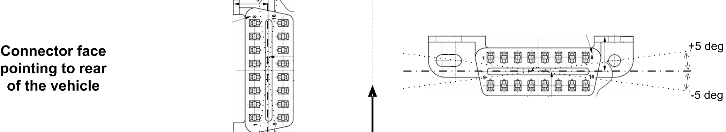
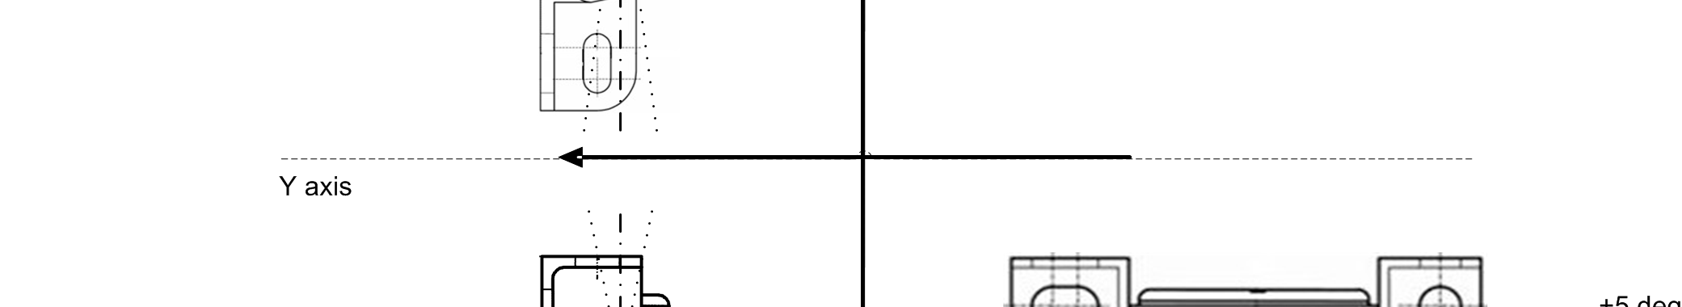
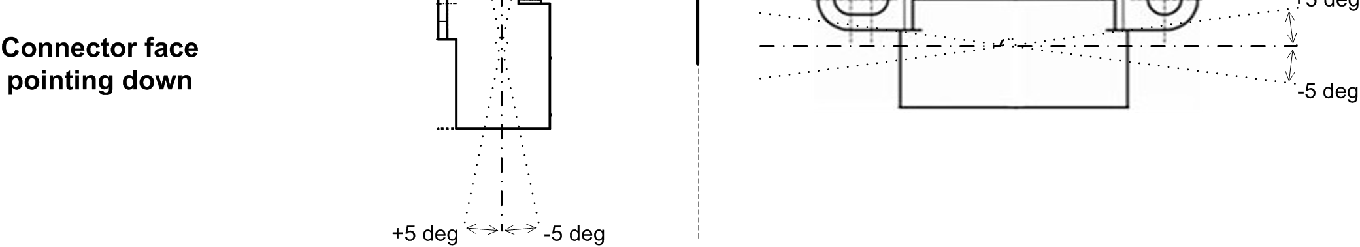
Connector A Orientation
Src:SAE J1962

Slide 8
Ease of Access
Clearly designated with the letters OBD.
Easy to remove without any tools.
One hand operation should be possible
Shall remain attached to the vehicle (hinged, tethered, etc.)
“Keep Clear” areas around OBD port
Src:SAE J1962

Slide 9
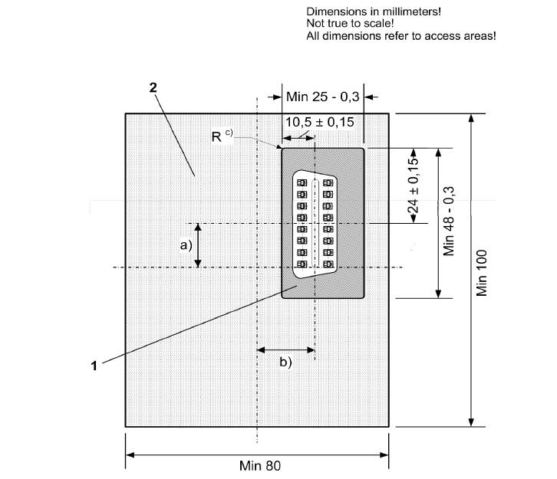
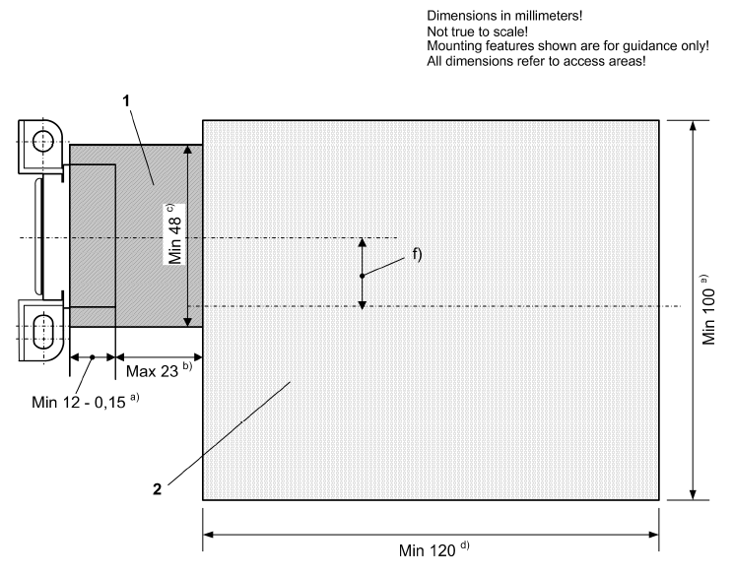
Keep Clear Areas
Src:SAE J1962

Slide 10
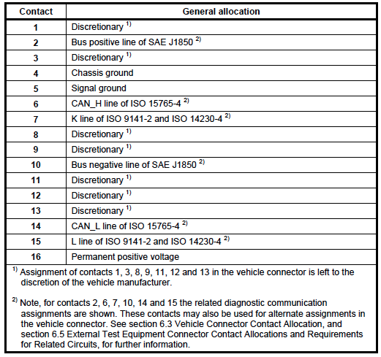
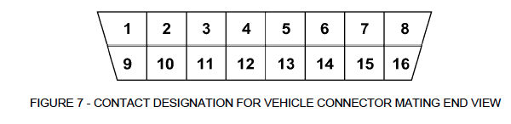
Connector Contacts
Src:SAE J1962

Slide 11
Protocols supported by OBD-II port
SAE J1850 PWM
SAE J1850 Variable Pulse Width
IS 9141-2 (like RS232)
ISO 14230-4 (KeyWord Protocol)
ISO 15765-4 (CAN)
Src:SAE J1962

Slide 12
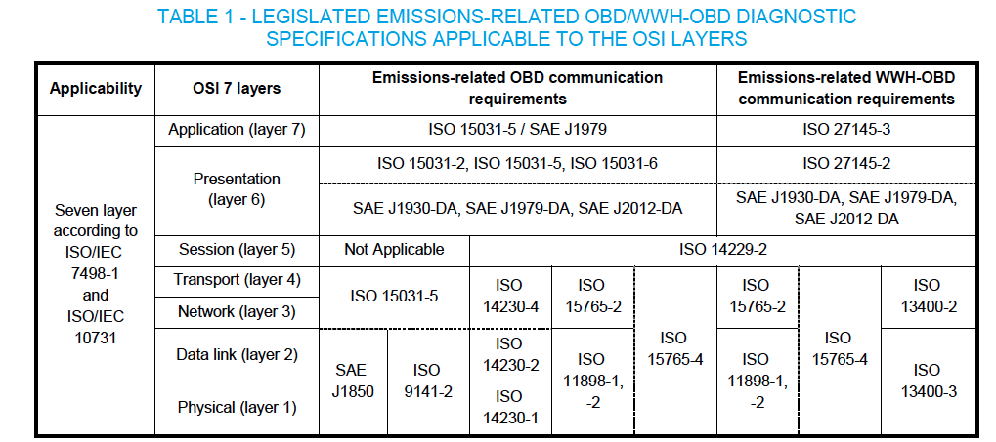
OSI Protocol stack for OBD
Source: SAE J1979

Slide 13
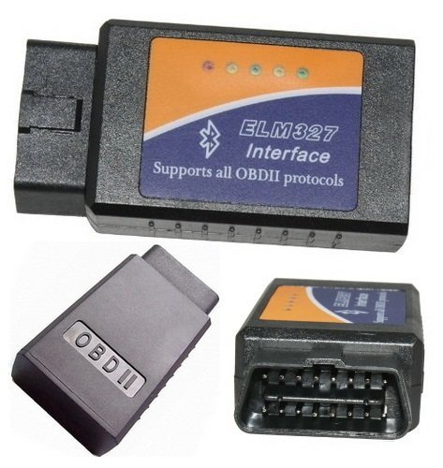
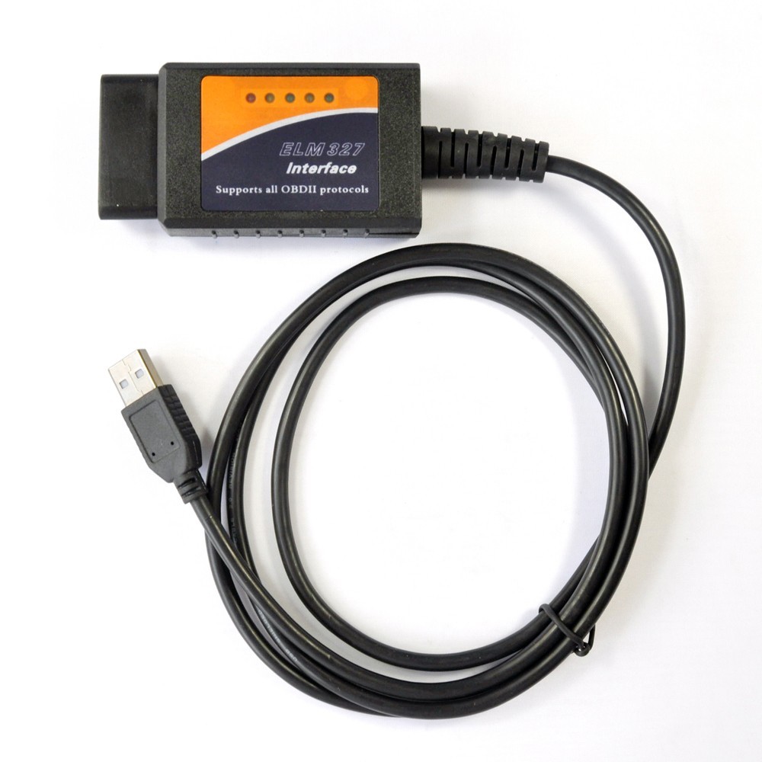
ELM327 based Scanners – Life made easy
Use ELM327 ICs (http://elmelectronics.com/obdic.html#ELM327 )
OBD to RS232 Interpreters
Scanners available for
Serial (RS232)
Serial (USB)
Bluetooth
Wifi

Slide 14



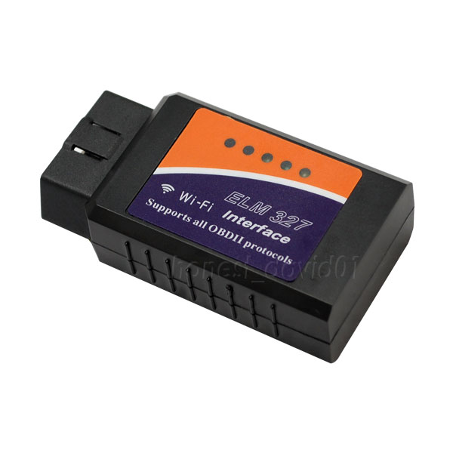

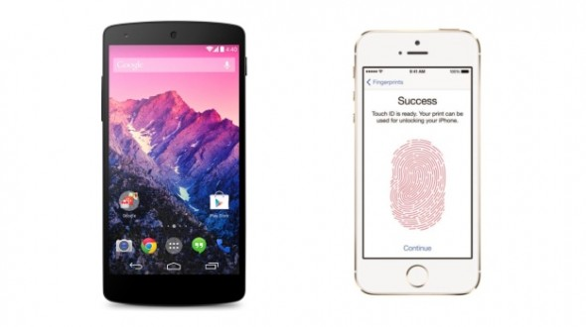
Accessing OBD via ELM327 scanner
Serial
Bluetooth
Wifi
OBD Port

Slide 15
What do I need to know to read OBD data?
OBD Commands (SAE J1979, J1979-DA)
AT Commands (http://elmelectronics.com/ELM327/AT_Commands.pdf )
Serial/Bluetooth/Wifi interface programming for host platform

Slide 16
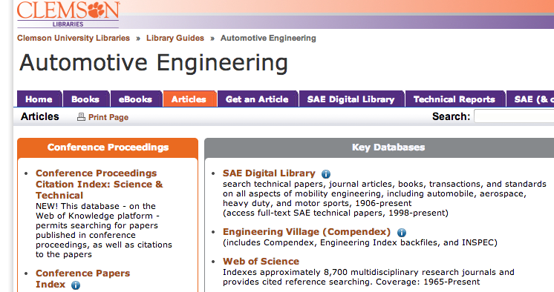
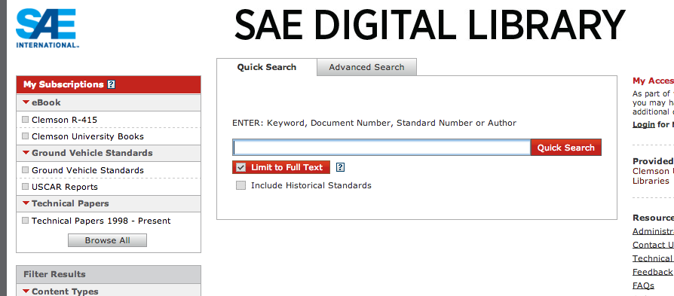
Accessing SAE Documents
http://clemson.libguides.com/content.php?pid=46348&sid=449232

Slide 17
Service / Mode types
Service ID / Mode (Hex) | Description
0x01 | Request current powertrain diagnostic data
0x02 | Request powertrain freeze frame data
0x03 | Request Emission related diagnostic trouble codes
0x04 | Clear/reset emission related diagnostic information
0x05 | Request oxygen sensor monitoring test results
0x06 | Request on-board monitoring test results for monitored systems
0x07 | equest emission-related diagnostic trouble codes detected during current or last completed driving cycle
0x08 | Request control of on-board system, test or component
0x09 | Request vehicle information
0x0A | Request emission-related diagnostic trouble codes with permanent status
Src: SAE J1979

Slide 18
OBD Service 1 – List of some generic PIDs
PID | Description
0x05 | Engine Coolant temp
0x0A | Fuel Pressure
0x0B | Intake Manifold Pressure
0x0C | Engine RPM
0x0D | Vehicle Speed Sensor
0x0E | Ignition Timing
0x10 | Air Flow Rate from MAF sensor
0x11 | Absolute Throttle Position
0x1C | OBD requirements to which vehicle is certified
0x1F | Time since engine Start
0x21 | Distance traveled while MIL is activated
0x46 | Ambient Air temperature
0x49 | Accelerator pedal position
0x5A | Relative Accelerator Pedal Position
0x5B | Hybrid/EV Battery Pack Remaining Charge
0x5C | Engine Oil Temperature
0x5D | Fuel injection timing
0x5E | Engine Fuel Rate
0x78 | Exhaust Gas Temperature Bank 1
0x79 | Exhaust Gas Temperature Bank2
For more:
SAE J1979-DA

Slide 19
OBD Commands
2 to 7 byte commands. SID followed by RID, MSB first, LSB last
SID – Service IDs, Mode
RID – Request IDs
Parameter ID (PID) – service 1/2
OBD Monitor ID (OBDMID) – service 6
Test ID (TID) – service 8
InfoTypes – Service 9
Command To fetch
Rpm – “0x010C”
Vehicle speed – “0x010D”
1 byte | 1 byte
SID | PID
7 bytes max
SID | PID1 | PID2 | PID3 | PID4 | PID5 | PID6

Slide 20
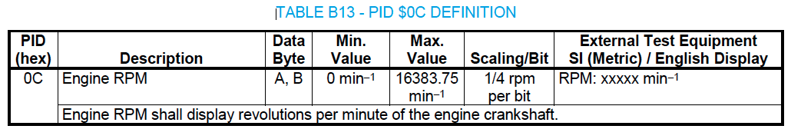
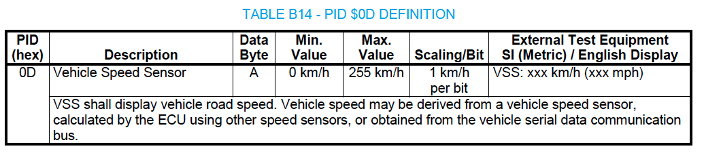
Service 1 - Response
Src: SAE J1979-DA

Slide 21
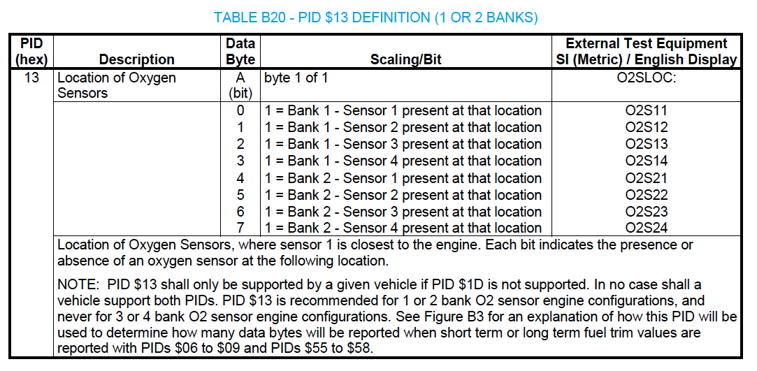
Service 1 - Response
Src: SAE J1979-DA

Slide 22
Service 3 – Request Emission related DTCs
DTC = Diagnostic Trouble Code
Send “0x0101” request, get the number of emission-related DTCs from all ECUs that have this available.
Send a “0x03” request for all emission-related DTCs. Each ECU that has DTCs will respond with one or more messages, each containing up to three (3) DTCs.
Src: SAE J1979-DA

Slide 23
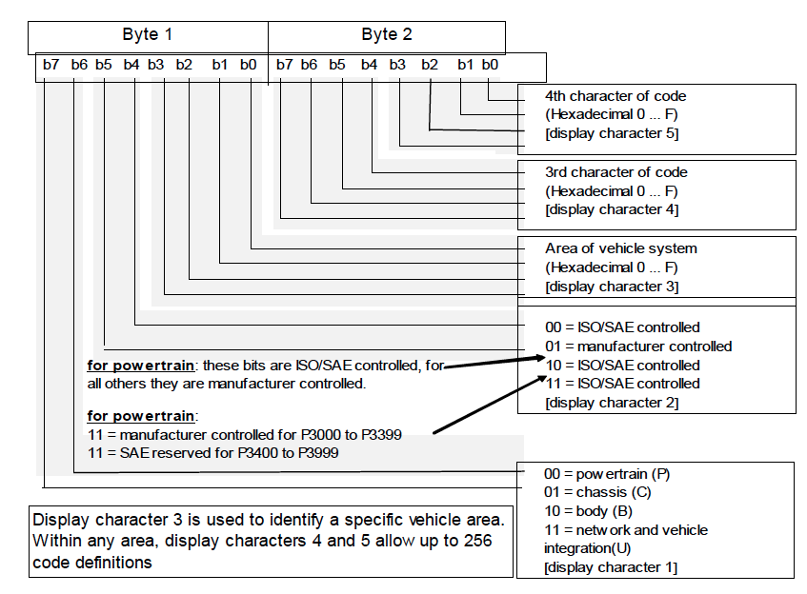
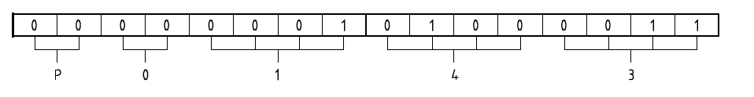
Service 3 – Resp Emission related DTCs
For description of
DTCs: SAE J2012, J2012-DA
Src: SAE J2012

Slide 24
ELM327 Commands
http://elmelectronics.com/DSheets/ELM327DS.pdf
ELM327 accepts 2 sets of commands
AT commands start with “AT”
Rest assumed to be OBD commands
All commands need to terminate with a carriage return character (0x0D in ASCII, <CR>)
RPM – “0x010C<CR>”
Vehicle Speed – “0x010D<CR>”
<CR> repeats last command
Protocol interpreter, does not assess OBD messages
Software should wait for ‘>’ before sending next command
Key commands for ELM327
“AT Z” – reset
“AT SP0” – auto protocol detection
More - http://elmelectronics.com/ELM327/AT_Commands.pdf

Slide 25
ELM327 with COM port
Android bluetooth socket: http://developer.android.com/reference/android/bluetooth/BluetoothSocket.html
Bluetooth from Mac: http://decyborg.wordpress.com/2013/09/08/bluetooth-serial-communication-with-arduino-jy-mcu-bluetooth-and-macbook-pro/
Wifi access into ELM327 scanners: http://xcardiag.over-blog.com/article-how-to-set-up-wifi-elm327-the-obd2-auto-scanner-adapter-to-iphone-ipad-ipod-109788558.html

Slide 26
Queries
Thank you…!!
jasprig@clemson.edu

